Slide 2
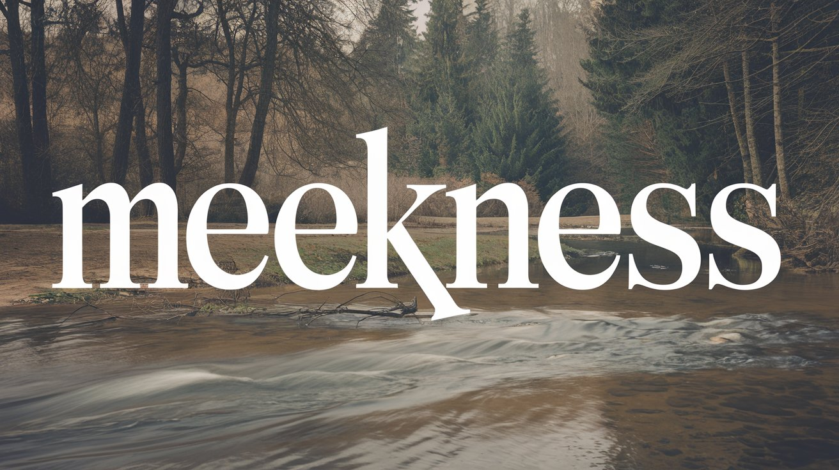

Slide 3
meekness - prautes
Difficult to translate with a single English word.
Carries the idea of strength under control,
“the quiet use of strength.”
The word originally applied to a horse that had been broken and would accept a bridle.
Gentleness and humility that comes from an honest consideration of one’s own spiritual condition before God; shown first to God then to others.

Slide 4
Examples of Meekness
Moses - Numbers 12:3
Paul - 1 Cor. 4:12-13
Jesus - Matt. 11:28-30; 2 Cor. 10:1

Slide 5
Examples of Meekness
Moses - Numbers 12:3
Paul - 1 Cor. 4:12-13
Jesus - Matt. 11:28-30; 2 Cor. 10:1
Meekness is not weakness.
Meekness is not apathy.
Meekness is the greatest exercise of strength – the willingness and ability to control ourselves and treat others with kindness, whether they deserve it or not.

Slide 6
Our Need for Meekness
To properly receive God’s word - James 1:21
To defend our faith - 1 Peter 3:15
To restore the erring - Gal. 6:1; 2 Tim. 2:25
To maintain unity - Col. 3:12-14
To live properly with others - Titus 3:1-2

Slide 7
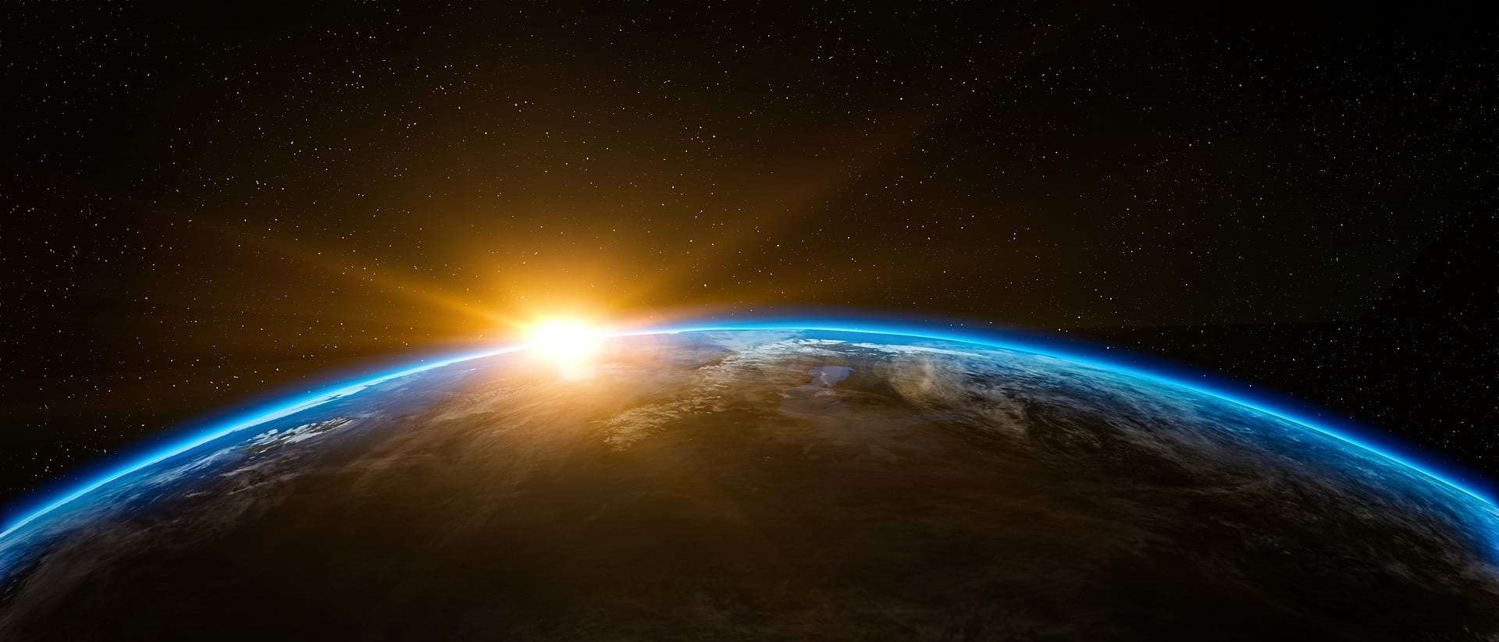
“Blessed are the meek, for they shall inherit the earth.” Matthew 5:5
In Darwin’s model of “natural selection,” the strong survive while the weak become extinct.
In Jesus’ model of “Divine Selection,” the arrogant and self-assertive are destroyed while the meek survive to enjoy blessings and peace.

