Slide 2

Doctrine
That Makes Us
Different

Slide 3
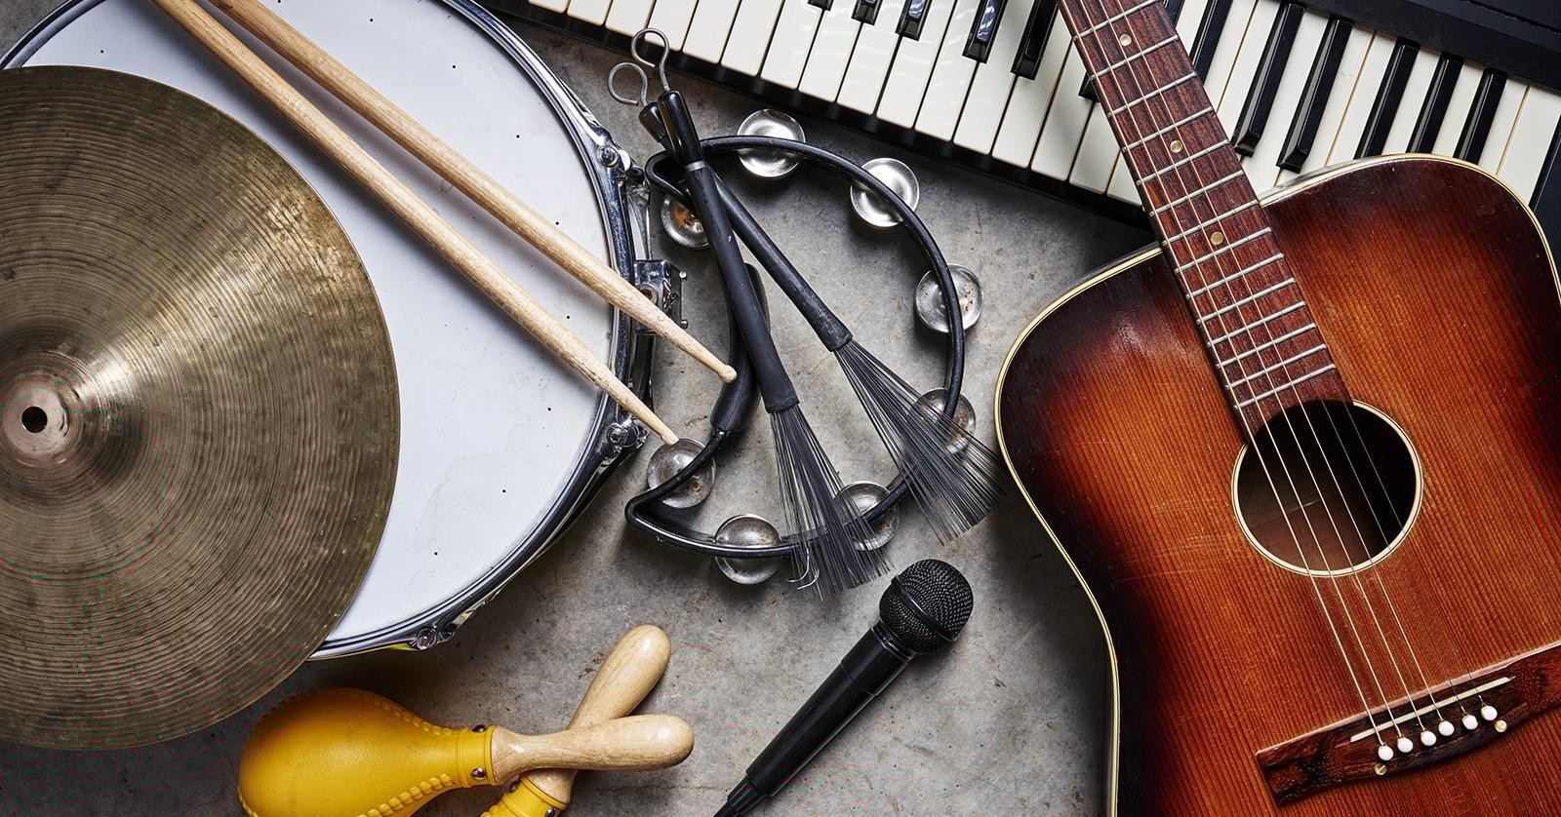
Why We Don’t Use Instrumental Music in
Our Worship Services

Slide 4
1. We Are Told To Sing

Slide 5

1. We Are Told To Sing
Matthew 26:30
Mark 14:26
Acts 16:25
Romans 15:9
1 Corinthians 14:15
Ephesians 5:19
Colossians 3:16
Hebrews 2:12, 13:15
James 5:13

Slide 6
1. We Are Told To Sing
“Whoever transgresses and does not abide in the doctrine of Christ does not have God…” (2 John 9)

Slide 7
1. We Are Told To Sing
“sing”
“Whoever transgresses and does not abide in the doctrine of Christ does not have God…” (2 John 9)

Slide 8
1. We Are Told To Sing
musical instruments
“sing”
“Whoever transgresses and does not abide in the doctrine of Christ does not have God…” (2 John 9)

Slide 9
2. Instruments Are Not Authorized

Slide 10
2. Instruments Are Not Authorized
“Show me where the Bible says, ‘Thou shalt not use instruments?’”

Slide 11
2. Instruments Are Not Authorized
“Show me where the Bible says, ‘Thou shalt not use instruments?’”
“Where does the Bible say that we can use musical instruments?”

Slide 12
2. Instruments Are Not Authorized
Hebrews 7:12-14 - silence of Scripture is prohibitive, not permissive.
Genesis 6:14-16 - gopher wood automatically excluded all other types of wood.
Numbers 19:2 - animal specified by God automatically excluded all other animals.
“Singing” automatically excludes all other types of music.

Slide 13
3. Arguments in Favor of Instruments Answered by Appeal to Bible Authority
“They used musical instruments in the Old Testament.”
“There are harps in heaven.”

Slide 14
Why We Don’t Use Instrumental Music in
Our Worship Services
We sing because that is what God has told us to do. That is what He wants in worship today.
When we add instruments, we step outside the boundaries set by God’s Word.

