Slide 2


Home Improvement

Slide 3
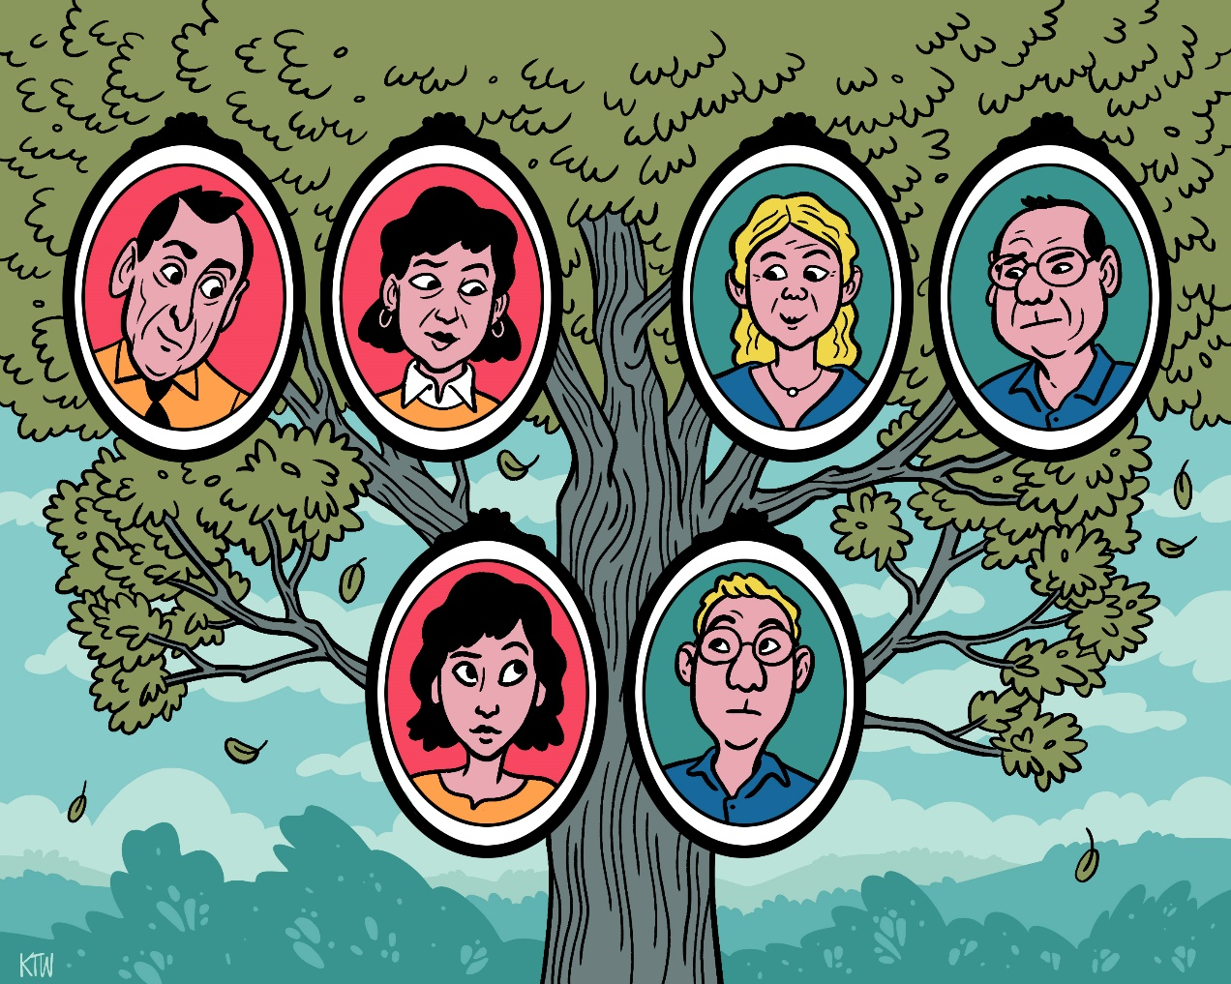
How to Be a Good In-Law
Exodus 18

Slide 4
Jethro Was a Good Father-in-Law
Exodus 18
He Reunited His Daughter’s Family vs. 1-7
He Rejoiced and Worshiped God vs. 8-12
He Offered Advice vs. 13-23
He Went Home v. 27

