Slide 1



Please take this time to prepare yourself for the worship service.

Slide 2
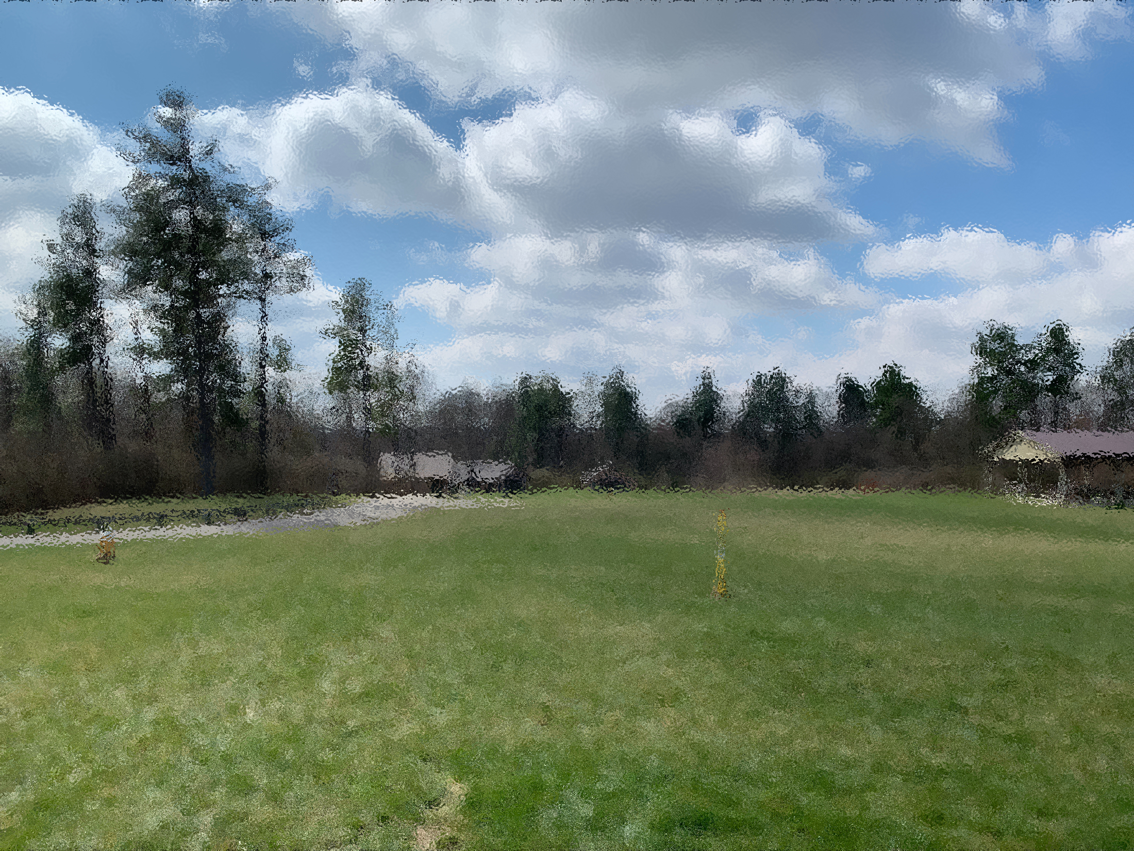
Please take this time to prepare yourself for the worship service.

Slide 3
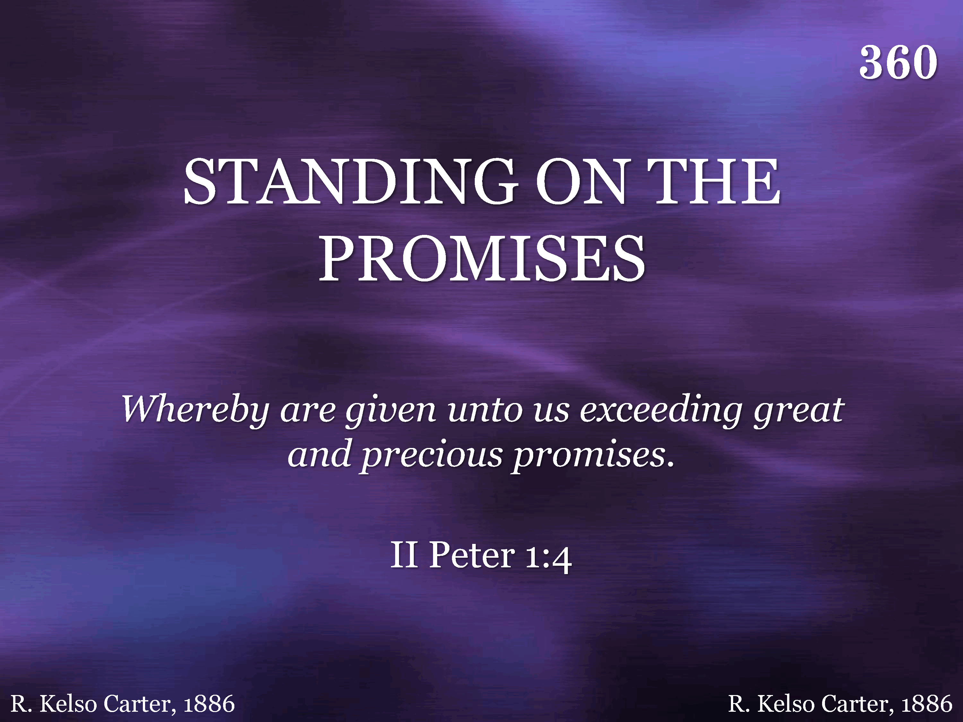
360 - Standing On The Promises - Title

Slide 4
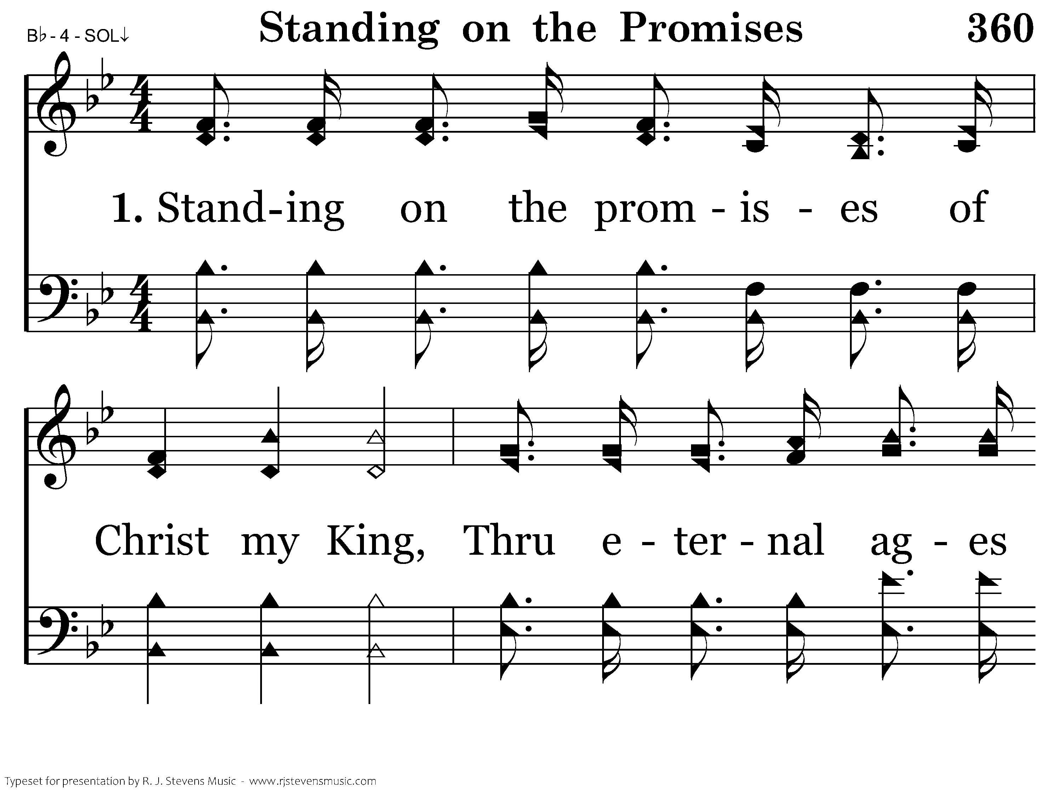
360 - Standing On The Promises - 1.1

Slide 5
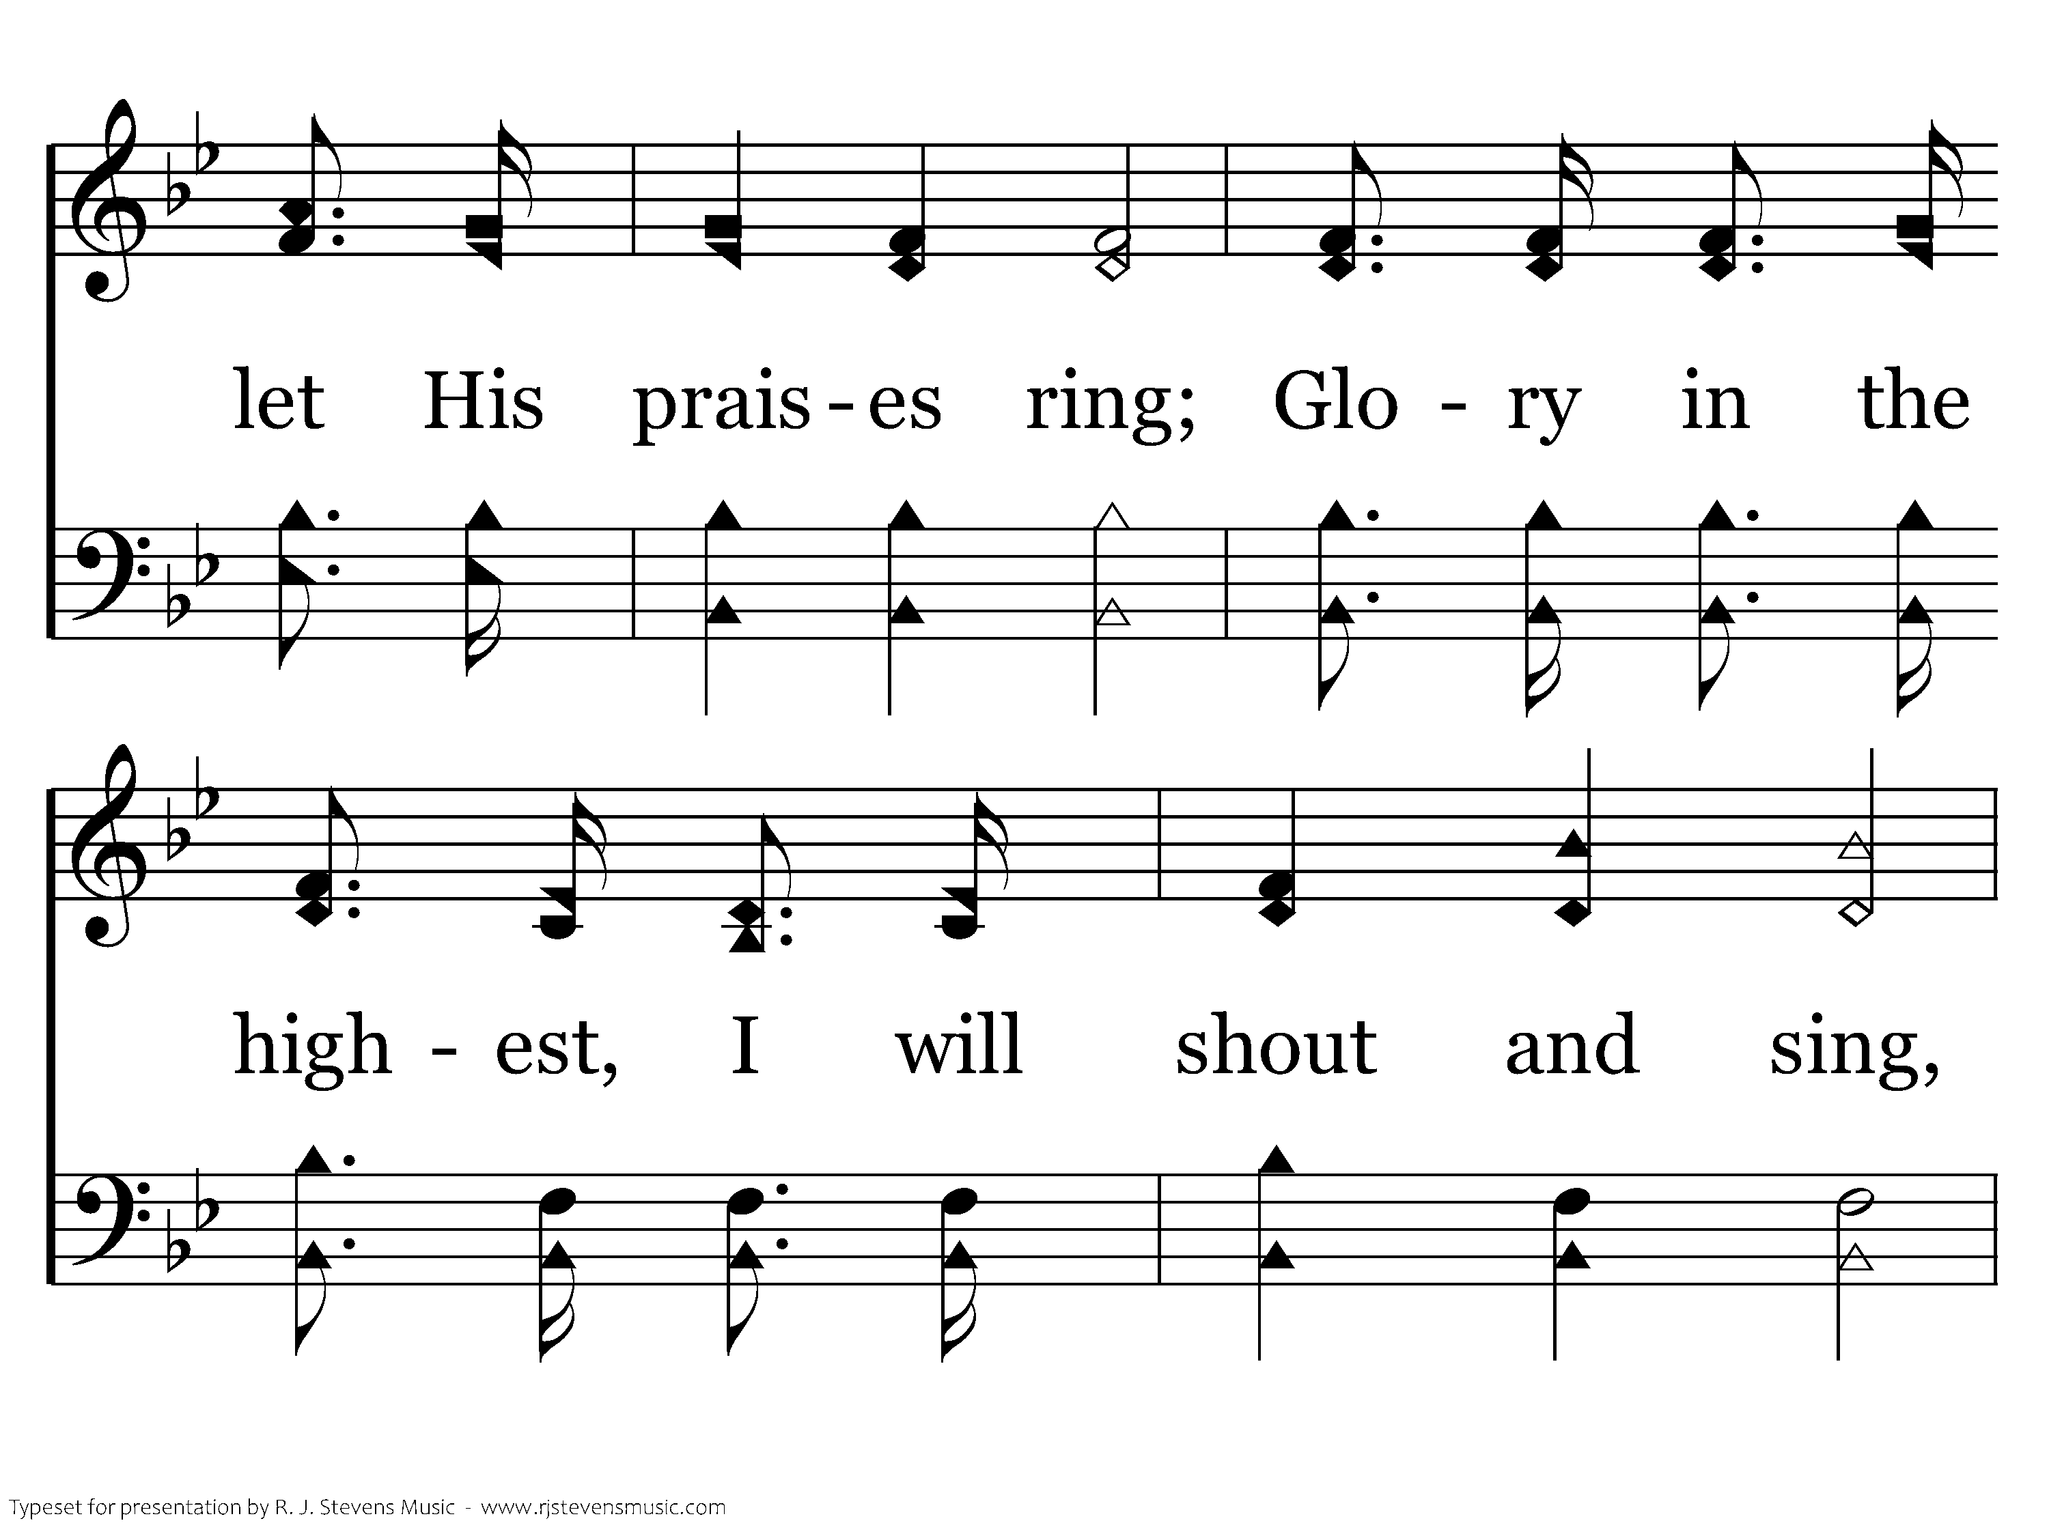
360 - Standing On The Promises - 1.2

Slide 6
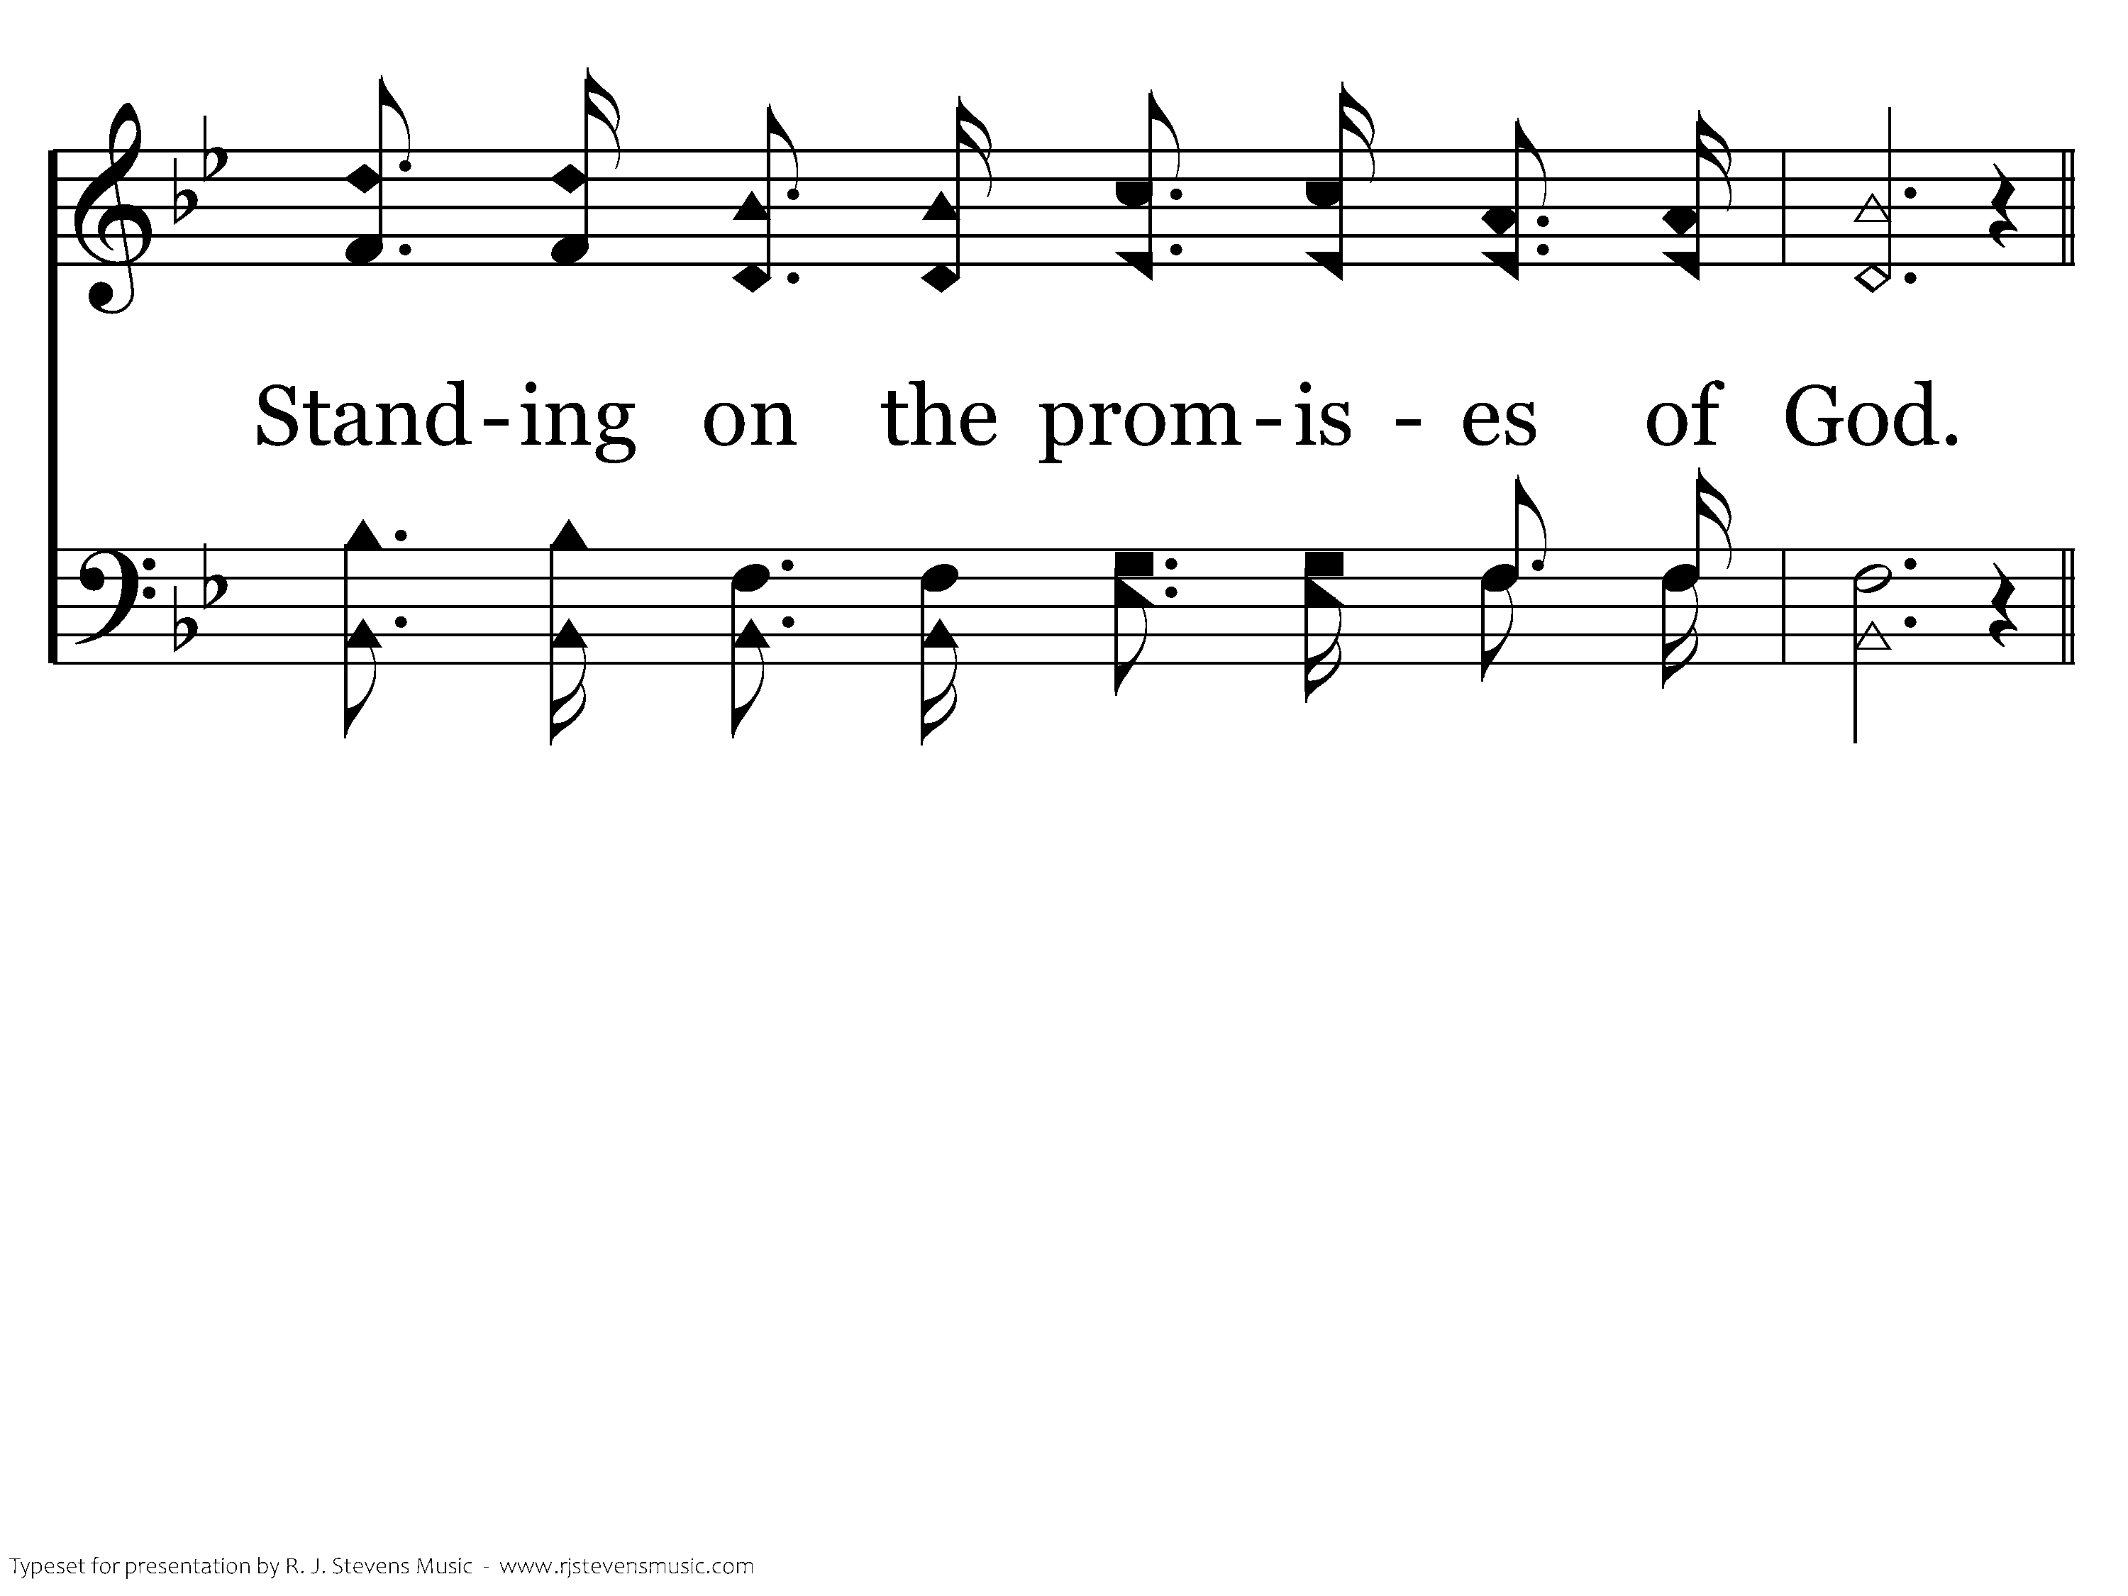
360 - Standing On The Promises - 1.3

Slide 7
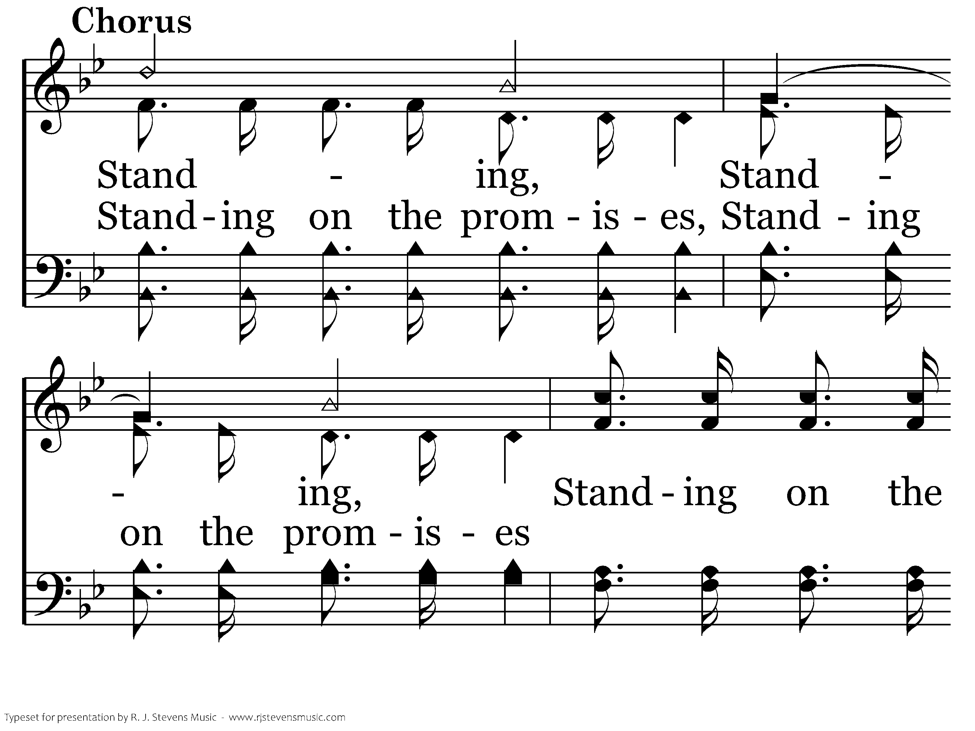
360 - Standing On The Promises - C.1

Slide 8
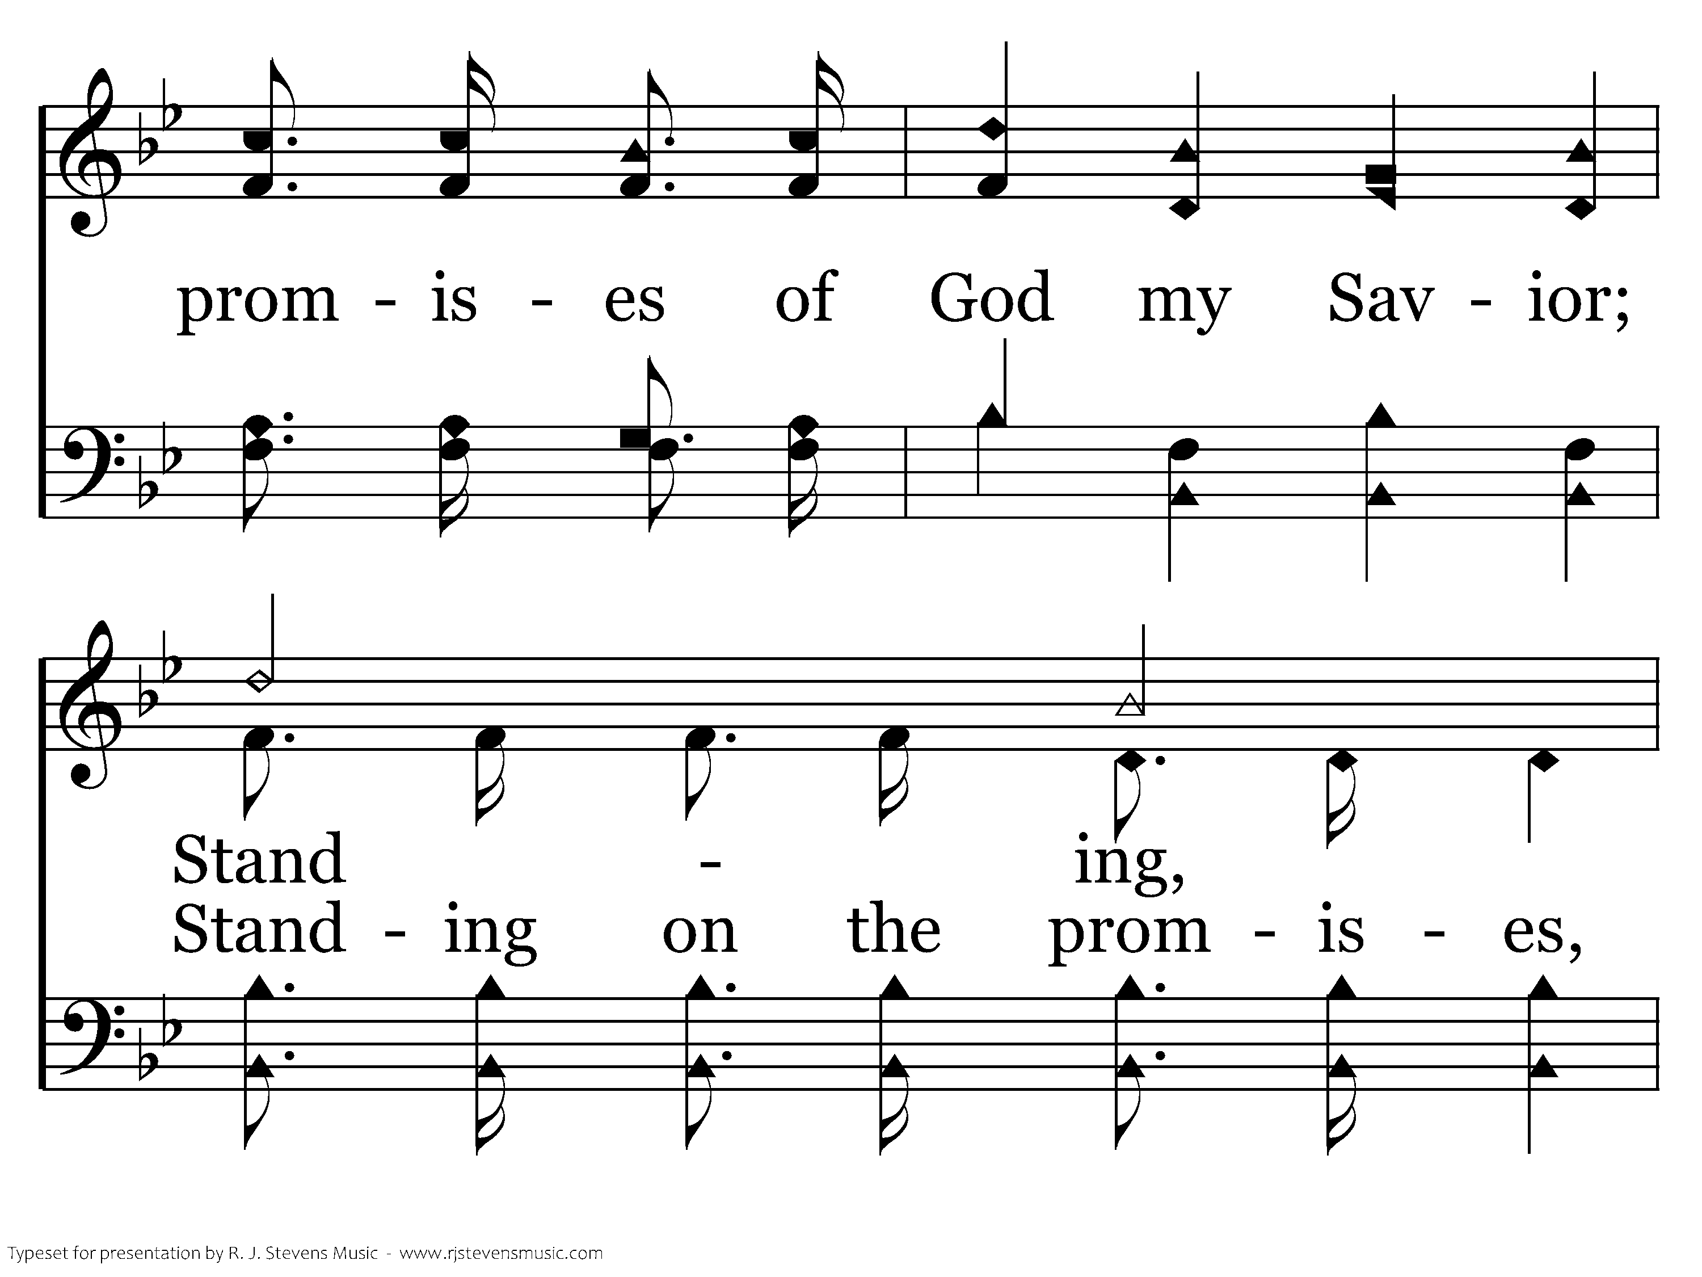
360 - Standing On The Promises - C.2

Slide 9
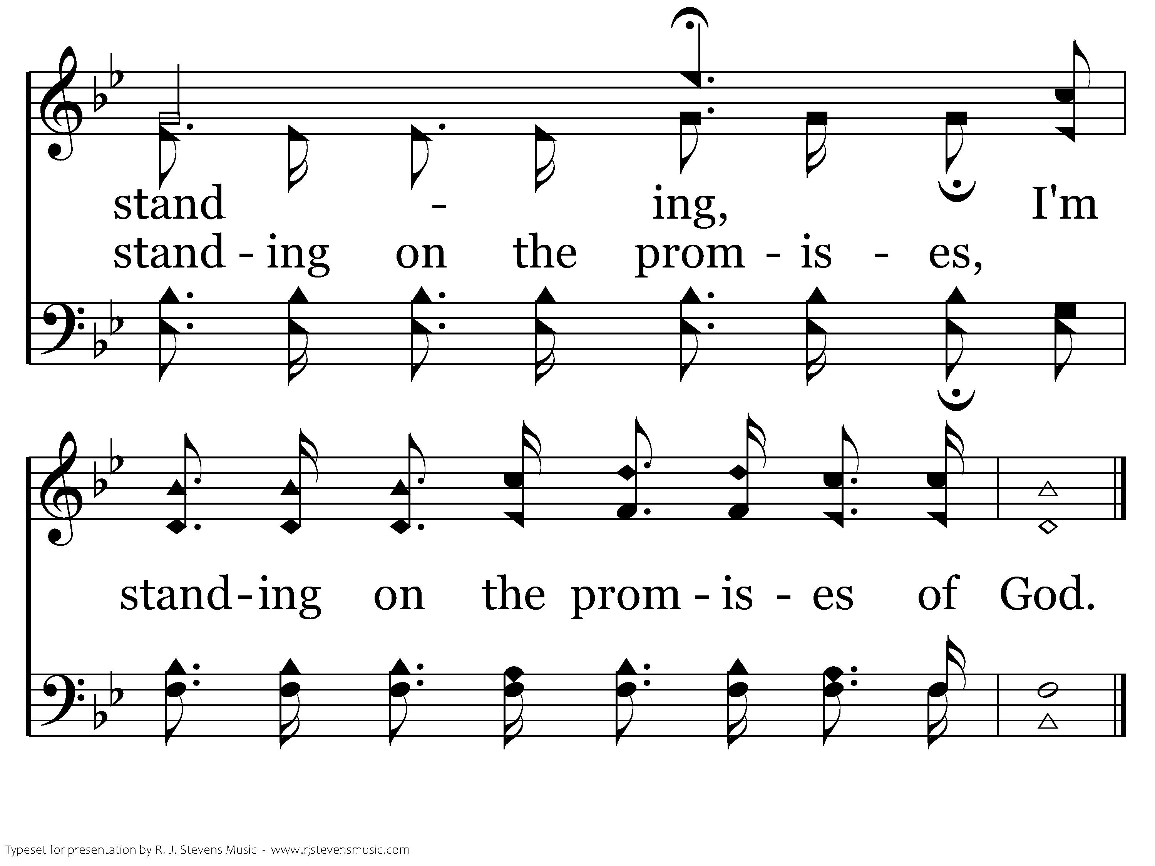
360 - Standing On The Promises - C.3
End of Verse 1

Slide 10
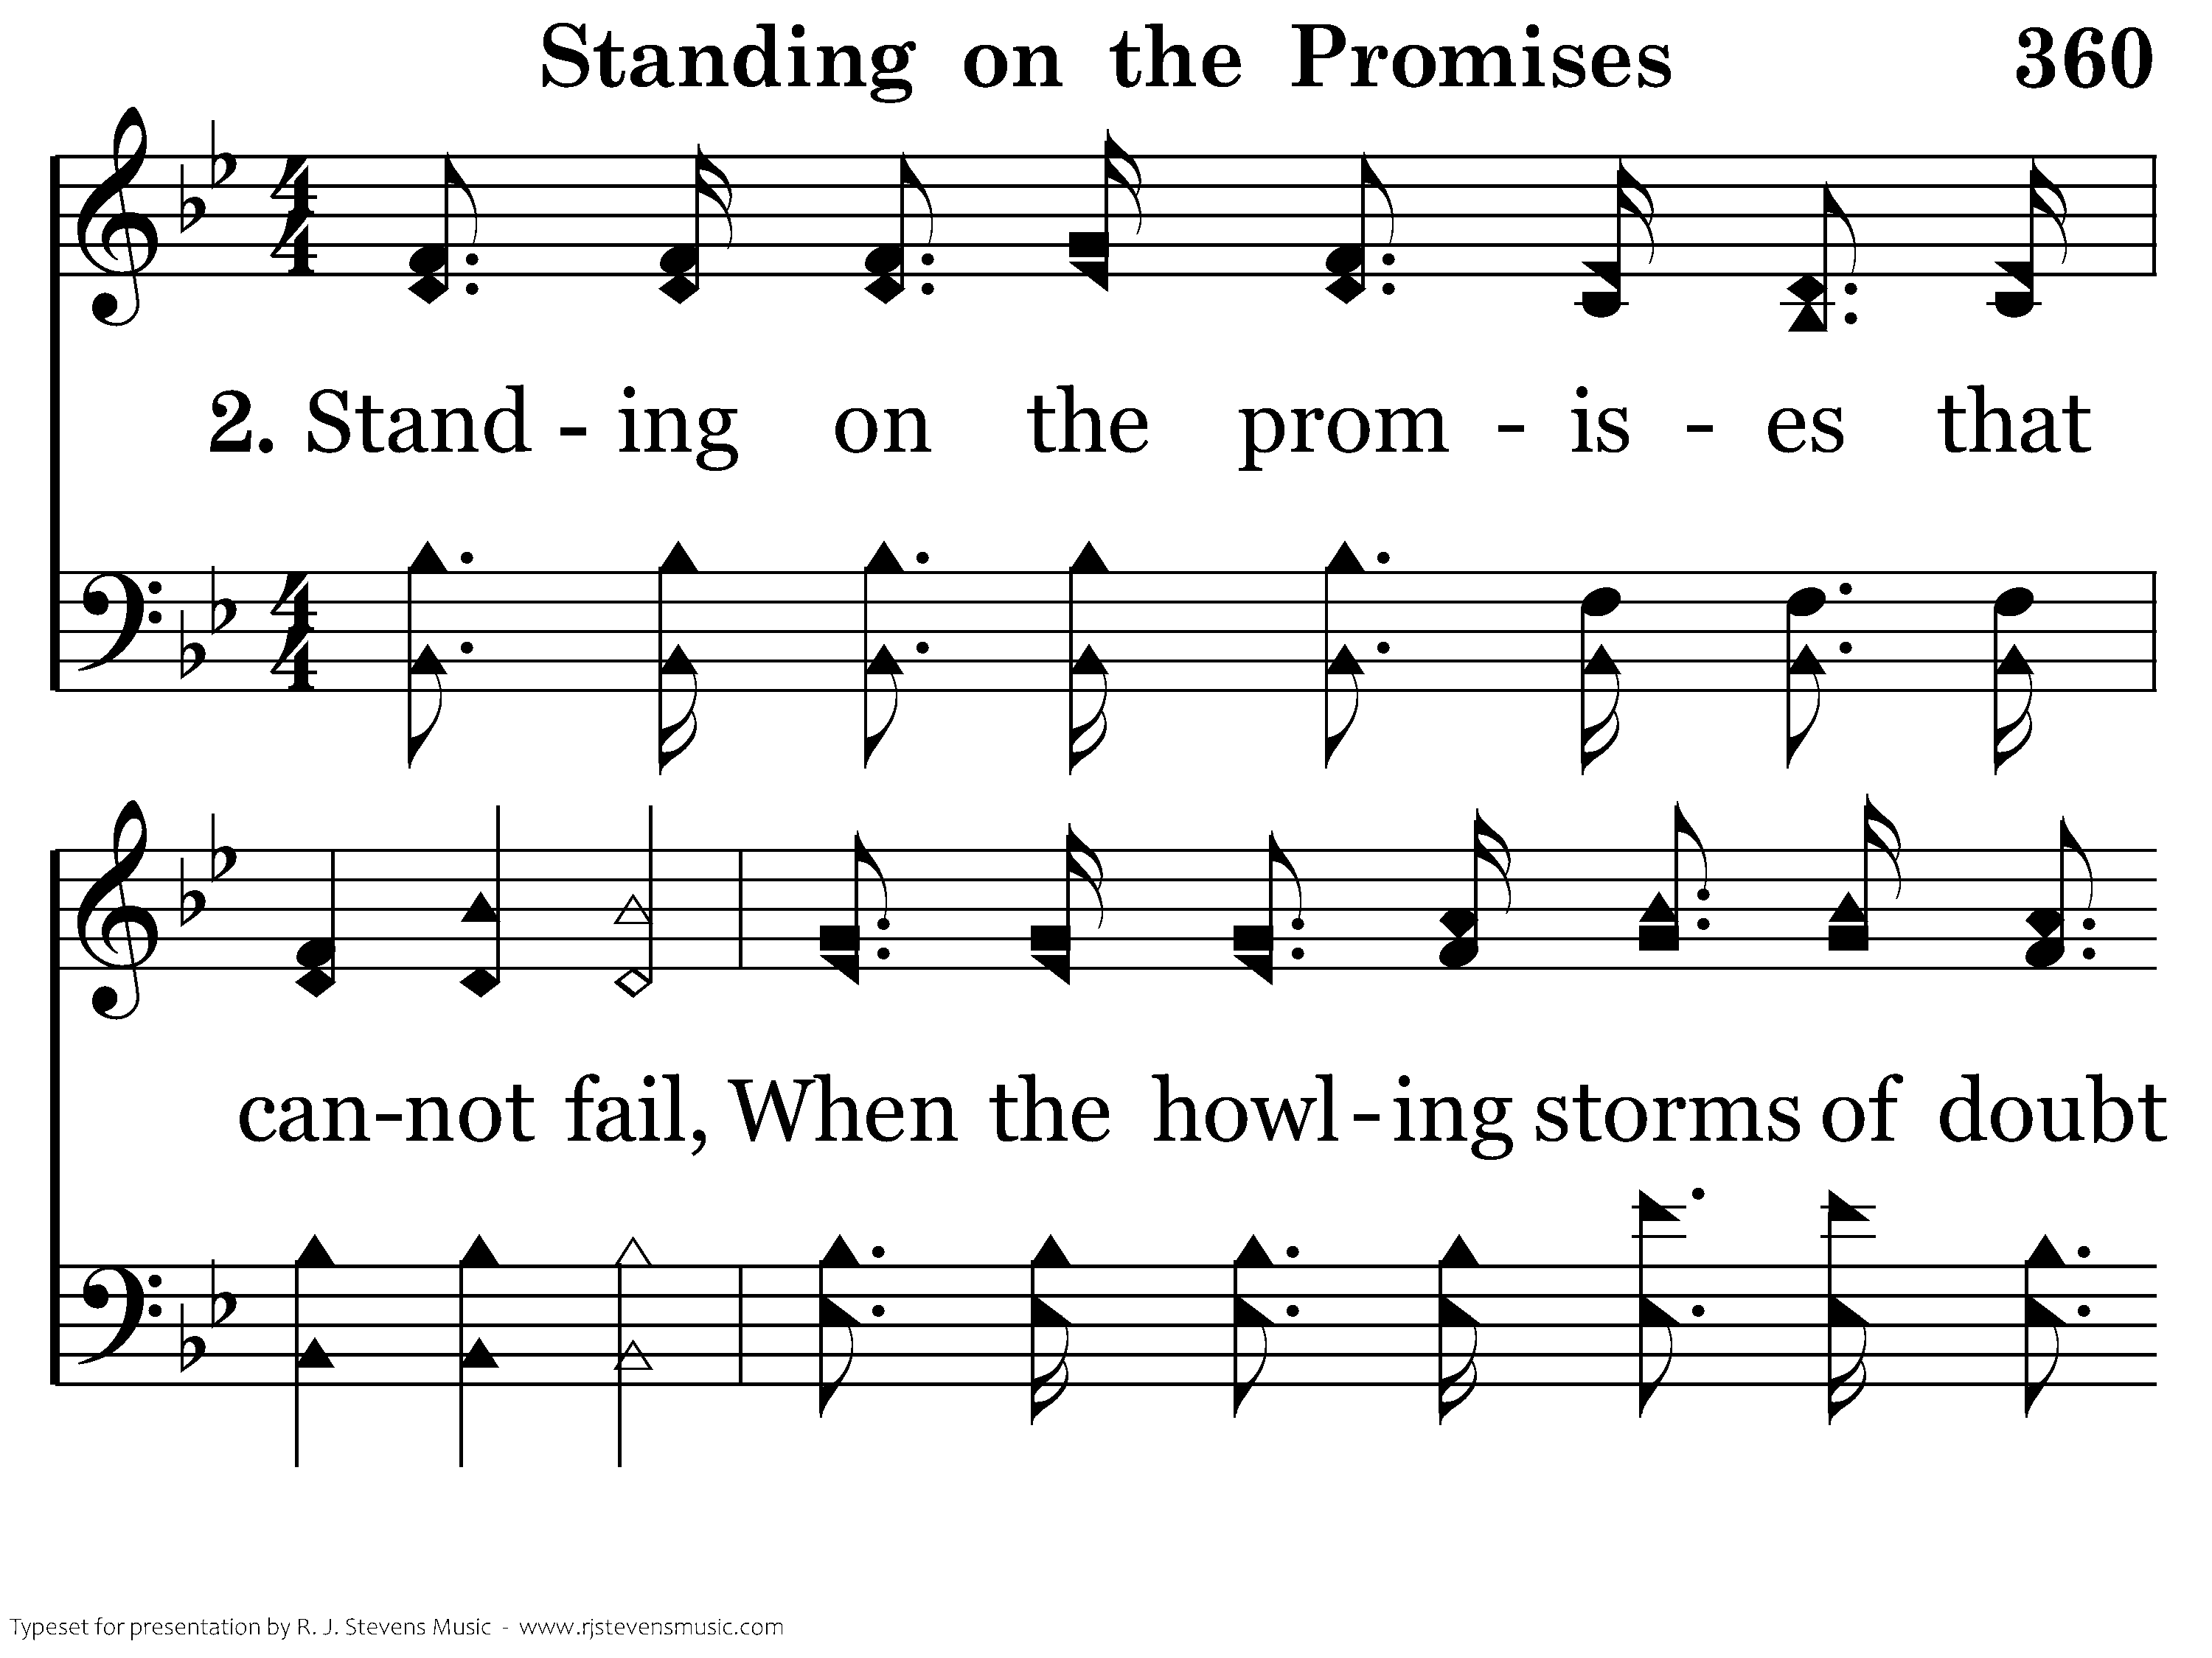
360 - Standing On The Promises - 2.1

Slide 11
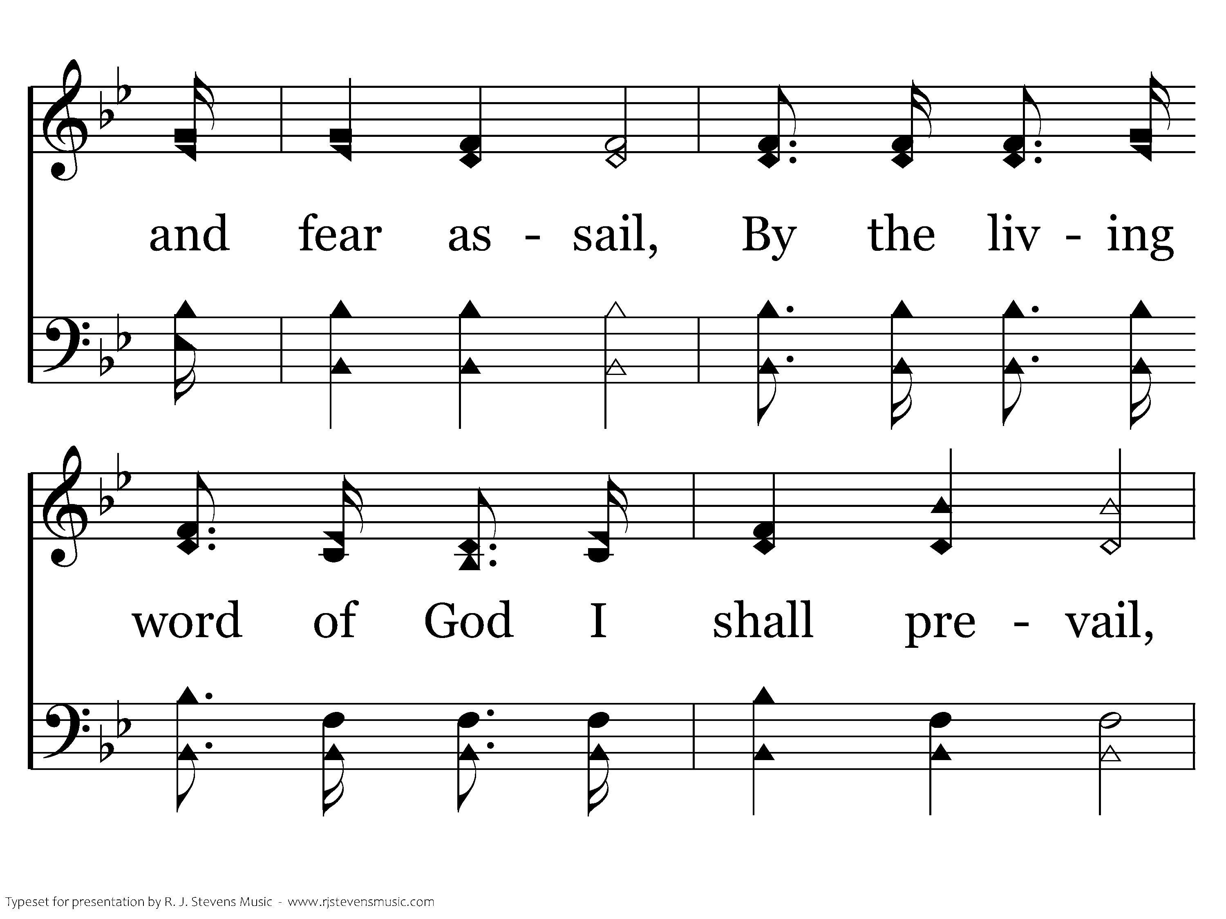
360 - Standing On The Promises - 2.2

Slide 12
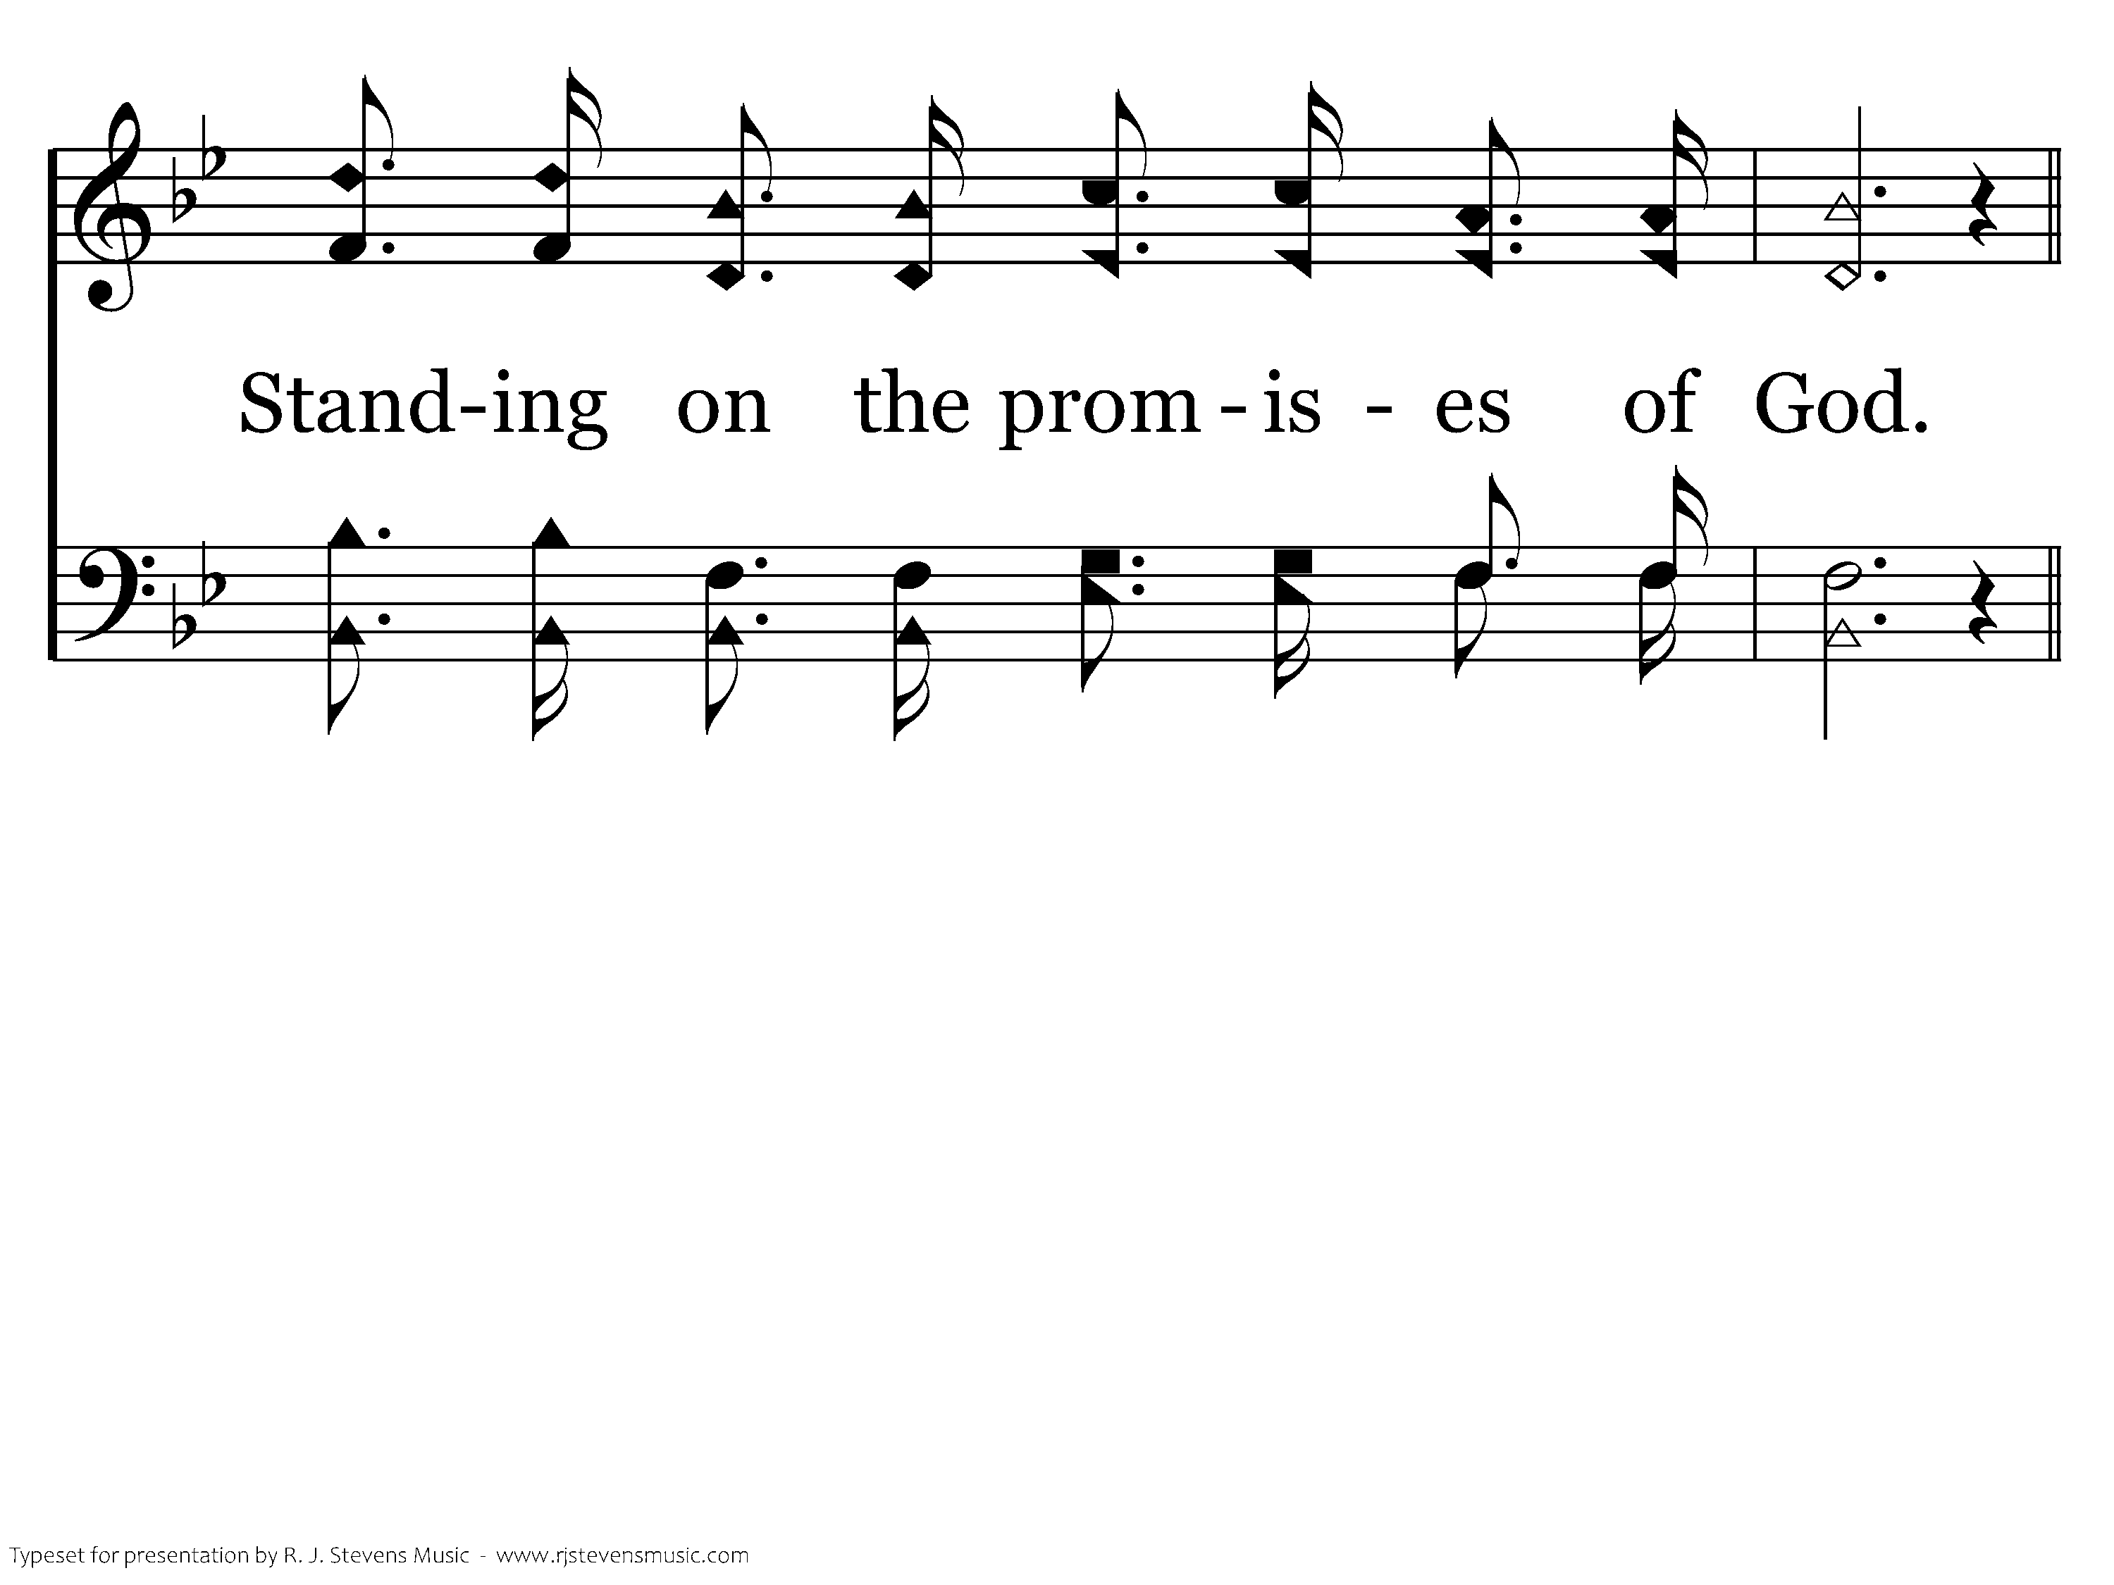
360 - Standing On The Promises - 2.3

Slide 13

Doctrine
That Makes Us
Different

Slide 14
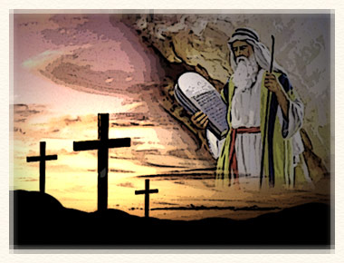
The
Two
Covenants
Hebrews 8:6-13

Slide 15
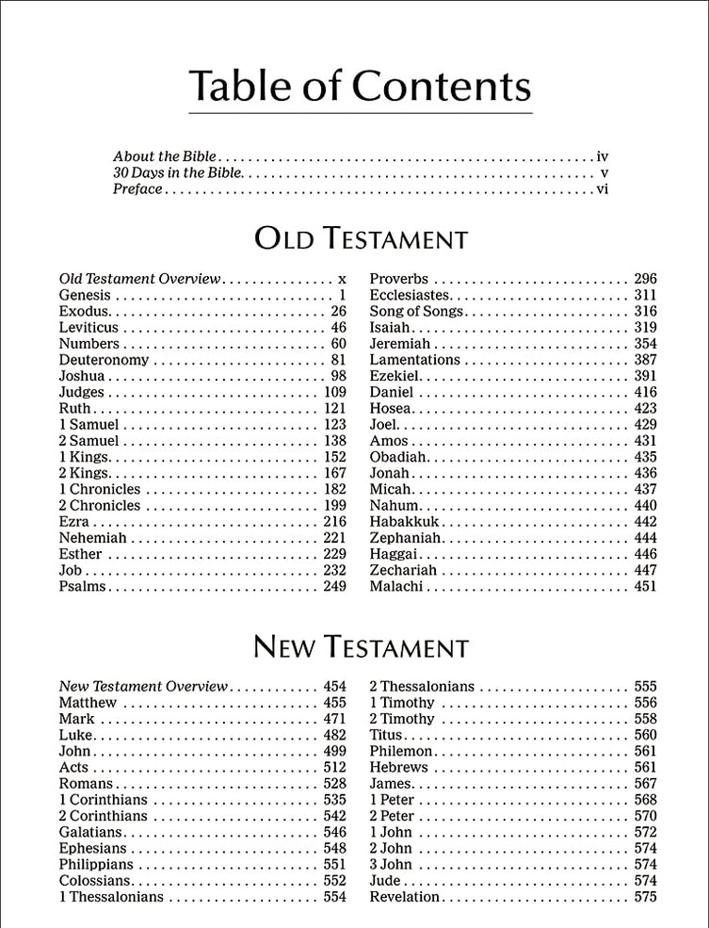

Slide 16
There Are Two Covenants
The covenant God made with Israel at Mt Sinai.
  Exodus 24:7-8
  “Law of Moses,” “Old Law,” “the Law”
Jeremiah 31:31-34 prophesies a change in this covenant.
Hebrews 8:6-13 shows this prophesy was fulfilled in Christ.
Jesus spoke of the “new covenant” when He instituted the Lord’s Supper - Luke 22:20.

Slide 17
Purpose of the Old Covenant
Regulate and atone for sin.
  Galatians 3:19
Bring us to Christ.
  Galatians 3:23-25
This covenant was fulfilled.
  Matt. 5:17; Rom. 10:4

Slide 18
The Old Covenant Was Taken Away
“Then He said, ‘Behold, I have come to do Your will, O God.’ He takes away the first that He may establish the second.”
Hebrews 10:9

Slide 19
The Old Covenant Was Taken Away
When Jesus died on the cross.
“Having wiped out the handwriting of requirements that was against us, which was contrary to us. And He has taken it out of the way, having nailed it to the cross” (Col. 2:14).
“Having abolished in His flesh the enmity, that is, the law of commandments contained in ordinances, so as to create in Himself one new man from the two, thus making peace” (Eph. 2:15).

Slide 20
The Old Covenant Was Taken Away
When Jesus died, His will (testament, covenant) went into effect.
  For where there is a testament, there must also of necessity be the death of the testator.
  For a testament is in force after men are dead, since it has no power at all while the testator lives.
  Hebrews 9:16-17

Slide 21
Failure to Understand the
Change in Covenants
We will follow and bind practices abolished by the death of Christ.
  Colossians 2:15-17
We remove ourselves from salvation in Christ and obligate ourselves to a law that can’t save us.
  Galatians 5:1-4

