Slide 2

“Let Us”
Hebrews 10:19-25

Slide 3
Therefore, brethren, having boldness to enter the Holiest by the blood of Jesus,
by a new and living way which He consecrated for us, through the veil, that is, His flesh,
and having a High Priest over the house of God,
Hebrews 10:19-21

Slide 4
Therefore, brethren, having boldness to enter the Holiest by the blood of Jesus,
by a new and living way which He consecrated for us, through the veil, that is, His flesh,
and having a High Priest over the house of God,
Hebrews 10:19-21

Slide 5
Therefore, brethren, having boldness to enter the Holiest by the blood of Jesus,
by a new and living way which He consecrated for us, through the veil, that is, His flesh,
and having a High Priest over the house of God,
Hebrews 10:19-21
“Let us therefore come boldly to the throne of grace, that we may obtain mercy and find grace to help in time of need.”
Hebrews 4:16

Slide 6
Therefore, brethren, having boldness to enter the Holiest by the blood of Jesus,
by a new and living way which He consecrated for us, through the veil, that is, His flesh,
and having a High Priest over the house of God,
Hebrews 10:19-21

Slide 7
Therefore, brethren, having boldness to enter the Holiest by the blood of Jesus,
by a new and living way which He consecrated for us, through the veil, that is, His flesh,
and having a High Priest over the house of God,
Hebrews 10:19-21

Slide 8
1. Let Us Draw Near
Let us draw near with a true heart in full assurance of faith, having our hearts sprinkled from an evil conscience and our bodies washed with pure water.
Hebrews 10:22

Slide 9
1. Let Us Draw Near
Let us draw near with a true heart in full assurance of faith, having our hearts sprinkled from an evil conscience and our bodies washed with pure water.
Hebrews 10:22

Slide 10
1. Let Us Draw Near
Let us draw near with a true heart in full assurance of faith, having our hearts sprinkled from an evil conscience and our bodies washed with pure water.
Hebrews 10:22

Slide 11
1. Let Us Draw Near
Let us draw near with a true heart in full assurance of faith, having our hearts sprinkled from an evil conscience and our bodies washed with pure water.
Hebrews 10:22

Slide 12
1. Let Us Draw Near
Let us draw near with a true heart in full assurance of faith, having our hearts sprinkled from an evil conscience and our bodies washed with pure water.
Hebrews 10:22

Slide 13
2. Let Us Hold Fast Our Confession
Let us hold fast the confession of our hope without wavering, for He who promised is faithful.
Hebrews 10:23

Slide 14
2. Let Us Hold Fast Our Confession
Let us hold fast the confession of our hope without wavering, for He who promised is faithful.
Hebrews 10:23

Slide 15
3. Let Us Consider One Another
And let us consider one another in order to stir up love and good works,
not forsaking the assembling of ourselves together, as is the manner of some, but exhorting one another, and so much the more as you see the Day approaching.
Hebrews 10:24-25

Slide 16
3. Let Us Consider One Another
And let us consider one another in order to stir up love and good works,
not forsaking the assembling of ourselves together, as is the manner of some, but exhorting one another, and so much the more as you see the Day approaching.
Hebrews 10:24-25

Slide 17
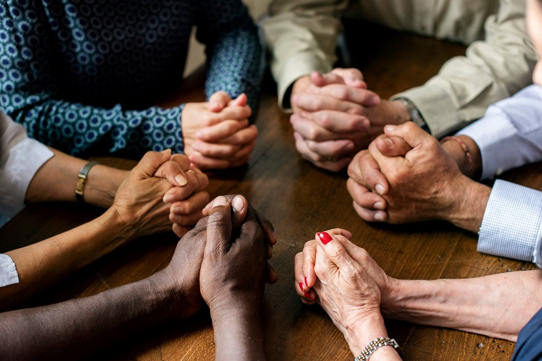
Let Us Draw Near to God
Let Us Hold Fast Our Confession
Let Us Consider One Another

