Slide 2
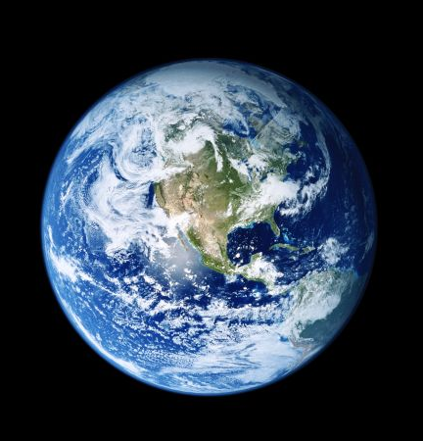
Respectable Worldliness

Slide 3
Beloved, I beg you as sojourners and pilgrims, abstain from fleshly lusts which
war against the soul.
1 Peter 2:11

Slide 4
I beseech you therefore, brethren, by the mercies of God, that you present your bodies a living sacrifice, holy, acceptable to God, which is your reasonable service.
And do not be conformed to this world, but be transformed by the renewing of your mind, that you may prove what is that good and acceptable and perfect will of God.
Romans 12:1-2

Slide 5
Therefore come out from among them and be separate, says the Lord. Do not touch what is unclean, and I will receive you.
I will be a Father to you, and you shall be My sons and daughters, says the Lord Almighty.
2 Corinthians 6:17-18

Slide 6
Adulterers and adulteresses! Do you not know that friendship with the world is enmity with God? Whoever therefore wants to be a friend of the world makes himself an enemy
of God.
James 4:4

Slide 7
1. Gambling
Gambling is growing in popularity and profitability.
  $71.9 billion wagered in 2024
Sports betting made legal in Ohio in 2023.
  $8.9 billion wagered in 2024

Slide 8
1. Gambling
Gambling is the betting or staking of something of value, with the consciousness of risk and hope of gain, on the outcome of a game, contest, or uncertain event.

Slide 9
Gambling violates the authorized means of gaining wealth.
Work
  Luke 10:7; Eph. 4:28; 2 Thess. 3:10
Commerce, exchange of goods
  Matt. 13:44; Acts 4:34-37; James 4:13
Gift
  Eph. 4:28; Matt. 2:11; Acts 20:35
Inheritance
  Luke 12:13; 15:12; Num. 27:1-11

Slide 10
Gambling is Sinful
Violates the principle of brotherly love
  Matt. 7:12; 22:39; Rom. 13:10
Motivated by sin
  Luke 12:15; Col. 3:5
Addictive
  1 Cor. 6:12

Slide 11
2. Drinking Alcohol

Slide 12
2. Drinking Alcohol
“Jesus turned water into wine” (John 2)
“Timothy was told to drink a little wine for his stomach’s sake” (1 Tim. 5:23).
“Deacons are not to be given to much wine”
(1 Tim. 3:8).
“We are told to drink wine with a merry heart” (Eccl. 9:7; Ps. 104:15).

Slide 13
2. Drinking Alcohol
The Greek word for “wine” (oinos) is not limited to fermented grape juice, but to the juice of the grape in every stage, including still being in the cluster
(Is. 65:8).
Jesus did not make 180 gallons of liquor!
  John 2:6; Habakkuk 2:15

Slide 14
2. Drinking Alcohol
Christians are not to be engaging in “drunkenness, revelries, drinking parties” (1 Peter 4:3).
Christians are commanded to be sober.
  1 Thess. 5:6, 8; 1 Pet. 1:13; 5:8
  Alcohol begins impacting the brain within minutes of consumption; reducing inhibitions and impairing judgment.

Slide 15
3. Inappropriate Dress

Slide 16
3. Inappropriate Dress
1 Timothy 2:9
“modest apparel, with propriety and moderation” (NKJV)
“proper clothing, modestly and discreetly” (NASB)
“proper clothing, with modesty and self-restraint” (LSB)
“respectable apparel, with modesty and self-control” (ESV)
“modest clothing, with decency and good sense” (CSB)
“modest apparel, with shamefacedness and sobriety” (KJV)

Slide 17
Nakedness
Gen. 2:25 – Adam and Eve were naked and were not ashamed.
Gen. 3:7 – their eyes were opened and they made coverings for themselves.
Gen. 3:10 – even with these coverings, they said they were “naked.”
Gen. 3:21 – God adequately clothed them with tunics.

Slide 18
Nakedness
Tunic (kutoneth) – “refers to a tunic that was worn next to a person’s body, often with long or half sleeves and reaching to the knees or ankles”
“He has shown you, O man, what is good; and what does the Lord require of you…” (Mal. 6:8).

Slide 19
The Shame of Nakedness
Micah 1:11; Nahum 3:5; Revelation 3:18; 16:15
Thigh – Isaiah 47:2-3
Buttocks – Isaiah 20:4
Breasts – Ezekiel 16:7

Slide 20
Therefore come out from among them and be separate, says the Lord. Do not touch what is unclean, and I will receive you.
I will be a Father to you, and you shall be My sons and daughters, says the Lord Almighty.
2 Corinthians 6:17-18

