Slide 2
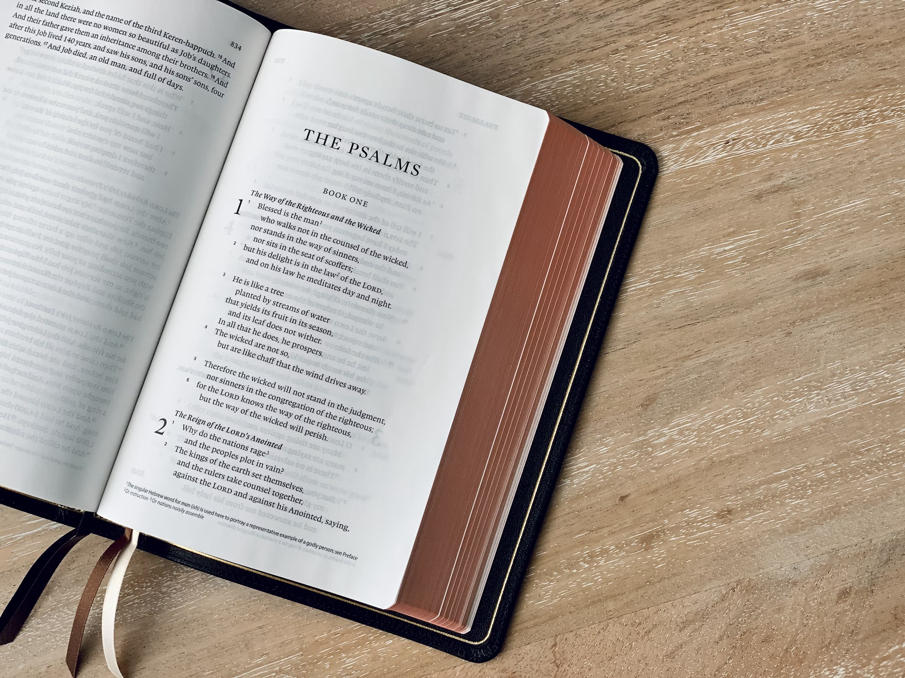
Praying Through The Psalms
Psalm 13
Gavin Thomas
Psalm 18
Kaz Willis
Psalm 23
Micah Blackaby
Psalm 28
Ravyn Philbeck

