Slide 2
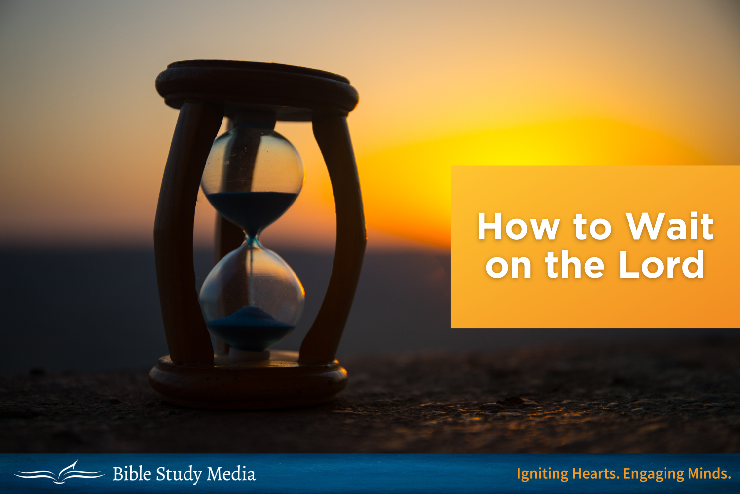

Slide 3
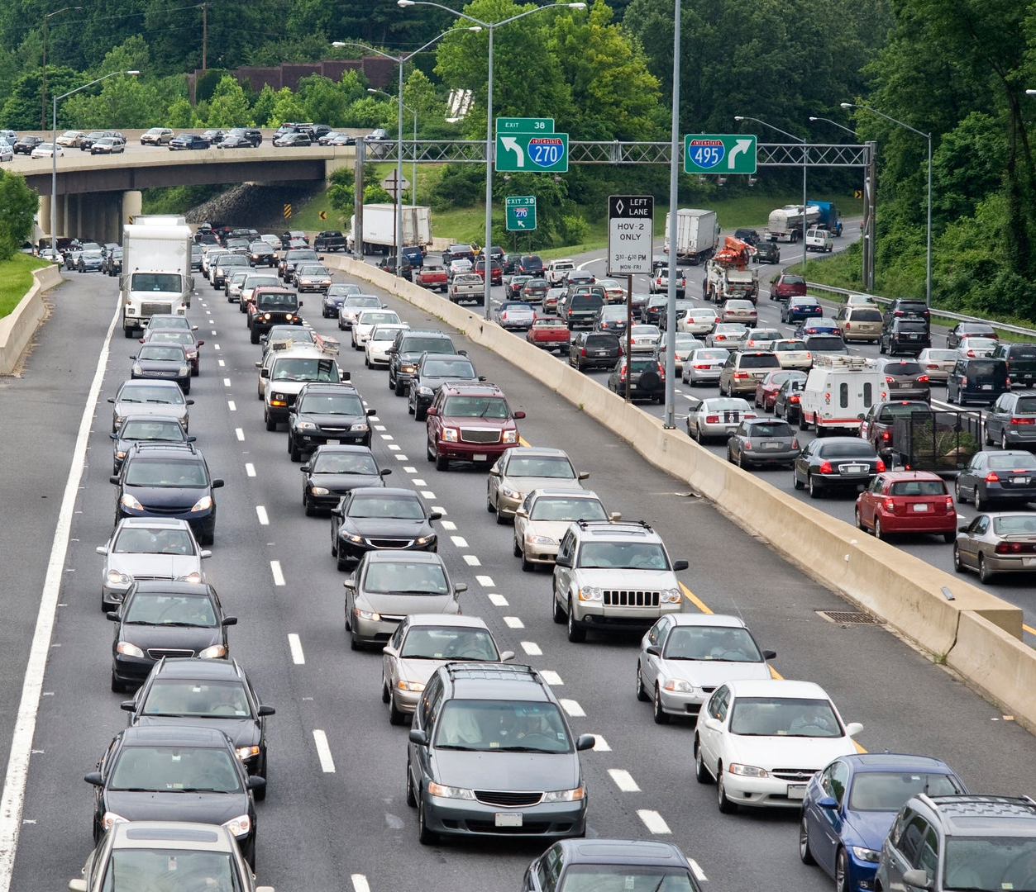
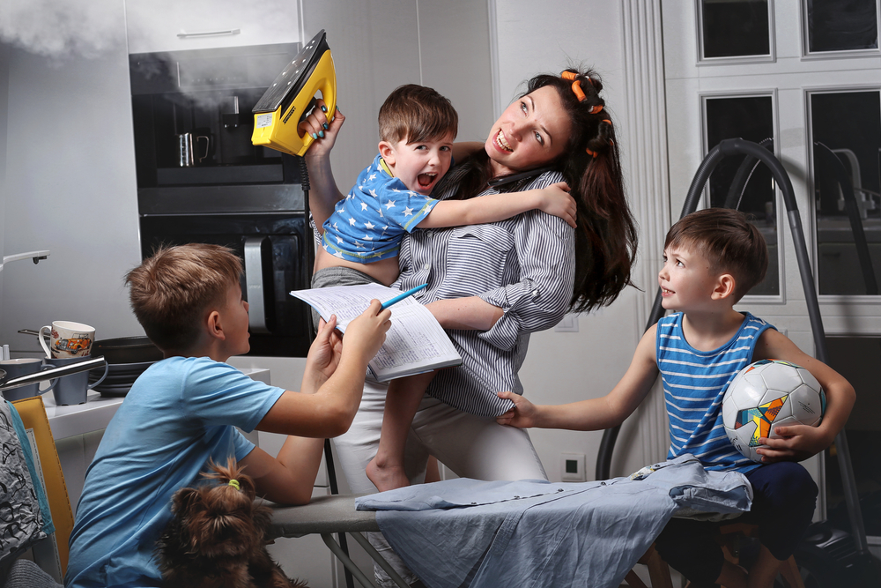
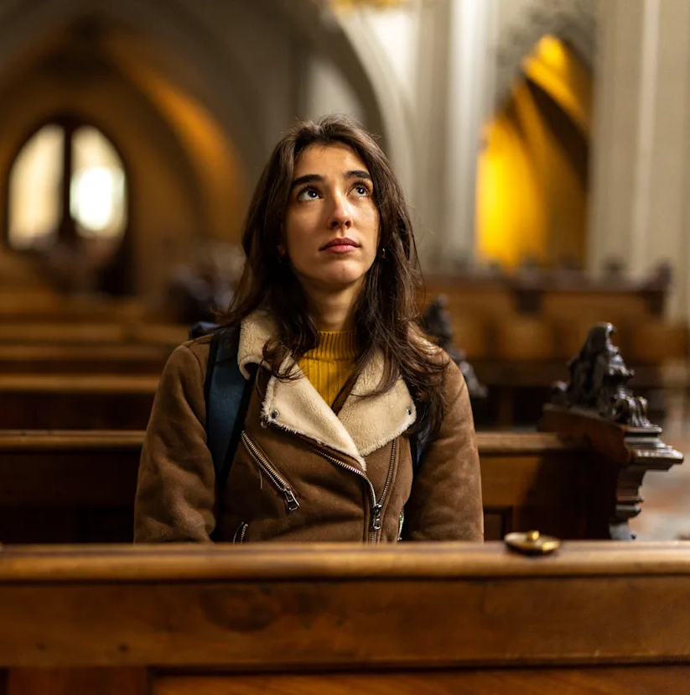
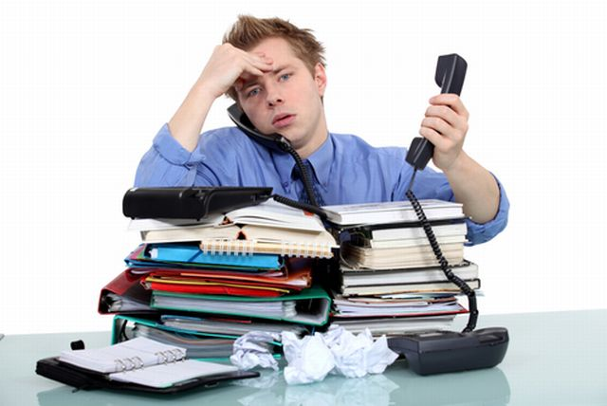


Slide 4
1. Confident Trust
Those who trust in the Lord are like Mount Zion, which cannot be moved, but abides forever.
As the mountains surround Jerusalem, so the Lord surrounds His people from this time forth and forever.
Psalm 125:1-2

Slide 5
1. Confident Trust
Now I know that the Lord saves His anointed; He will answer him from His holy heaven with the saving strength of His right hand.
Some trust in chariots, and some in horses; but we will remember the name of the Lord our God.
They have bowed down and fallen; but we have risen and stand upright.
Psalm 20:6-8

Slide 6
1. Confident Trust
Trust in the Lord with all your heart, and lean not on your own understanding;
In all your ways acknowledge Him, and He shall direct your paths.
Proverbs 3:5-6

Slide 7
1. Confident Trust
Have you not known? Have you not heard? The everlasting God, the Lord, the Creator of the ends of the earth, neither faints nor is weary. His understanding is unsearchable.
He gives power to the weak, and to those who have no might He increases strength...
But those who wait on the Lord shall renew their strength; they shall mount up with wings like eagles, they shall run and not be weary, they shall walk and not faint.
Isaiah 40:28-31

Slide 8
1. Confident Trust
Now this is the confidence that we have in Him, that if we ask anything according to His will, He hears us.
And if we know that He hears us, whatever we ask, we know that we have the petitions that we have asked of Him.
1 John 5:14-15

Slide 9
2. Patient Endurance

Slide 10
2. Patient Endurance
For the vision is yet for an appointed time; but at the end it will speak, and it will not lie. Though it tarries, wait for it; because it will surely come, it will not tarry.
Behold the proud, his soul is not upright in him; but the just shall live by his faith.
Habakkuk 2:3-4

Slide 11
2. Patient Endurance
My brethren, count it all joy when you fall into various trials,
knowing that the testing of your faith produces patience.
But let patience have its perfect work, that you may be perfect and complete, lacking nothing.
James 1:2-4

Slide 12
2. Patient Endurance
I waited patiently for the Lord; and He inclined to me, and heard my cry.
He also brought me up out of a horrible pit, out of the miry clay, and set my feet upon a rock, and established my steps.
He has put a new song in my mouth - praise to our God; many will see it and fear, and will trust in the Lord.
Psalm 40:1-3

Slide 13
2. Patient Endurance
Do not say, “I will recompense evil”;
wait for the Lord, and He will save you.
Proverbs 20:22

Slide 14
3. Steadfast Hope
This hope we have as an anchor of the soul, both sure and steadfast, and which enters the Presence behind the veil.
Hebrews 6:19

Slide 15
3. Steadfast Hope
For we were saved in this hope, but hope that is seen is not hope; for why does one still hope for what he sees?
But if we hope for what we do not see, we eagerly wait for it with perseverance.
Romans 8:24-25

Slide 16
3. Steadfast Hope
In hope of eternal life which God, who cannot lie, promised before time began.
Titus 1:2

Slide 17
3. Steadfast Hope
I wait for the Lord, my soul waits, and in His word I do hope.
My soul waits for the Lord more than those who watch for the morning - yes, more than those who watch for the morning.
O Israel, hope in the Lord; for with the Lord there is mercy, and with Him is abundant redemption.
Psalm 130:5-7

Slide 18
4. Willing Obedience
Waiting on the master requires continued faithful service (Matt. 24:45-51).
The Master returned “after a long time” (Matt. 25:19).
“And let us not grow weary while doing good, for in due season we shall reap if we do not lose heart” (Gal. 6:9).

Slide 19
Waiting on the Lord
“Wait on the Lord; be of good courage, and He shall strengthen your heart; wait, I say, on the Lord!” (Psalm 27:14).
“It is good that one should hope and wait quietly For the
salvation of the Lord” (Lam. 3:26).
“But those who wait on the Lord shall renew their strength; they shall mount up with wings like eagles, they shall run and not be weary, they shall walk and not faint” (Isaiah 40:31).

