Slide 2
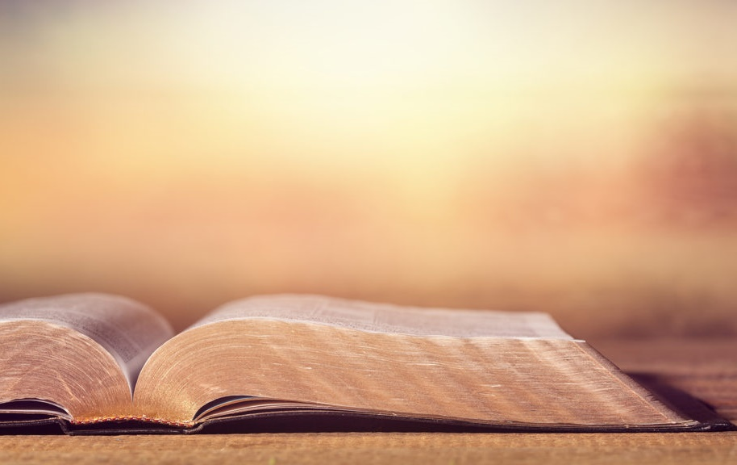
Doctrine
That Makes Us
Different

Slide 3
The One True Church
“And I also say to you that you are Peter, and on this rock I will build My church, and the gates of Hades shall not prevail against it.”
Matthew 16:18

Slide 4
Most people see the church of Christ as another denomination, just a part of the religious landscape.
Presbyterian
Pentecostal
Church of Christ
Catholic
Lutheran
Baptist
Methodist
Nazarene

Slide 5
Most people see the church of Christ as another denomination, just a part of the religious landscape.
Church of Christ
Catholic
Presbyterian
Lutheran
Pentecostal
Baptist
Methodist
Nazarene

Slide 6
What is the Church?
The church is the body of saved people -
Acts 2:47
The church is the “called out” body.
  EKKLESIA: EK - out of, KLESIS - a calling.
Used in two senses in the New Testament:
  Universal - all the saved.
  Local - all the saved meeting together in a specific location.

Slide 7
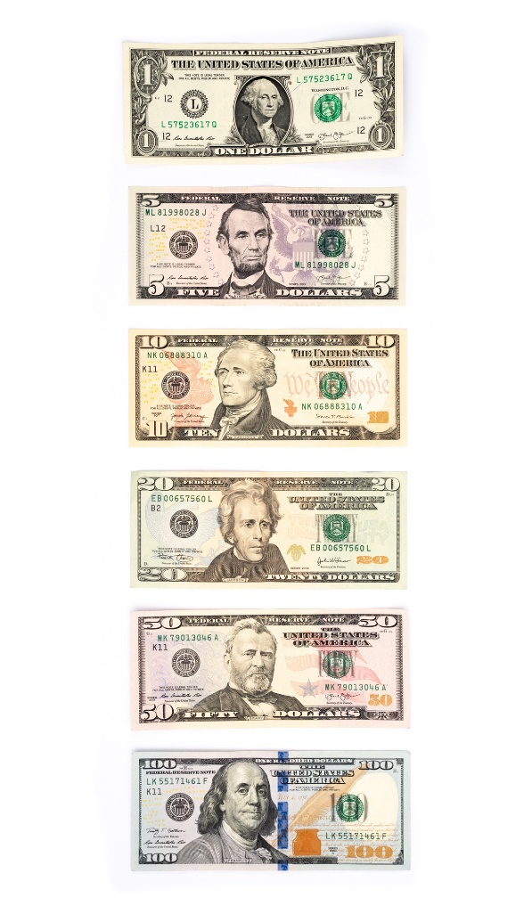
The Lord’s Church is
NOT a Denomination
A denomination is a division, a part of something.
All parts are equally valid.

Slide 8
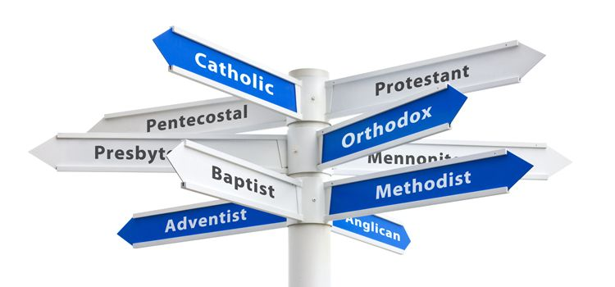
The Lord’s Church is
NOT a Denomination
A denomination is a division, a part of something.
All parts are equally valid.
The denominational view of the church is that all denominations are equally valid parts of the Lord’s church.

Slide 9
The Lord’s Church is
NOT a Denomination
Jesus only built one church - Matt. 16:18
There is only one body - Eph. 4:4
Jesus is the Savior of one body - Eph. 5:23
Jesus prayed for the unity of His believers -
John 17:20-21
Believers are not allowed to be divided by doctrinal differences - 1 Cor. 1:10-13

Slide 10
What About People in Denominations?
They may be morally good believers, but most of them have not obeyed the gospel and are not saved. Like others who are lost, they need to be taught with love and patience, and encouraged to obey the pure gospel of Jesus Christ.
Those who have been baptized for the remission of their sins are joined to (having fellowship with) those who are not saved. They need to repent of this error and identify themselves with a faithful local church.

