Slide 2
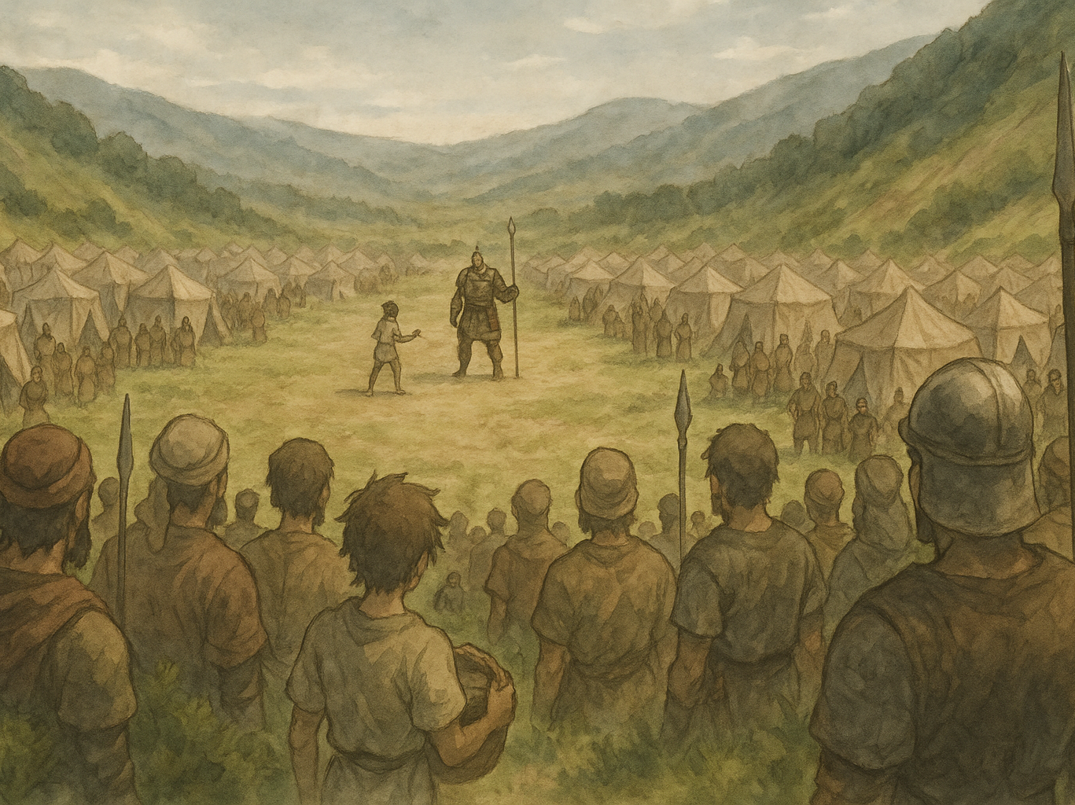
David and Goliath
Courage in the Valley

Slide 3
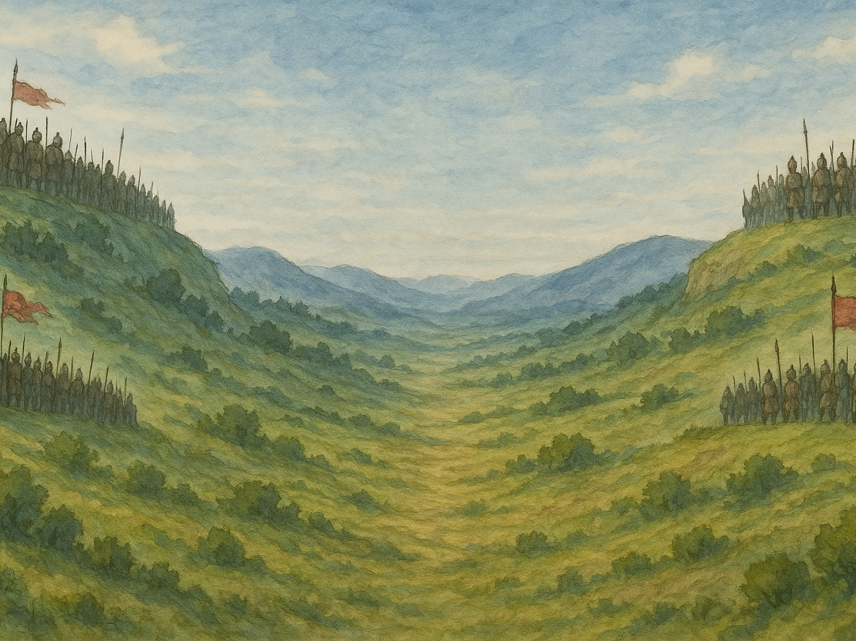
Main Characters
David – The Young Shepard
Goliath – Philistine Champion
King Saul – Israel’s King
Eliab – David’s Older Brother

Slide 4
Setting the Scene
Two armies on opposing hills, valley between them
Goliath issues daily challenges for 40 days
Israelite army, including Saul, is terrified

Slide 5
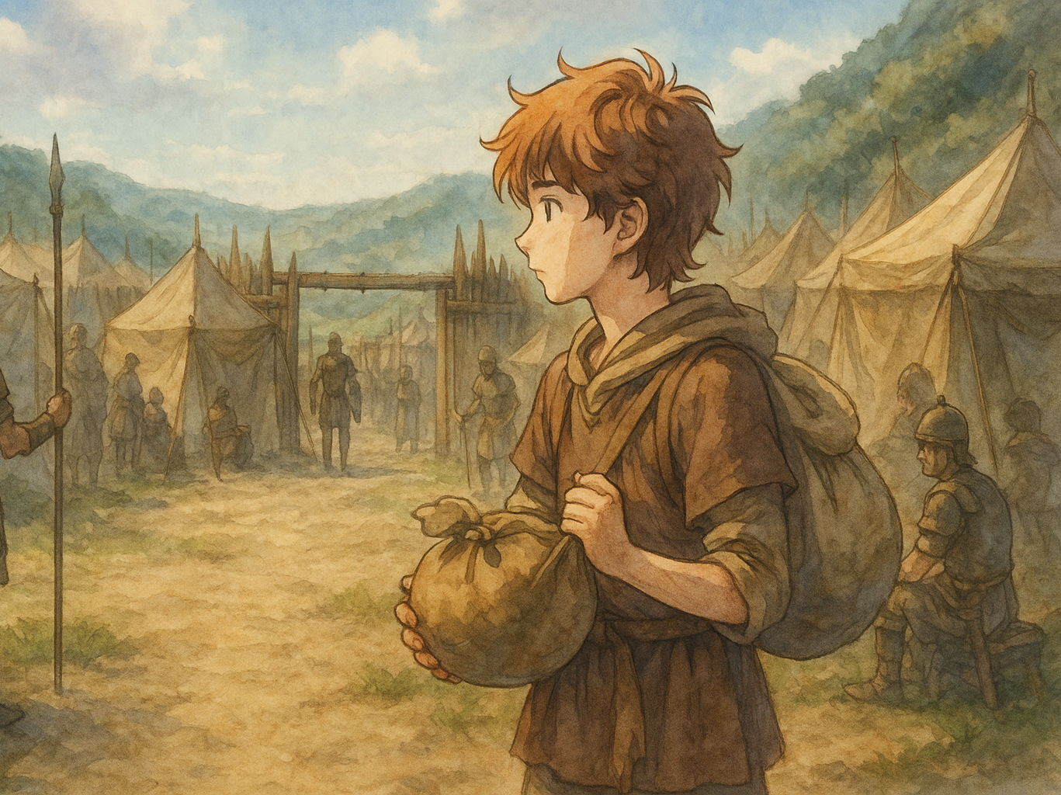
David Enters the Scene
Sent by his father to check on his brothers.
Witnesses Goliath’s taunts and is deeply bothered

Slide 6
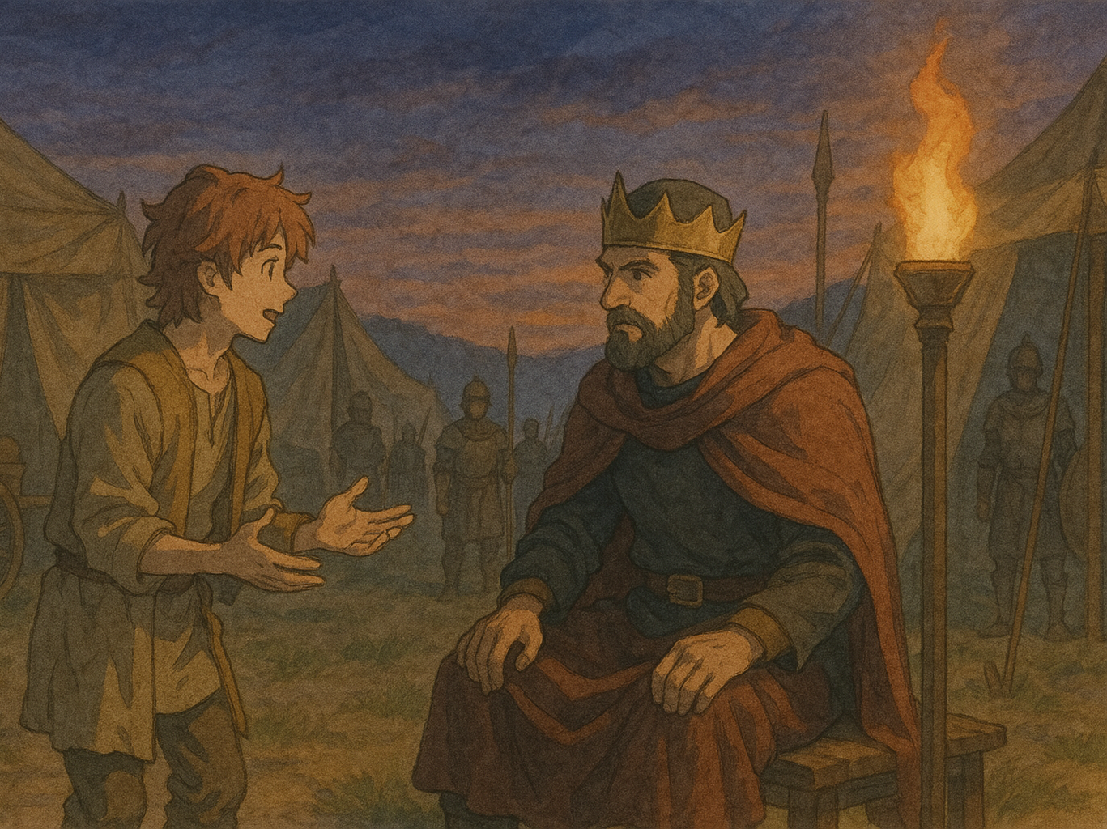
David’s Feats of Courage
David shows courage from the moment he hears Goliath’s challenge
David is willing to do what he challenged others to do
David trusts in God’s faithfulness, not his own strength

Slide 7
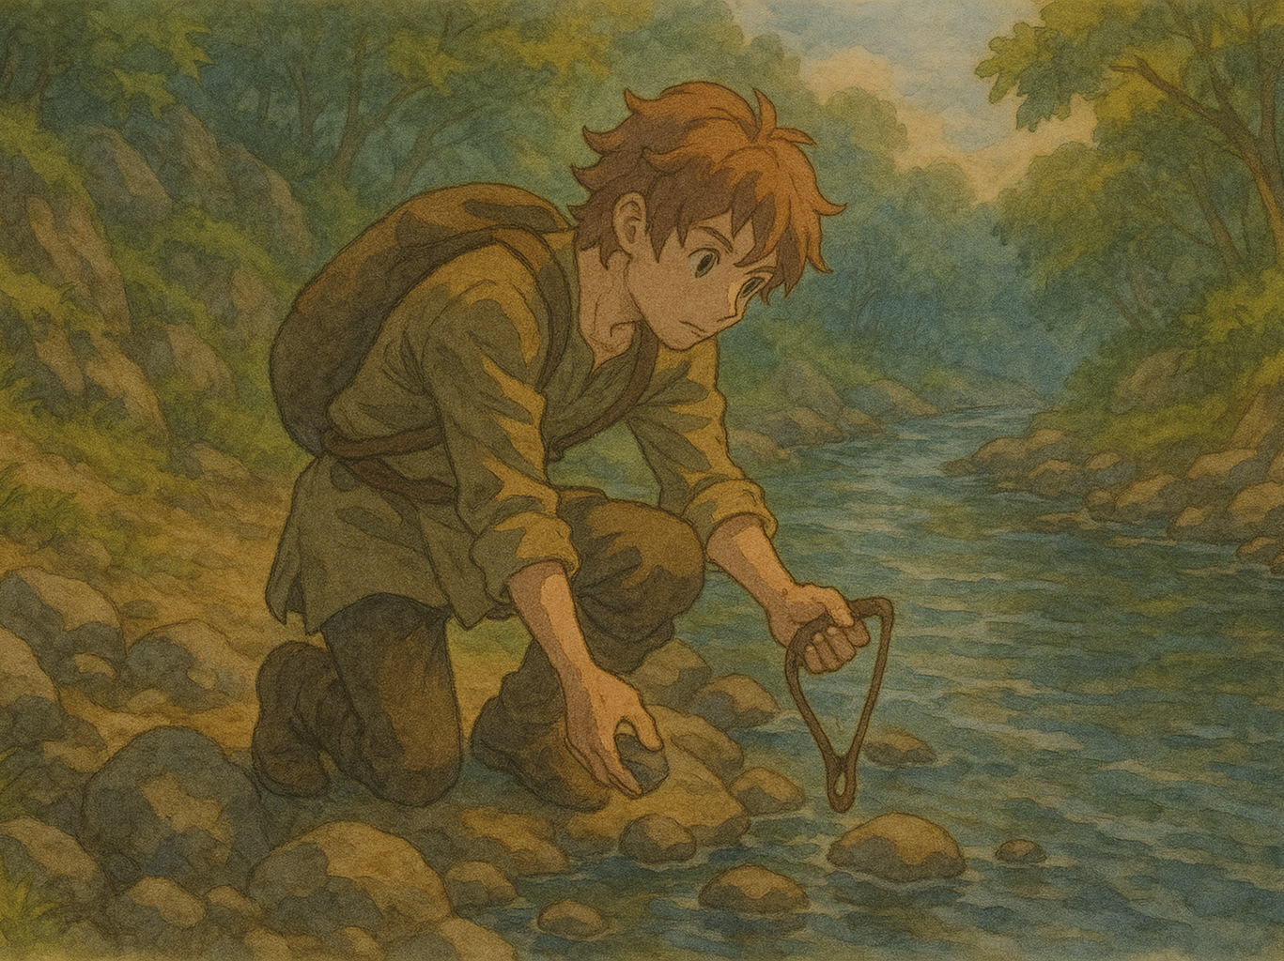
The Battle
David’s Preparation
Goliath’s Mockery
David’s Victory

Slide 8
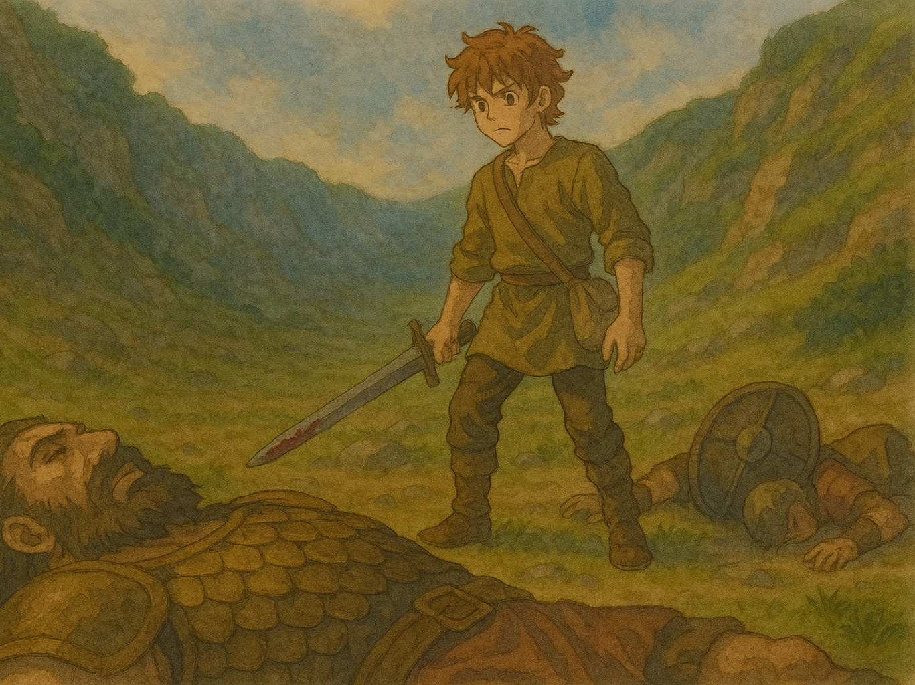
The Conclusion
It’s never too early to be courageous
Be led by faith not by fear
Our courageous actions should be to honor God

