Slide 2
Portraits of a Preacher
2 Timothy 2:1-7

Slide 3
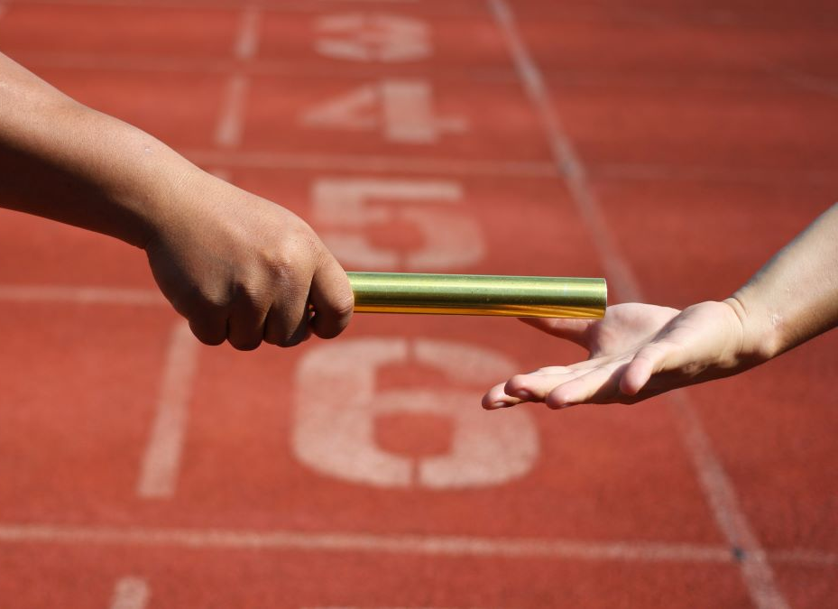
1. Relay Runner
And the things that you have heard from me among many witnesses, commit these to faithful men who will be able to teach others also.
2 Tim. 2:2

Slide 4
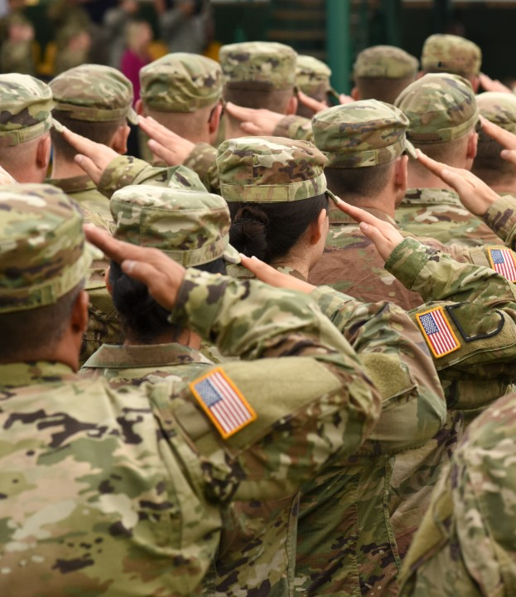
2. Soldier
You therefore must endure hardship as a good soldier of Jesus Christ.
No one engaged in warfare entangles himself with the affairs of this life, that he may please him who enlisted him as a soldier.
2 Tim. 2:3-4

Slide 5

3. Athlete
And also if anyone competes in athletics, he is not crowned unless he competes according to the rules.
2 Tim. 2:5

Slide 6
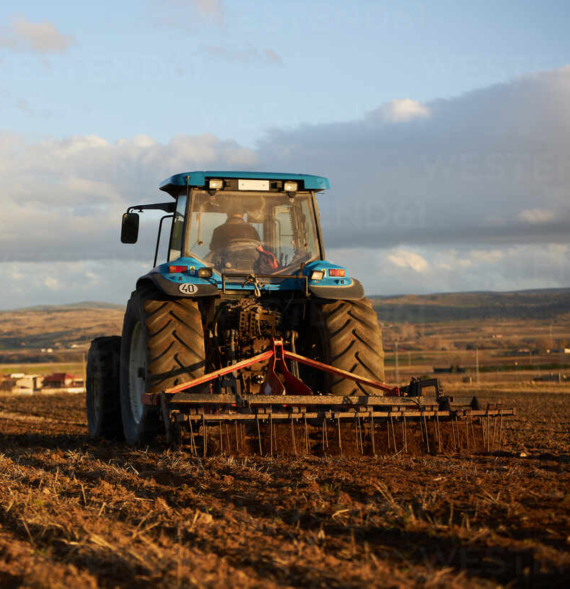
4. Farmer
The hardworking farmer must be first to partake of the crops.
2 Tim. 2:6

Slide 7
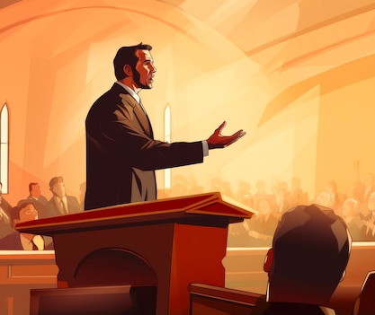
A Faithful Gospel Preacher is Like a…
Relay Runner
Soldier
Athlete
Farmer

