Slide 2
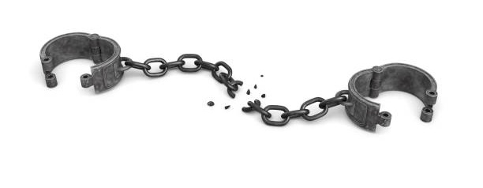
The Truth Shall
Make You Free
John 8:31-36

Slide 3
The Truth Shall Free Us From…
Sin - John 8:34-36
Ignorance - Acts 17:30
Law of Moses - Galatians 5:1
False Doctrine - 1 John 4:1
Human Traditions - Colossians 2:8-10

Slide 4
“Therefore if the Son makes you free, you shall be free indeed.”
John 8:36

