Slide 2
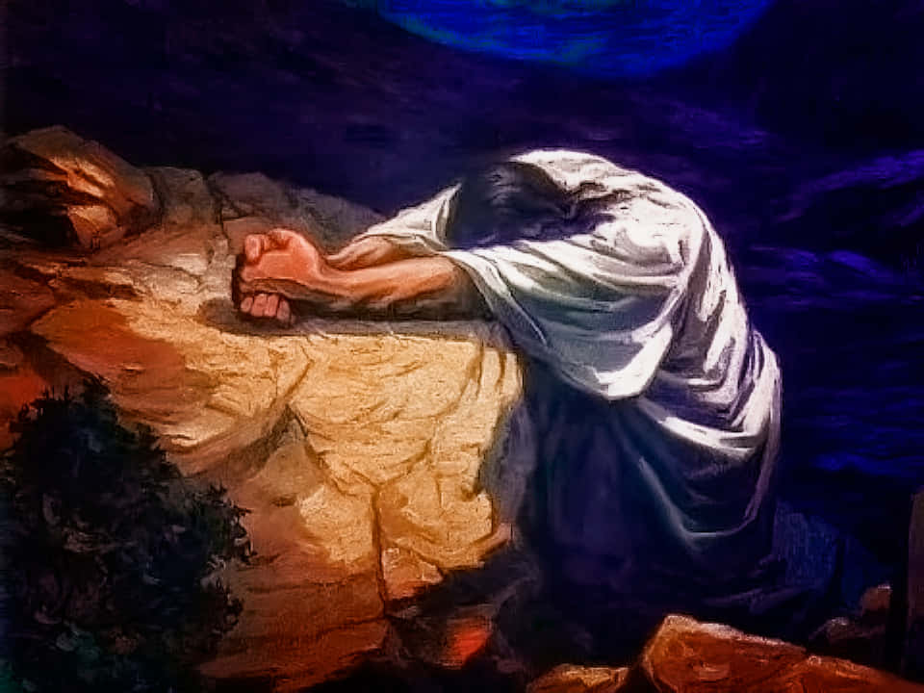
Prayer and Solitude

Slide 3
And when you pray, you shall not be like the hypocrites. For they love to pray standing in the synagogues and on the corners of the streets, that they may be seen by men. Assuredly, I say to you, they have their reward.
But you, when you pray, go into your room, and when you have shut your door, pray to your Father who is in the secret place; and your Father who sees in secret will reward you openly.
And when you pray, do not use vain repetitions as the heathen do. For they think that they will be heard for their many words.
Matthew 6:5-7

Slide 4
And when you pray, you shall not be like the hypocrites. For they love to pray standing in the synagogues and on the corners of the streets, that they may be seen by men. Assuredly, I say to you, they have their reward.
But you, when you pray, go into your room, and when you have shut your door, pray to your Father who is in the secret place; and your Father who sees in secret will reward you openly.
And when you pray, do not use vain repetitions as the heathen do. For they think that they will be heard for their many words.
Matthew 6:5-7

Slide 5
And when you pray, you shall not be like the hypocrites. For they love to pray standing in the synagogues and on the corners of the streets, that they may be seen by men. Assuredly, I say to you, they have their reward.
But you, when you pray, go into your room, and when you have shut your door, pray to your Father who is in the secret place; and your Father who sees in secret will reward you openly.
And when you pray, do not use vain repetitions as the heathen do. For they think that they will be heard for their many words.
Matthew 6:5-7

Slide 6
And when you pray, you shall not be like the hypocrites. For they love to pray standing in the synagogues and on the corners of the streets, that they may be seen by men. Assuredly, I say to you, they have their reward.
But you, when you pray, go into your room, and when you have shut your door, pray to your Father who is in the secret place; and your Father who sees in secret will reward you openly.
And when you pray, do not use vain repetitions as the heathen do. For they think that they will be heard for their many words.
Matthew 6:5-7

Slide 7

Importance of Solitude
Place for quiet, private, alone time.
Maintaining our emotional well-being and developing inner discipline and peace.
Spend much time reacting
and responding, solitude
gives us the opportunity
to reflect and rebuild.

Slide 8
Prayers of Solitude

Slide 9
Prayers of Solitude
But know that the Lord has set apart for Himself him who is godly; the Lord will hear when I call to Him.
Be angry, and do not sin. Meditate within your heart on your bed, and be still.
Psalm 4:3-4
David

Slide 10
Prayers of Solitude
O God, You are my God; early will I seek You; my soul thirsts for You; my flesh longs for You in a dry and thirsty land where there is no water.
When I remember You on my bed, I meditate on You in the night watches.
Psalm 63:1, 6
David

Slide 11
Prayers of Solitude
Then he turned his face toward the wall, and prayed to the Lord, saying,
“Remember now, O Lord, I pray, how I have walked before You in truth and with a loyal heart, and have done what was good in Your sight.” And Hezekiah wept bitterly.
2 Kings 20:2-3
Hezekiah

Slide 12
Prayers of Solitude
Now when Daniel knew that the writing was signed, he went home. And in his upper room, with his windows open toward Jerusalem, he knelt down on his knees three times that day, and prayed and gave thanks before his God, as was his custom since early days.
Daniel 6:10
Daniel

Slide 13
The Private Prayers of Jesus

Slide 14
The Private Prayers of Jesus
Now in the morning, having risen a long while before daylight, He went out and departed to a solitary place; and there He prayed.
And Simon and those who were with Him searched for Him.
Mark 1:35-36

Slide 15
The Private Prayers of Jesus
However, the report went around concerning Him all the more; and great multitudes came together to hear, and to be healed by Him of their infirmities.
So He Himself often withdrew into the wilderness and prayed.
Luke 5:15-16

Slide 16
The Private Prayers of Jesus
Now it came to pass in those days that He went out to the mountain to pray, and continued all night in prayer to God.
Luke 6:12

Slide 17
The Private Prayers of Jesus
And when He had sent the multitudes away, He went up on the mountain by Himself to pray. Now when evening came, He was alone there.
But the boat was now in the middle of the sea, tossed by the waves, for the wind was contrary.
Now in the fourth watch of the night Jesus went to them, walking on the sea.
Matthew 14:23-25

Slide 18
The Private Prayers of Jesus
Now it came to pass, about eight days after these sayings, that He took Peter, John, and James and went up on the mountain to pray.
Luke 9:28

Slide 19
The Private Prayers of Jesus
And He was withdrawn from them about a stone’s throw, and He knelt down and prayed,
saying, “Father, if it is Your will, take this cup away from Me; nevertheless not My will, but Yours, be done.”
Luke 22:41-42

Slide 20
The Apostles Followed His Example
The next day, as they went on their journey and drew near the city, Peter went up on the housetop to pray, about the sixth hour.
Then he became very hungry and wanted to eat; but while they made ready, he fell into a trance.
Acts 10:9-10

Slide 21
The Apostles Followed His Example
Then we went ahead to the ship and sailed to Assos, there intending to take Paul on board; for so he had given orders, intending himself to go on foot.
And when he met us at Assos, we took him on board and came to Mitylene.
Acts 20:13-14

Slide 22

The Spiritual Significance of Solitude in Prayer
But you, when you pray, go into your inner room, and when you have shut your door, pray to your Father who is in secret, and your Father who sees in secret will repay you.
Matthew 6:6, NASB

Slide 23
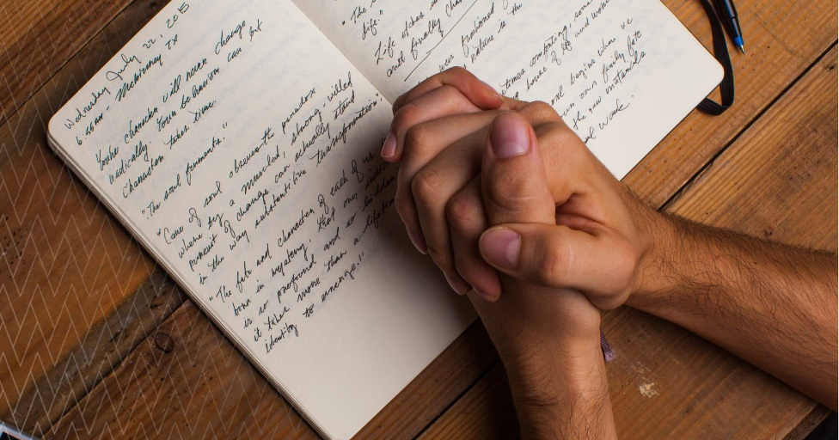
Developing the Discipline of Prayer
A time when you’re at your best mentally and physically.
A place where you will not be disturbed.
Your prayer list or
praying journal.
A mind prepared
to approach God.

Slide 24
Prayer and Solitude

