Slide 2
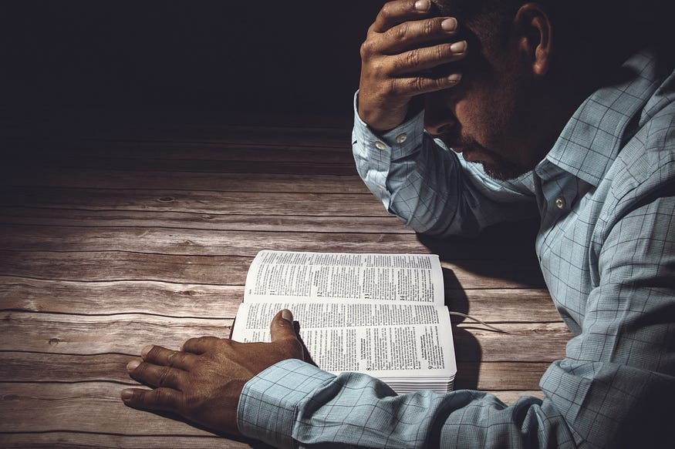
God Tests Our Faith
1 Peter 1:6-7

Slide 3

Our Faith Can Be…
Sincere (1 Tim. 1:5)
Genuine (2 Tim. 1:5)
Strengthened (Rom. 4:20)
Increased (2 Cor. 10:15)
Great (Matt. 8:10)
Rich (James 2:5)
Perfected (James 2:22)
Little (Matt. 8:26)
Weak (Rom. 14:1)
Cast Off (1 Tim. 5:12)
Overthrown (2 Tim. 2:18)
Shipwrecked (1 Tim. 1:19)
Dead (James 2:17, 20)

Slide 4
How God Tests Our Faith
Allows Satan to Temps Us
  James 1:12-13; 1 Cor. 10:13; Job 1:12; 2:6
Through His Commandments
  Ex. 20:20
Through Difficult Circumstances
  John 6:6; 2 Cor. 12:7-10; 2 Chron. 32:31
Through Difficult People
  Eph. 4:1-2; Matt. 5:23-24; 18:15

Slide 5
Why God Tests Our Faith
He Loves Us
  Hebrews 12:3-11
To Purify Our Faith
  1 Peter 1:6-7; Psalm 57:1
To Strengthen Our Faith
  Romans 4:20; James 2:22

