Slide 2
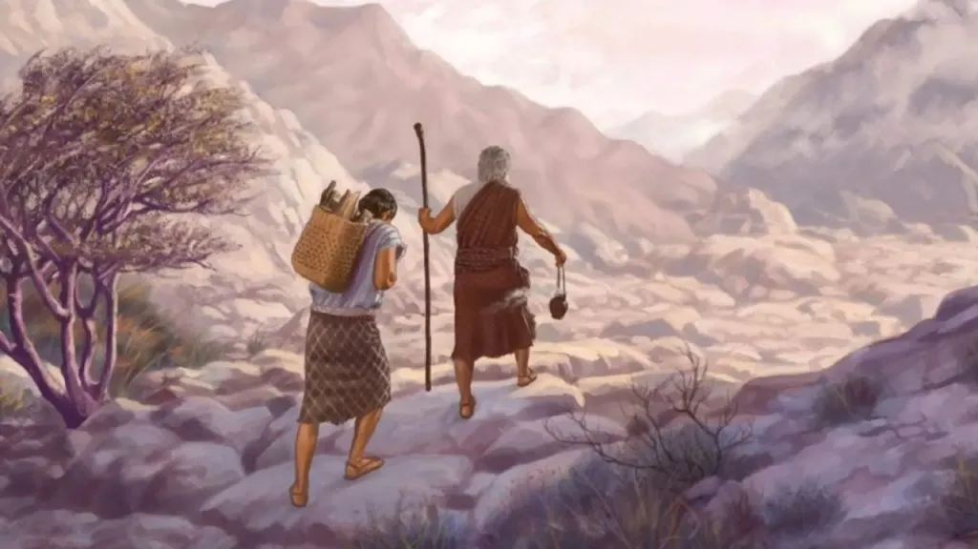
Abraham Offers Isaac
Genesis 22

Slide 3
Lessons from Abraham’s Faith
Genesis 22
God tests us by asking us to obey difficult commands.
God doesn’t always explain Himself.
God’s tests require us to use what we know.

Slide 4
What did Abraham know?
He would become a great nation (12:2)
A physical heir would give him descendants as numerous as the stars (15:4-6)
A son would be born through Sarah (17:15-19)
These blessings would come through Isaac (21:12).
All of Abraham’s spiritual hopes
were centered on Isaac!

Slide 5
How Abraham worked out this dilemma:
By faith Abraham, when he was tested, offered up Isaac, and he who had received the promises offered up his only begotten son,
of whom it was said, “In Isaac your seed shall be called,”
concluding that God was able to raise him up, even from the dead, from which he also received him in a figurative sense.
Hebrews 11:17-19

Slide 6
Lessons from Abraham’s Faith
Genesis 22
God tests us by asking us to obey difficult commands.
God doesn’t always explain Himself.
God’s tests require us to use what we know.
Our faith must be grounded on God’s promises.
“God will provide” (v. 8)

Slide 7
Lessons from Abraham’s Faith
Genesis 22
God tests us by asking us to obey difficult commands.
God doesn’t always explain Himself.
God’s tests require us to use what we know.
Our faith must be grounded on God’s promises.
Our faith must result in obedience.
James 2:20-24

Slide 8
Seeing Jesus in Genesis 22
Miraculous births of Isaac and Jesus.
Both Abraham and God offered their only sons whom they loved.
Isaac carried the wood; Jesus carried the cross.
Isaac and Jesus willingly submitted.
A ram was offered in the place of Isaac; Jesus was the Lamb of God offered in our place.
Ram caught in thorns; crown of thorns on Jesus.
Abraham received Isaac from the dead, Jesus was raised from the dead.

Slide 9
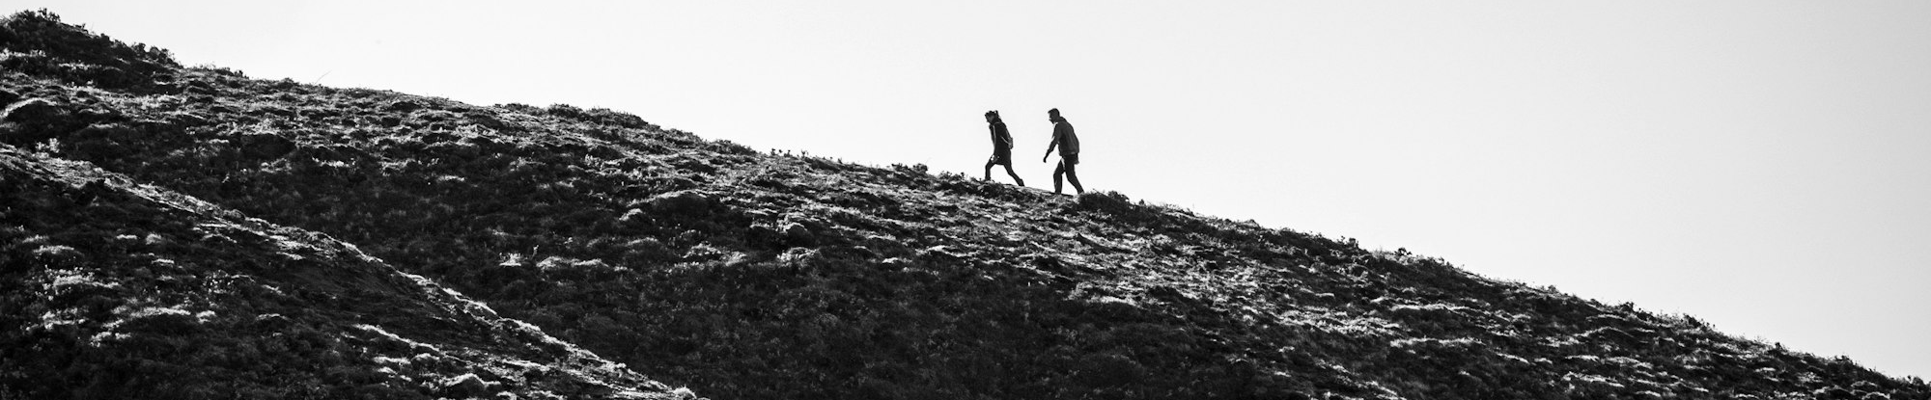
God tests us with difficult commands.
God doesn’t always explain Himself.
God’s tests require us to use what we know.
Our faith must believe “God will provide.”
Our faith must result in obedience.

