Slide 1
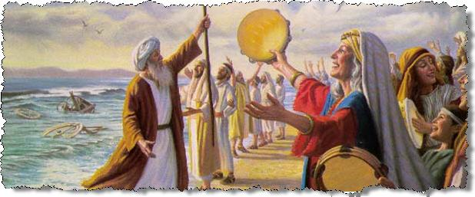
Miriam
The Sister of Aaron and Moses

Slide 2
For I brought you up from the land of Egypt, I redeemed you from the house of bondage; And I sent before you Moses, Aaron, and Miriam.
Micah 6:4

Slide 3
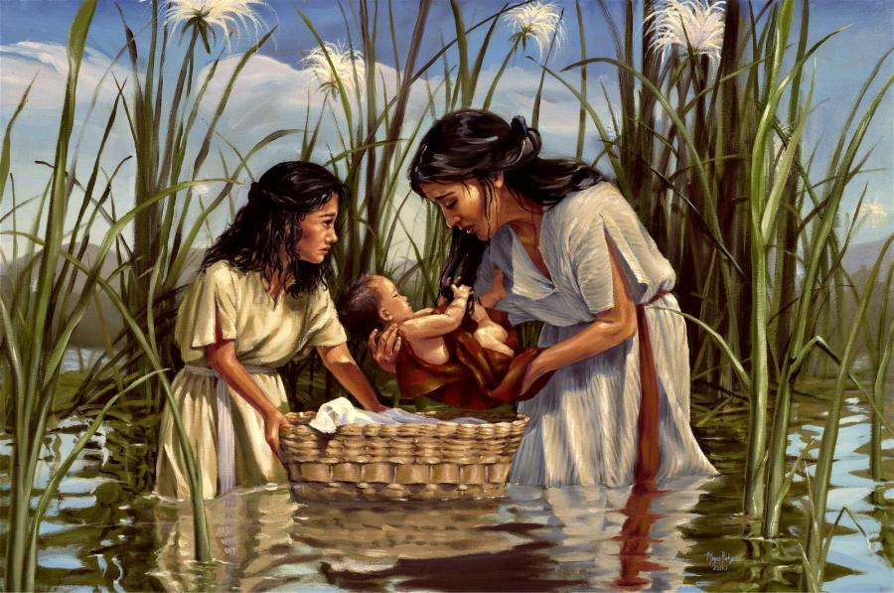
1. Miriam’s Childhood
Miriam is the oldest child of Amram and Jochebed (Ex. 6:20).
Miriam was probably 10-12 years older than Moses.
Aaron was three years older than Moses (Ex. 7:7).

Slide 4
1. Miriam’s Childhood
Exodus 2:4-8
Miriam was brave and compassionate.
Moses probably wouldn’t have become the spiritual man he was if Miriam hadn’t stepped forward and reconnected him with his mother.

Slide 5
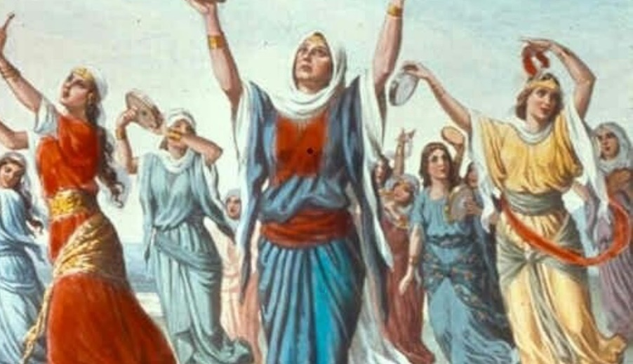
2. Miriam in the Exodus
Exodus 15:20-21
She was a prophetess (Num. 12:2).
She led the women in worship.
Her death and burial are mentioned (Num. 20:1).

Slide 6
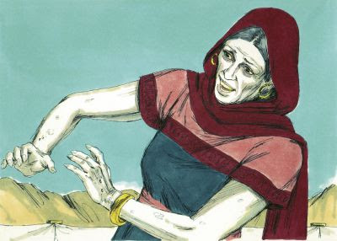
3. Miriam’s Sin
Numbers 12:1-15
She was jealous of Moses.
She and Aaron were rebelling against God.
There are consequences for
sin, especially if one is
a leader of God’s people.

Slide 7
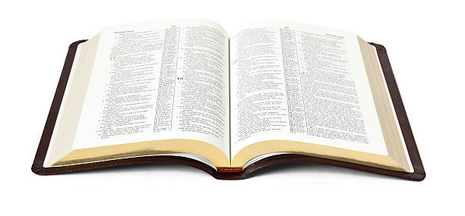
Lessons from Miriam
She had courage and compassion.
She had faith and influence for good.
She sinned: but repented, accepted the consequences, and continued to serve God.

