Slide 2
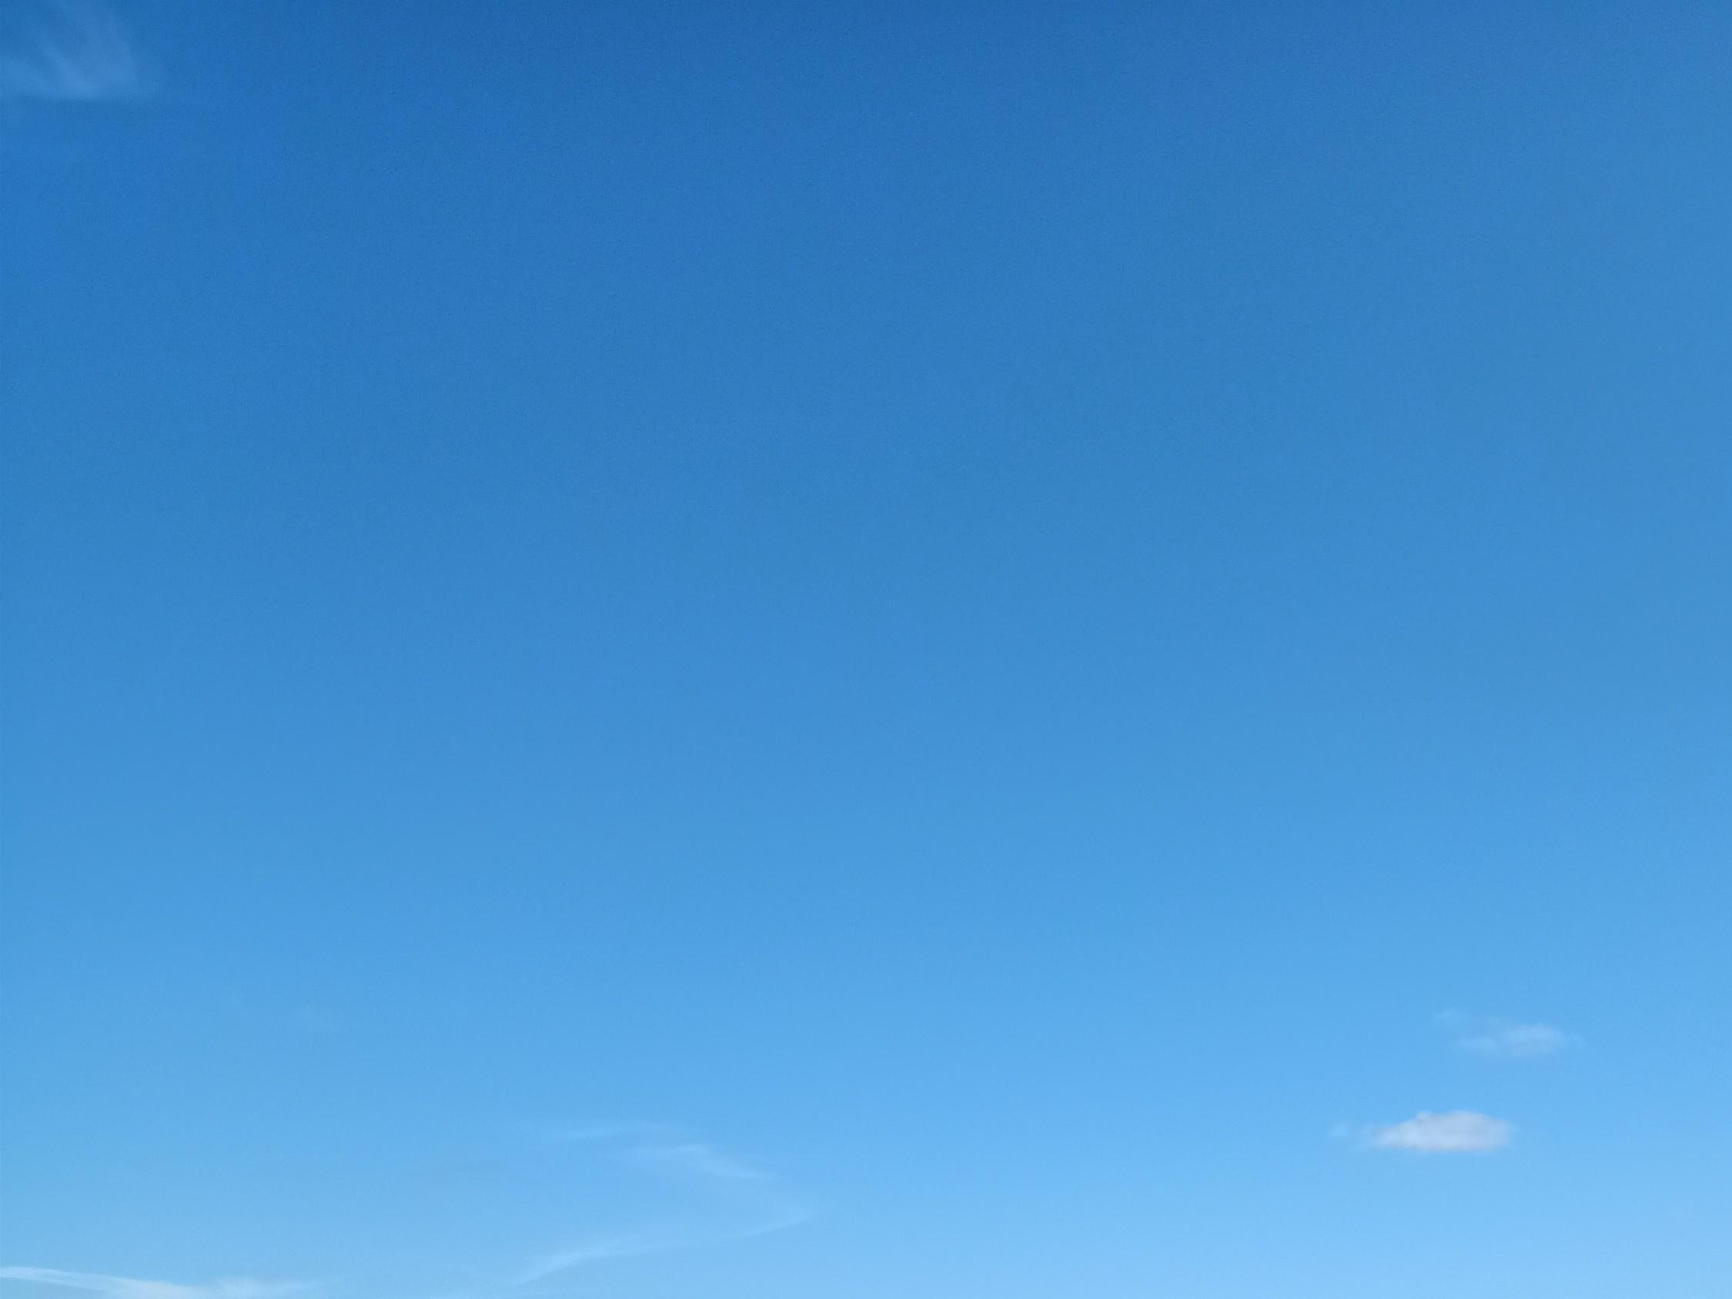
Why I Long for Heaven

Slide 3
Why I Long for Heaven
It is My Home
Who is There
How it is Described
It is My Rest
I’m Wanted There

