Slide 2
Once Saved Always Saved
Can a truly saved person
ever lose their salvation?

Slide 3
Warnings of Apostasy

Slide 4
Warnings of Apostasy
But I discipline my body and bring it into subjection, lest, when I have preached to others, I myself should become disqualified.
1 Corinthians 9:27

Slide 5
Warnings of Apostasy
Therefore let him who thinks he stands take heed lest he fall.
1 Corinthians 10:12

Slide 6
Warnings of Apostasy
For it is impossible for those who were once enlightened, and have tasted the heavenly gift, and have become partakers of the Holy Spirit,
and have tasted the good word of God and the powers of the age to come,
if they fall away, to renew them again to repentance, since they crucify again for themselves the Son of God, and put Him to an open shame.
Hebrews 6:4-6

Slide 7
Warnings of Apostasy
Brethren, if anyone among you wanders from the truth, and someone turns him back,
let him know that he who turns a sinner from the error of his way will save a soul from death and cover a multitude of sins.
James 5:19-20

Slide 8
Warnings of Apostasy
Every branch in Me that does not bear fruit He takes away; and every branch that bears fruit He prunes, that it may bear more fruit.
If anyone does not abide in Me, he is cast out as a branch and is withered; and they gather them and throw them into the fire, and they are burned.
John 15:1-8

Slide 9
Warnings of Apostasy
He who overcomes shall be clothed in white garments, and I will not blot out his name from the Book of Life; but I will confess his name before My Father and before His angels.
Revelation 3:5

Slide 10
Warnings of Apostasy
You have become estranged from Christ, you who attempt to be justified by law; you have fallen from grace.
Galatians 5:4

Slide 11
Security of the Believer
These things I have written to you who believe in the name of the Son of God, that you may know that you have eternal life, and that you may continue to believe in the name of the Son of God.
1 John 5:13

Slide 12
Our Continued Faithfulness
My sheep hear My voice, and I know them, and they follow Me.
And I give them eternal life, and they shall never perish; neither shall anyone snatch them out of My hand.
My Father, who has given them to Me, is greater than all; and no one is able to snatch them out of My Father’s hand.
John 10:27-29

Slide 13
Our Continued Faithfulness
My sheep hear My voice, and I know them, and they follow Me.
And I give them eternal life, and they shall never perish; neither shall anyone snatch them out of My hand.
My Father, who has given them to Me, is greater than all; and no one is able to snatch them out of My Father’s hand.
John 10:27-29

Slide 14
Our Continued Faithfulness
Therefore consider the goodness and severity of God: on those who fell, severity; but toward you, goodness, if you continue in His goodness. Otherwise you also will be cut off.
Romans 11:22

Slide 15
Our Continued Faithfulness
And you, who once were alienated and enemies in your mind by wicked works, yet now He has reconciled
in the body of His flesh through death, to present you holy, and blameless, and above reproach in His sight
if indeed you continue in the faith, grounded and steadfast, and are not moved away from the hope of the gospel which you heard, which was preached to every creature under heaven, of which I, Paul, became a minister.
Colossians 1:21-23

Slide 16
Our Continued Faithfulness
Beware, brethren, lest there be in any of you an evil heart of unbelief in departing from the living God;
but exhort one another daily, while it is called “Today,” lest any of you be hardened through the deceitfulness of sin.
For we have become partakers of Christ if we hold the beginning of our confidence steadfast to the end.
Hebrews 3:12-14

Slide 17
Our Continued Faithfulness
But if we walk in the light as He is in the light, we have fellowship with one another, and the blood of Jesus Christ His Son cleanses us from all sin.
1 John 1:7

Slide 18
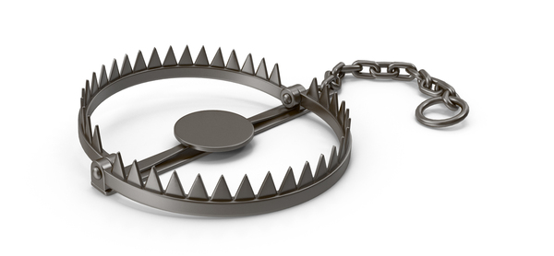
Once Saved Always Saved
Offers False Security
Offers False Comfort
Offers a License to Sin

