Slide 2
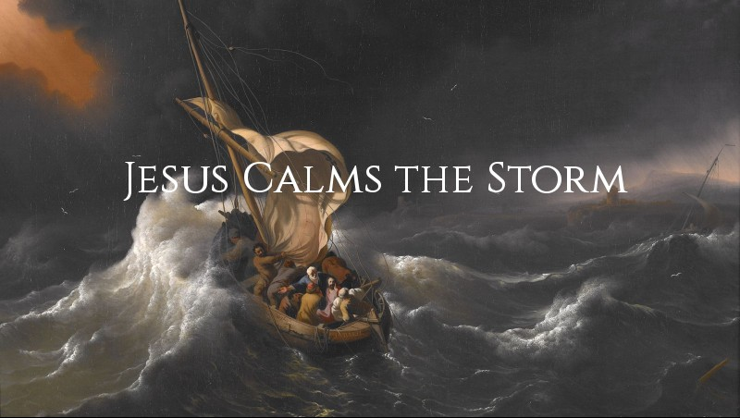

Slide 3
1. Lessons About Our Lord
He was human – He fell asleep in the boat because He was tired.
He was deity – He calmed the storm with the power of His spoken word.

Slide 4
2. Lessons About Our Storms
Storms can come after times of work and success.
Storms often come unexpectedly.
Storms come even when Jesus is in the boat.

Slide 5
3. Lessons About Our Faith
Like the disciples, we can question the Lord’s presence and concern.
    “Teacher, do You not care that we are perishing?”
Like the disciples, our faith is sometimes weak.
    “Why are you so fearful? How is it that you have no faith?”

Slide 6

Jesus Calms the Storm
Lessons About Our Lord
Lessons About Our Storms
Lessons About Our Faith

