Slide 1



Please take this time to prepare yourself for the worship service.

Slide 2


Slide 3
Controlling Our Speech
“Set a guard, O Lord, over my mouth; keep watch over the door of my lips.”
Psalm 141:3

Slide 4
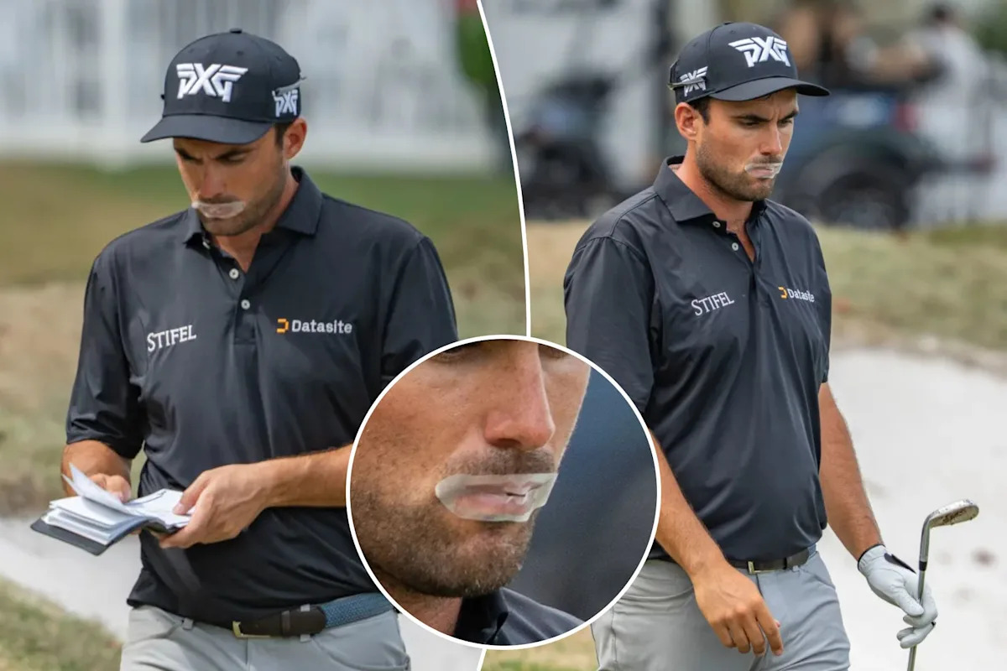

Slide 5
1. Lying
Telling something we know to be false with the intent to deceive.
Minor exaggerations, deliberate fabrications, slandering others, omitting facts.
Hypocrisy
White Lies
Gray Lies

Slide 6
1. Lying
“You shall not bear false witness against your neighbor” (Ex. 20:16).
“But the cowardly, unbelieving, abominable, murderers, sexually immoral, sorcerers, idolaters, and all liars shall have their part in the lake which burns with fire and brimstone, which is the second death” (Rev. 21:8).

Slide 7
1. Lying
God cannot tell a lie (Titus 1:2), but the devil is the father of lies (John 8:44).
“Therefore, putting away lying, ‘Let each one of you speak truth with his neighbor,’ for we are members of one another” (Eph. 4:25).

Slide 8
2. Gossip
Casual or idle talk about people; often about their behaviors or private lives. Usually lacks malicious intent, but can still be hurtful and damaging.

Slide 9
2. Gossip
We are not to help circulate damaging reports about others (Ex. 23:1).
Gossip kindles strife (Prov. 26:20-21) and separates friends (Prov. 16:28).
Love will not allow us to gossip (1 Cor. 13:4-7).

Slide 10
3. Bad Language
“Let no corrupt word proceed out of your mouth, but what is good for necessary edification, that it may impart grace to the hearers” (Eph. 4:29).
“But now you yourselves are to put off all these: anger, wrath, malice, blasphemy, filthy language out of your mouth” (Col. 3:8).

Slide 11
3. Bad Language
Euphemism - the substituting of a less offensive word or phrase for one considered offensive.
Euphemisms mean the same thing as their vulgar counterparts.
Euphemisms come from the same place in the heart as their vulgar counterparts (Matt. 12:34-35).

Slide 12
4. Complaining
1 Corinthians 10:5-11
Lusted after evil things
Practiced idolatry
Sexual immorality
Tempted Christ
Complained

Slide 13
4. Complaining
“Do all things without complaining and disputing, that you may become blameless and harmless, children of God without fault in the midst of a crooked and perverse generation, among whom you shine as lights in the world” (Phil. 2:14-15).

Slide 14


