Slide 1
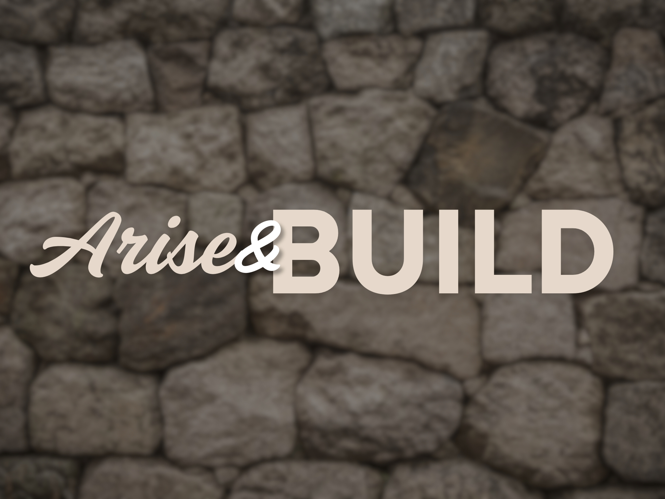

Slide 2
The Rest of the Story
A Brief Overview Of The Book
Chapter 1: Nehemiah received terrible news.
Chapter 2: Nehemiah acted. God is with him.
Chapter 3: Work on the wall begins.
Chapter 4: Opposition arises against the people.
Chapter 5: There’s an outcry among the people.
Chapter 6: The wall is completed in 52 days.

Slide 3
The Rest of the Story
A Brief Overview Of The Book
Chapter 7: The book of the Genealogy.
Chapters 8-9: Spiritual building also begins.
Chapter 10: The people are determined to do God’s will.
Chapter 11: Living arrangements are established.
Chapter 12: Praise and worship are given at the wall.
Chapter 13: More spiritual building is needed.

Slide 4
The Rest of the Story
God’s people need to love one another.
Nehemiah 5
God’s people need to hear God’s word.
Nehemiah 8
God’s people need to remember God!
Nehemiah 9

