Slide 1
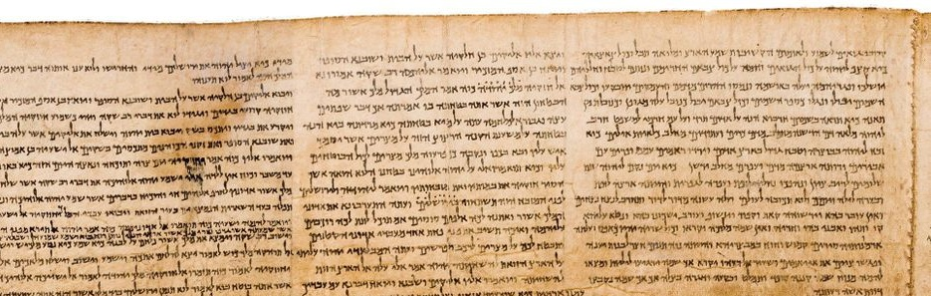
The Prophetic Origin of the Lord’s Church
Isaiah 2:2-4

Slide 2
Now it shall come to pass in the latter days that the mountain of the Lord’s house shall be established on the top of the mountains, and shall be exalted above the hills; and all nations shall flow to it.
Many people shall come and say, “Come, and let us go up to the mountain of the Lord, to the house of the God of Jacob; He will teach us His ways, and we shall walk in His paths.” For out of Zion shall go forth the law, and the word of the Lord from Jerusalem.
He shall judge between the nations, and rebuke many people; they shall beat their swords into plowshares, and their spears into pruning hooks; nation shall not lift up sword against nation, neither shall they learn war anymore.
Isaiah 2:2-4

Slide 3
Now it shall come to pass in the latter days that the mountain of the Lord’s house shall be established on the top of the mountains, and shall be exalted above the hills; and all nations shall flow to it.
Many people shall come and say, “Come, and let us go up to the mountain of the Lord, to the house of the God of Jacob; He will teach us His ways, and we shall walk in His paths.” For out of Zion shall go forth the law, and the word of the Lord from Jerusalem.
He shall judge between the nations, and rebuke many people; they shall beat their swords into plowshares, and their spears into pruning hooks; nation shall not lift up sword against nation, neither shall they learn war anymore.
Isaiah 2:2-4

Slide 4
Now it shall come to pass in the latter days that the mountain of the Lord’s house shall be established on the top of the mountains, and shall be exalted above the hills; and all nations shall flow to it.
Many people shall come and say, “Come, and let us go up to the mountain of the Lord, to the house of the God of Jacob; He will teach us His ways, and we shall walk in His paths.” For out of Zion shall go forth the law, and the word of the Lord from Jerusalem.
He shall judge between the nations, and rebuke many people; they shall beat their swords into plowshares, and their spears into pruning hooks; nation shall not lift up sword against nation, neither shall they learn war anymore.
Isaiah 2:2-4

Slide 5
Now it shall come to pass in the latter days that the mountain of the Lord’s house shall be established on the top of the mountains, and shall be exalted above the hills; and all nations shall flow to it.
Many people shall come and say, “Come, and let us go up to the mountain of the Lord, to the house of the God of Jacob; He will teach us His ways, and we shall walk in His paths.” For out of Zion shall go forth the law, and the word of the Lord from Jerusalem.
He shall judge between the nations, and rebuke many people; they shall beat their swords into plowshares, and their spears into pruning hooks; nation shall not lift up sword against nation, neither shall they learn war anymore.
Isaiah 2:2-4

Slide 6
Now it shall come to pass in the latter days that the mountain of the Lord’s house shall be established on the top of the mountains, and shall be exalted above the hills; and all nations shall flow to it.
Many people shall come and say, “Come, and let us go up to the mountain of the Lord, to the house of the God of Jacob; He will teach us His ways, and we shall walk in His paths.” For out of Zion shall go forth the law, and the word of the Lord from Jerusalem.
He shall judge between the nations, and rebuke many people; they shall beat their swords into plowshares, and their spears into pruning hooks; nation shall not lift up sword against nation, neither shall they learn war anymore.
Isaiah 2:2-4

Slide 7
Now it shall come to pass in the latter days that the mountain of the Lord’s house shall be established on the top of the mountains, and shall be exalted above the hills; and all nations shall flow to it.
Many people shall come and say, “Come, and let us go up to the mountain of the Lord, to the house of the God of Jacob; He will teach us His ways, and we shall walk in His paths.” For out of Zion shall go forth the law, and the word of the Lord from Jerusalem.
He shall judge between the nations, and rebuke many people; they shall beat their swords into plowshares, and their spears into pruning hooks; nation shall not lift up sword against nation, neither shall they learn war anymore.
Isaiah 2:2-4

Slide 8
Now it shall come to pass in the latter days that the mountain of the Lord’s house shall be established on the top of the mountains, and shall be exalted above the hills; and all nations shall flow to it.
Many people shall come and say, “Come, and let us go up to the mountain of the Lord, to the house of the God of Jacob; He will teach us His ways, and we shall walk in His paths.” For out of Zion shall go forth the law, and the word of the Lord from Jerusalem.
He shall judge between the nations, and rebuke many people; they shall beat their swords into plowshares, and their spears into pruning hooks; nation shall not lift up sword against nation, neither shall they learn war anymore.
Isaiah 2:2-4

Slide 9
Now it shall come to pass in the latter days that the mountain of the Lord’s house shall be established on the top of the mountains, and shall be exalted above the hills; and all nations shall flow to it.
Many people shall come and say, “Come, and let us go up to the mountain of the Lord, to the house of the God of Jacob; He will teach us His ways, and we shall walk in His paths.” For out of Zion shall go forth the law, and the word of the Lord from Jerusalem.
He shall judge between the nations, and rebuke many people; they shall beat their swords into plowshares, and their spears into pruning hooks; nation shall not lift up sword against nation, neither shall they learn war anymore.
Isaiah 2:2-4

Slide 10
Now it shall come to pass in the latter days that the mountain of the Lord’s house shall be established on the top of the mountains, and shall be exalted above the hills; and all nations shall flow to it.
Many people shall come and say, “Come, and let us go up to the mountain of the Lord, to the house of the God of Jacob; He will teach us His ways, and we shall walk in His paths.” For out of Zion shall go forth the law, and the word of the Lord from Jerusalem.
He shall judge between the nations, and rebuke many people; they shall beat their swords into plowshares, and their spears into pruning hooks; nation shall not lift up sword against nation, neither shall they learn war anymore.
Isaiah 2:2-4

Slide 11
1. When?
The “latter days.”
But this is what was spoken by the prophet Joel:
“And it shall come to pass in the last days, says God, that I will pour out of My Spirit on all flesh; your sons and your daughters shall prophesy, your young men shall see visions, your old men shall dream dreams.”
Acts 2:16-17

Slide 12
2. Where?
“Jerusalem”
And being assembled together with them, He commanded them not to depart from Jerusalem, but to wait for the Promise of the Father, “which,” He said, “you have heard from Me.”
Acts 1:4

Slide 13
3. Who?
“all nations, many people”
And there were dwelling in Jerusalem Jews, devout men, from every nation under heaven.
Acts 2:5

Slide 14
4. What Happened?

Slide 15
4. What Happened?
The mountain of the Lord’s house was established.
Mark 9:1
Acts 1:8
Acts 2:1-4
Matthew 16:18-19

Slide 16
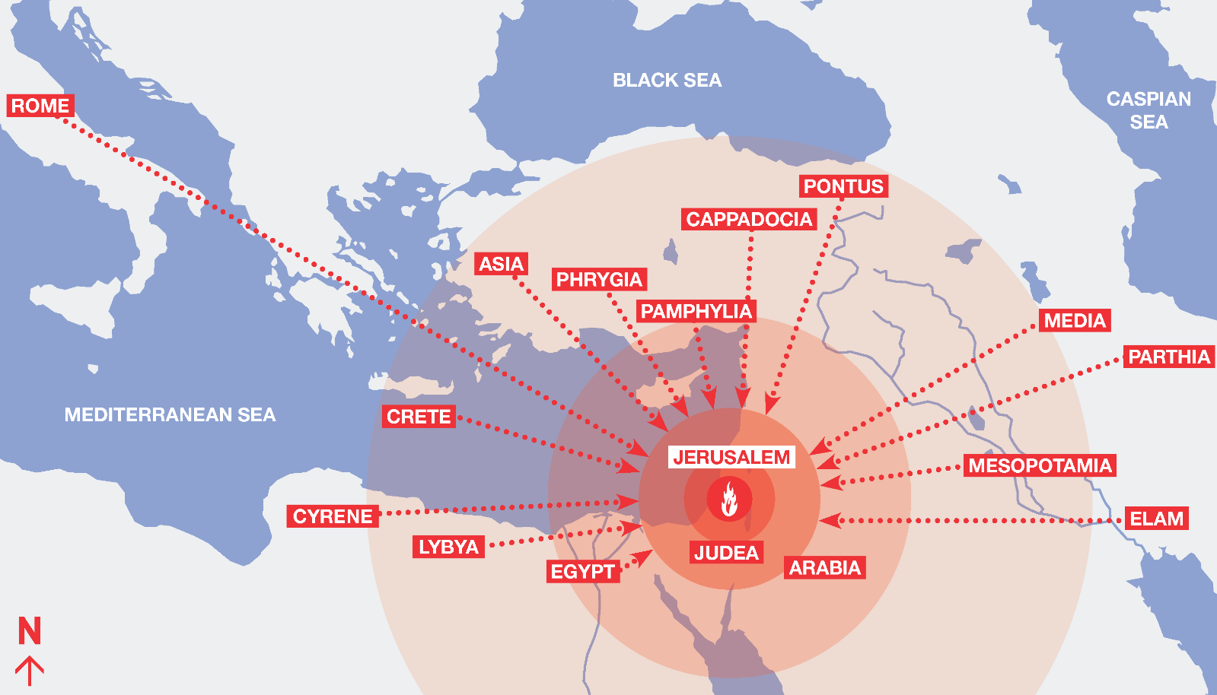
4. What Happened?
All nations shall flow to it.
Acts 2:5

Slide 17
4. What Happened?
The word of the Lord shall go out from Jerusalem.
And that repentance and remission of sins should be preached in His name to all nations, beginning at Jerusalem.
Luke 24:47

Slide 18
4. What Happened?
God shall judge and rebuke many people.
These Jews were judged and condemned of crucifying their Messiah (Acts 2:36).
“they were cut to the heart” (v. 37) – this rebuke was effective.

Slide 19
4. What Happened?
Swords beaten into plowshares, spears into pruning hooks.
Swords and spears are weapons. Implements of war are turned into implements of peace, labor, and prosperity.
The church is the body of saved people who are
at peace with God and with one another
(Acts 2:44-46; Eph. 2:14-17).

Slide 20
Isaiah 2:2-4 is fulfilled in Acts 2
The Lord’s church is not a man-made organization or an unintentional outgrowth of the gospel.
It is not a social club chartered to meet the physical needs of the community.
It is a part of God’s divine plan put in motion before the world began.
As such, it continues to manifest God’s wisdom and glory.

