Slide 2
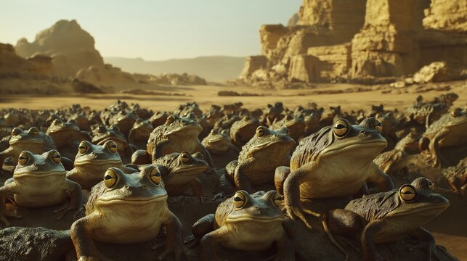
One More Night with the Frogs
Exodus 8:1-15

Slide 3
But if you refuse to let them go, behold, I will smite all your territory with frogs.
So the river shall bring forth frogs abundantly, which shall go up and come into your house, into your bedroom, on your bed, into the houses of your servants, on your people, into your ovens, and into your kneading bowls.
And the frogs shall come up on you, on your people, and on all your servants.
Exodus 8:2-4

Slide 4
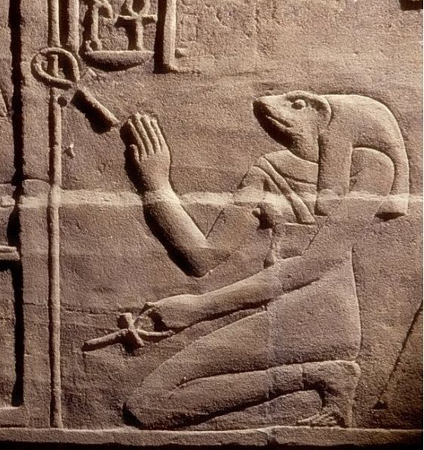
The Egyptians Viewed Frogs
As Sacred Animals
Associated with the flooding of the Nile River.
Came to be associated with some of their gods.
No Egyptian was allowed to
kill a frog. Even the accidental
killing of a frog could result in
an Egyptian’s execution.

Slide 5
And Moses said to Pharaoh, “Accept the honor of saying when I shall intercede for you, for your servants, and for your people, to destroy the frogs from you and your houses, that they may remain in the river only.”
So he said, “Tomorrow.” And he said, “Let it be according to your word, that you may know that there is no one like the Lord our God.”
Exodus 8:9-10

Slide 6
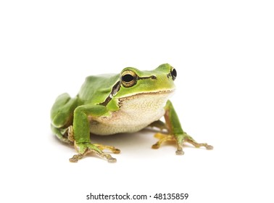
We will liken our
Sin to these Frogs
We are powerless to remove our sins. Only God has this power.
Just as these frogs were everywhere - sin is invasive.
  Into our homes (house).
  Into our everyday lives (ovens, kneading bowls).
  Impacting our peace of mind (bed).
  Enslaving us.

Slide 7
One More Night with the Frogs
Carry the Burden of My Sin One More Day
  Psalm 32:1-5; Prov. 28:13; Col. 1:20-22
Further Damage My Conscience
  Heb. 3:13; 1 Tim. 4:2
Risk My Soul with Uncertain Opportunities
  James 4:13-17; Acts 24:24-25

Slide 8
And Moses said to Pharaoh, “Accept the honor of saying when I shall intercede for you, for your servants, and for your people, to destroy the frogs from you and your houses, that they may remain in the river only.”
So he said, “Tomorrow.” And he said, “Let it be according to your word, that you may know that there is no one like the Lord our God.”
Exodus 8:9-10

