Slide 2


Slide 3
Romans 8:31-39
“What then shall we say to these things? If God is for us, who can be against us?” (v. 31)
God is truly for us in every way possible and will work all things together for the good He has prepared for us as His children.

Slide 4
“More Than Conquerors”
Hupernikao
  Huper – “over” “superior to, more than”
  Nikao – “to overcome”
“to gain a surpassing victory” (Vine’s)
This was a powerful and comforting concept to First Century Christians, and should be to us today!

Slide 5
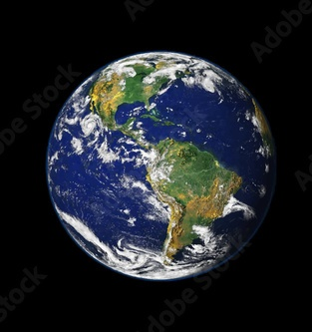
Conquering and Overcoming the World

Slide 6

1. The Fear of the World
John 15:18-20
1 John 5:4-5
Matthew 10:28-31

Slide 7
2. The Allurements of the World

Slide 8
2. The Allurements of the World
“For all that is in the world —
the lust of the flesh,
the lust of the eyes,
and the pride of life —
is not of the Father but is of the world.”
1 John 2:16

Slide 9
2. The Allurements of the World
Jesus overcame these allurements:
Luke 4:1-10
Stones to bread - “the lust of the flesh”
Showed the kingdoms - “the lust of the eyes”
Throw Yourself down - “the pride of life”

Slide 10
3. Conforming to the World
I beseech you therefore, brethren, by the mercies of God, that you present your bodies a living sacrifice, holy, acceptable to God, which is your reasonable service.
And do not be conformed to this world, but be transformed by the renewing of your mind, that you may prove what is that good and acceptable and perfect will of God.
Romans 12:1-2

Slide 11
We are
More Than Conquerors over this world
Its Fear
Its Allurements
Its Pressure to
Conform

