Slide 2
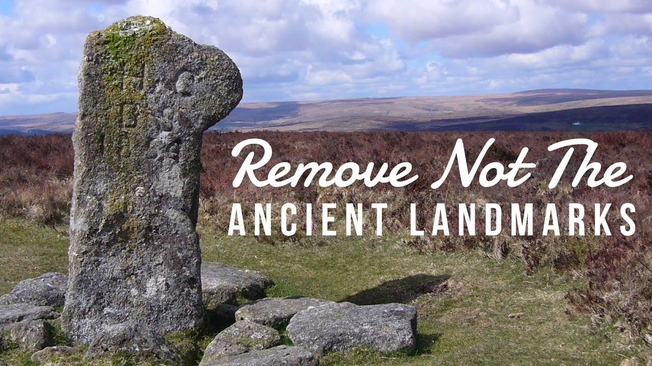
Remove not the ancient landmark, which thy fathers have set.
Proverbs 22:28, KJV

Slide 3
The Law of Moses
Protected Property Rights
You shall not remove your neighbor’s landmark, which the men of old have set, in your inheritance which you will inherit in the land that the Lord your God is giving you to possess (Deut. 19:14).
“Cursed is the one who moves his neighbor’s landmark.” And all the people shall say, “Amen!” (Deut. 27:17).

Slide 4
The Law of Moses
Protected Property Rights
You shall not remove your neighbor’s landmark, which the men of old have set, in your inheritance which you will inherit in the land that the Lord your God is giving you to possess (Deut. 19:14).
“Cursed is the one who moves his neighbor’s landmark.” And all the people shall say, “Amen!” (Deut. 27:17).

Slide 5
The Law of Moses
Protected Property Rights
You shall not remove your neighbor’s landmark, which the men of old have set, in your inheritance which you will inherit in the land that the Lord your God is giving you to possess (Deut. 19:14).
“Cursed is the one who moves his neighbor’s landmark.” And all the people shall say, “Amen!” (Deut. 27:17).

Slide 6
The Law of Moses
Protected Property Rights
You shall not remove your neighbor’s landmark, which the men of old have set, in your inheritance which you will inherit in the land that the Lord your God is giving you to possess (Deut. 19:14).
“Cursed is the one who moves his neighbor’s landmark.” And all the people shall say, “Amen!” (Deut. 27:17).

Slide 7
The Law of Moses
Protected Property Rights
Even if no penalty was enforced, such behavior was condemned by all righteous people (Job 24:2; Hosea 5:10).
With the Ancient Landmarks the children of Israel had to respect the boundaries and learn to be content with what they had.

Slide 8
The New Testament Sets Forth Boundaries (Landmarks)

Slide 9
The New Testament Sets Forth Boundaries (Landmarks)
“Now these things, brethren, I have figuratively transferred to myself and Apollos for your sakes, that you may learn in us not to think beyond what is written, that none of you may be puffed up on behalf of one against the other” (1 Cor. 4:6).

Slide 10
The New Testament Sets Forth Boundaries (Landmarks)
“Brethren, join in following my example, and note those who so walk, as you have us for a pattern” (Phil. 3:17).
“Therefore, brethren, stand fast and hold the traditions which you were taught, whether by word or our epistle” (2 Thess. 2:15).

Slide 11
The New Testament Sets Forth Boundaries (Landmarks)
“Whoever transgresses and does not abide in the doctrine of Christ does not have God. He who abides in the doctrine of Christ has both the Father and the Son” (2 John 9).

Slide 12
The New Testament Sets Forth Boundaries (Landmarks)
“Whoever transgresses and does not abide in the doctrine of Christ does not have God. He who abides in the doctrine of Christ has both the Father and the Son” (2 John 9).
Doctrine
of
Christ

Slide 13
Restoration Movement
1840’s – instrumental music, missionary societies
1900’s – church support of colleges
1940’s – sponsoring church arrangement, support of institutions, social gospel
1980-90’s – divorce and remarriage
Today – instrumental music, women preachers and elders

Slide 14
Quail Springs church of Christ, Oklahoma City, OK
Started using musical instruments Jan. 27, 2008.
Their young people had been using them in the building on Saturday nights.
Began exerting pressure on the elders to have the instrument in worship on Sunday mornings.
Fearing they would lose their young people, they made the change.

Slide 15
The New Testament Sets Forth Boundaries for the Church
Membership - saved people
Organization - men as elders, deacons
Worship - vocal praise, preaching, prayers Lord’s Supper, collection
Work - edification, evangelism, benevolence
Purpose - a spiritual family working
together to spread, uphold, and
defend the truth (1 Tim. 3:15).

Slide 16
Remove not the ancient landmark, which thy fathers have set.
Proverbs 22:28, KJV

