Slide 2
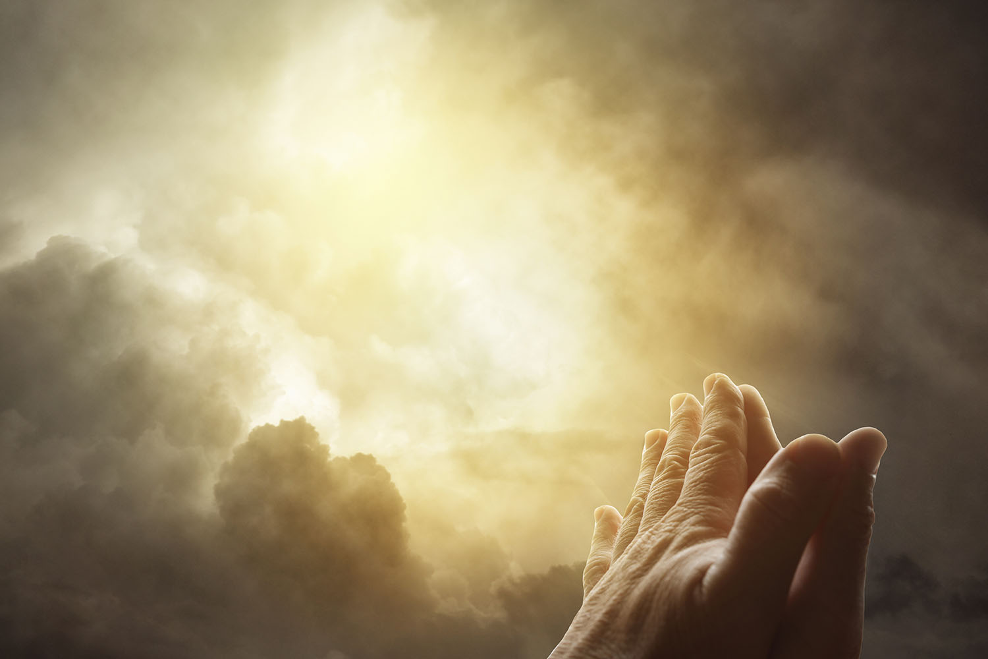
Three Facts About Prayer from Isaiah 65-66

Slide 3
Isaiah 65-66
God is willing to save Israel, but not in their sin and hypocrisy.
They had to learn that God could not be ignored, provoked, and manipulated.
Although not the primary focus of the text, some facts about prayer stand out in these chapters.

Slide 4
1. God Will Not Bless
Those Who Persist in Sin
Isaiah 65:1-12
We can fall into the same trap. If we persist in our sins, God will not hear and answer our prayers!

Slide 5
1. God Will Not Bless
Those Who Persist in Sin
Isaiah 65:1-12
We can fall into the same trap. If we persist in our sins, God will not hear and answer our prayers!
“If I regard iniquity in my heart, the Lord will not hear” (Psalm 66:18)
“One who turns away his ear from hearing the law, even his prayer is an abomination” (Proverbs 28:9).

Slide 6
2. God Hears and Answers the Prayers of the Righteous
“It shall come to pass that before they call, I will answer; and while they are still speaking, I will hear” (Isaiah 65:24).
God is always at hand: ready and willing to respond to their prayers (Psalm 145:18-19).
This is evidenced in Daniel 9:20-23.

Slide 7
3. God Looks on the
Humble and Reverent
“But on this one will I look: on him who is poor and of a contrite spirit, and who trembles at My word” (Isaiah 66:2).

Slide 8
3. God Looks on the
Humble and Reverent
“But on this one will I look: on him who is poor and of a contrite spirit, and who trembles at My word” (Isaiah 66:2).
Poor – realize they are spiritually bankrupt before God (Is. 64:6; Matt. 5:3).

Slide 9
3. God Looks on the
Humble and Reverent
“But on this one will I look: on him who is poor and of a contrite spirit, and who trembles at My word” (Isaiah 66:2).
Contrite – Hebrew word used to refer to the lame legs of Mephibosheth (2 Sam. 4:4; 9:3).
In this context, it stresses a sense of inability and dependence (Ps. 51:16-17).

Slide 10
3. God Looks on the
Humble and Reverent
“But on this one will I look: on him who is poor and of a contrite spirit, and who trembles at My word” (Isaiah 66:2).
Ezra 9:4; 10:3
Such a one takes everything God says seriously and responds in obedience.
Holding God’s word in trust and the deepest reverence (Ps. 119:161).

Slide 11
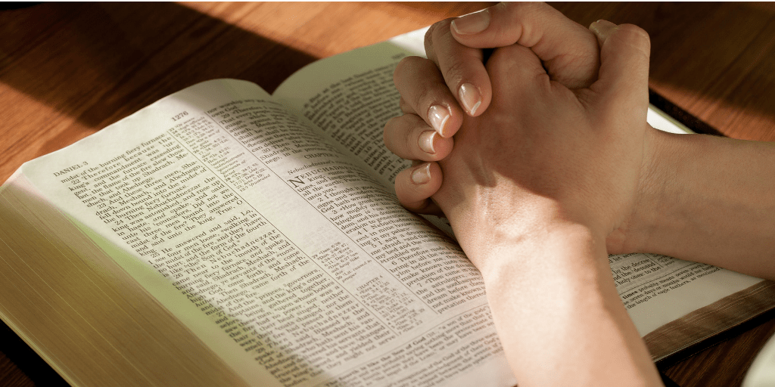
Three Facts About Prayer
God Will Not Bless Those Who Persist in Sin
God Hears and Answers the Prayers of the Righteous
God Looks on the Humble and Reverent

