Slide 2
Knowing God

Slide 3
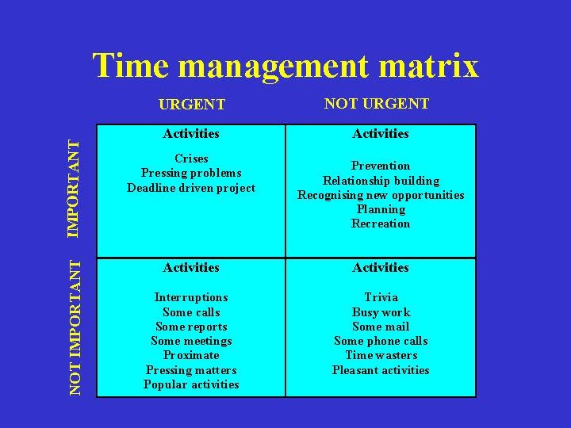
Where do we put
Bible study
Prayer
Meditation
Steven Covey – 7 Habits of highly effective people

