Slide 1
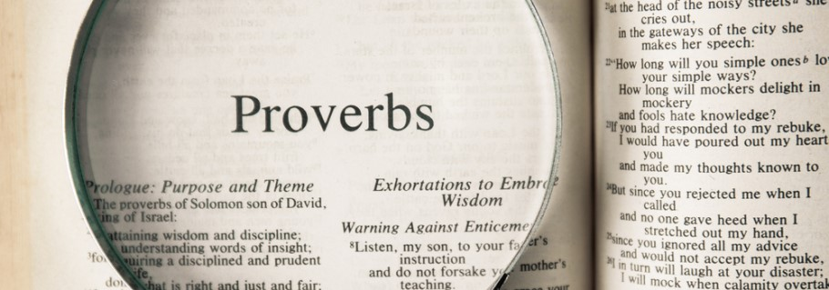
The Five Characteristics of the Prudent Person

Slide 2
prudent
aruwm - “shrewd, sensible”
It is a root word with both positive (prudent) and negative (shrewdness) connotations.
prudent - capable of exercising sound judgment in practical matters, esp. as concerns one’s own interests; cautious or discrete in conduct (Webster’s Dictionary).

Slide 3
1. Always Seeks to Learn
“The heart of the prudent acquires knowledge, and the ear of the wise seeks knowledge.”
Proverbs 18:15

Slide 4
1. Always Seeks to Learn
“The heart of the prudent acquires knowledge, and the ear of the wise seeks knowledge.”
Proverbs 18:15
“A wise man will hear and increase learning, and a man of understanding will attain wise counsel.”
Proverbs 1:5

Slide 5
1. Always Seeks to Learn
“The heart of the prudent acquires knowledge, and the ear of the wise seeks knowledge.”
Proverbs 18:15
“Wisdom is the principal thing; therefore get wisdom. And in all your getting, get understanding.”
Proverbs 4:7

Slide 6
1. Always Seeks to Learn
“The heart of the prudent acquires knowledge, and the ear of the wise seeks knowledge.”
Proverbs 18:15
“A fool has no delight in understanding, but in expressing his own heart.”
Proverbs 18:2

Slide 7
1. Always Seeks to Learn
“The heart of the prudent acquires knowledge, and the ear of the wise seeks knowledge.”
Proverbs 18:15

Slide 8
1. Always Seeks to Learn
“The heart of him who has understanding seeks knowledge, but the mouth of fools feeds on foolishness.”
Proverbs 15:14

Slide 9
2. Will Listen to and Receive
Correction and Rebuke
“A fool despises his father’s instruction, but he who receives correction is prudent.”
Proverbs 15:5

Slide 10
2. Will Listen to and Receive
Correction and Rebuke
“A fool despises his father’s instruction, but he who receives correction is prudent.”
Proverbs 15:5
“The way of a fool is right in his own eyes, but he who heeds counsel is wise.”
Proverbs 12:15

Slide 11
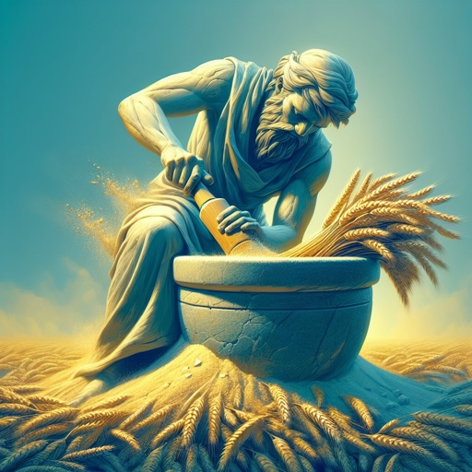
2. Will Listen to and Receive
Correction and Rebuke
“Though you grind a fool in a mortar with a pestle along with crushed grain, yet his foolishness will not depart from him.”
Proverbs 27:22

Slide 12
2. Will Listen to and Receive
Correction and Rebuke
“A word fitly spoken is like apples of gold in settings of silver. Like an earring of gold and an ornament of fine gold is a wise rebuker to an obedient ear.”
Proverbs 25:11-12

Slide 13
3. Always Thinks Before Speaking
“A prudent man conceals knowledge, but the heart of fools proclaims foolishness.”
Proverbs 12:23

Slide 14
3. Always Thinks Before Speaking
“A prudent man conceals knowledge, but the heart of fools proclaims foolishness.”
Proverbs 12:23
“A fool vents all his feelings, but a wise man holds them back.”
Proverbs 29:11

Slide 15
3. Always Thinks Before Speaking
“A prudent man conceals knowledge, but the heart of fools proclaims foolishness.”
Proverbs 12:23
“So then, my beloved brethren, let every man be swift to hear, slow to speak, slow to wrath.”
James 1:19

Slide 16
3. Always Thinks Before Speaking
“A prudent man conceals knowledge, but the heart of fools proclaims foolishness.”
Proverbs 12:23
“He who answers a matter before he hears it, it is folly and shame to him.”
Proverbs 18:13

Slide 17
3. Always Thinks Before Speaking
“He who has knowledge spares his words, and a man of understanding is of a calm spirit. Even a fool is counted wise when he holds his peace; when he shuts his lips, he is considered perceptive.”
Proverbs 17:27-28

Slide 18
4. Always Thinks Before Acting
“The simple believes everything, but the prudent gives thought to his steps. One who is wise is cautious and turns away from evil, but a fool is reckless and careless.”
Proverbs 14:15-16, ESV

Slide 19
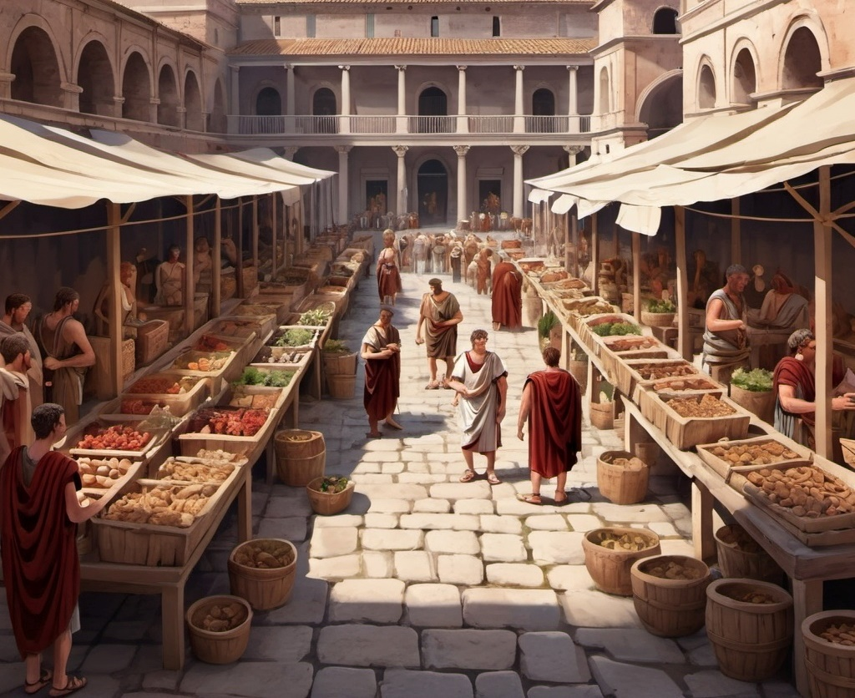
4. Always Thinks Before Acting
“Every prudent man acts with knowledge, but a fool lays open his folly.”
Proverbs 13:16

Slide 20
5. Will Control Their Temper
Proverbs 12:16
“A fool’s wrath is known at once, but a prudent man covers shame” (NKJV).
“A fool’s anger is known at once, but a prudent man conceals dishonor” (NASU).
“The vexation of a fool is known at once, but the prudent ignores an insult” (ESV).

Slide 21
The Prudent Person
Always Seeks to Learn
Will Listen to and Receive Correction and Rebuke
Always Thinks Before They Speak
Always Thinks Before They Act
Controls Their Temper

