Slide 1
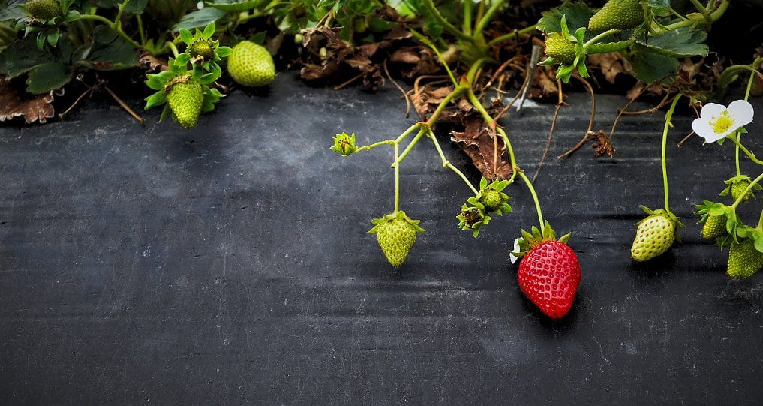
Producing the Fruit of the Spirit
Galatians 5:16-25

Slide 2
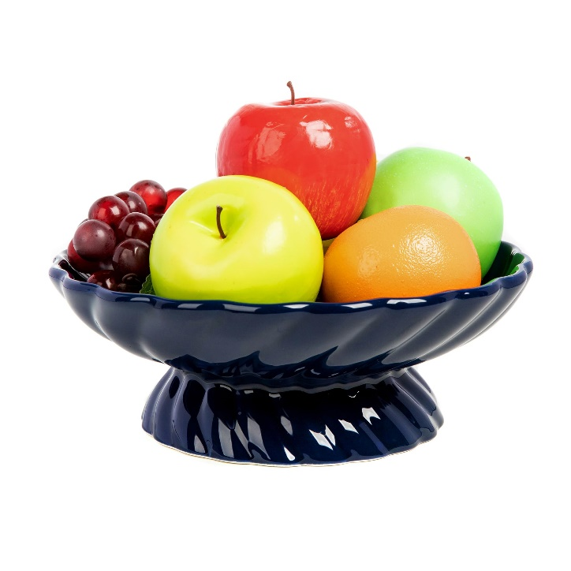
The Fruit of the Spirit
Love
Joy
Peace
Longsuffering
Kindness
Goodness
Faithfulness
Gentleness
Self-Control

Slide 3
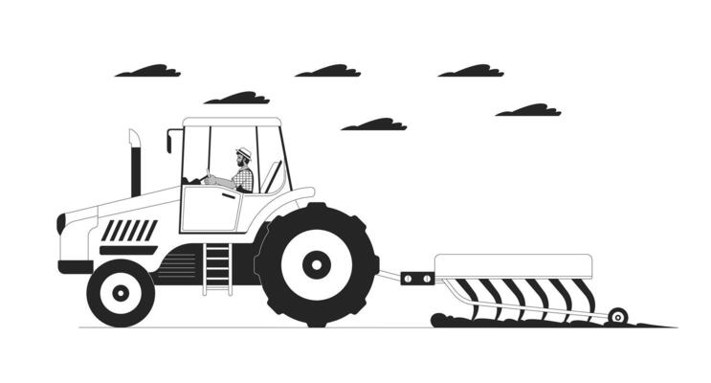
1. Allow God’s Word to Change Your Heart
“Therefore lay aside all filthiness and overflow of wickedness, and receive with meekness the implanted word, which is able to save your souls.”
James 1:21

Slide 4
1. Allow God’s Word to Change Your Heart
“And do not be conformed to this world, but be transformed by the renewing of your mind, that you may prove what is that good and acceptable and perfect will of God” (Rom. 12:2).
“and be renewed in the spirit of your mind”
(Eph. 4:23).

Slide 5
2. Be Filled with the Spirit
“walk in the Spirit” (Gal. 5:16)
“led by the Spirit” (Gal. 5:18)
“live in the Spirit” (Gal. 5:25)

Slide 6
2. Be Filled with the Spirit
“And do not be drunk with wine, in which is dissipation; but be filled with the Spirit, speaking to one another in psalms and hymns and spiritual songs, singing and making melody in your heart to the Lord.”
Ephesians 5:18-19
“Let the word of Christ dwell in you richly in all wisdom, teaching and admonishing one another in psalms and hymns and spiritual songs, singing with grace in your hearts to the Lord.”
Colossians 3:16

Slide 7
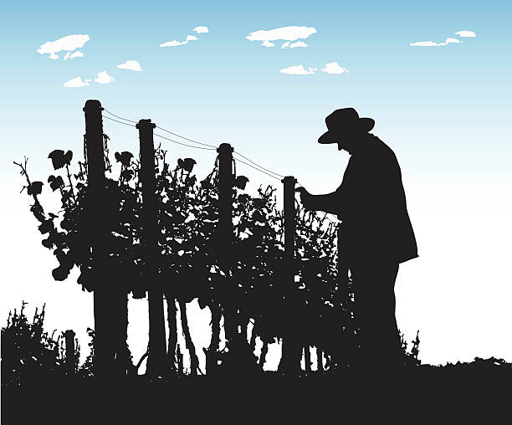
3. Allow God’s Pruning
“Every branch in Me that does not bear fruit He takes away; and every branch that bears fruit He prunes, that it may bear more fruit.”
John 15:2

Slide 8
4. Be Patient
“But the ones that fell on the good ground are those who, having heard the word with a noble and good heart, keep it and bear fruit with patience” (Luke 8:15).
“Therefore be patient, brethren, until the coming of the Lord. See how the farmer waits for the precious fruit of the earth, waiting patiently for it until it receives the early and latter rain”
(James 5:7).

Slide 9
4. Be Patient
Time from planting to bearing fruit:
Apples 2-5 years
Bananas 2-3 years
Citrus 1-2 years
Pears 4-6 years
Sweet Cherry 4-7 years
Grapes 3 years

Slide 10
4. Be Patient
“And let us not grow weary while doing good, for in due season we shall reap if we do not lose heart.”
Galatians 6:9

Slide 11
Producing the Fruit of the Spirit
Allow God’s Word to Change Your Heart
Be Filled with the Spirit
Allow God’s Pruning
Be Patient

