Slide 2
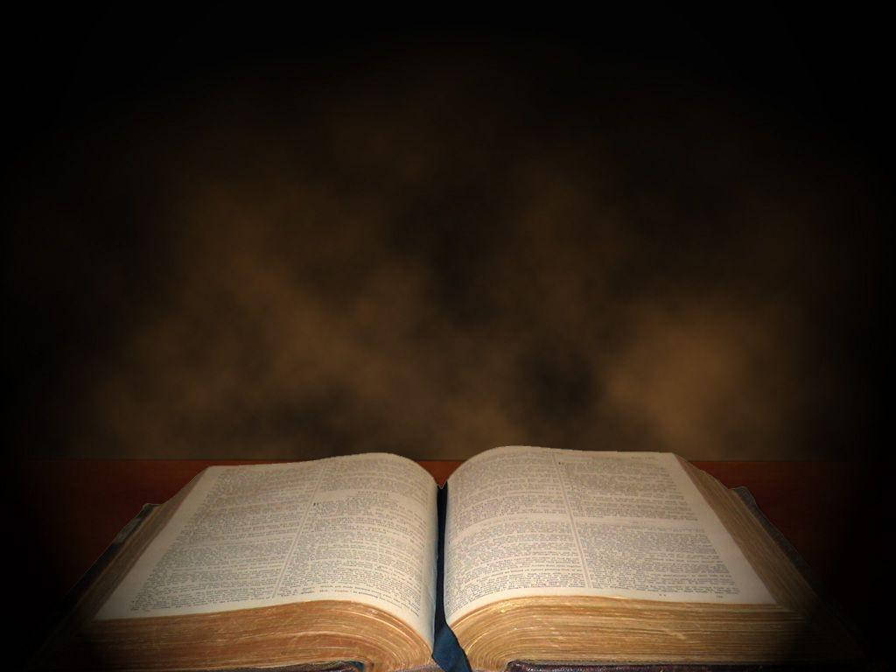
The Christian and Drinking Alcohol

Slide 3
Jesus turned water into wine!
“and wine that makes glad the heart of man” (Ps. 104:15).
“Go, eat your bread with joy, and drink your wine with a merry heart; for God has already accepted your works” (Eccl. 9:7).
Drunkenness is the sin, not drinking.
Deacons are not to be given to much wine (1 Tim. 3:8).
Timothy was told to drink wine for his stomach’s sake
(1 Tim. 5:23).

Slide 4
1. Commanded to Be Sober
“Therefore let us not sleep, as others do, but let us watch and be sober” (1 Thess. 5:6).
“That the older men be sober…” (Titus 2:2).
“Therefore gird up the loins of your mind,
be sober…” (1 Pet. 1:13).
“Be sober, be vigilant; because your adversary the devil walks about like a roaring lion…” (1 Pet. 5:8).

Slide 5
1. Commanded to Be Sober
sober (nepho)
“to be free from the influence of intoxicants. Metaphorically, it is used in association with ‘watchfulness’” (Vine).

Slide 6
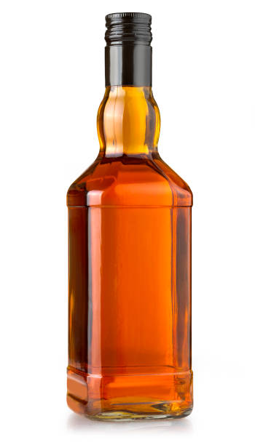
How Alcohol Works
Metabolized extremely quickly by the body.
20% absorbed directly across the walls of an empty stomach, can reach the brain within one minute.
Interferes with communication between the nerve cells.

Slide 7
2. Alcohol Impairs Judgment and Lowers Inhibitions
“But they also have erred through wine, and through intoxicating drink are out of the way…” (Isaiah 28:7).
“They reel to and fro, and stagger like a drunken man, and are at their wits’ end” (Psalm 107:27).
Noah (Gen. 9:20-21)
Lot (Gen. 19:32-35)

Slide 8
Kings and Priests were forbidden from drinking alcohol.
“It is not for kings, O Lemuel, it is not for kings to drink wine, nor for princes intoxicating drink; lest they drink and forget the law, and pervert the justice of all the afflicted” (Prov. 31:4-5).
“Do not drink wine or intoxicating drink, you, nor your sons with you, when you go into the tabernacle of meeting, lest you die. It shall be a statute forever throughout your generations” (Lev. 10:9).

Slide 9
Kings and Priests were forbidden from drinking alcohol.
“It is not for kings, O Lemuel, it is not for kings to drink wine, nor for princes intoxicating drink; lest they drink and forget the law, and pervert the justice of all the afflicted” (Prov. 31:4-5).
“Do not drink wine or intoxicating drink, you, nor your sons with you, when you go into the tabernacle of meeting, lest you die. It shall be a statute forever throughout your generations” (Lev. 10:9).
Christians are both
Kings and Priests!
“And has made us kings and priests to His God and Father, to Him be glory and dominion forever and ever. Amen” (Revelation 1:6).

Slide 10
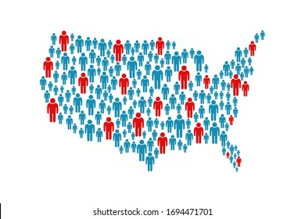
3. Alcohol is Addictive
In 2023, 28.1 million adults in the US had an alcohol use disorder.
This comes to 10.9% of adults in the US.
Statistically, one in every 10-11 people who drink will become alcoholics.

Slide 11
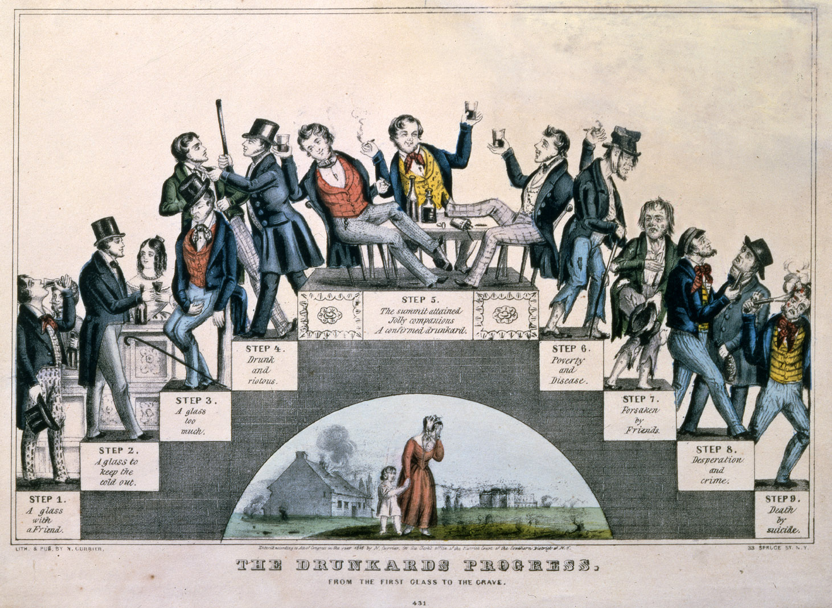

Slide 12
3. Alcohol is Addictive
“All things are lawful for me, but not all things are helpful. All things are lawful for me, but I will not be enslaved by anything.”
1 Corinthians 6:12, ESV

Slide 13

3. Alcohol is Addictive
“Whoever causes one of these little ones who believe in Me to sin, it would be better for him if a millstone were hung around his neck, and he were drowned in the depth of the sea.
Woe to the world because of offenses! For offenses must come, but woe to that man by whom the offense comes!”
Matthew 18:6-7

Slide 14
4. Social Drinking is Condemned
“For we have spent enough of our past lifetime in doing the will of the Gentiles - when we walked in lewdness, lusts, drunkenness, revelries, drinking parties, and abominable idolatries.”
1 Peter 4:3

Slide 15
4. Social Drinking is Condemned
“For we have spent enough of our past lifetime in doing the will of the Gentiles - when we walked in lewdness, lusts, drunkenness, revelries, drinking parties, and abominable idolatries.”
1 Peter 4:3

Slide 16
4. Social Drinking is Condemned
“For we have spent enough of our past lifetime in doing the will of the Gentiles - when we walked in lewdness, lusts, drunkenness, revelries, drinking parties, and abominable idolatries.”
1 Peter 4:3

Slide 17
4. Social Drinking is Condemned
“For we have spent enough of our past lifetime in doing the will of the Gentiles - when we walked in lewdness, lusts, drunkenness, revelries, drinking parties, and abominable idolatries.”
1 Peter 4:3

Slide 18
The Bible’s So-Called Endorsement of Wine
“Wine” is translated from yayin (Hebrew) and oinos (Greek).
Refers to the juice of the grape in every form - including non-fermented grape juice.

Slide 19
The Bible’s So-Called Endorsement of Wine
Jesus turned 150 gallons of water into wine
(John 2:6).
Jesus was not a bartender (Habakkuk 2:15).
The word oinos does not demand fermented or alcoholic beverage.
Fresh grape juice was prized for its flavor
(John 2:8-10).

Slide 20
The Bible’s So-Called Endorsement of Wine
Even when fermented, Bible wine was not comparable to modern wine.
Wine allowed to ferment naturally resulted in an alcohol content no higher than 5-8%.
It was common practice of the ancients to cut or mix their wine with water.
Modern wine is fortified with additional alcohol, some of them as high as 20%.

Slide 21
Timothy was told to drink wine.
“No longer drink only water, but use a little wine for your stomach’s sake and your frequent infirmities” (1 Timothy 5:23).
He wasn’t told to drink (protos) wine, he was told to use (chraomai) wine for medicinal purposes.
The medicinal properties are in the grape juice, not the alcohol.
Today, we have better stomach medicines.

Slide 22
Proverbs 23:29-35

Slide 23
Proverbs 23:29-35
Who has woe? Who has sorrow? Who has contentions? Who has complaints? Who has wounds without cause? Who has redness of eyes?
Those who linger long at the wine, those who go in search of mixed wine.

Slide 24
Proverbs 23:29-35
Do not look on the wine when it is red, when it sparkles in the cup, when it swirls around smoothly;
At the last it bites like a serpent, and stings like a viper.

Slide 25
Proverbs 23:29-35
Your eyes will see strange things, and your heart will utter perverse things.
Yes, you will be like one who lies down in the midst of the sea, or like one who lies at the top of the mast, saying:
“They have struck me, but I was not hurt; they have beaten me, but I did not feel it. When shall I awake, that I may seek another drink?”

