Slide 2
Exodus 25:9
According to all that I show you, that is, the pattern of the tabernacle and the pattern of all its furnishings, just so you shall make it.
Exodus 25:40
And see to it that you make them according to the pattern which was shown you on the mountain.

Slide 3
pattern appears 6 times in the NKJV.
Acts 7:44 Tabernacle made according to Pattern
Hebrews 8:5 Tabernacle made according to Pattern
1 Timothy 1:16 –Christ is a pattern of long suffering (NT:5296)
2 Timothy 1:13 –There is a pattern of sound words (NT:5296)
Philippians 3:17 Paul and the apostles a pattern of life to follow
Titus 2:6-8 –Titus to be a pattern of good works.

Slide 4
The Greek word NT:5179 is translated (16) times
  Print: (2)
    John 20:25
  Figure: (2)
    Acts 7:43, Romans 5:14
  Pattern: (4)
    Acts 7:44, Hebrews 8:5, Philippians 3:17, Titus 2:7
  Manner: (1)
    Acts 23:25
  Form: (1)
    Romans 6:17
  Example: (6)
    1Corinthians 10:6, 1 Corinthians 10:11, 1 Thessalonians 1:7, 2 Thessalonians 3:9, 1 Timothy 4:12, 1 Peter 5:3

Slide 5
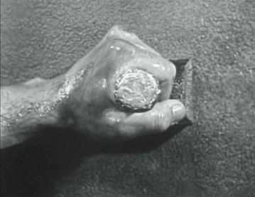
NT:5179 tupos (too'-pos); from NT:5180; a die (as struck), i.e. (by implication) a stamp or scar; by analogy, a shape, i.e. a statue, (figuratively) style or resemblance; specifically, a sampler ("type"), i.e. a model (for imitation) or instance (for warning):

Slide 6
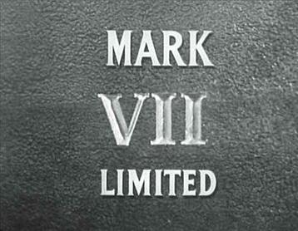

Slide 7
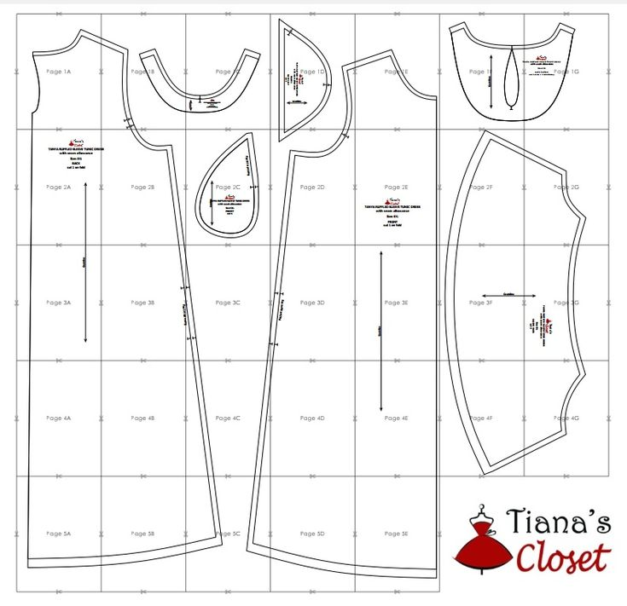

Slide 8
Patterns are important
Genesis 6:14-22 Noah
Exodus 25:40 The Tabernacle
Leviticus 10:1-2 Nadab and Abihu
1 Chronicles 28:9-21 Solomons Temple
2 Kings 16:10 King Ahaz
  2 Chronicles 28:22-23
  But they were the ruin of him and of all Israel.
Ezekiel 40:1-3 The Measuring of Solomon’ Temple
Ezekiel 43:10 Rebuild a copy

Slide 9
The New Testament
Col 3:17 What ever you do
Romans 12:2 Prove what is Good
2 Corinthians 13:5 Examine yourselves
1 Thessalonians 5:21 Test all things
1 John 4:1 Test the spirits
Acts 17:11 Search the Scriptures
John 12:48 Word is the standard.

Slide 10
And see to it that you make them according to the pattern which was shown you in the book
Rev. 20:11-15
The Books will be opened
The words spoken by Jesus will judge
Words and deeds compared to the patterns shown
The book of life
If I can’t read it, I cannot teach it or practice it in faith!

