Slide 2
Worthy is the Lamb
Revelation 5

Slide 3
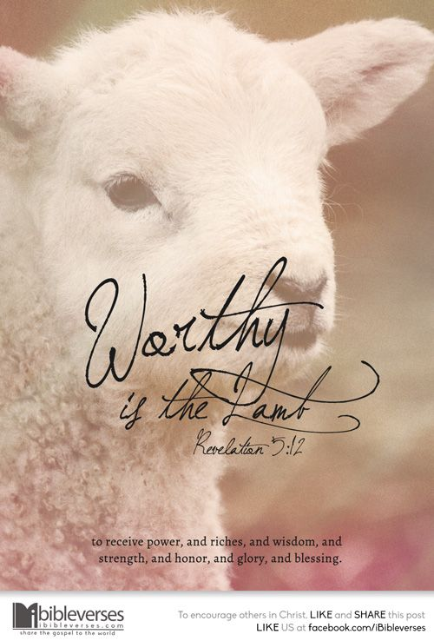
Revelation 5:1-5
Then I saw in the right hand of him who was seated on the throne a scroll written within and on the back, sealed with seven seals.
And I saw a mighty angel proclaiming with a loud voice, “Who is worthy to open the scroll and break its seals?”
And no one in heaven or on earth or under the earth was able to open the scroll or to look into it,
and I began to weep loudly because no one was found worthy to open the scroll or to look into it.
And one of the elders said to me, “Weep no more; behold, the Lion of the tribe of Judah, the Root of David, has conquered, so that he can open the scroll and its seven seals.”

Slide 4
Revelation 5:6-8
6 And between the throne and the four living creatures and among the elders I saw a Lamb standing, as though it had been slain, with seven horns and with seven eyes, which are the seven spirits of God sent out into all the earth.
7 And he went and took the scroll from the right hand of him who was seated on the throne.
8 And when he had taken the scroll, the four living creatures and the twenty-four elders fell down before the Lamb, each holding a harp, and golden bowls full of incense, which are the prayers of the saints.

Slide 5
Revelation 5:6-8
Why a lamb?
  Emphasis on the sacrifice and redemptive nature of who the Lion/lamb is.
  He was powerful but was not worthy because of His power, but due to His sacrifice through love
“In the midst” - First place among all present
Characteristics -
  Worthy to open the seals 6:1
  Wrath 6:16
  Saved attribute their salvation to Him 7:9-10
  Has the book of Life 13:8
  His name on His servant’s foreheads 14:1
  It is His song that is sung 15:3
  He is the victor 17:13-14

Slide 6
Revelation 5:9-14
Why is the Lamb worthy?
  Slain – A perfect sacrifice
  Purchase unto God - Romans 3:26 I Cor 6:20
  Made them a kingdom and priests unto our God 1:5-6
    What is our job? Heb. 13:15-6
    We belong to God
Ten thousand times ten thousand
  The Christians were not alone in their persecutions and neither are we.
  What do they say the Lamb is worth of?
  Why can we say in our own lives that the Lamb is worthy?

Slide 7
What does this mean?- Let us consider carefully
He has all authority in heaven and on earth – Matt 28:18
What part of God’s word is not important?
  In the Old Testament
    Round the corner of your beard – Lev. 19:27
    Tattoos – Lev. 19:28
    Type of fire offered – Lev. 10:1-3
    Touch the ark – Saved it from falling II Samuel 6:1-7
    Proper view of God Job 42:7 Eliphaz Job 4:8-16
  In the New Testament
    Obey the laws of the land – Rom. 13:1-2
    Our practices concerning worship – John 4:24
    Our views of God – Is He reverenced as He should be?
Let us learn to make applications of the principles of authority

