Slide 2
Seeing God
On His Throne

Slide 3
Beyond Our Understanding…
Power
Lord of All
Wisdom
Name
Love
Visage
Holiness
Purity
Grace
All things came into being by Him, and apart from Him nothing came into being that has come into being.
John 1:3
“Blessed art Thou, O Lord God of Israel our Father, forever and ever. Thine, O Lord, is the greatness and the power and the glory and the victory and the majesty, indeed everything that is in the heavens and the earth; Thine is the dominion, O Lord, and Thou doest exalt Thyself as head over all.”
1 Chronicles 29:10-11
It is He who made the earth by His power,
Who established the world by His wisdom,
And by His understanding He stretched out the heavens.
Jeremiah 51:15
"You shall not take the name of the LORD your God in vain, for the LORD will not leave him unpunished who takes His name in vain.
Exodus 20:7
"For God so loved the world, that He gave His only begotten Son, that whoever believes in Him shall not perish, but have eternal life.
John 3:16
Then Moses said, "I pray You, show me Your glory!“
But He said, "You cannot see My face, for no man can see Me and live!"
Exodus 33:18, 20
For I am the LORD your God. Consecrate yourselves therefore, and be holy, for I am holy.
Leviticus 11:44

Slide 4
Beyond Our Understanding…
For My thoughts are not your thoughts, Nor are your ways My ways," declares the LORD.
For as the heavens are higher than the earth,
So are My ways higher than your ways
And My thoughts than your thoughts.
- Isaiah 55:8-9

Slide 5
Beyond Our Understanding…
Power
Wisdom
Name
Visage
Lord over all
Love
Purity
Grace
Faithfulness
Truth
Compassion
Righteousness

Slide 7
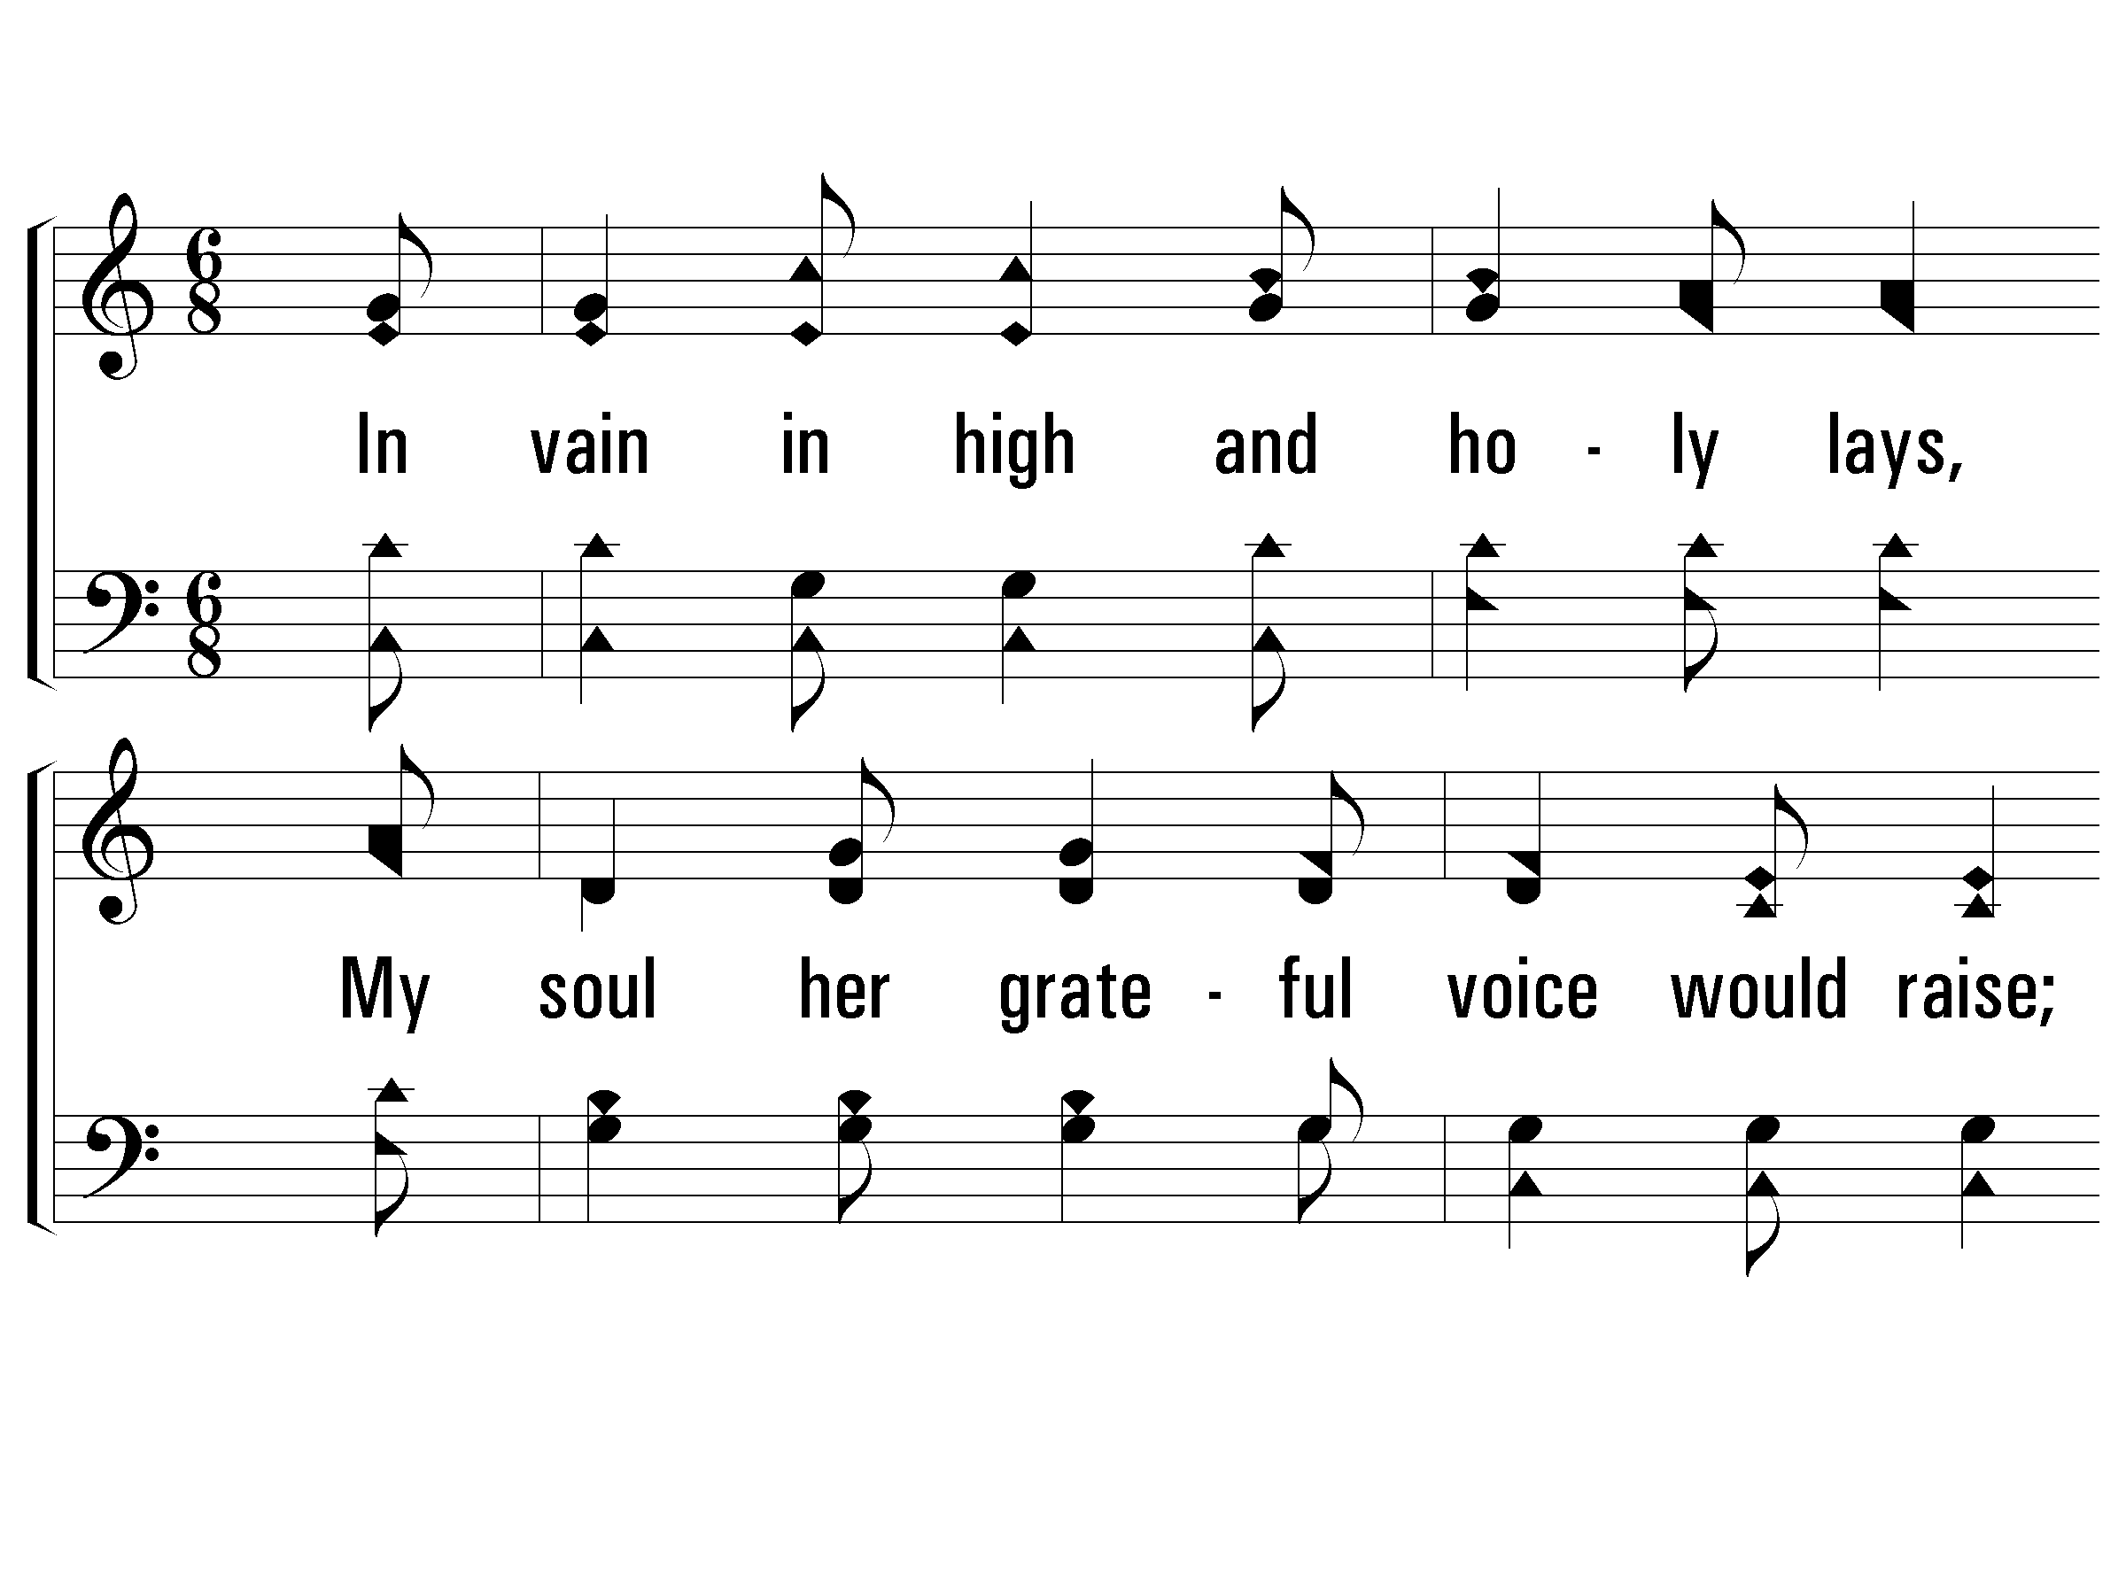
1 - In Vain In High and Holy Lays
1.
In vain in high and holy lays,
My soul her grateful voice would raise;
For who can sing the worthy praise
Of the wonderful love of Jesus!

Slide 8
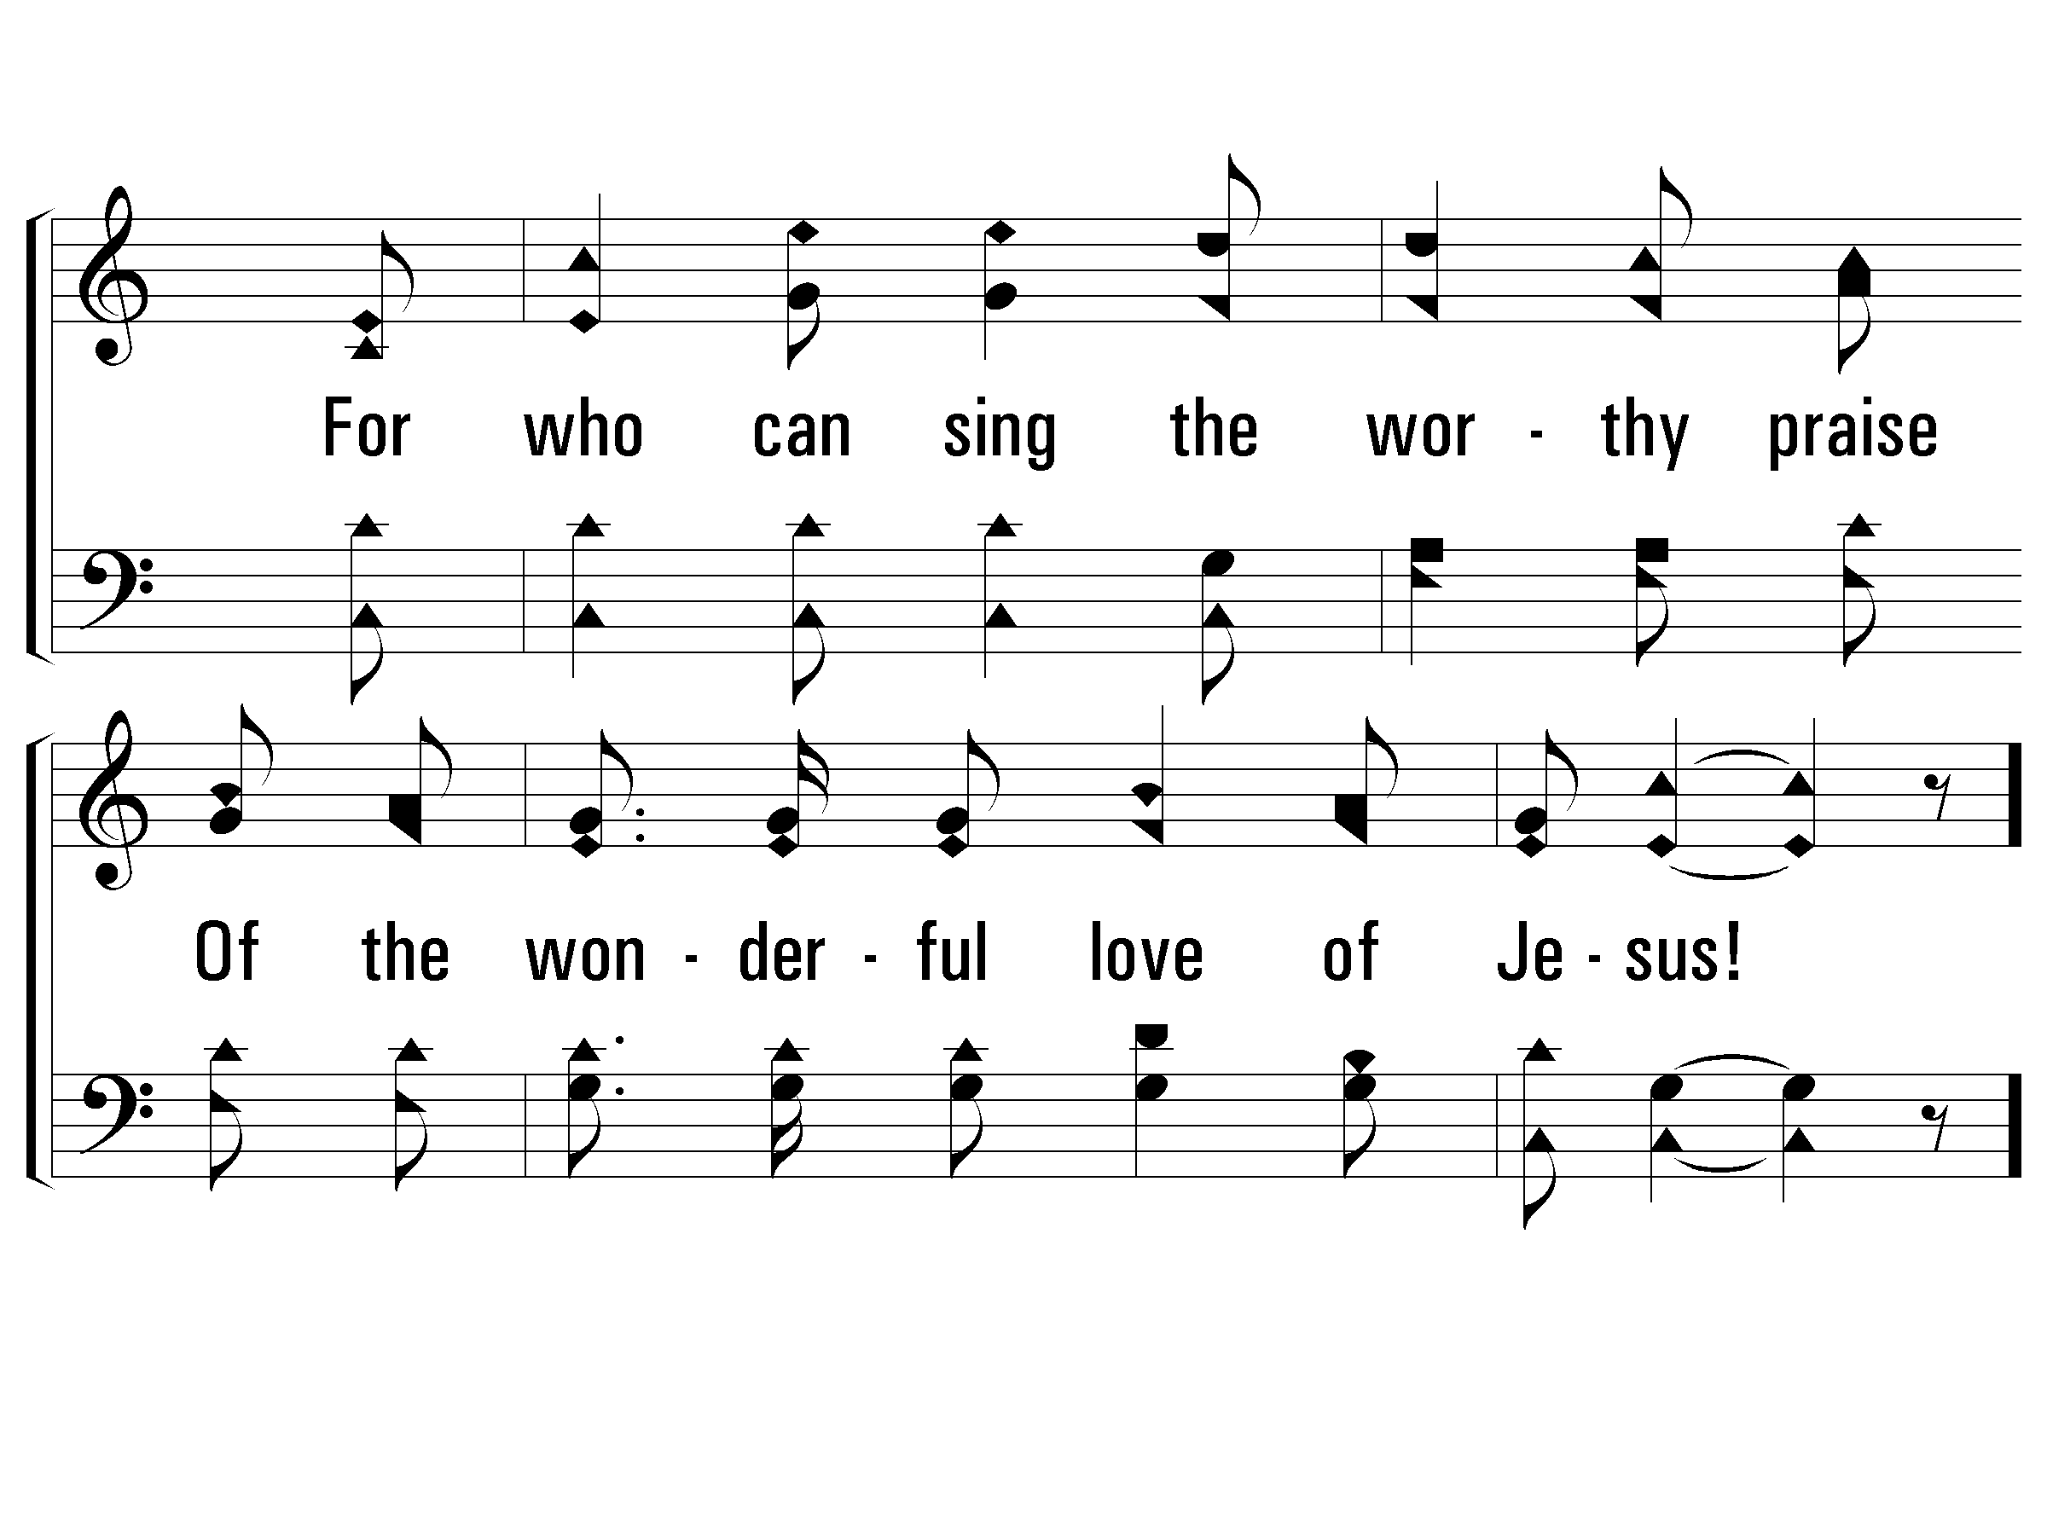
1 - In Vain In High and Holy Lays

Slide 9
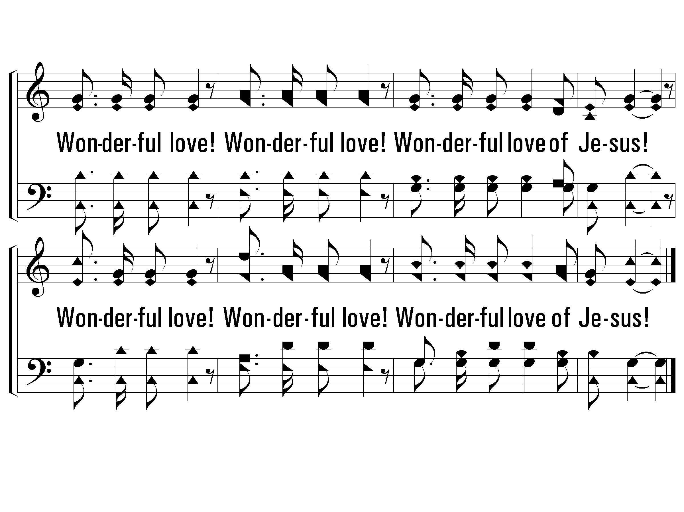
c - In Vain In High and Holy Lays
Wonderful love! Wonderful love!
Wonderful love of Jesus!
Wonderful love! Wonderful love!
Wonderful love of Jesus!

Slide 10
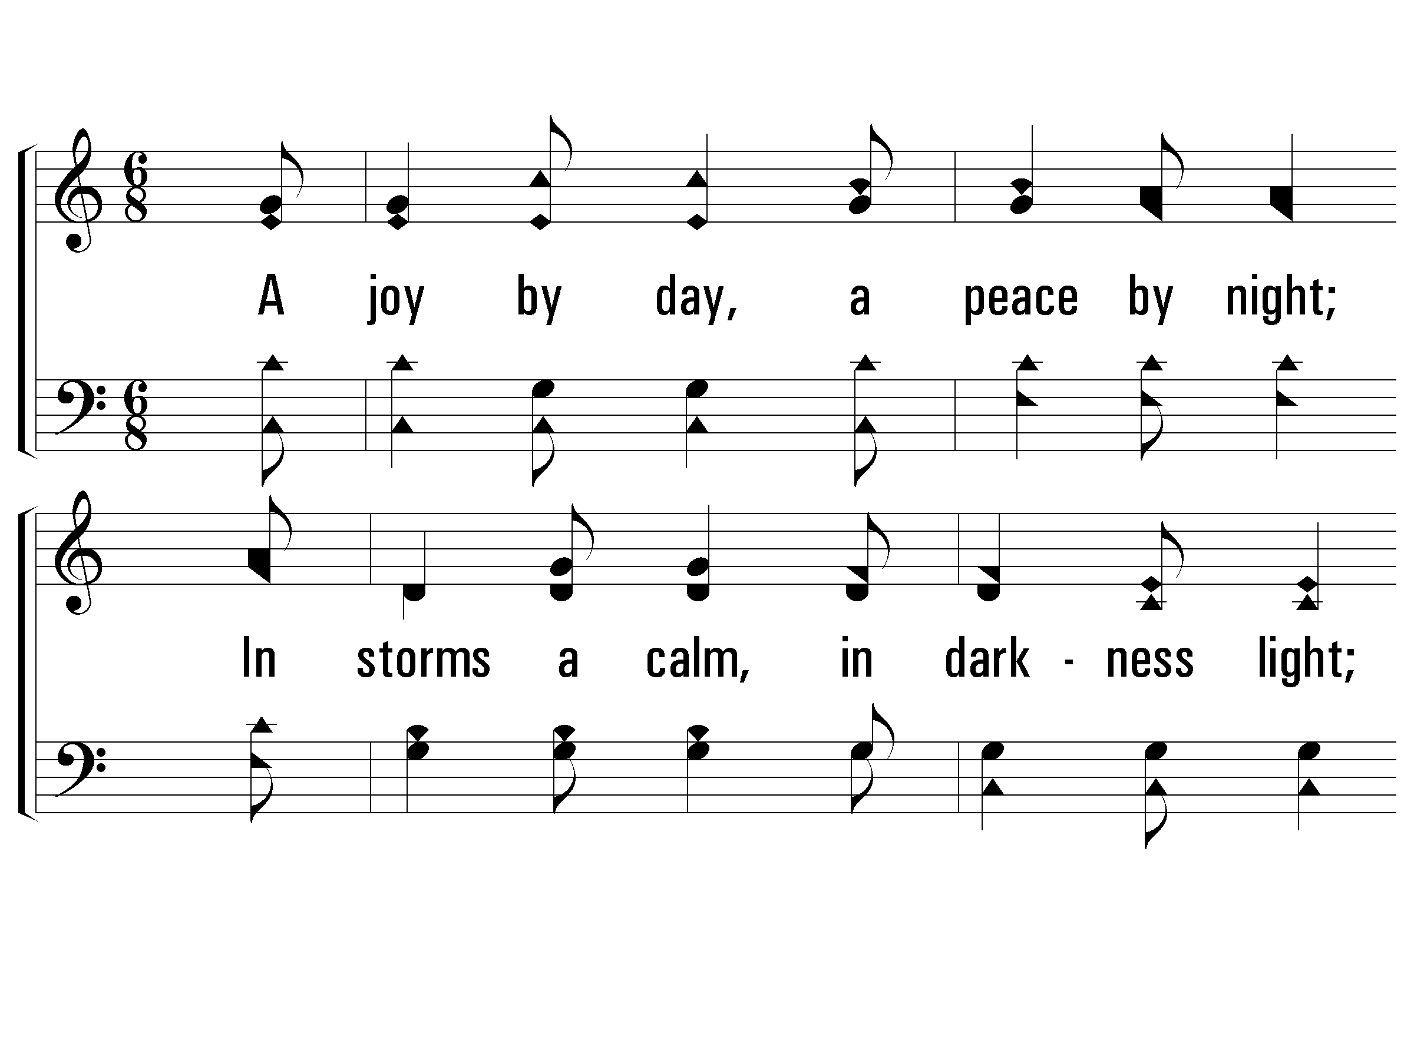
2 - In Vain In High and Holy Lays
2.
A joy by day, a peace by night;
In storms a calm, in darkness light;
In pain a balm, in weakness might,
Is the wonderful love of Jesus.

Slide 11
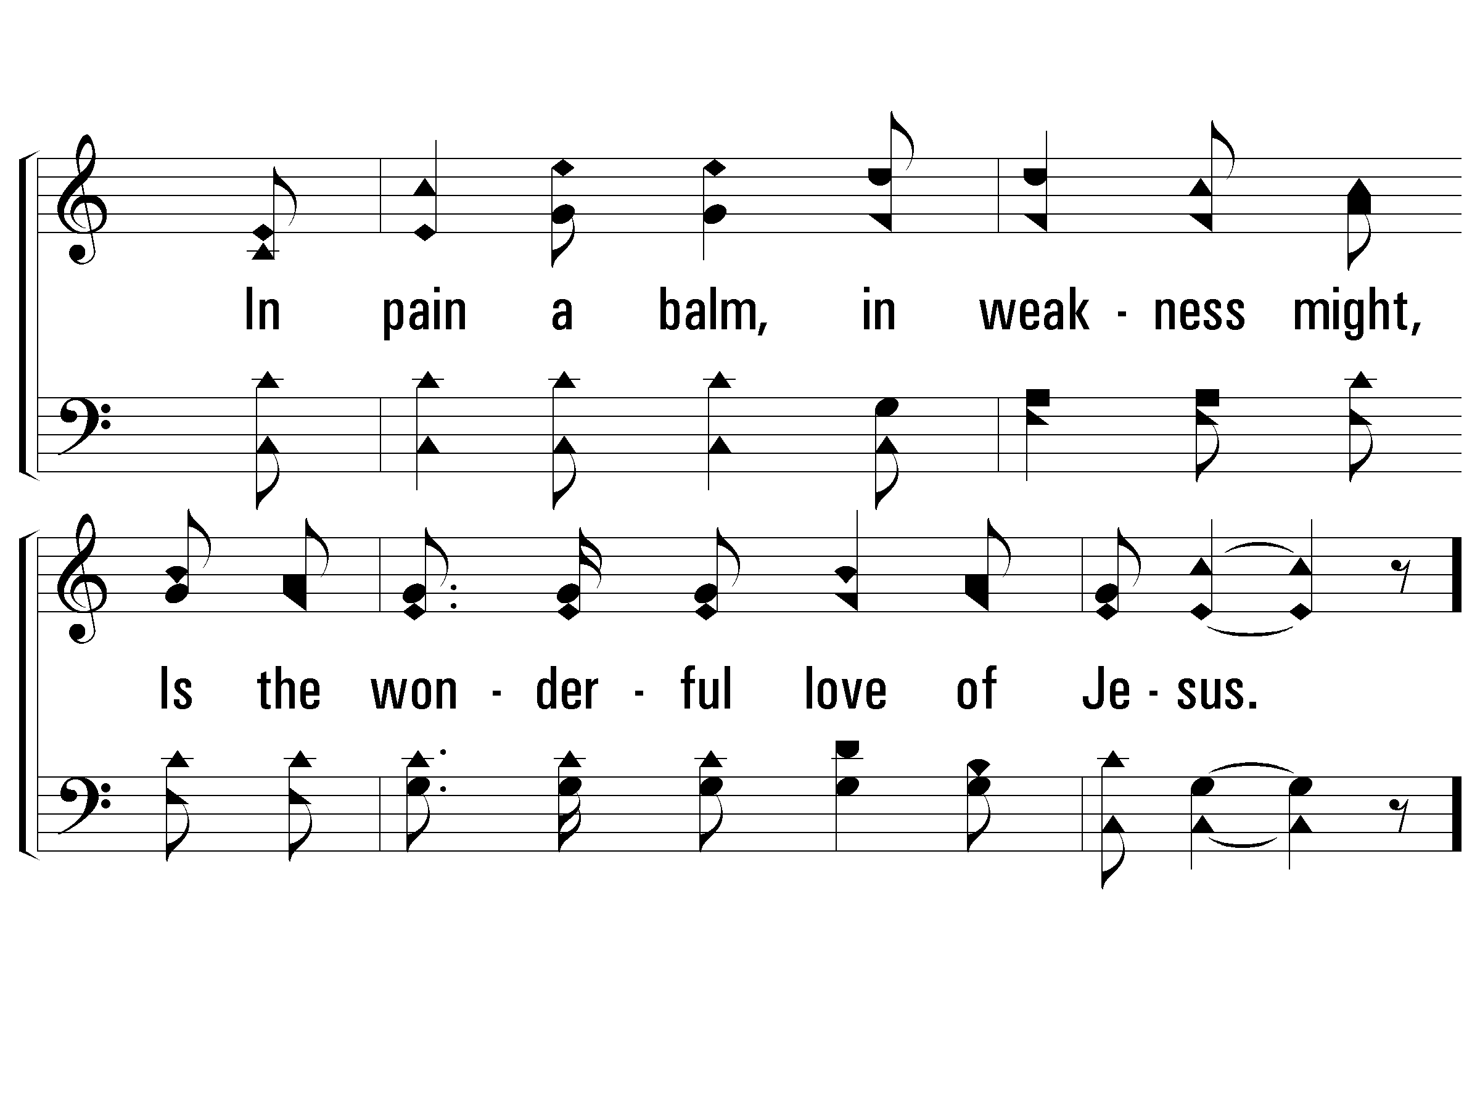
2 - In Vain In High and Holy Lays

Slide 12
c - In Vain In High and Holy Lays

Slide 13
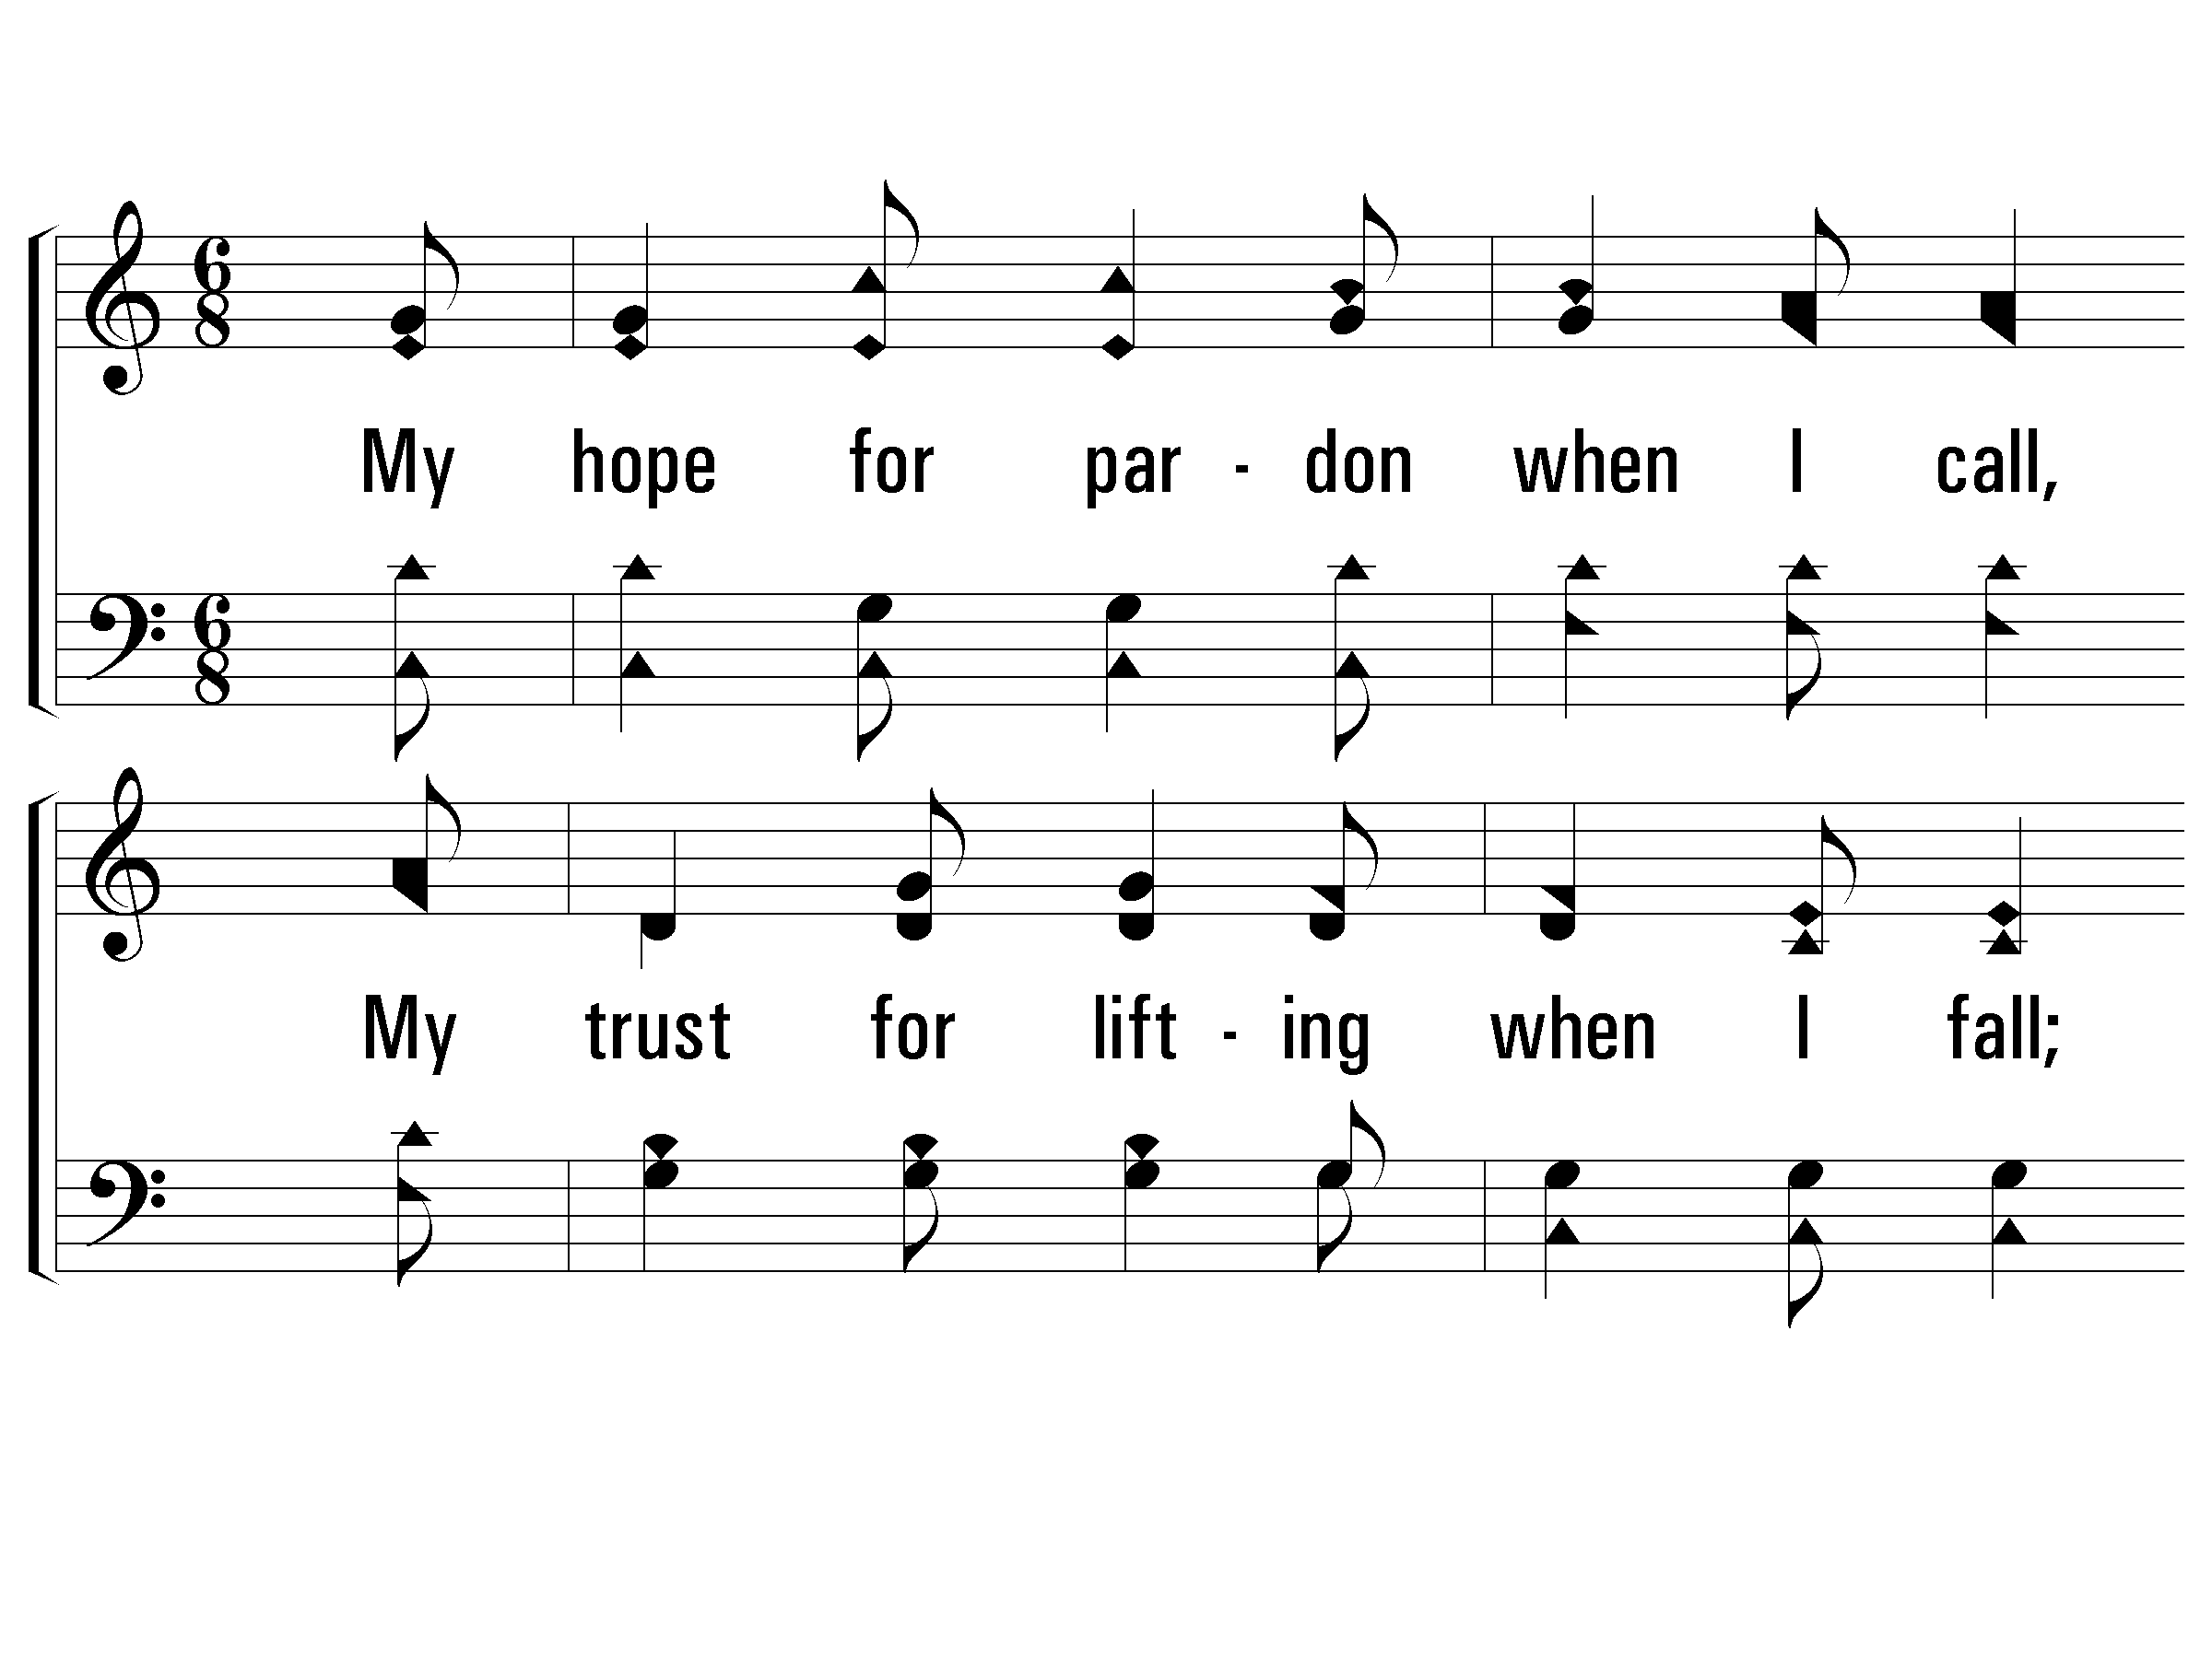
3 - In Vain In High and Holy Lays
3.
My hope for pardon when I call,
My trust for lifting when I fall;
In life, in death, my all in all,
Is the wonderful love of Jesus.

Slide 14
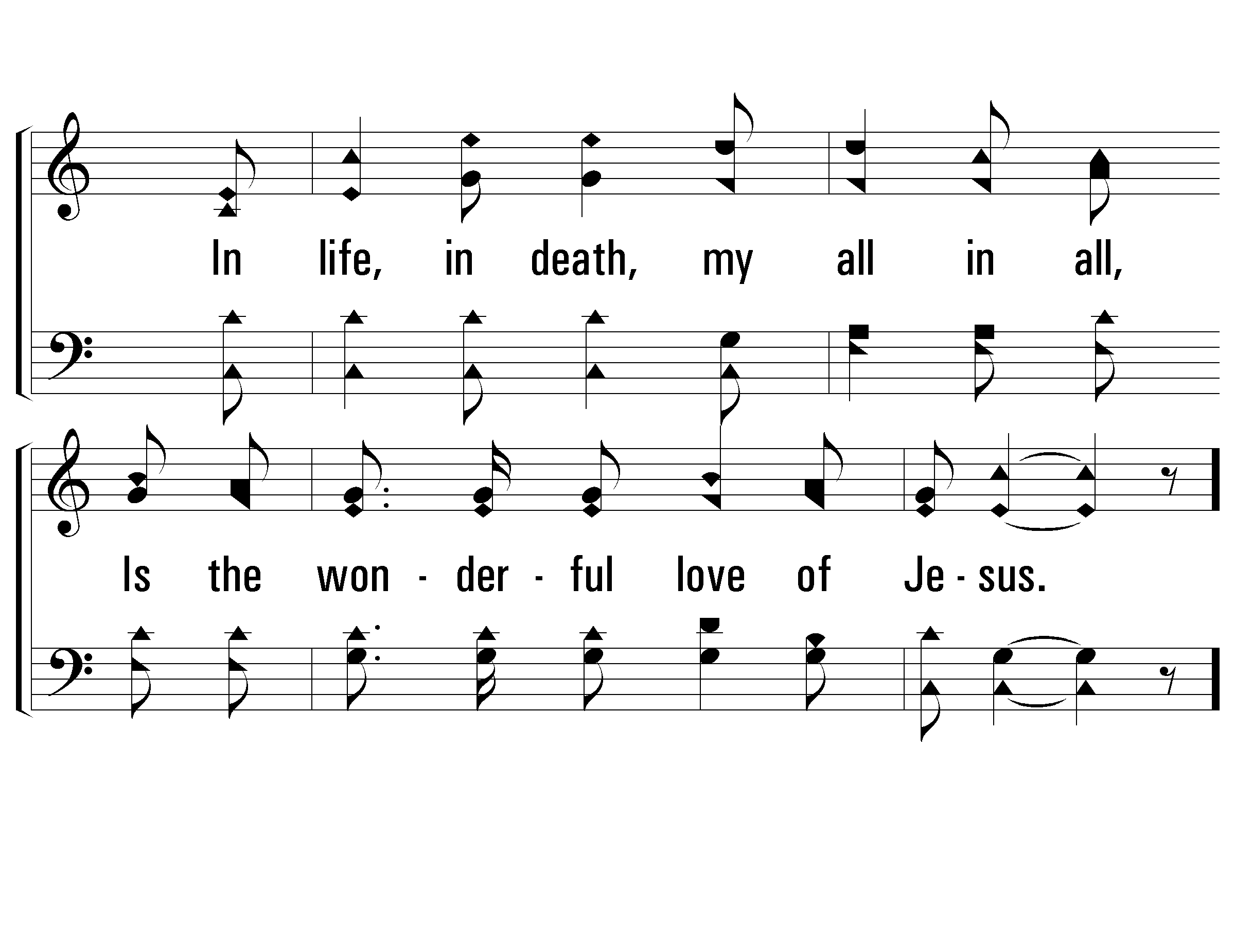
3 - In Vain In High and Holy Lays

Slide 15
c - In Vain In High and Holy Lays

Slide 17
1 Kings 6:7
The house, while it was being built, was built of stone prepared at the quarry, and there was neither hammer nor axe nor any iron tool heard in the house while it was being built.
Why?

Slide 18
But the LORD is in His holy temple.
Let all the earth be silent before Him.
Habakkuk 2:20

Slide 19
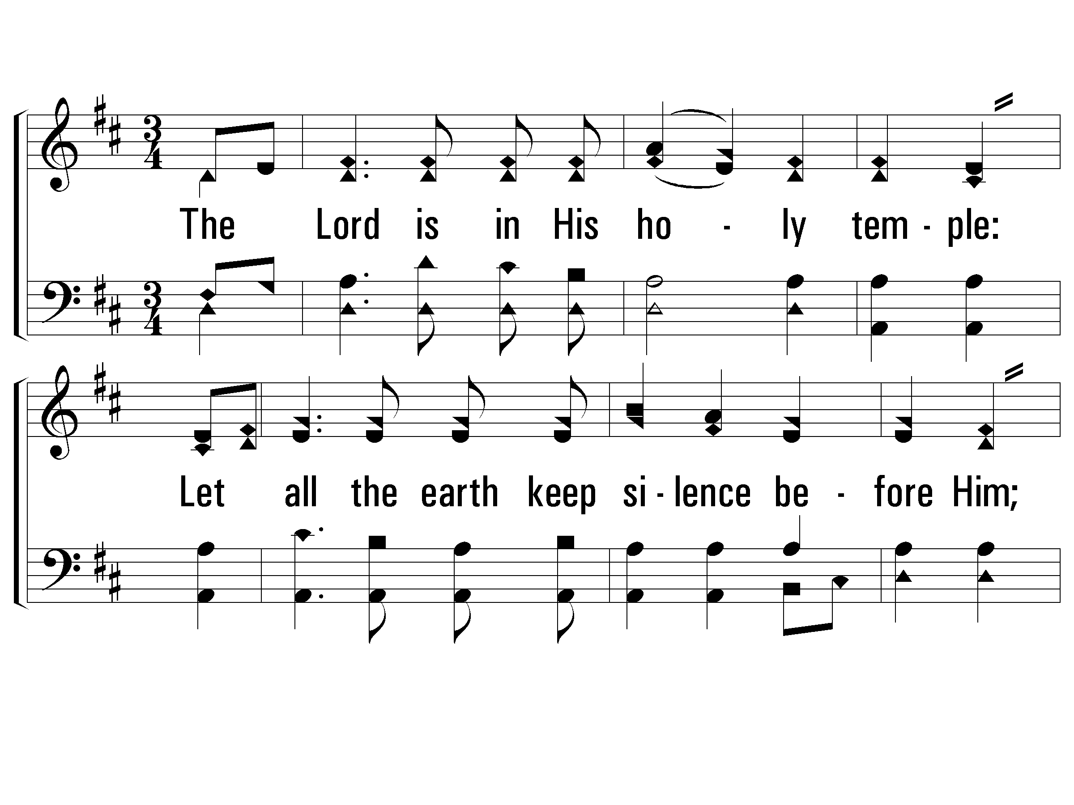
1 - The Lord Is in His Holy Temple
The Lord is in His holy temple:
Let all the earth keep silence before Him;
Keep silence, keep silence,
Keep silence before Him.

Slide 20
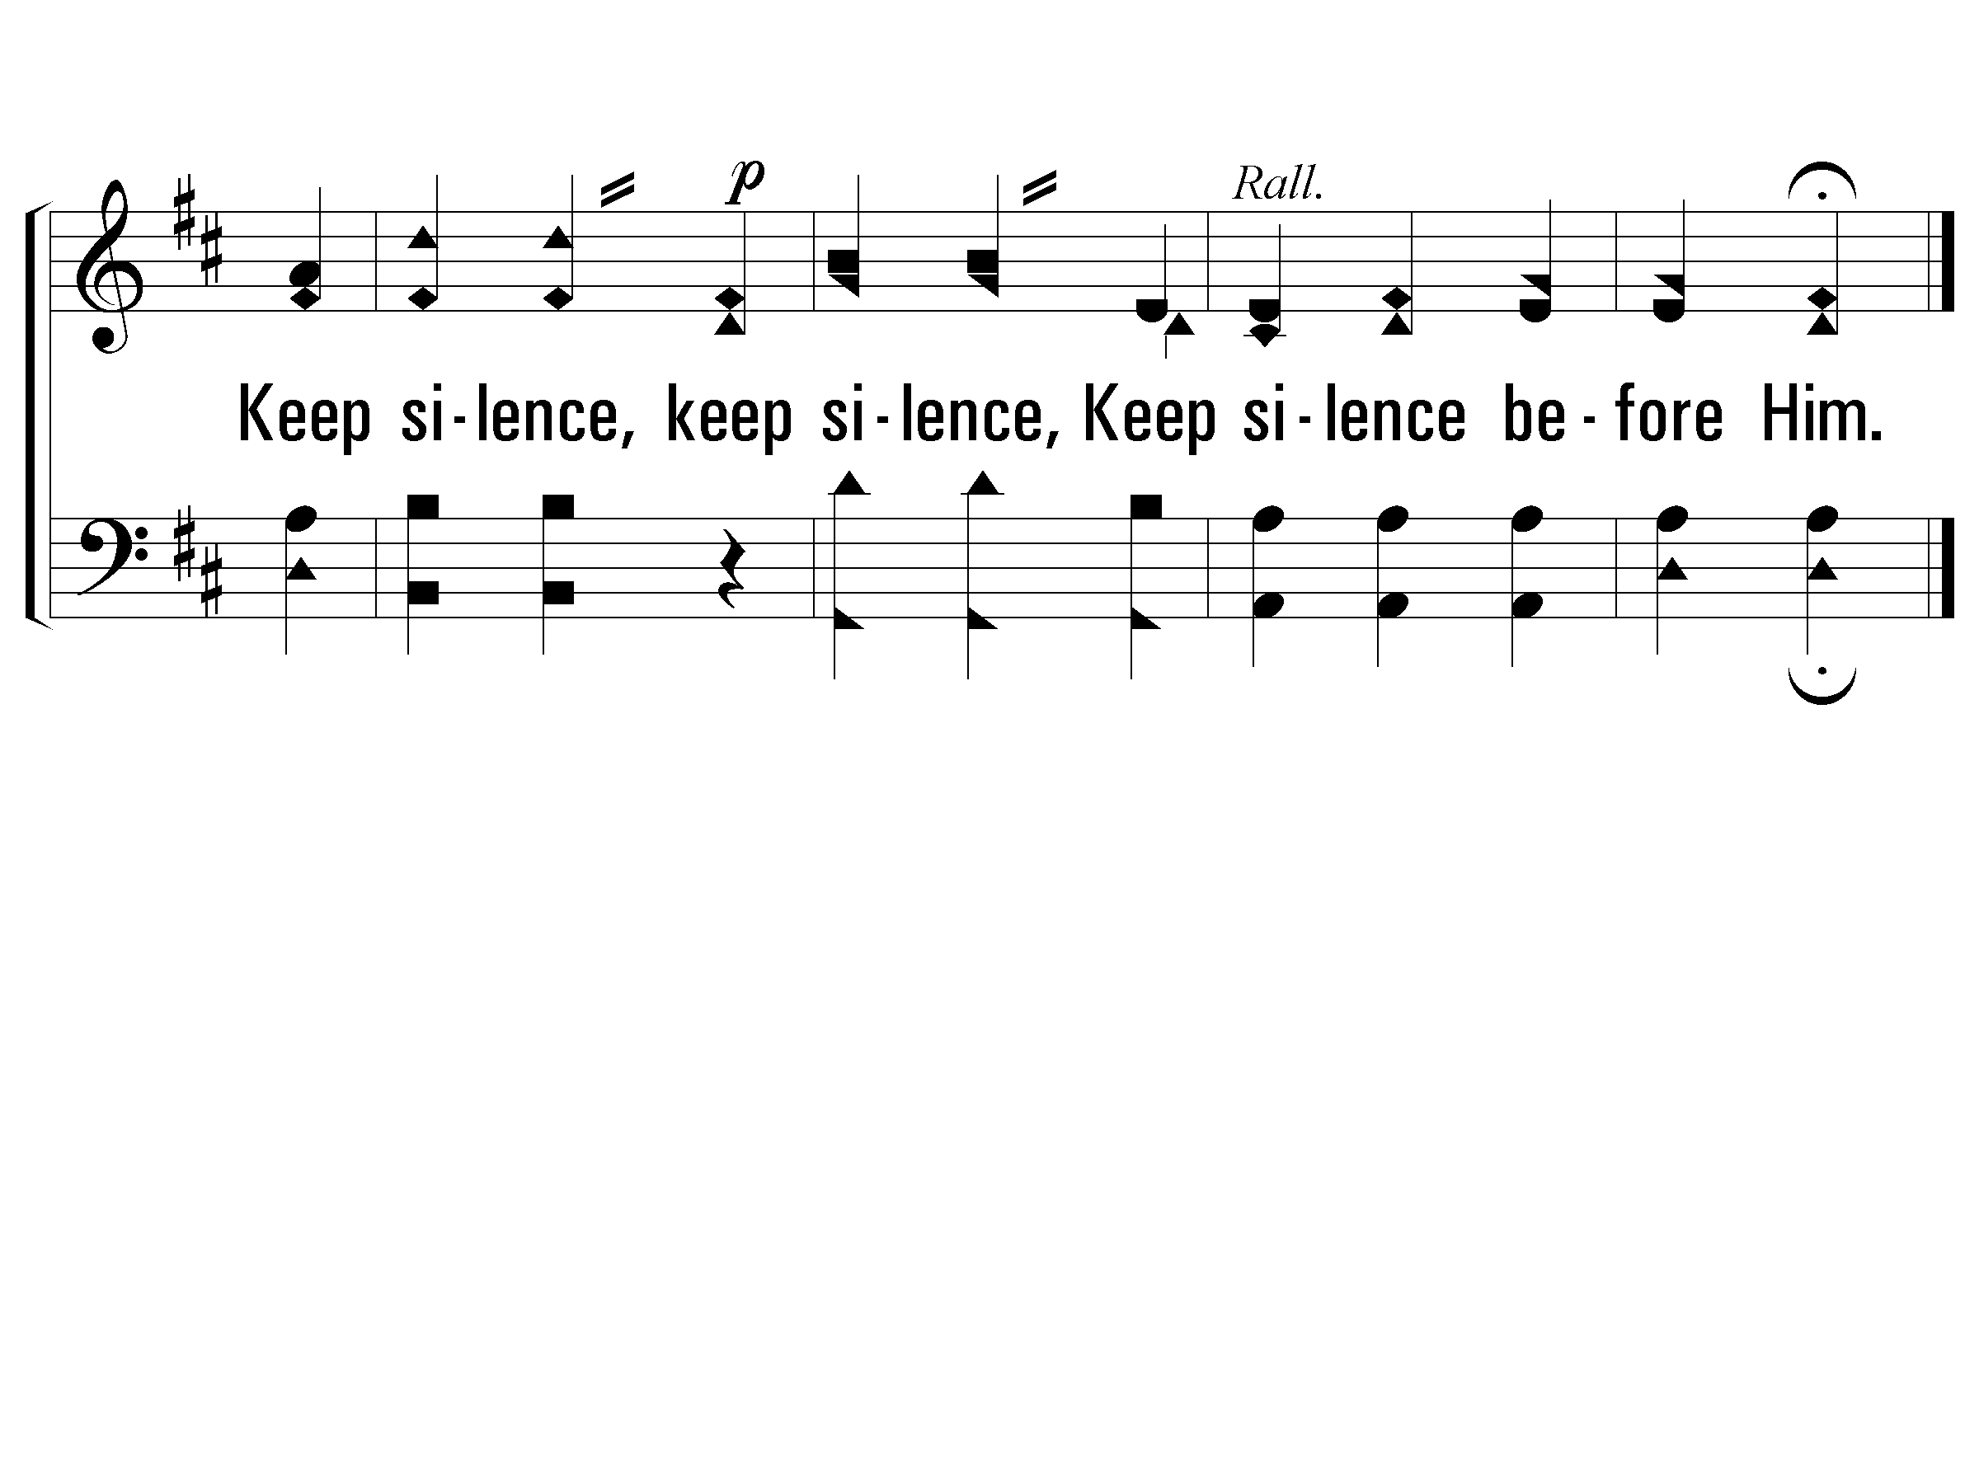
1 - The Lord Is in His Holy Temple

Slide 22

προσκυνεο - proskuneo
to fawn or crouch to, i.e. (literally or figuratively) prostrate oneself in homage (do reverence to, adore):
KJV – worship

Slide 23
Moses at the Burning Bush
“I am the God of your father, the God of Abraham, the God of Isaac, and the God of Jacob.” Then Moses hid his face, for he was afraid to look at God.
Exodus 3:6

Slide 24
Ezekiel’s Vision
As the appearance of the rainbow in the clouds on a rainy day, so was the appearance of the surrounding radiance. Such was the appearance of the likeness of the glory of the Lord. And when I saw it, I fell on my face and heard a voice speaking.
Ezekiel 1:28

Slide 25
Transfiguration
“This is My beloved Son, with whom I am well-pleased; listen to Him!” And when the disciples heard this, they fell on their faces and were much afraid.
Matthew 17:5-6

Slide 26
John’s Vision of Jesus
And in His right hand He held seven stars; and out of His mouth came a sharp two-edged sword; and His face was like the sun shining in its strength. And when I saw Him, I fell at His feet as a dead man.
Revelation 1:16-17

Slide 27
What About Us?
Therefore also God highly exalted Him, and bestowed on Him the name which is above every name, that at the name of Jesus EVERY KNEE SHOULD BOW, of those who are in heaven, and on earth, and under the earth, and that every tongue should confess that Jesus Christ is Lord, to the glory of God the Father.
Philippians 2:9-11

Slide 28
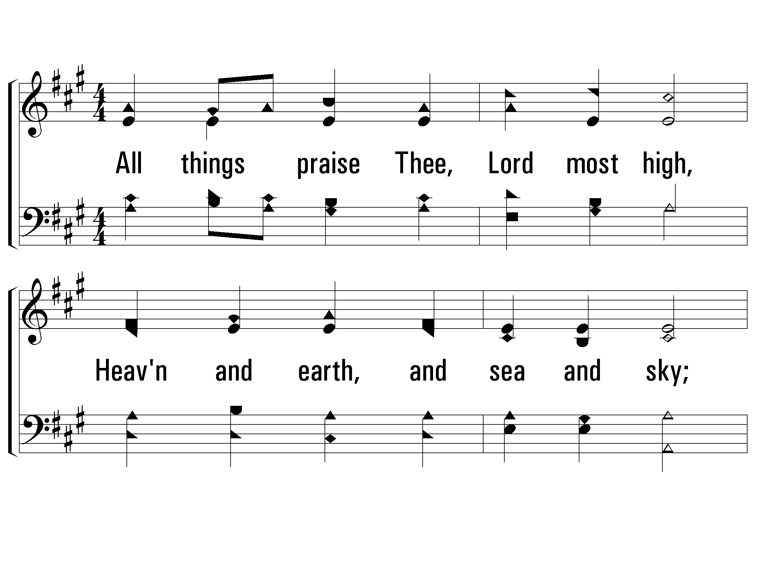
1 - All Things Praise Thee
1.
All things praise Thee, Lord most high,
Heaven and earth, and sea and sky;
All were for Thy glory made,
That Thy greatness, thus displayed,
Should all worship bring to Thee;
All things praise Thee— Lord, may we!
Words: George W. Conder
Music: Conrad Kocher / Arr.: William H. Monk
© 2006 The Paperless Hymnal®

Slide 29
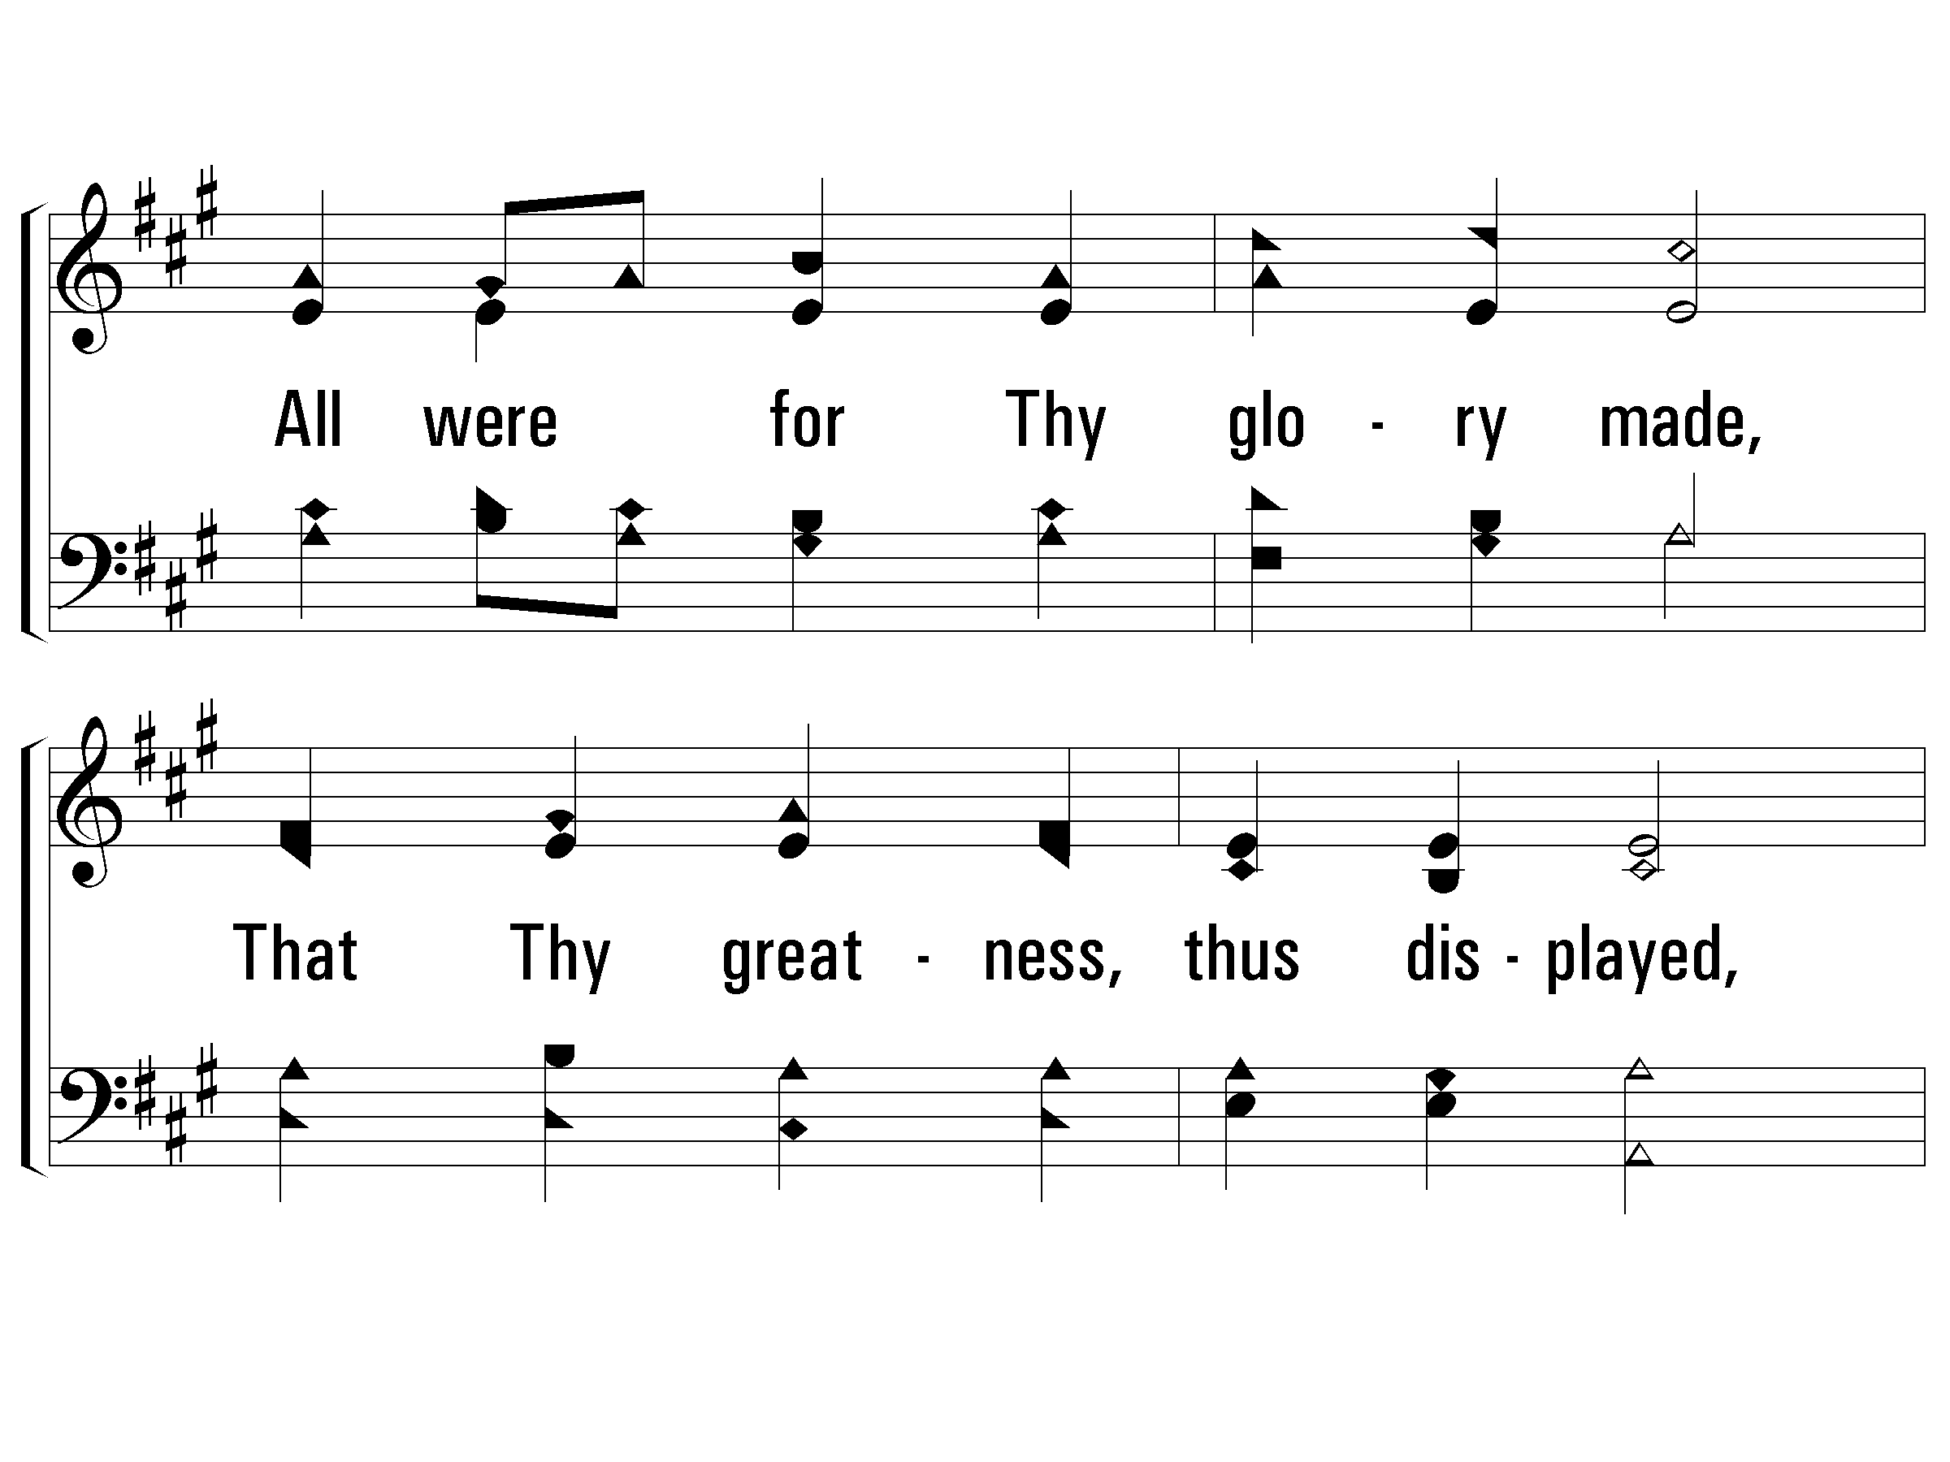
1 - All Things Praise Thee
© 2006 The Paperless Hymnal®

Slide 30
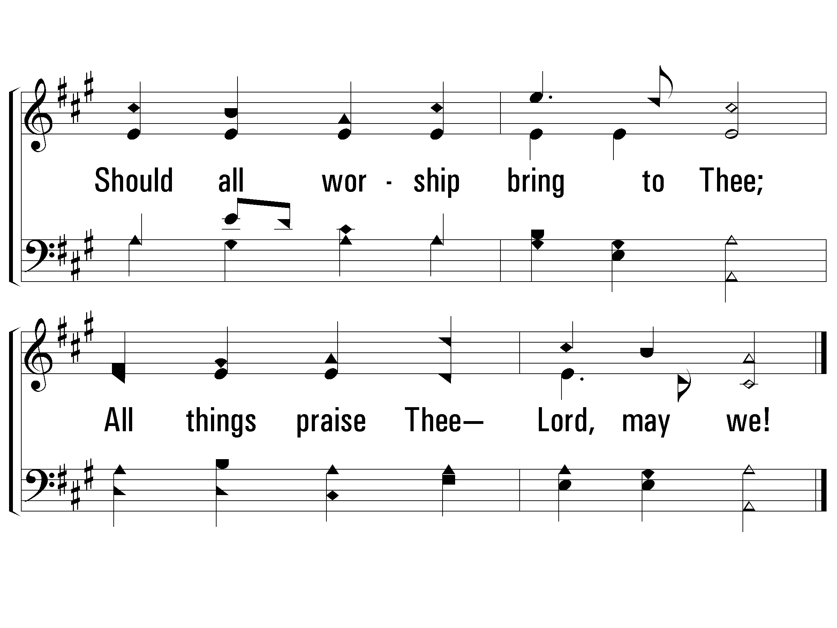
1 - All Things Praise Thee
© 2006 The Paperless Hymnal®

Slide 31
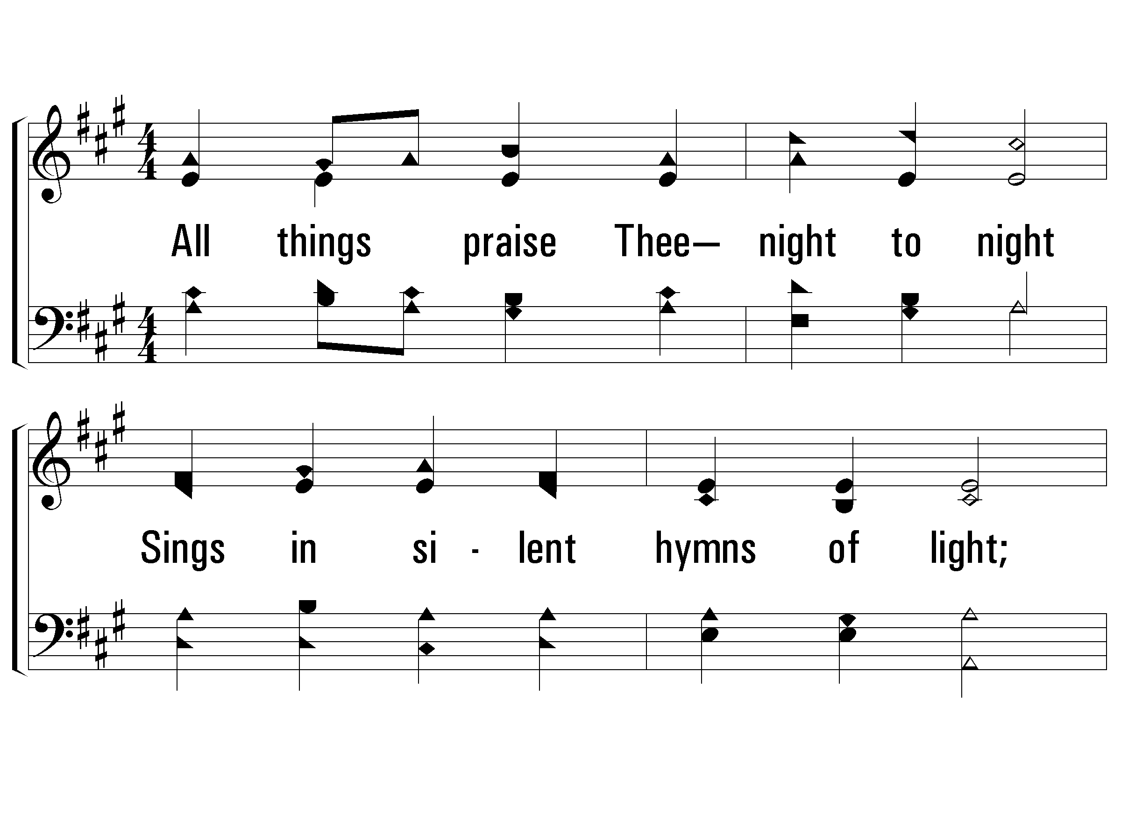
2 - All Things Praise Thee
2.
All things praise Thee— night to night
Sings in silent hymns of light;
All things praise Thee— day by day
Chants Thy power in burning ray;
Time and space are praising Thee;
All things praise Thee— Lord, may we!
Words: George W. Conder
Music: Conrad Kocher / Arr.: William H. Monk
© 2006 The Paperless Hymnal®

Slide 32
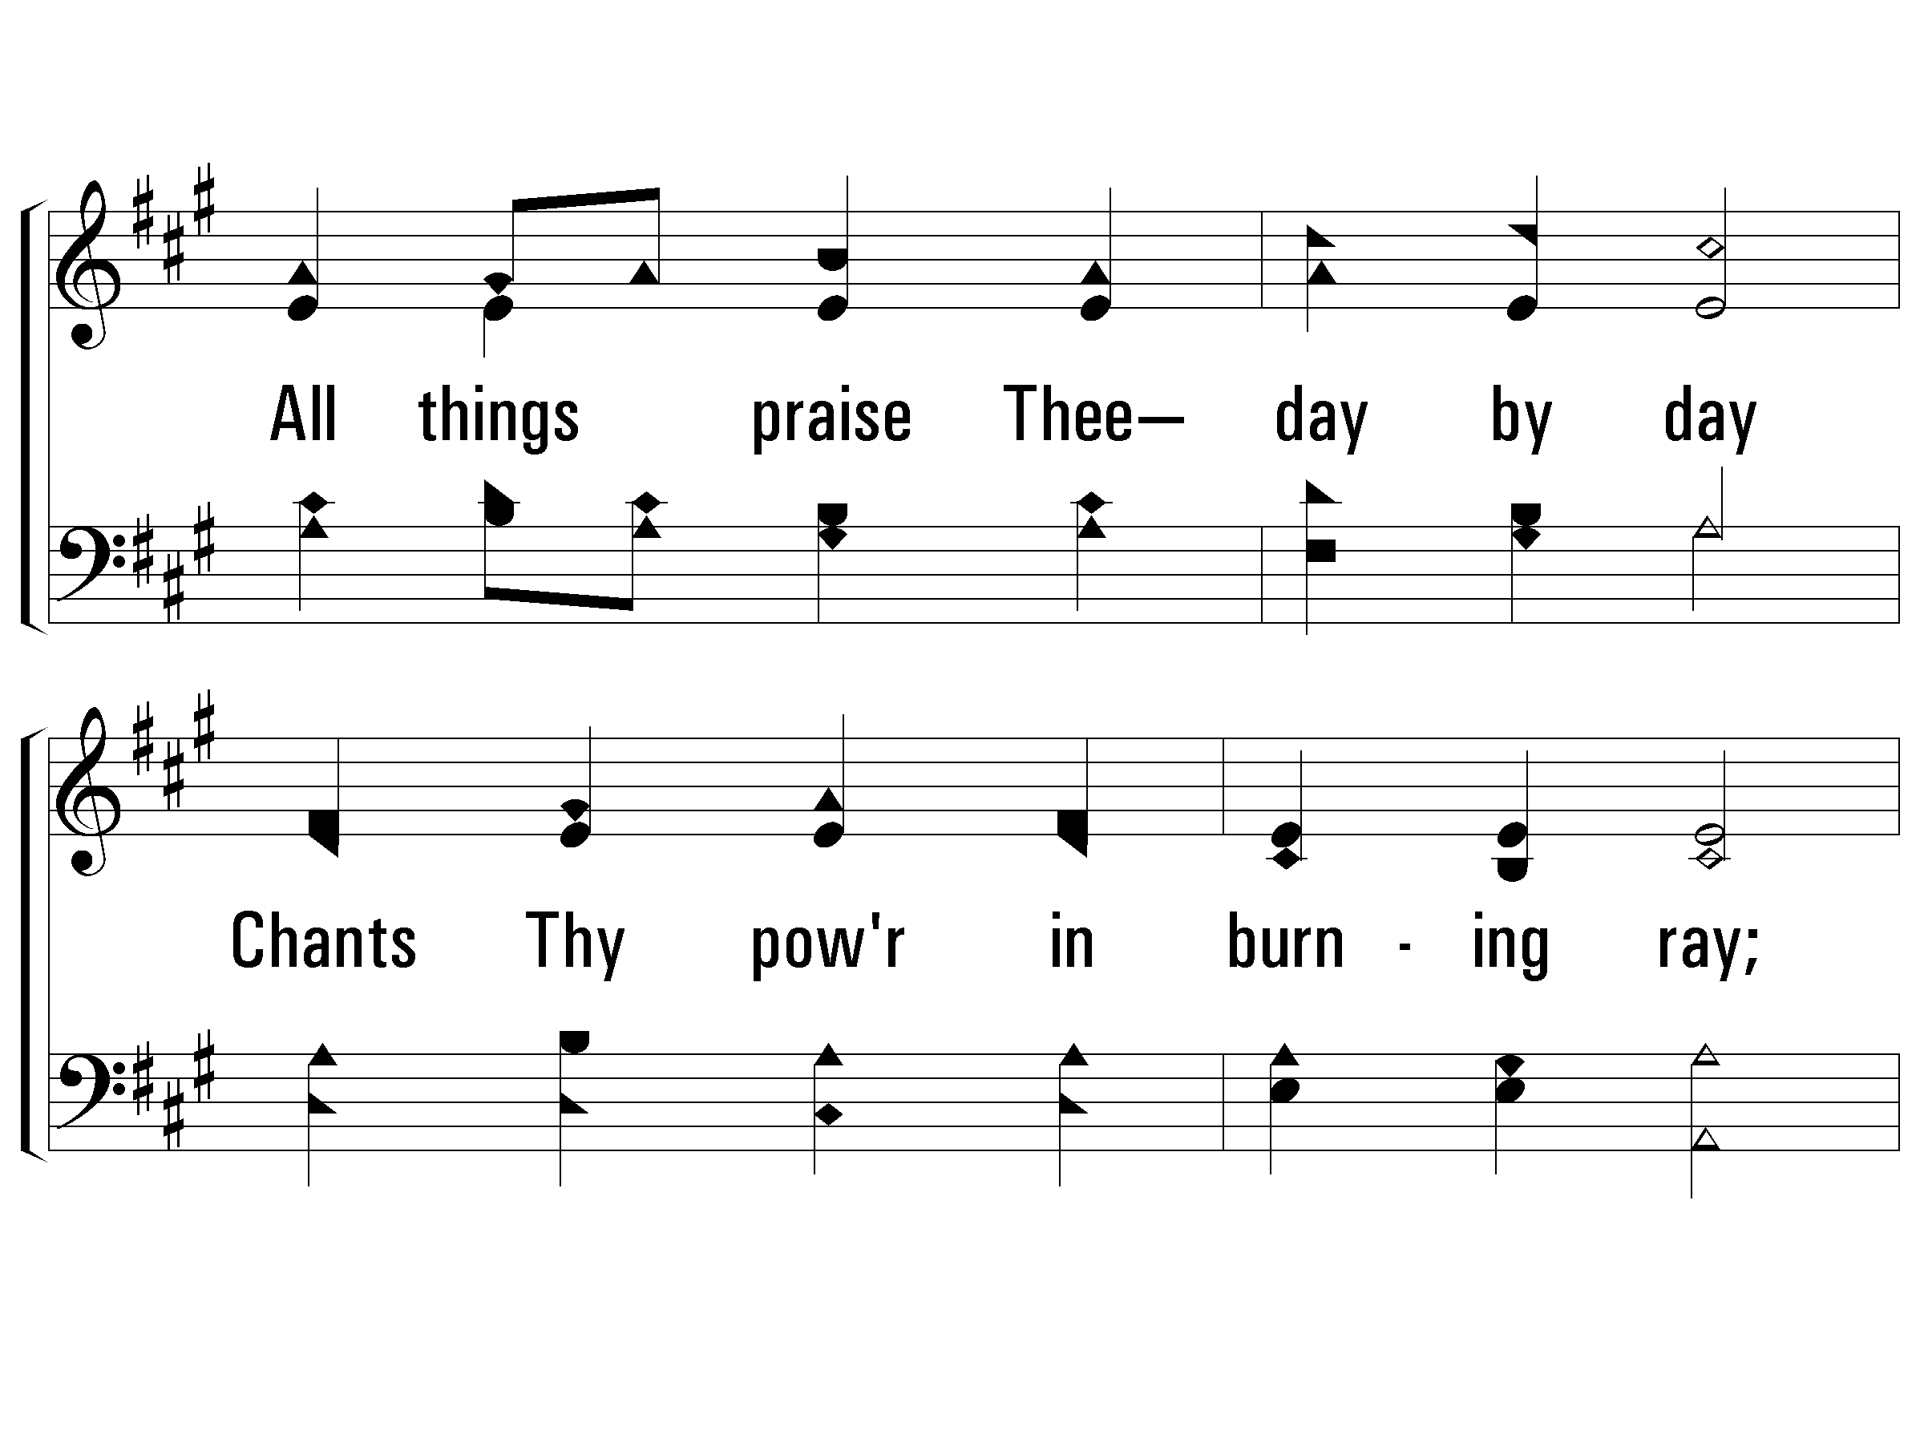
2 - All Things Praise Thee
© 2006 The Paperless Hymnal®

Slide 33
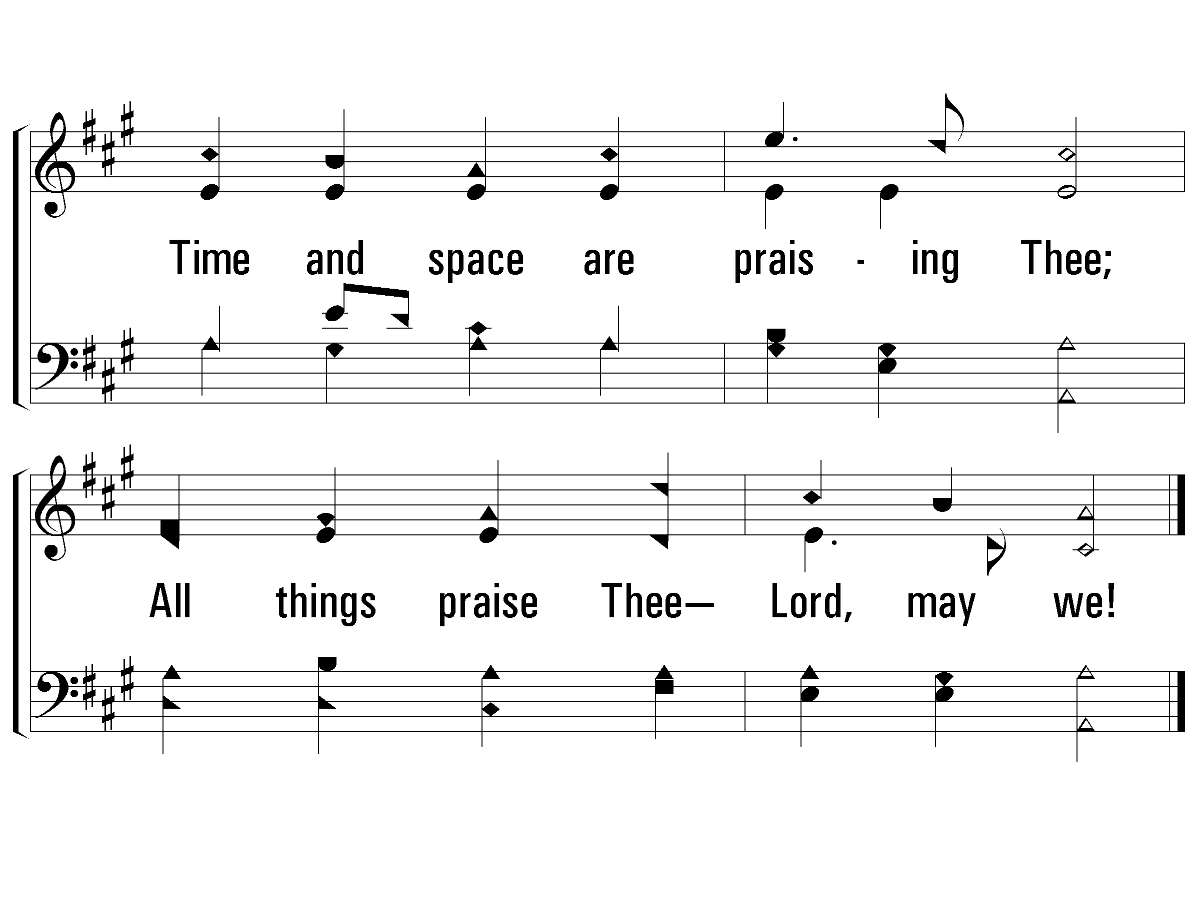
2 - All Things Praise Thee
© 2006 The Paperless Hymnal®

Slide 34
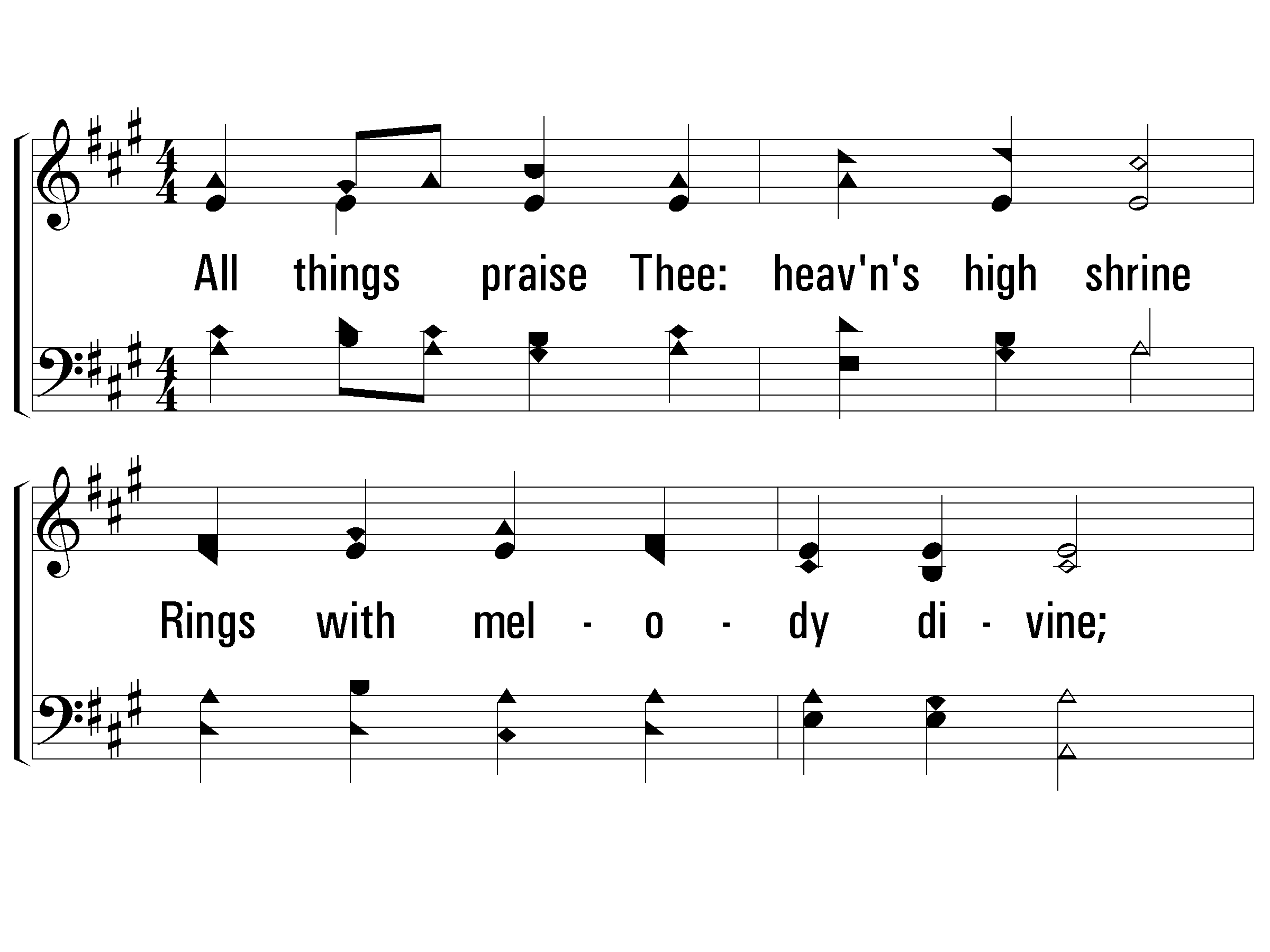
3 - All Things Praise Thee
3.
All things praise Thee: heaven's high shrine
Rings with melody divine;
Lowly bending at Thy feet,
Seraph and archangel meet;
This their highest bliss, to be
Ever praising— Lord, may we!
Words: George W. Conder
Music: Conrad Kocher / Arr.: William H. Monk
© 2006 The Paperless Hymnal®

Slide 35
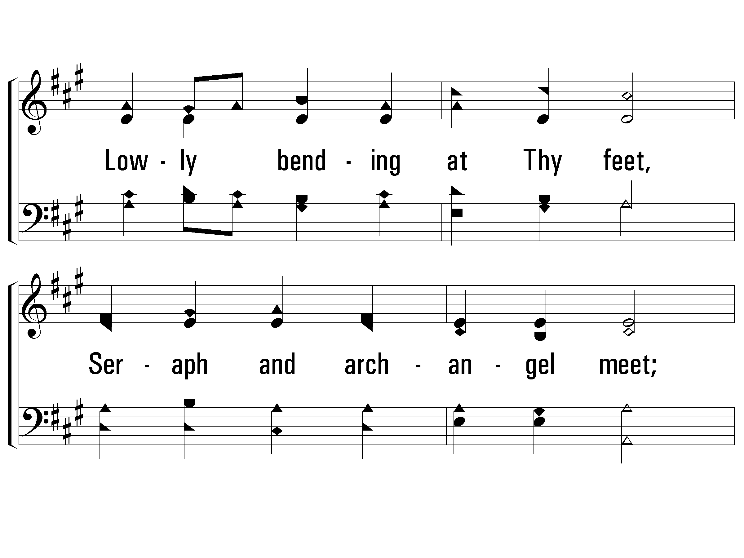
3 - All Things Praise Thee
© 2006 The Paperless Hymnal®

Slide 36
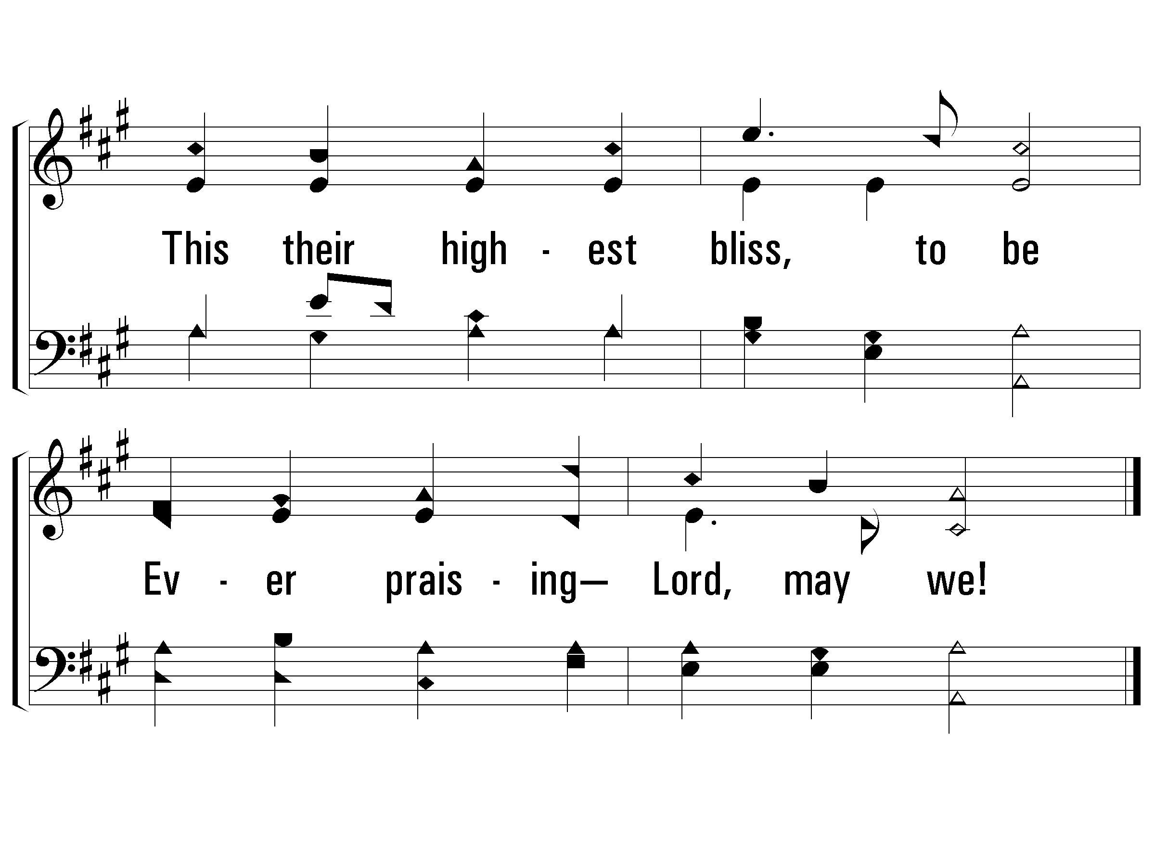
3 - All Things Praise Thee
© 2006 The Paperless Hymnal®

Slide 38
To Adore
I love Thee, O LORD, my strength.
Psalm 18:1

Slide 39
Emotion in Worship
O come, let us sing for joy to the LORD, Let us shout joyfully to the rock of our salvation. Let us come before His presence with thanksgiving, Let us shout joyfully to Him with psalms…
For the LORD is a great God and a great King above all gods, Come, let us worship and bow down, Let us kneel before the LORD our Maker.
Psalms 95:1-6

Slide 40
Emotion in Worship
Bless the LORD, O my soul: and all that is within me, bless His holy name.
Psalms 103:1

Slide 41
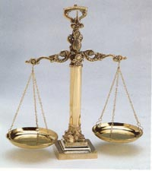
Emotion vs. Truth
Which is more important?
One without the other is wrong
  Truth with no emotion is empty ritualism – Pharisees condemned
  Emotion with no truth is ungodly emotionalism – pagans condemned

Slide 42
Source of Emotion
Music or God’s Revealed Word?
  Emotion in music is additive to the emotion that begins with God’s revelation
Is emotion the goal?
  Praising God is the goal; the emotion will come
What does it say? vs How does it sound?

Slide 43
What Does God Want?
‘YOU SHALL LOVE THE LORD YOUR GOD WITH ALL YOUR HEART, AND WITH ALL YOUR SOUL, AND WITH ALL YOUR MIND.’
The second is like it, ‘YOU SHALL LOVE YOUR NEIGHBOR AS YOURSELF.’
Matthew 22:37, 39

Slide 44
The Transforming
Power of Worship
Isaiah 6:1-8
Worship teaches us…
God is holy and righteous
We are lowly and sinful
We can be cleansed, forgiven
We need to serve God

Slide 46
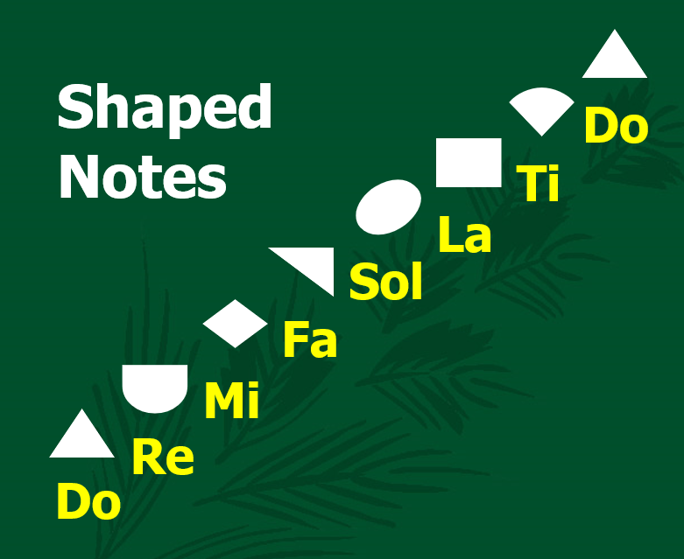
7
6
5
Shaped
Notes
Do
4
Ti
3
La
2
Sol
1
Fa
Mi
Re
Do

Slide 47
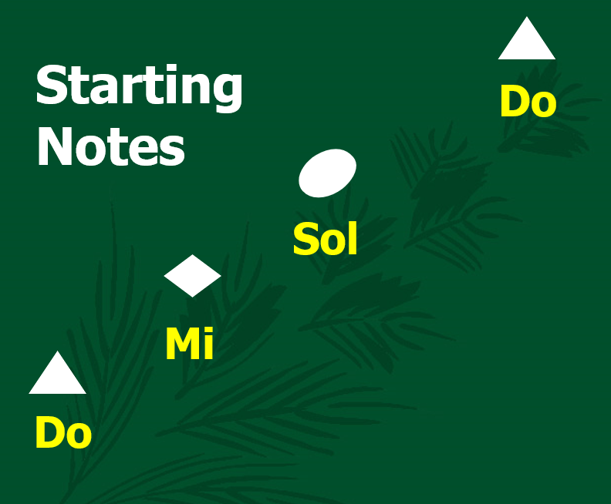
5
Starting
Notes
Do
3
Sol
1
Mi
Do

Slide 48
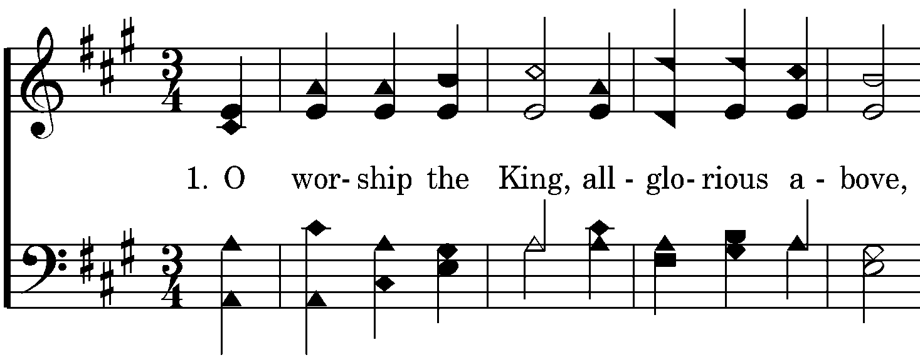
The Starting Pitch
Soprano
(Melody)
Alto
Tenor
Bass

Slide 49
5
Starting
Notes
Do
3
Sol
1
Mi
Do

Slide 50
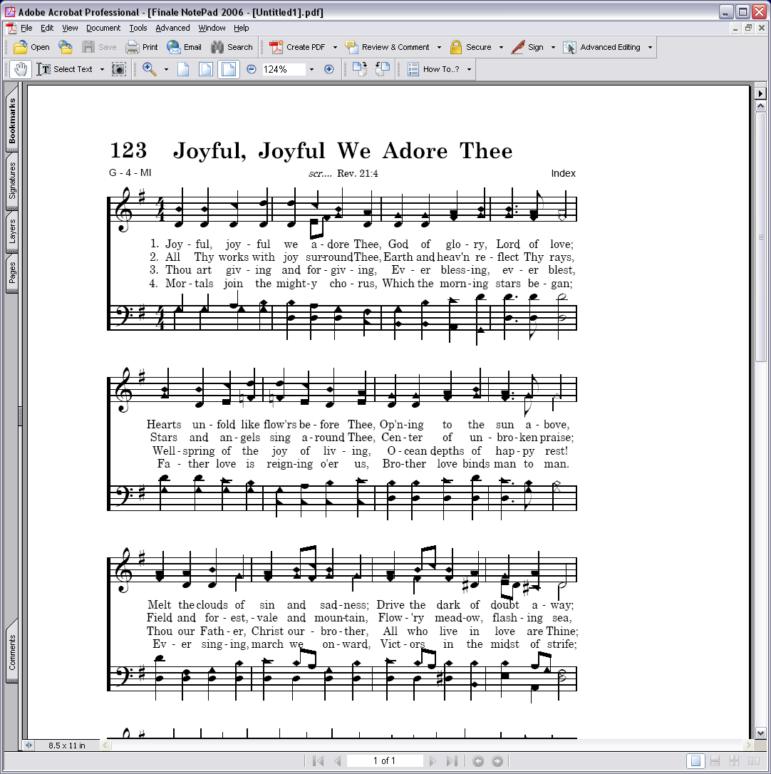

Slide 51
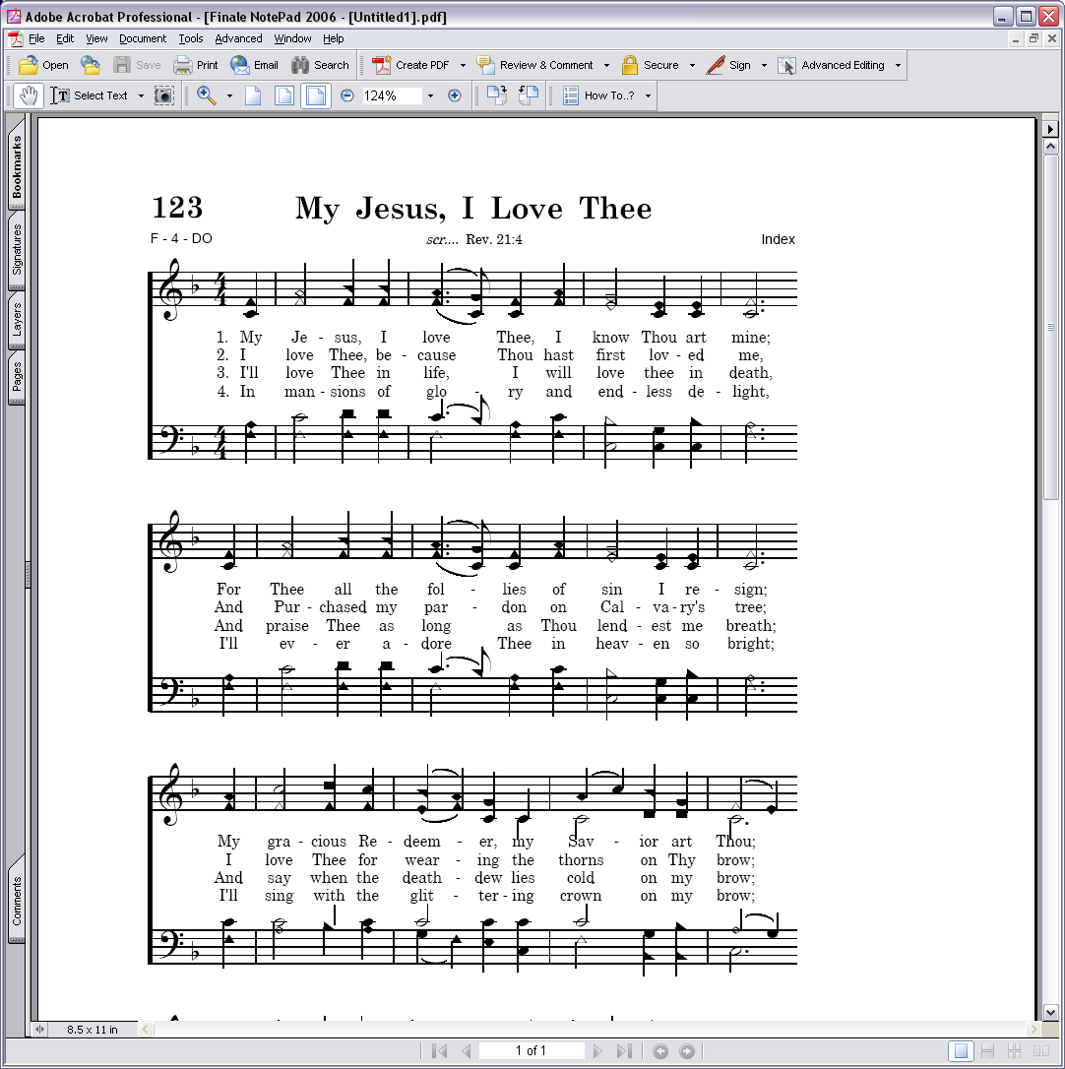

Slide 52
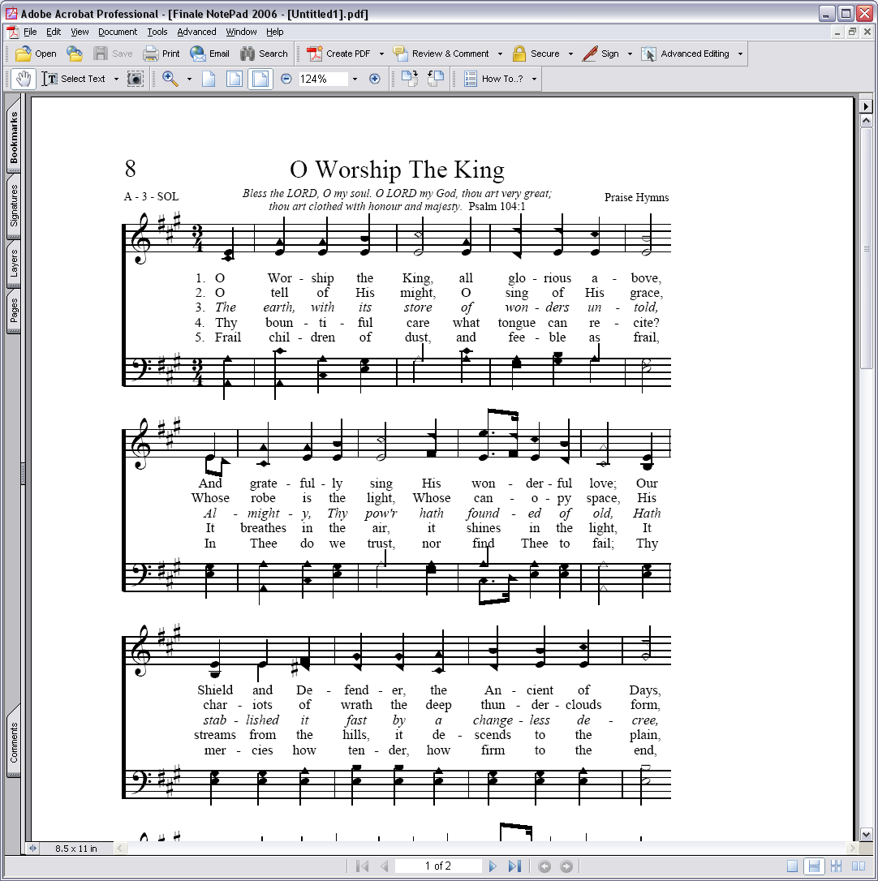

Slide 53
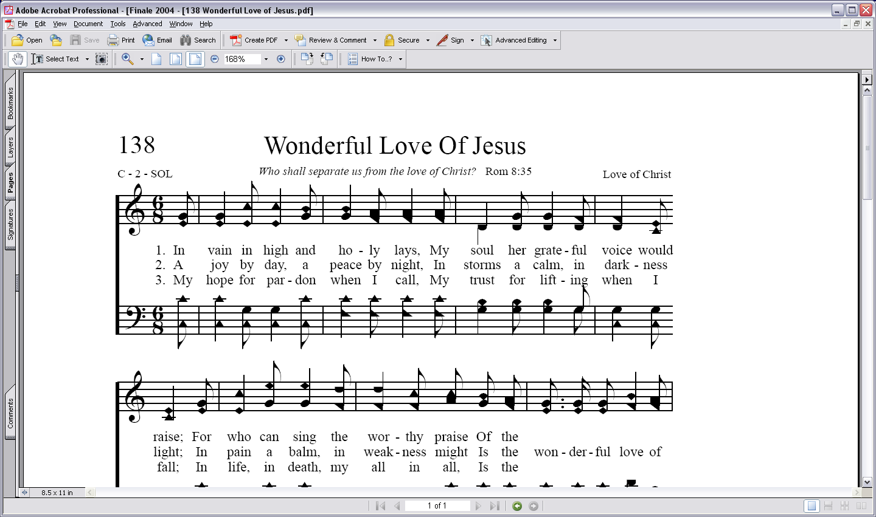

Slide 54
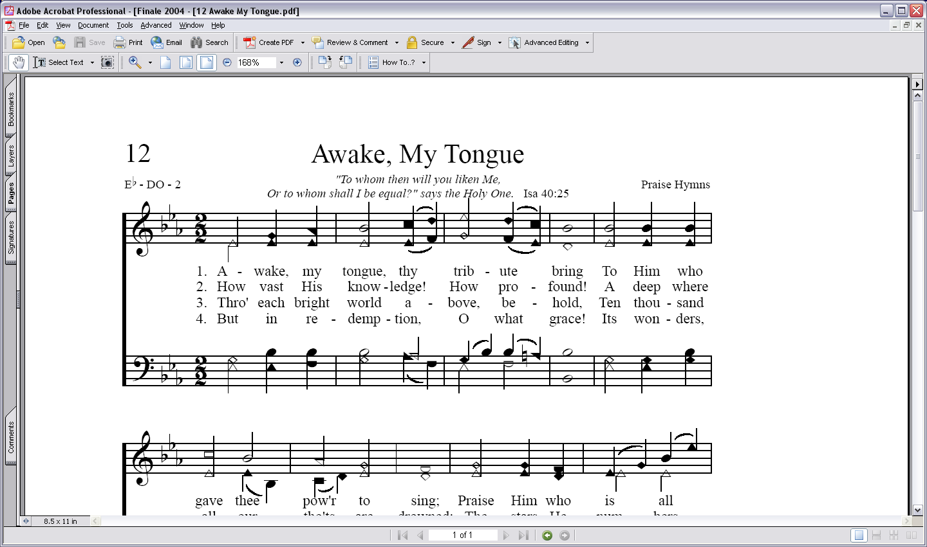

Slide 55
5
Starting
Notes
Do
3
Sol
1
Mi
Do

Slide 57
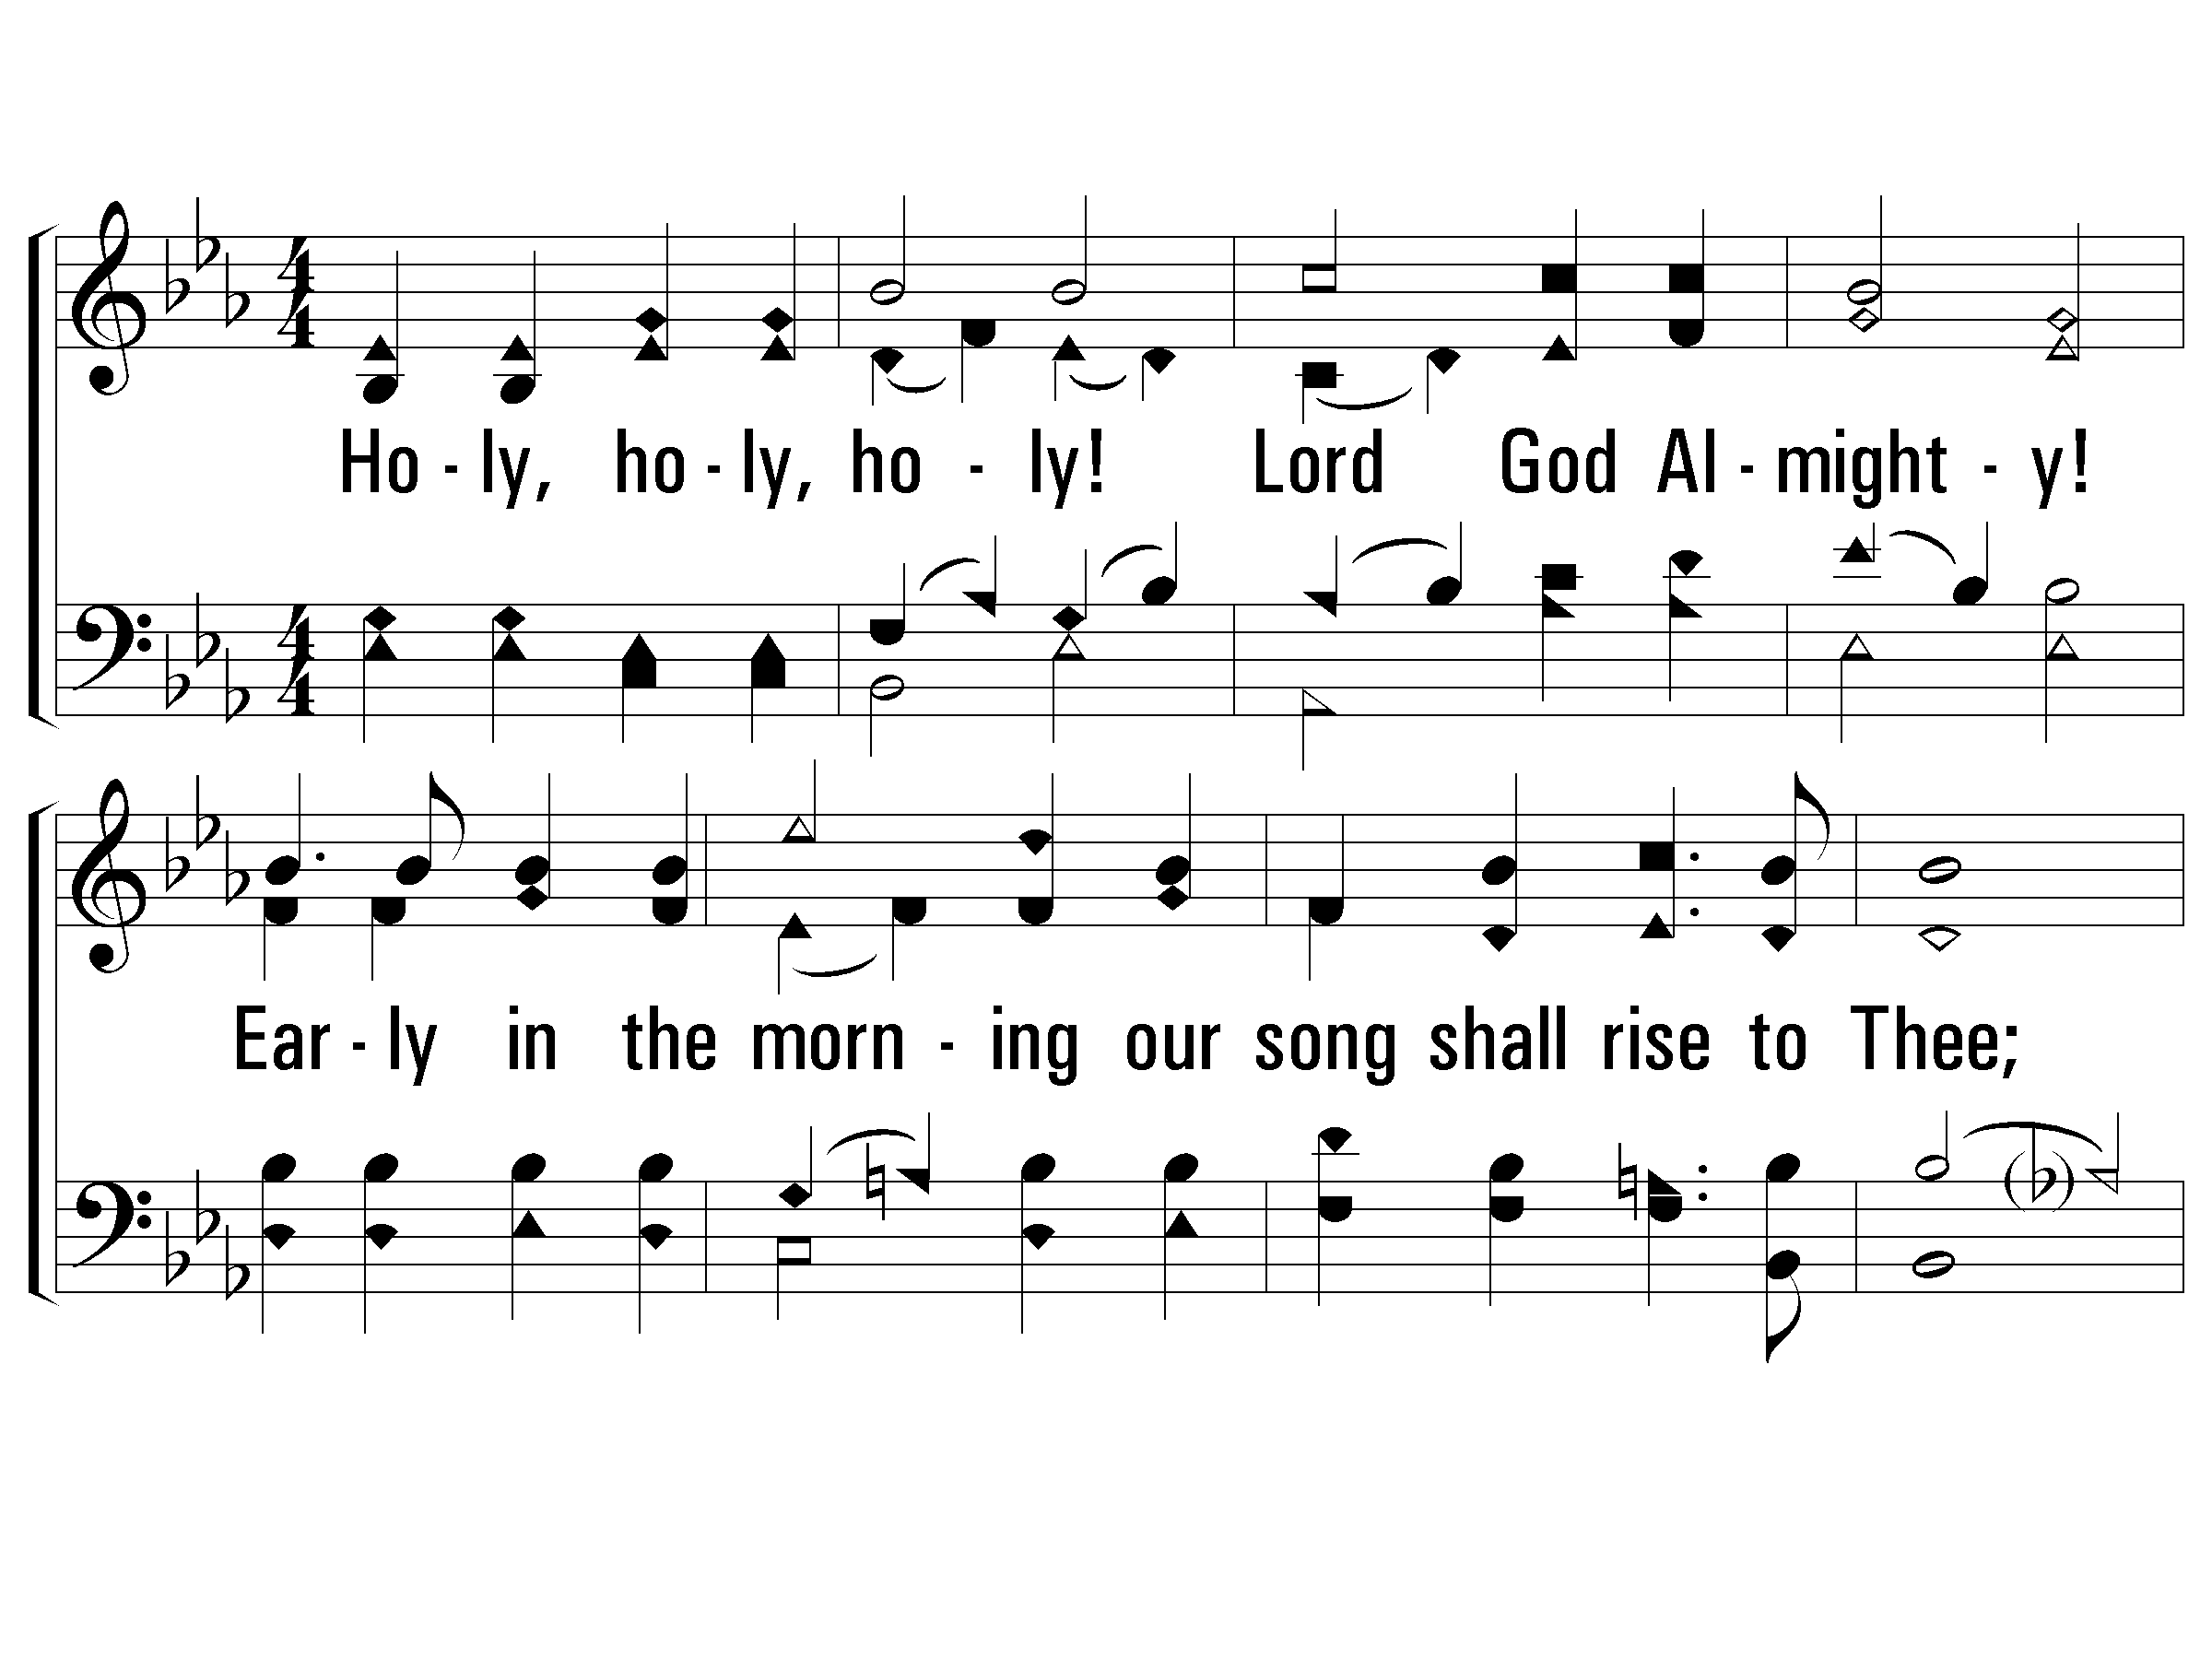
1 - Holy, Holy Holy!
1.
Holy, holy, holy! Lord God Almighty!
Early in the morning our song shall rise to Thee;
Holy, holy, holy! merciful and mighty!
God over all, and blest eternally.

Slide 58
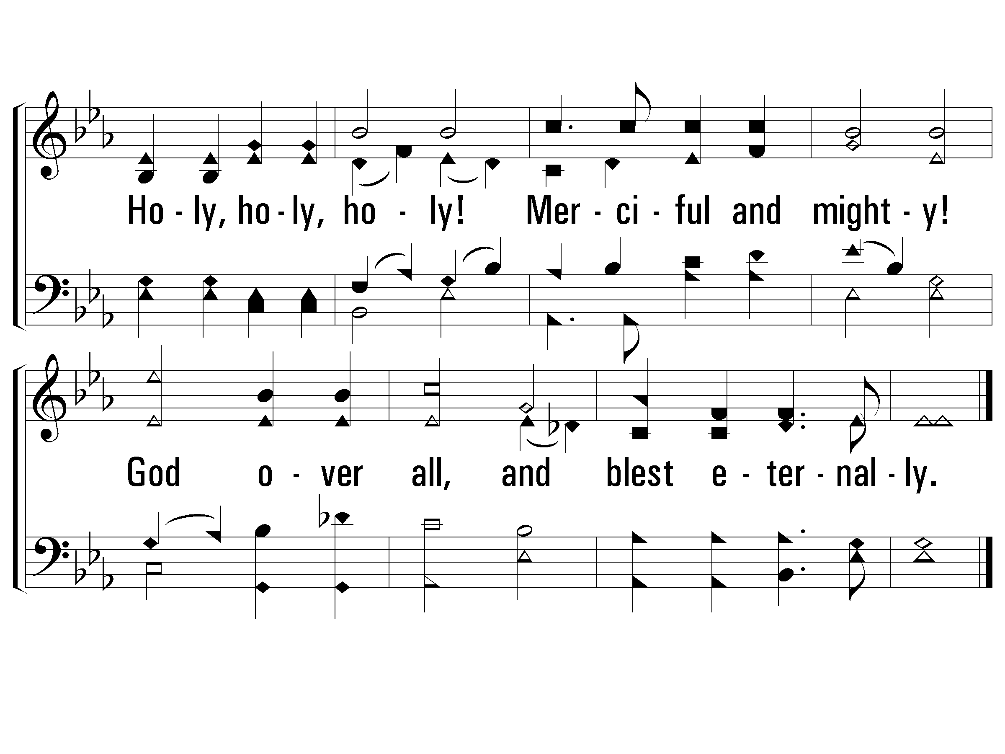
1 - Holy, Holy Holy!

Slide 59
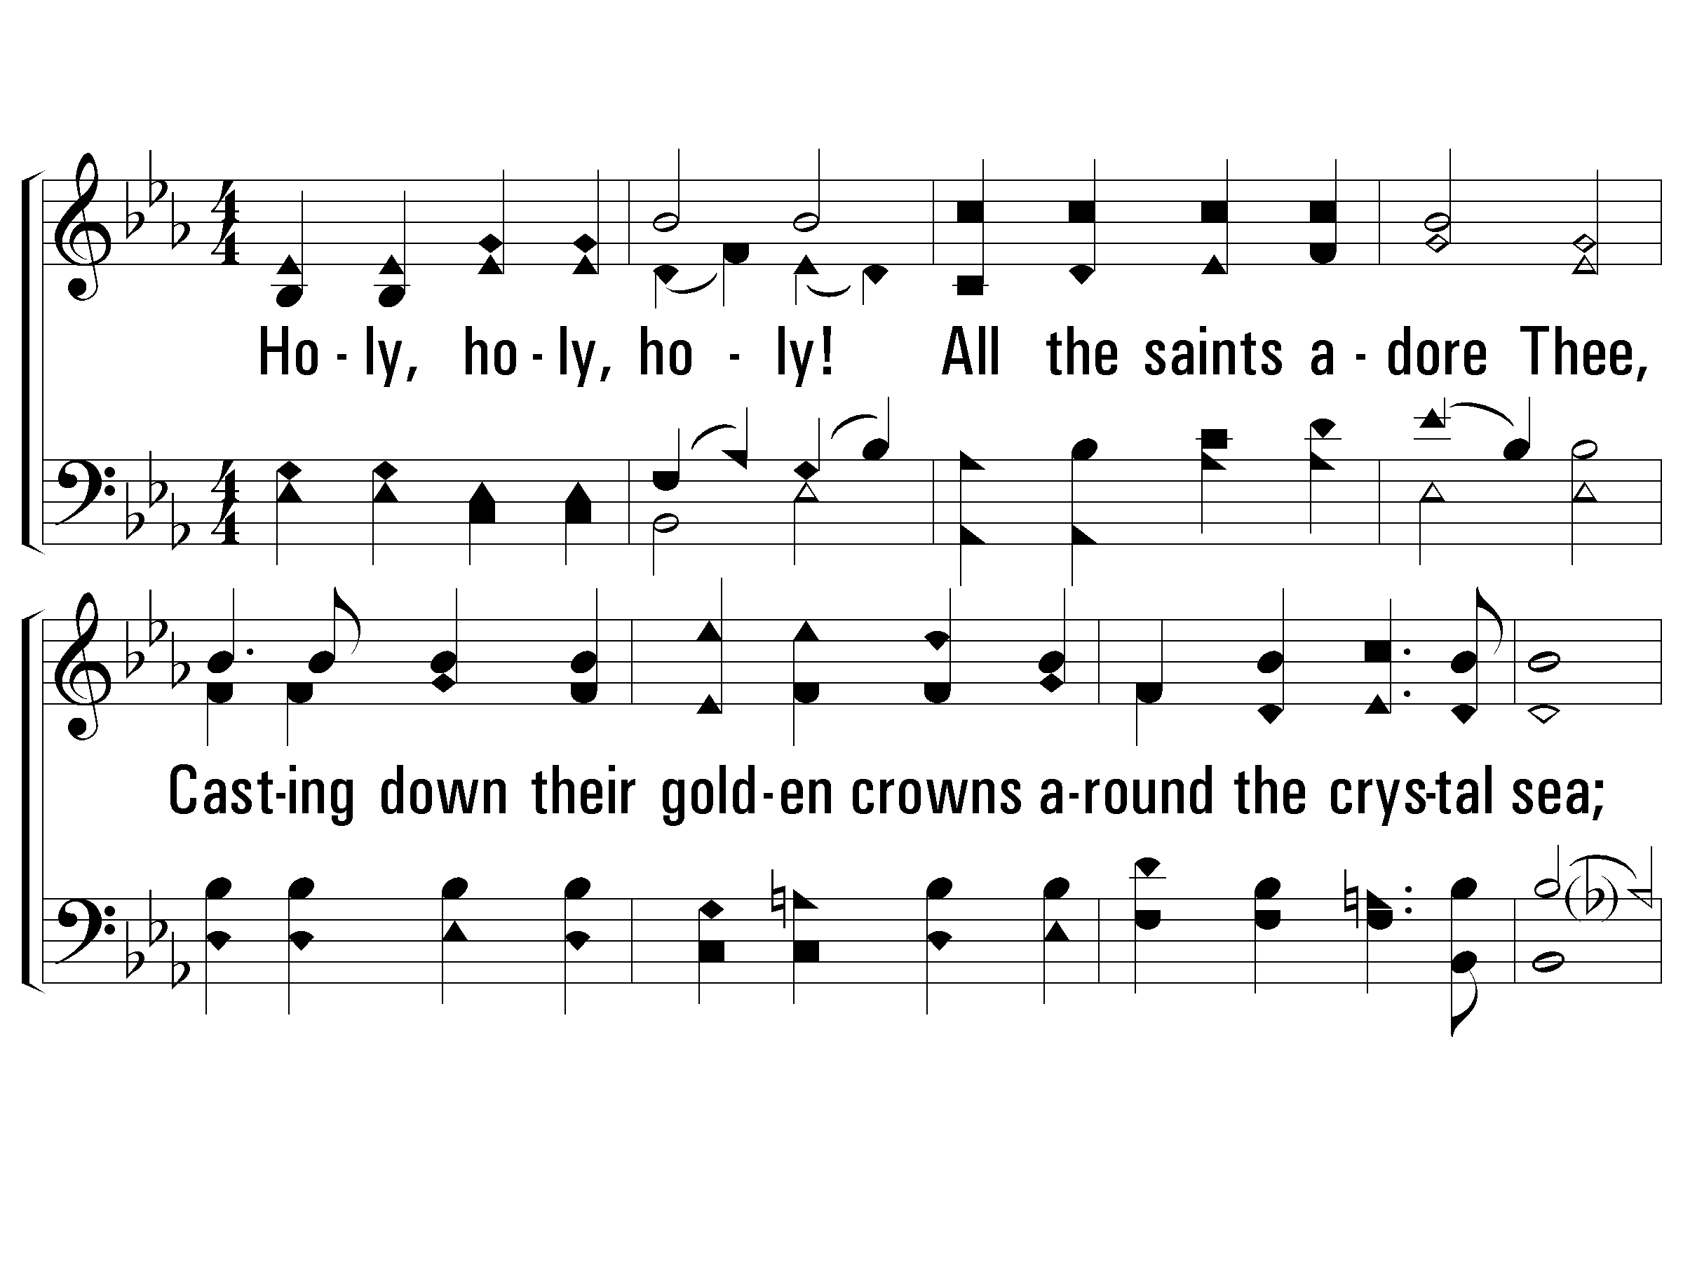
2 - Holy, Holy Holy!
2.
Holy, holy, holy! all the saints adore Thee,
Casting down their golden crowns around the crystal sea;
Cherubim and seraphim falling down before Thee,
Who wast, and art, and evermore shalt be.

Slide 60
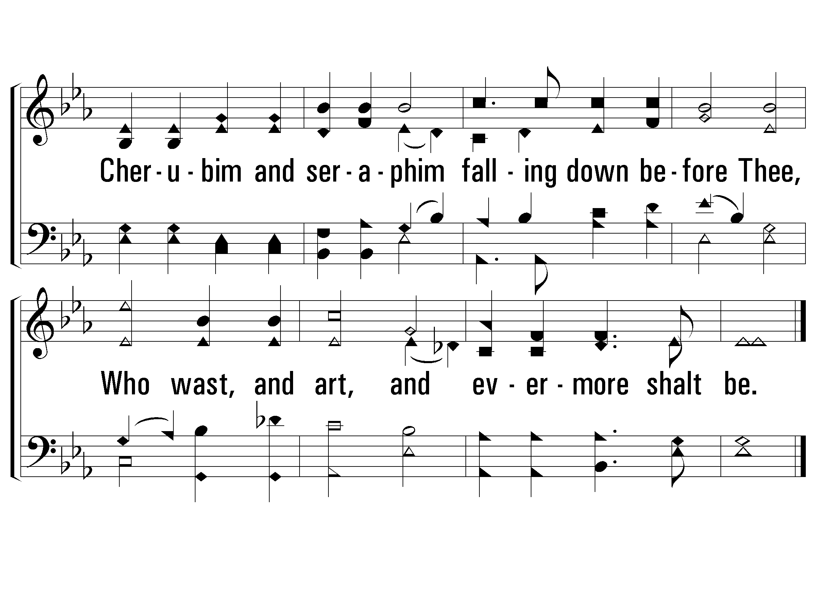
2 - Holy, Holy Holy!

Slide 61
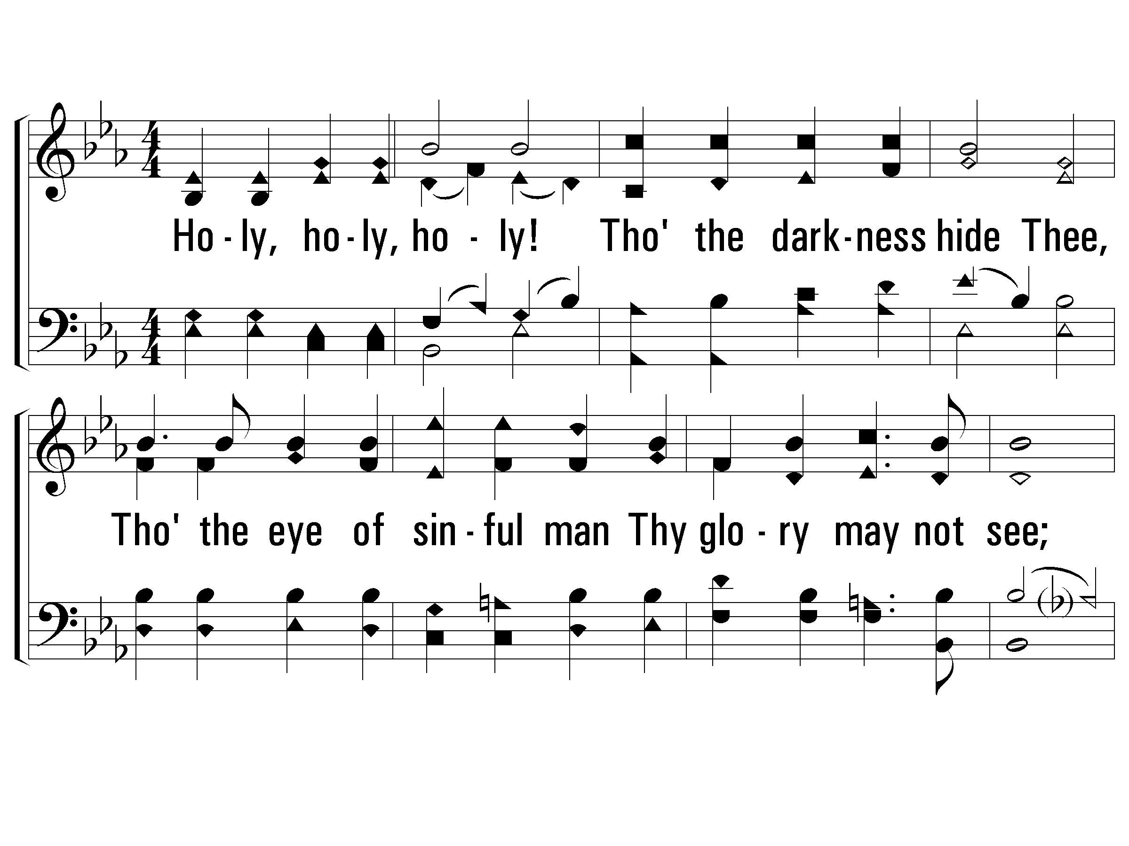
3 - Holy, Holy Holy!
3.
Holy, holy, holy! though the dark-ness hide Thee,
Though the eye of sinful man Thy glory may not see;
Only Thou art holy! there is none beside Thee,
Perfect in power, in love, and purity.

Slide 62
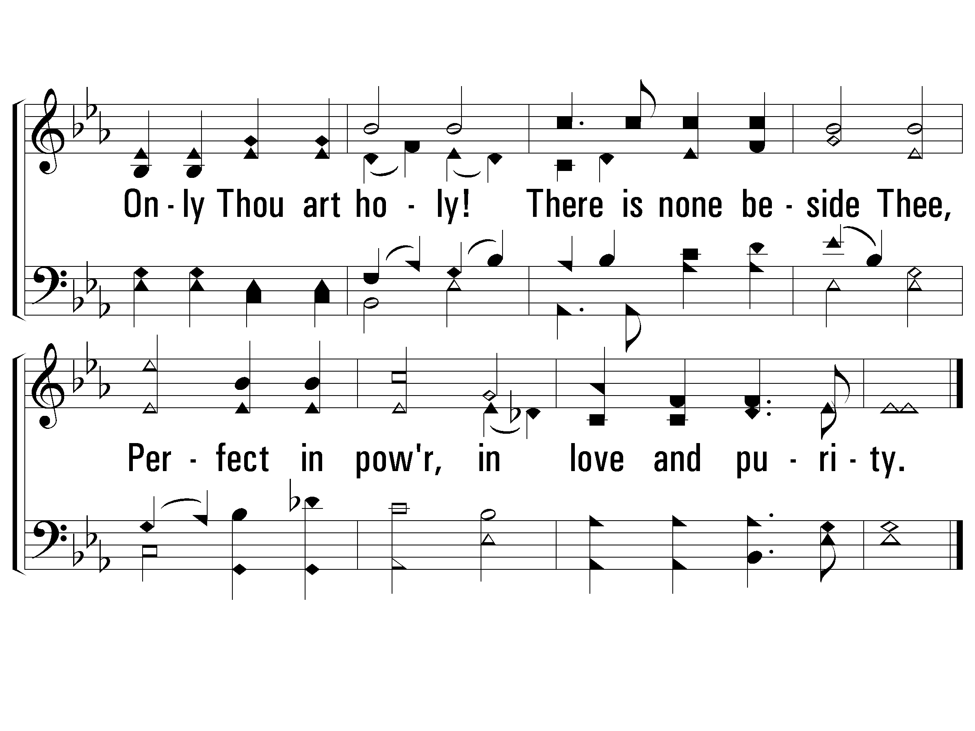
3 - Holy, Holy Holy!

Slide 63
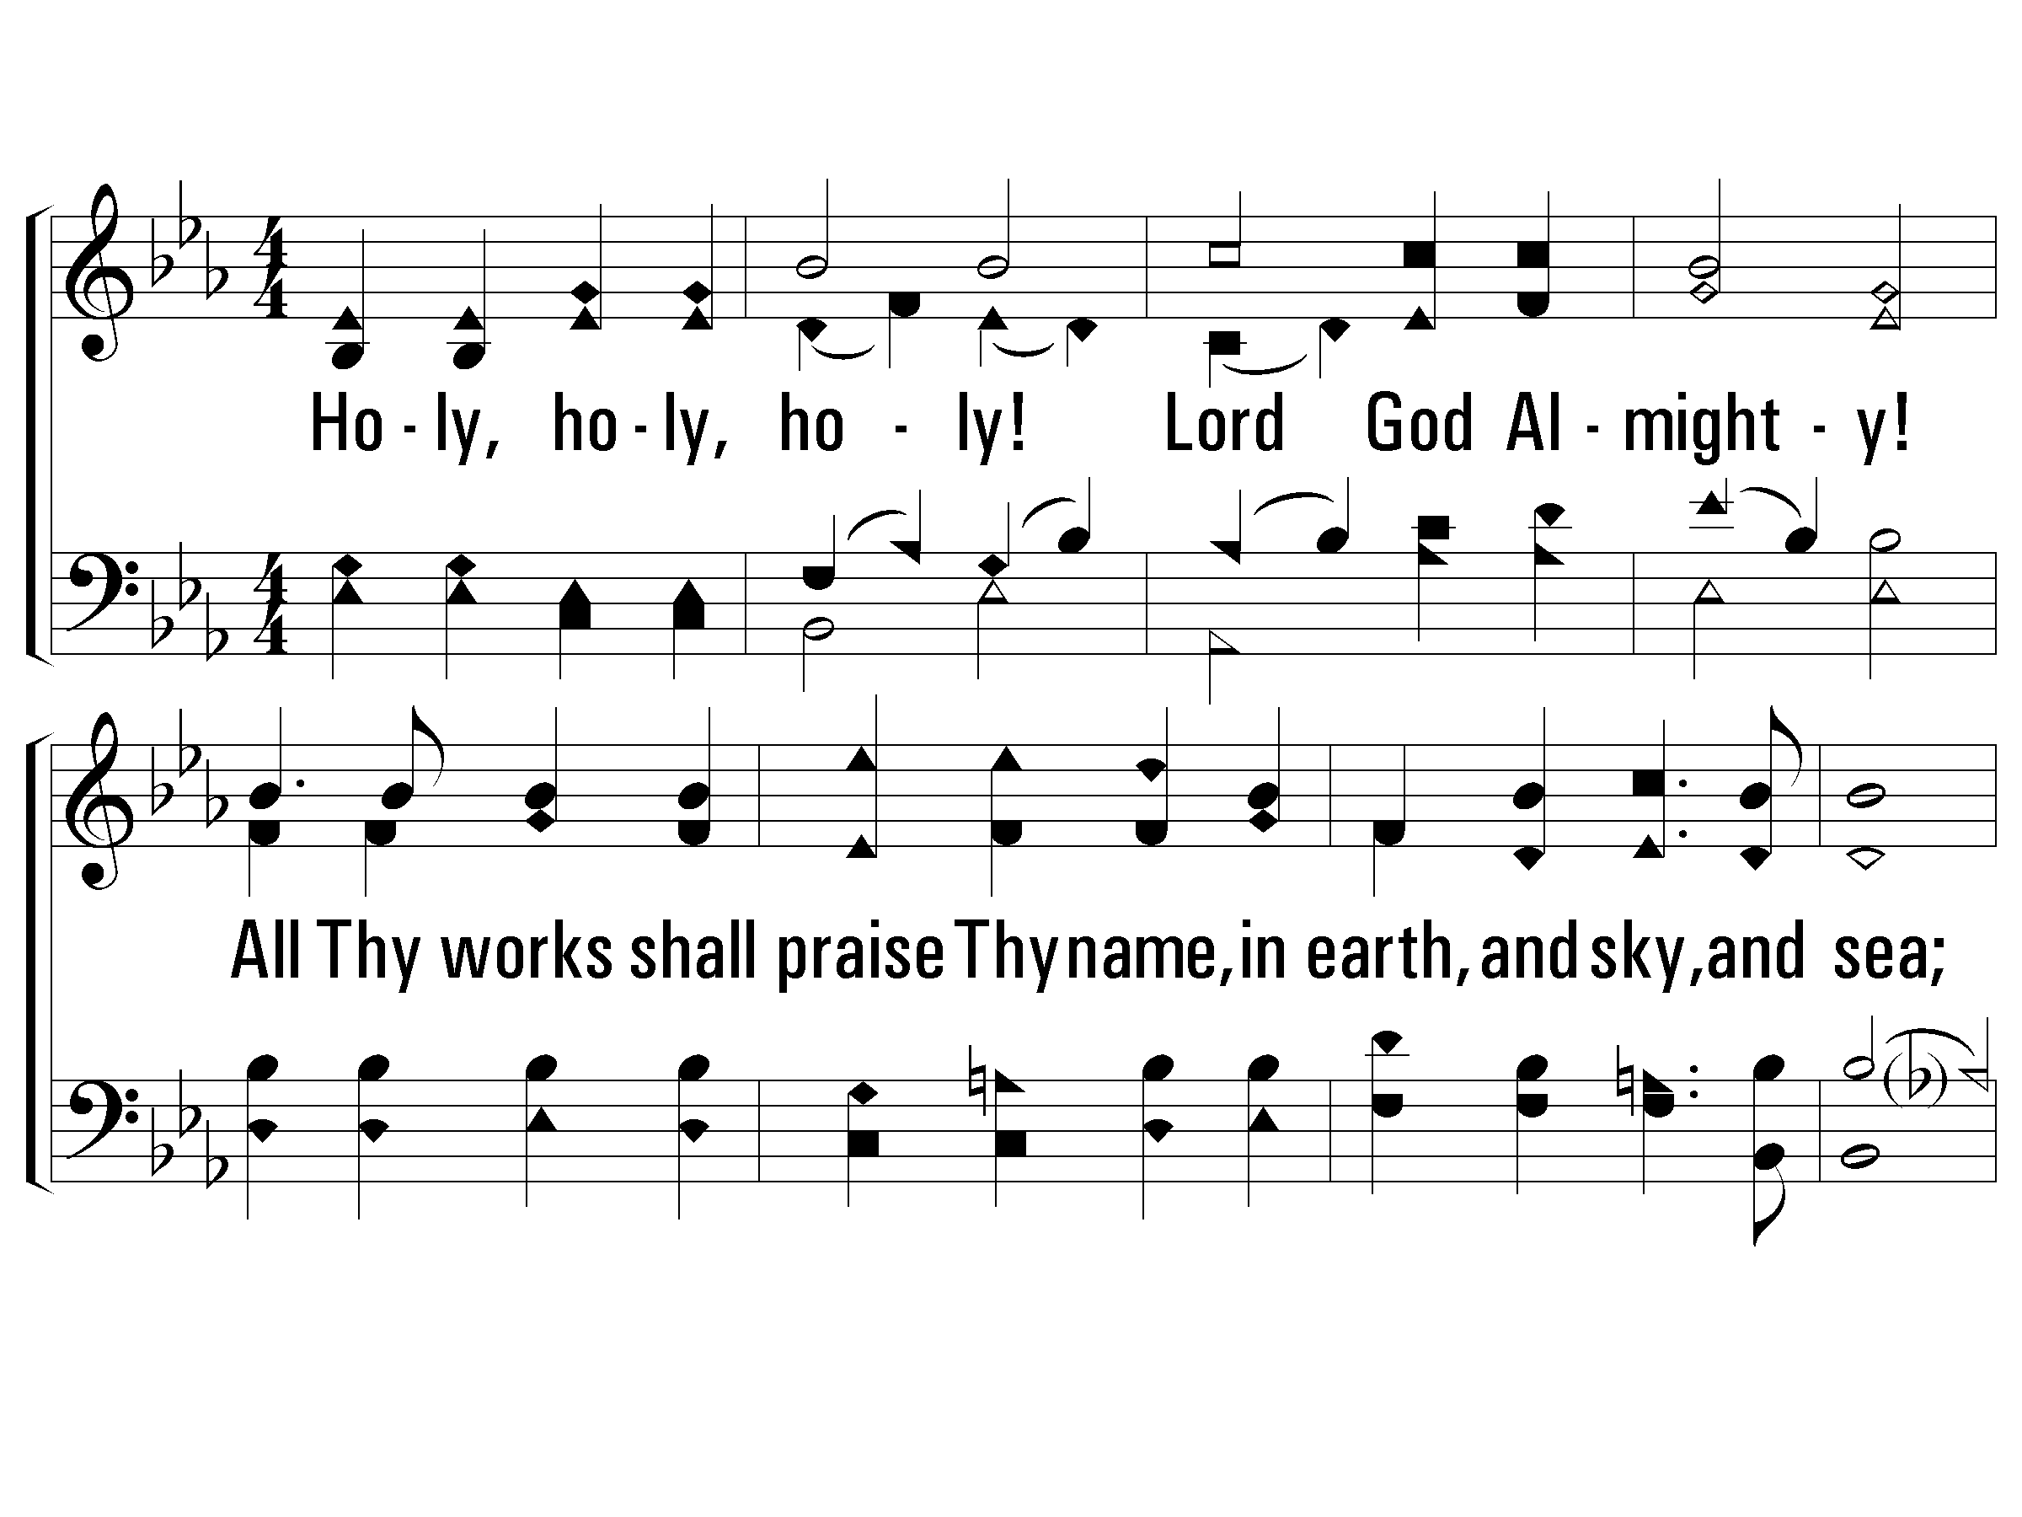
4 - Holy, Holy Holy!
4.
Holy, holy, holy! Lord God A-mighty!
All Thy works shall praise Thy name, in earth, and sky, and sea;
Holy, holy, holy! merciful and mighty!
God over all, and blest eternally.

Slide 64
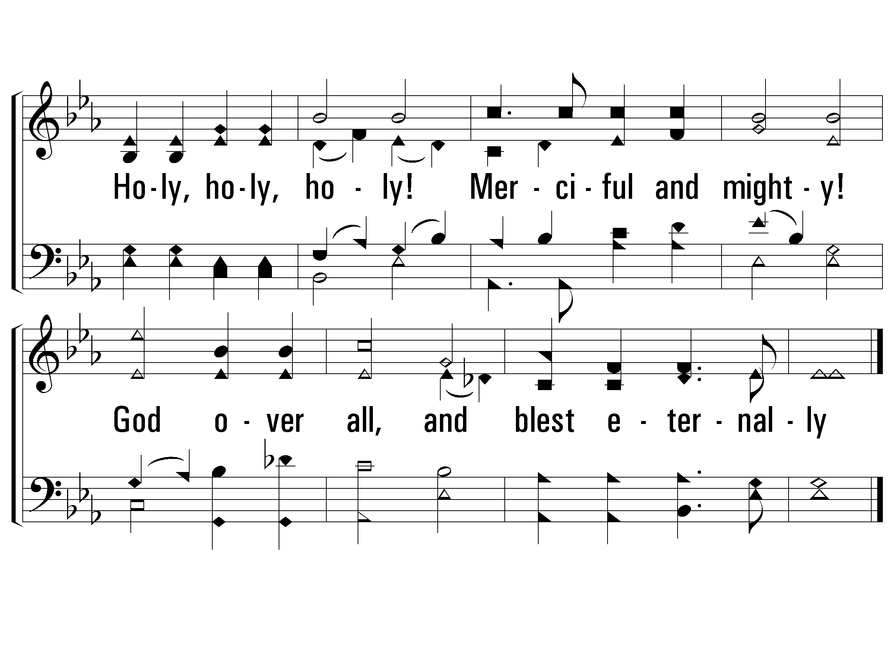
4 - Holy, Holy Holy!

Slide 66
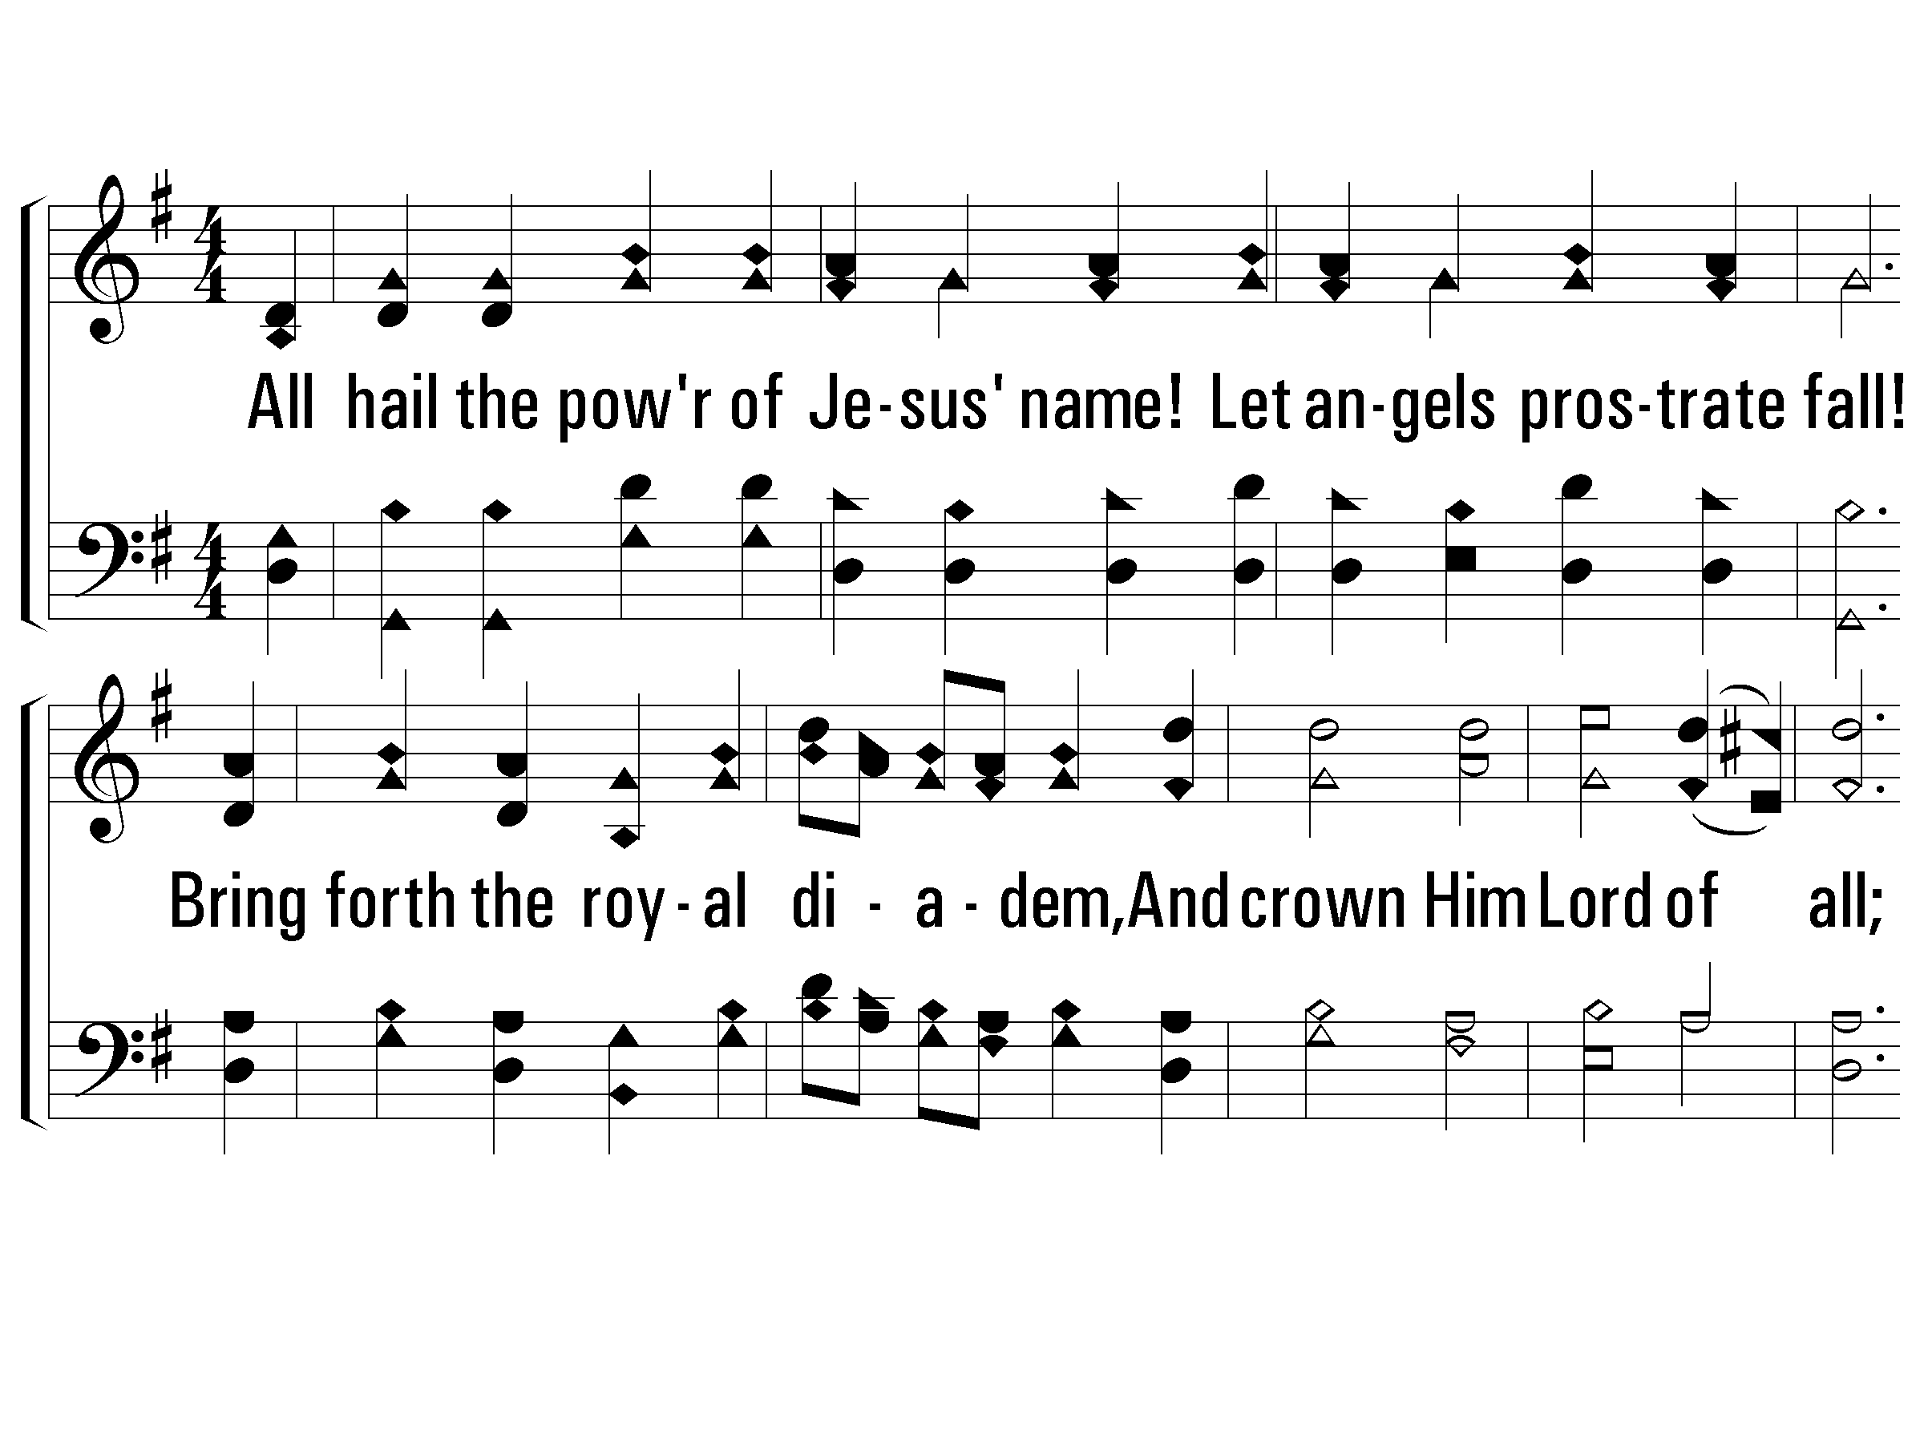
1 – All Hail the Power of Jesus’ Name
1.
All hail the power of Jesus' name!
Let angels prostrate fall!
Bring forth the royal diadem,
And crown Him Lord of all;
Bring forth the royal diadem,
And crown Him Lord of all.

Slide 67
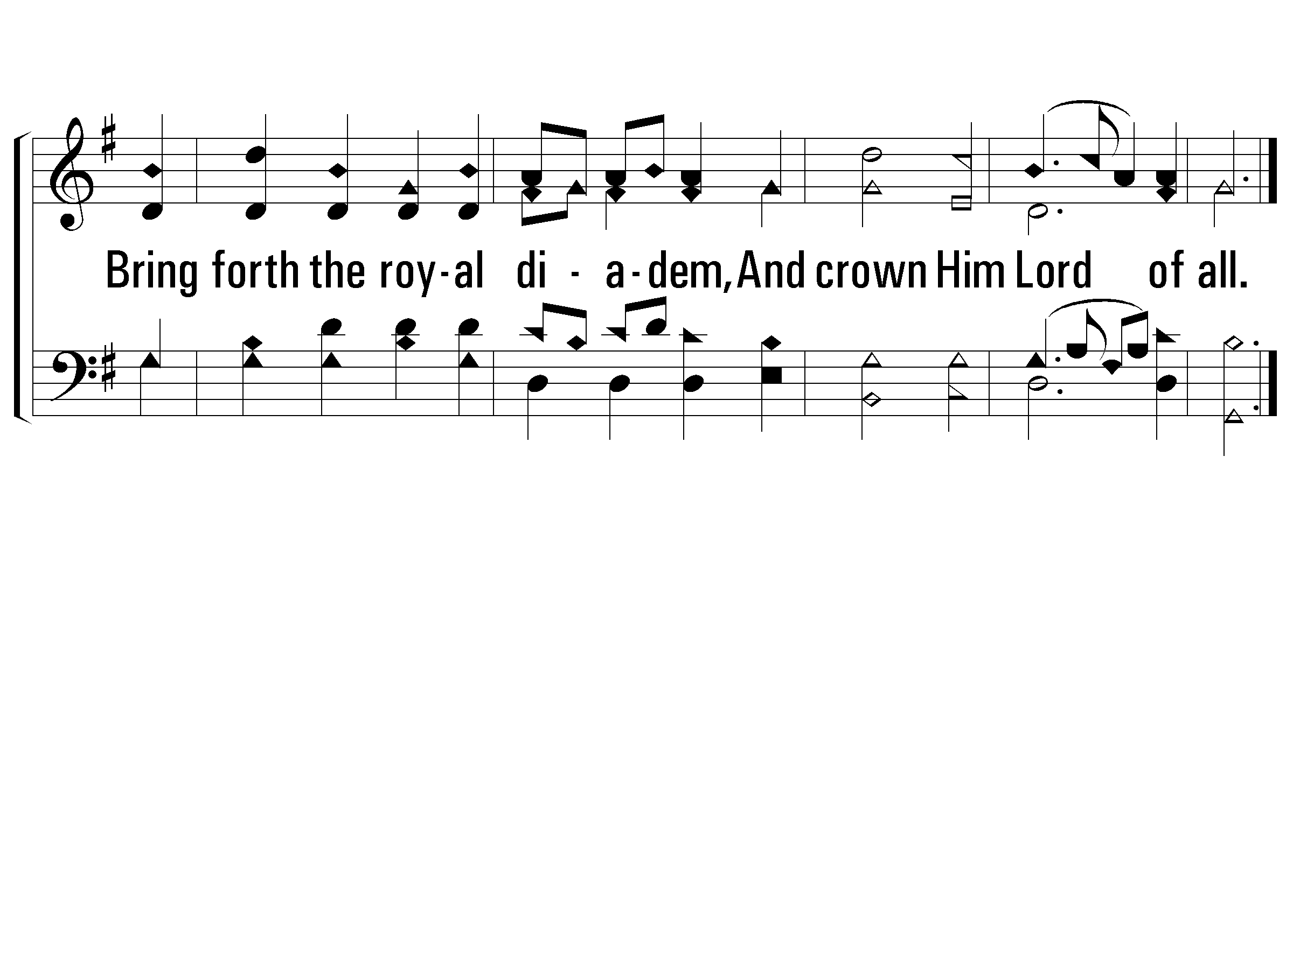
1 – All Hail the Power of Jesus’ Name

Slide 68
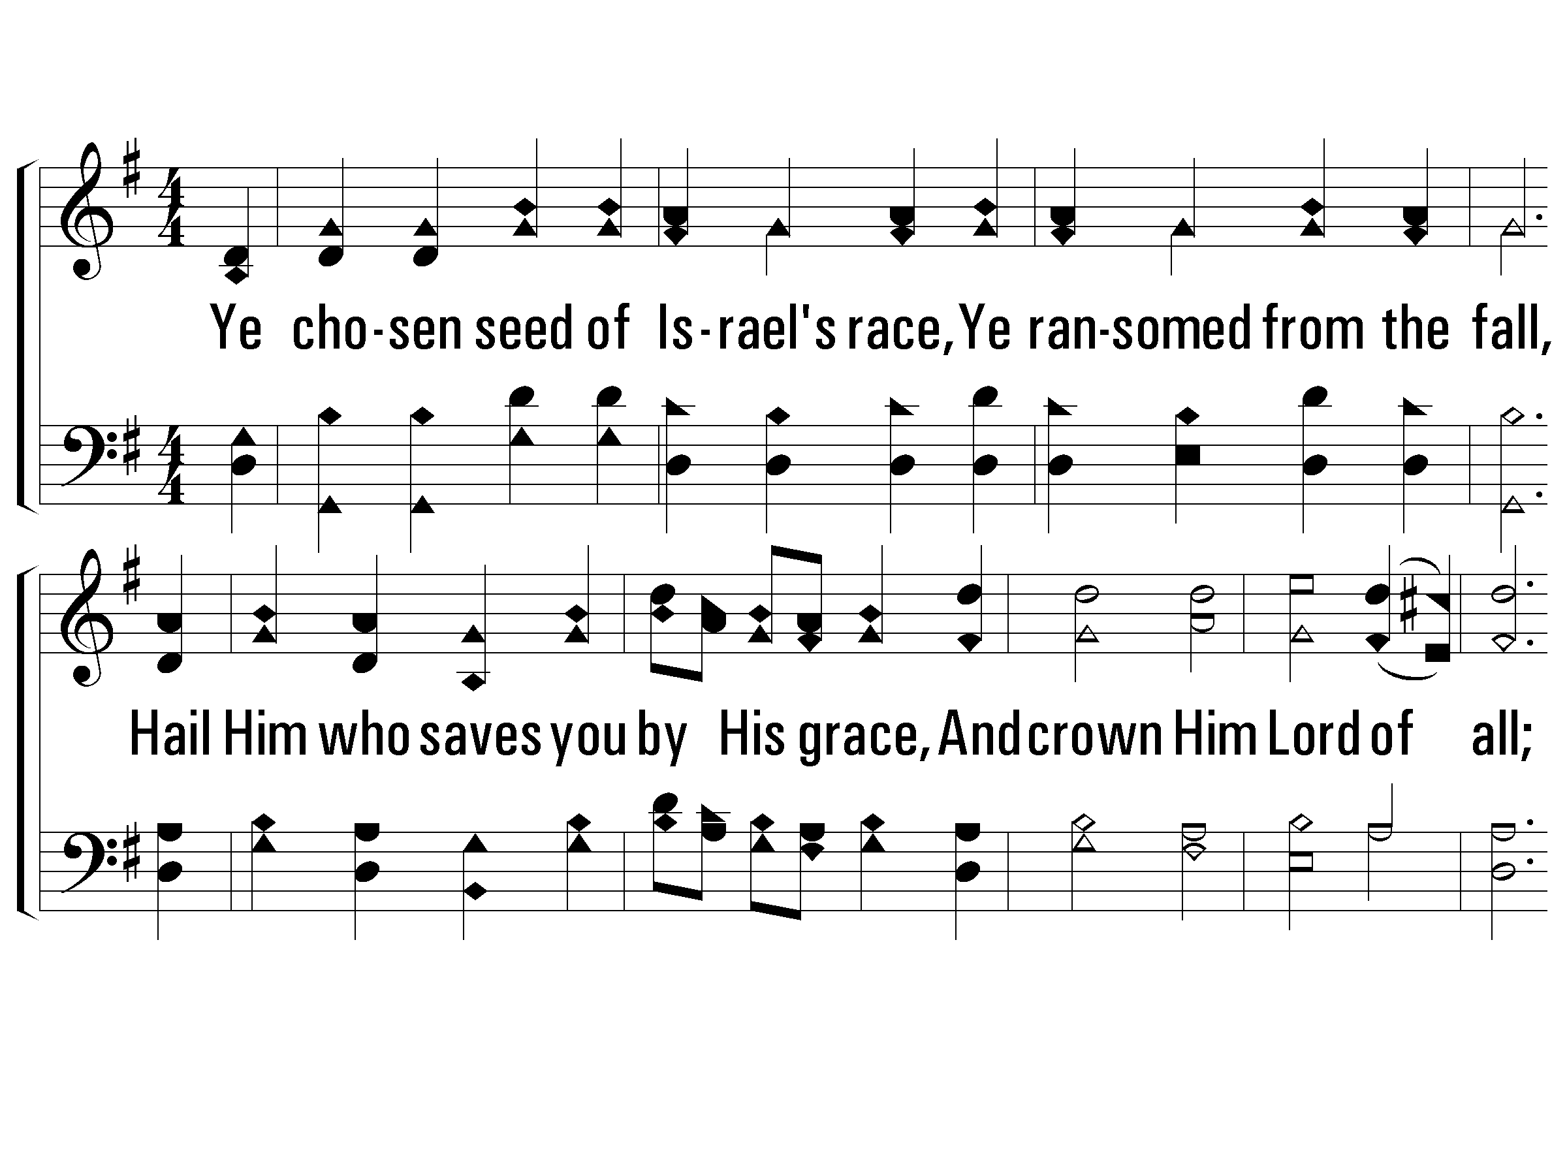
2 – All Hail the Power of Jesus’ Name
2.
Ye chosen seed of Israel's race,
Ye ransomed from the fall,
Hail Him who saves you by His grace,
And crown Him Lord of all;
Hail Him who saves you by His grace,
And crown Him Lord of all.

Slide 69
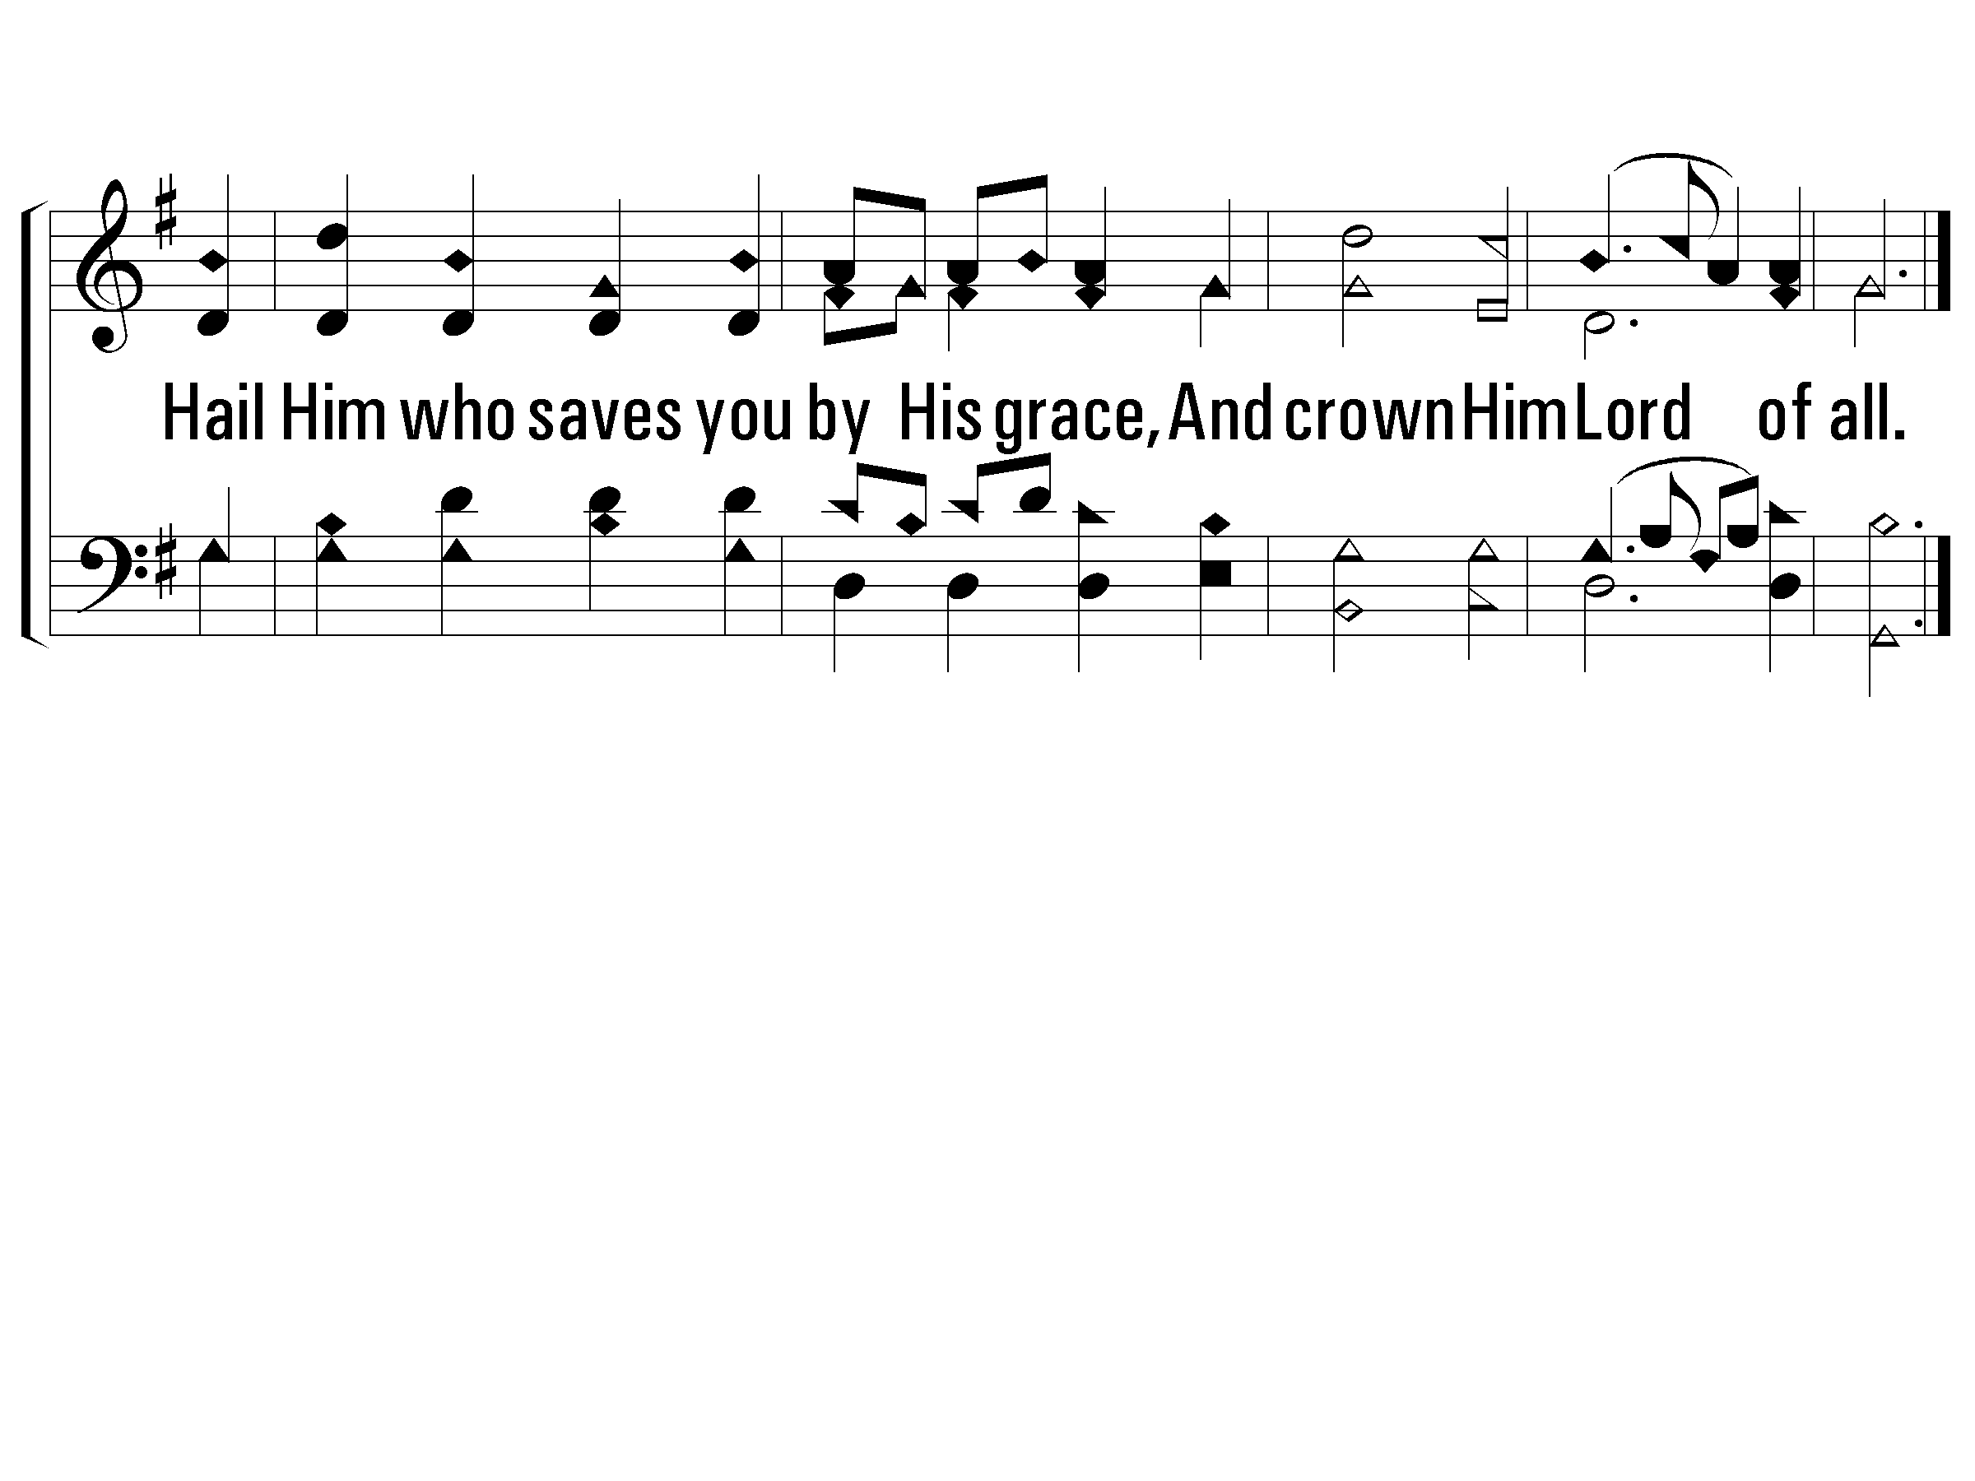
2 – All Hail the Power of Jesus’ Name

Slide 70
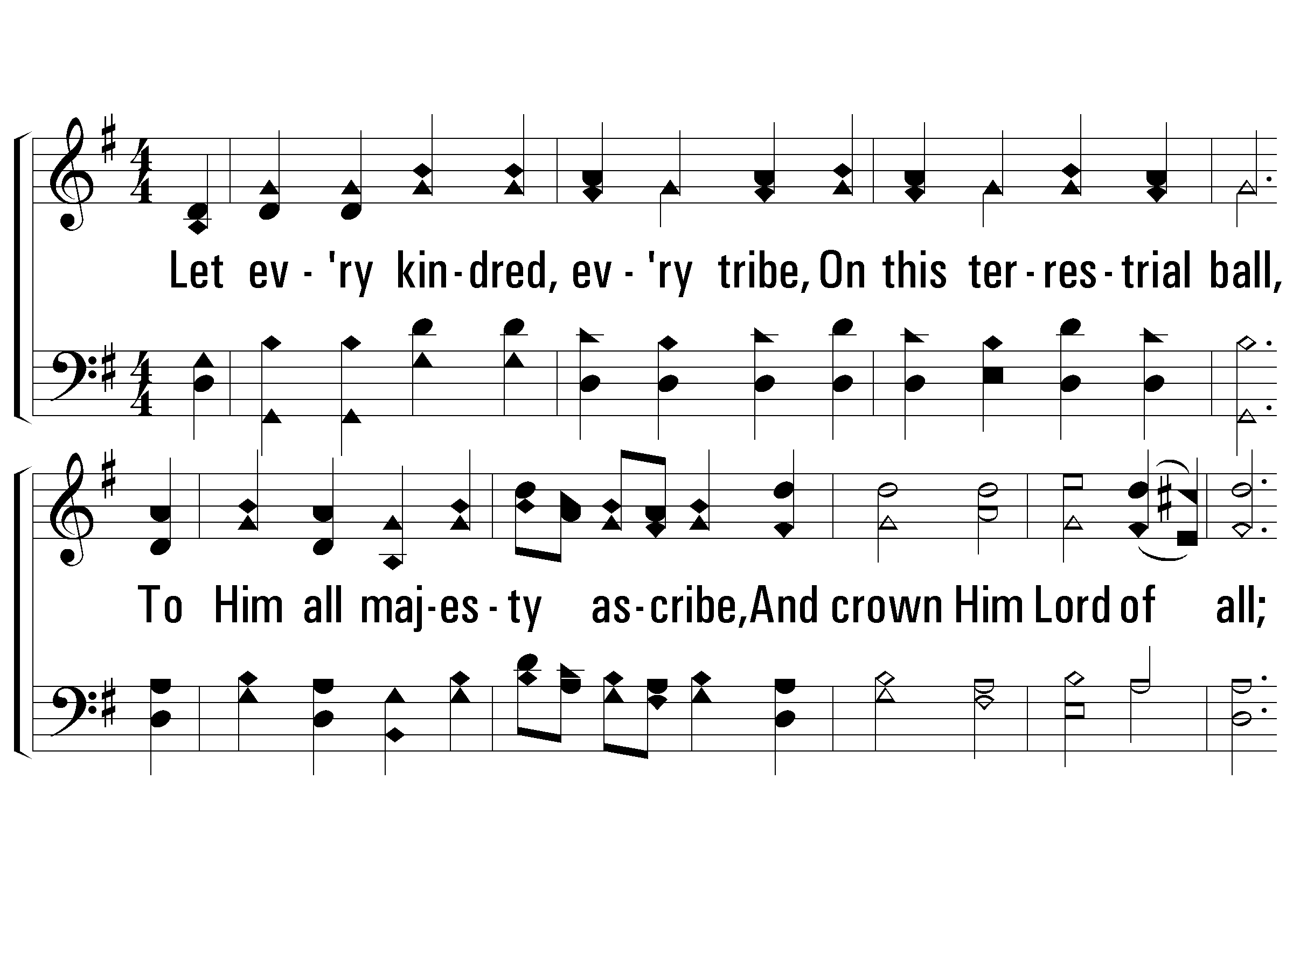
3 – All Hail the Power of Jesus’ Name

Slide 71
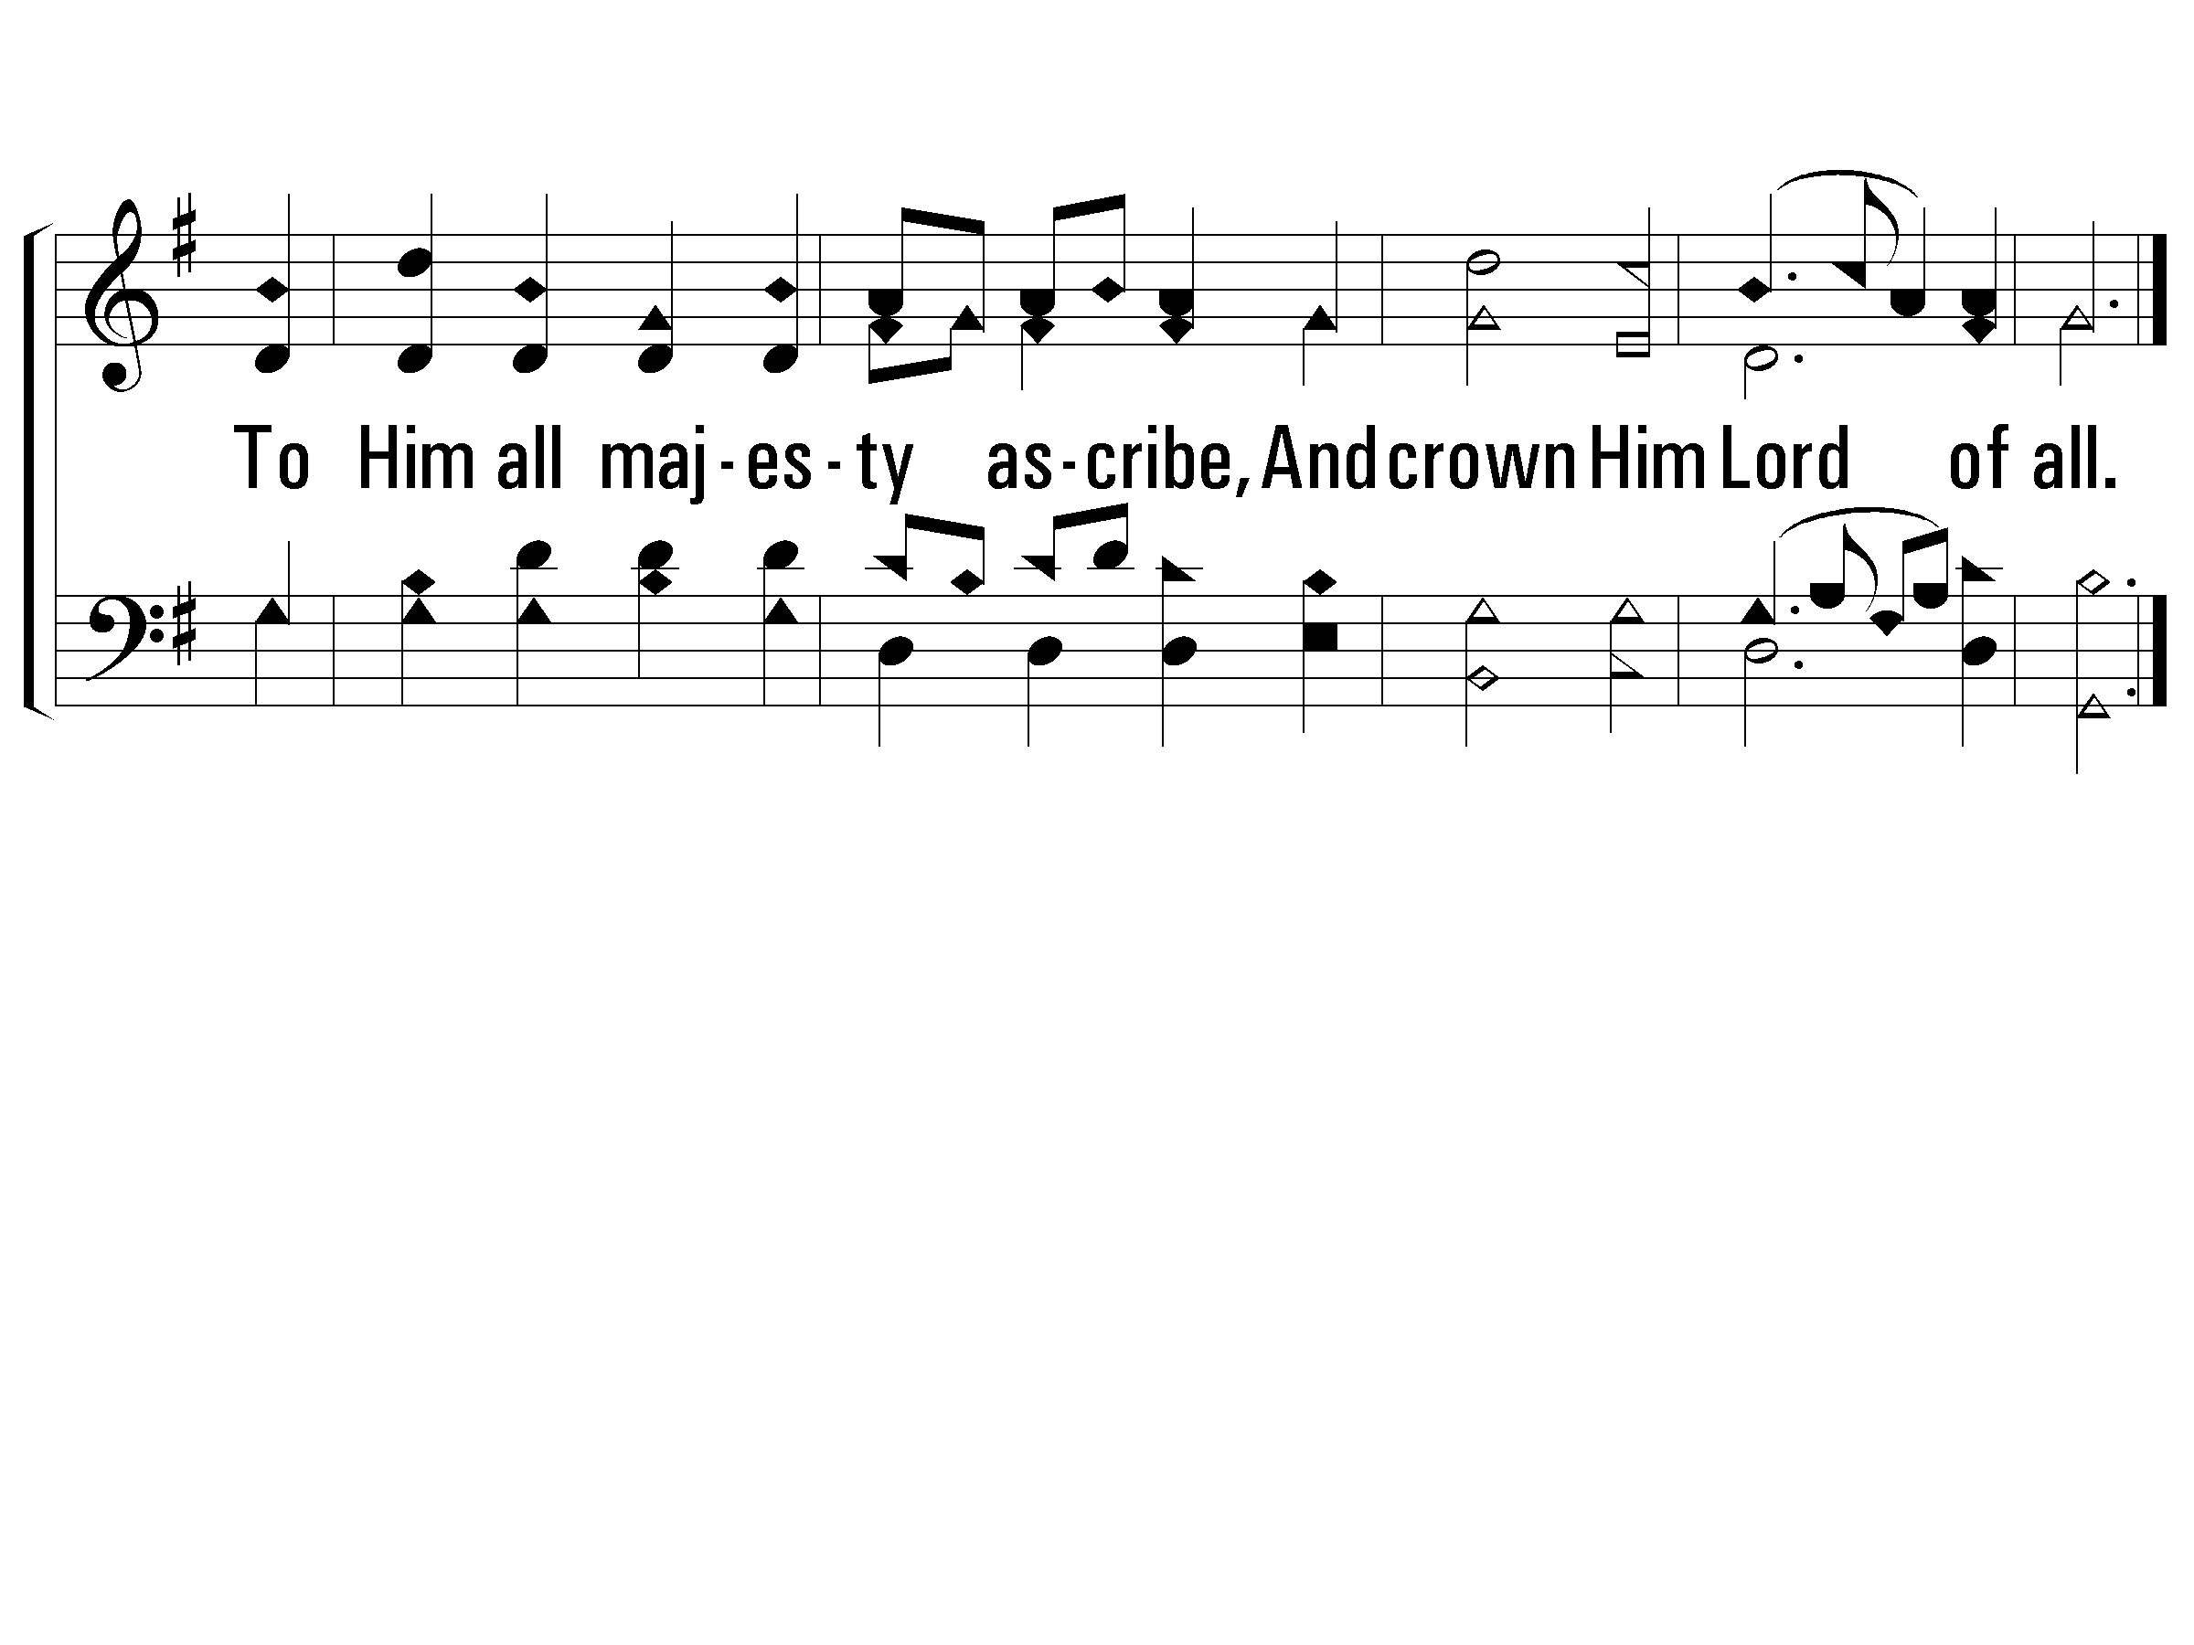
3 – All Hail the Power of Jesus’ Name

Slide 72
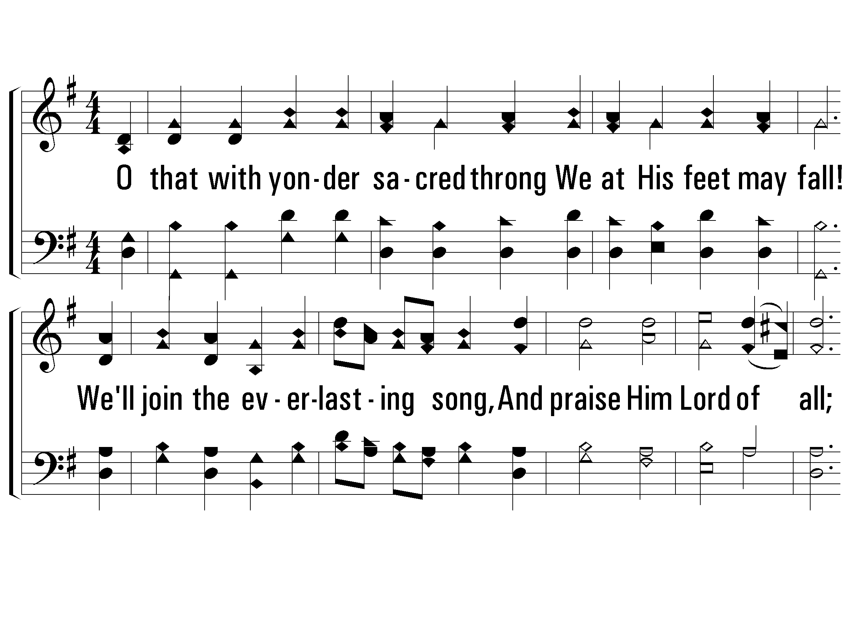
4 – All Hail the Power of Jesus’ Name
4.
O that with yonder sacred throng
We at His feet may fall!
We'll join the everlasting song,
And praise Him Lord of all;
We'll join the everlasting song,
And praise Him Lord of all.

Slide 73
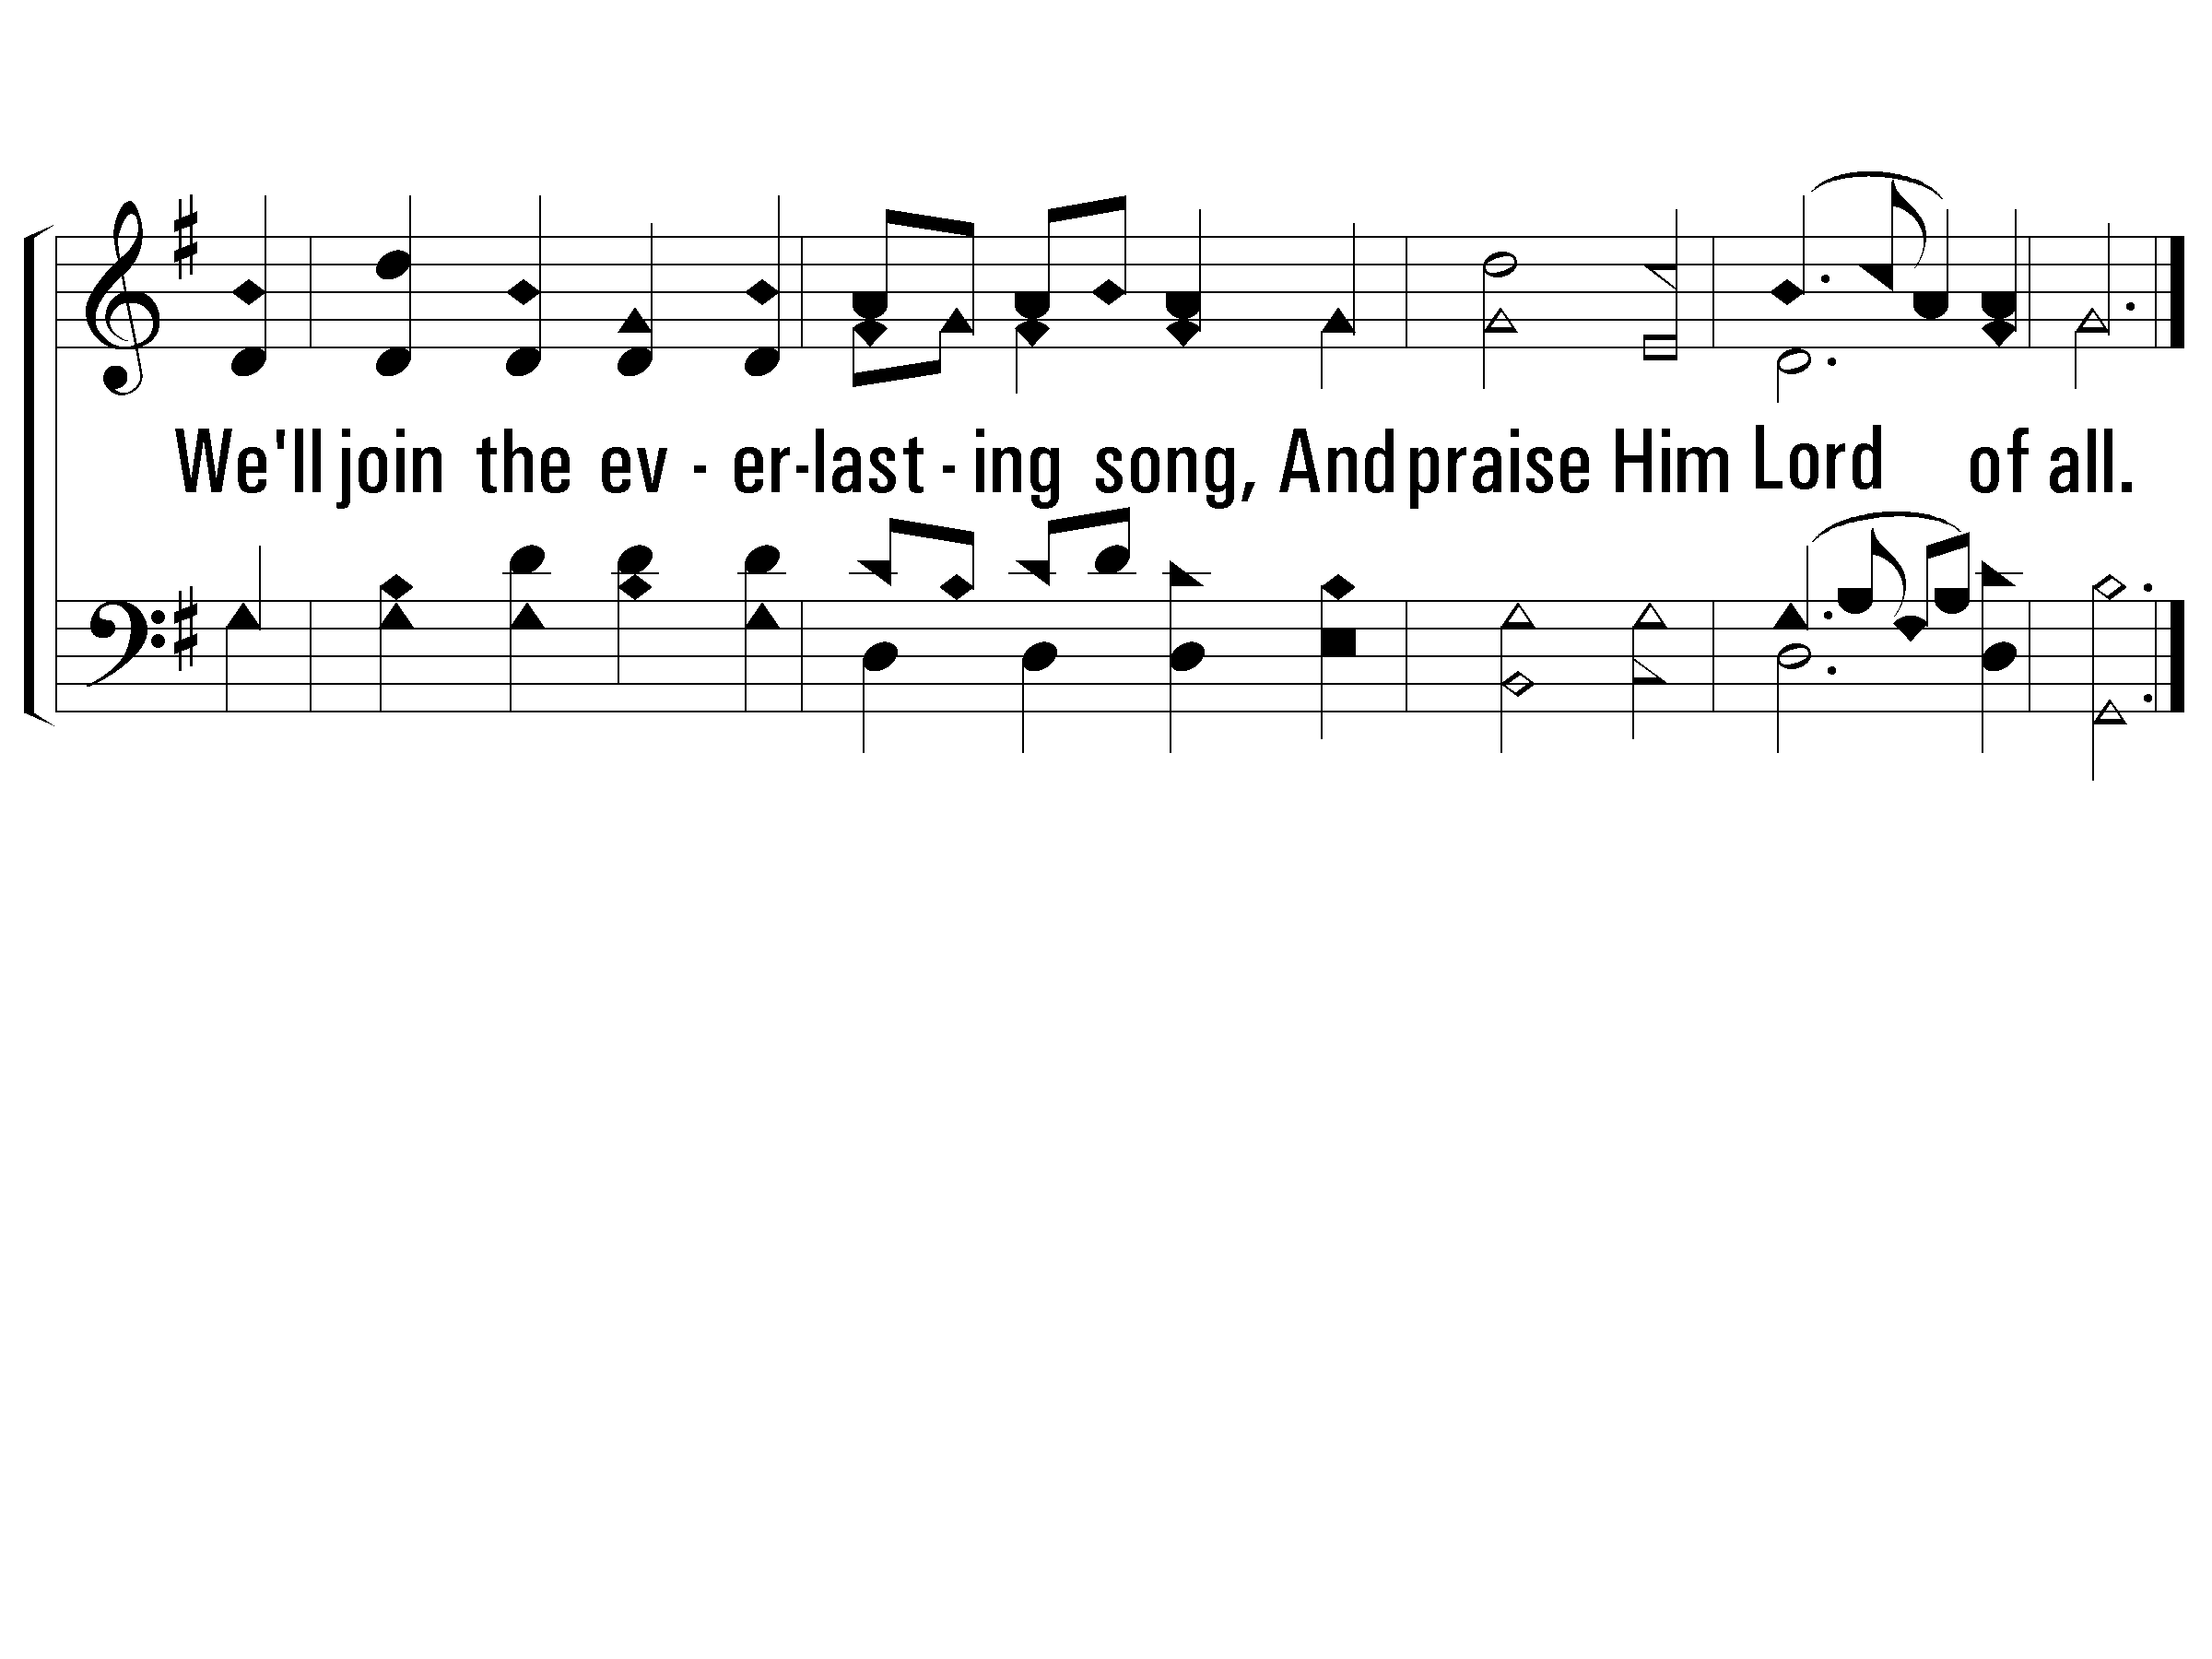
4 – All Hail the Power of Jesus’ Name

Slide 75
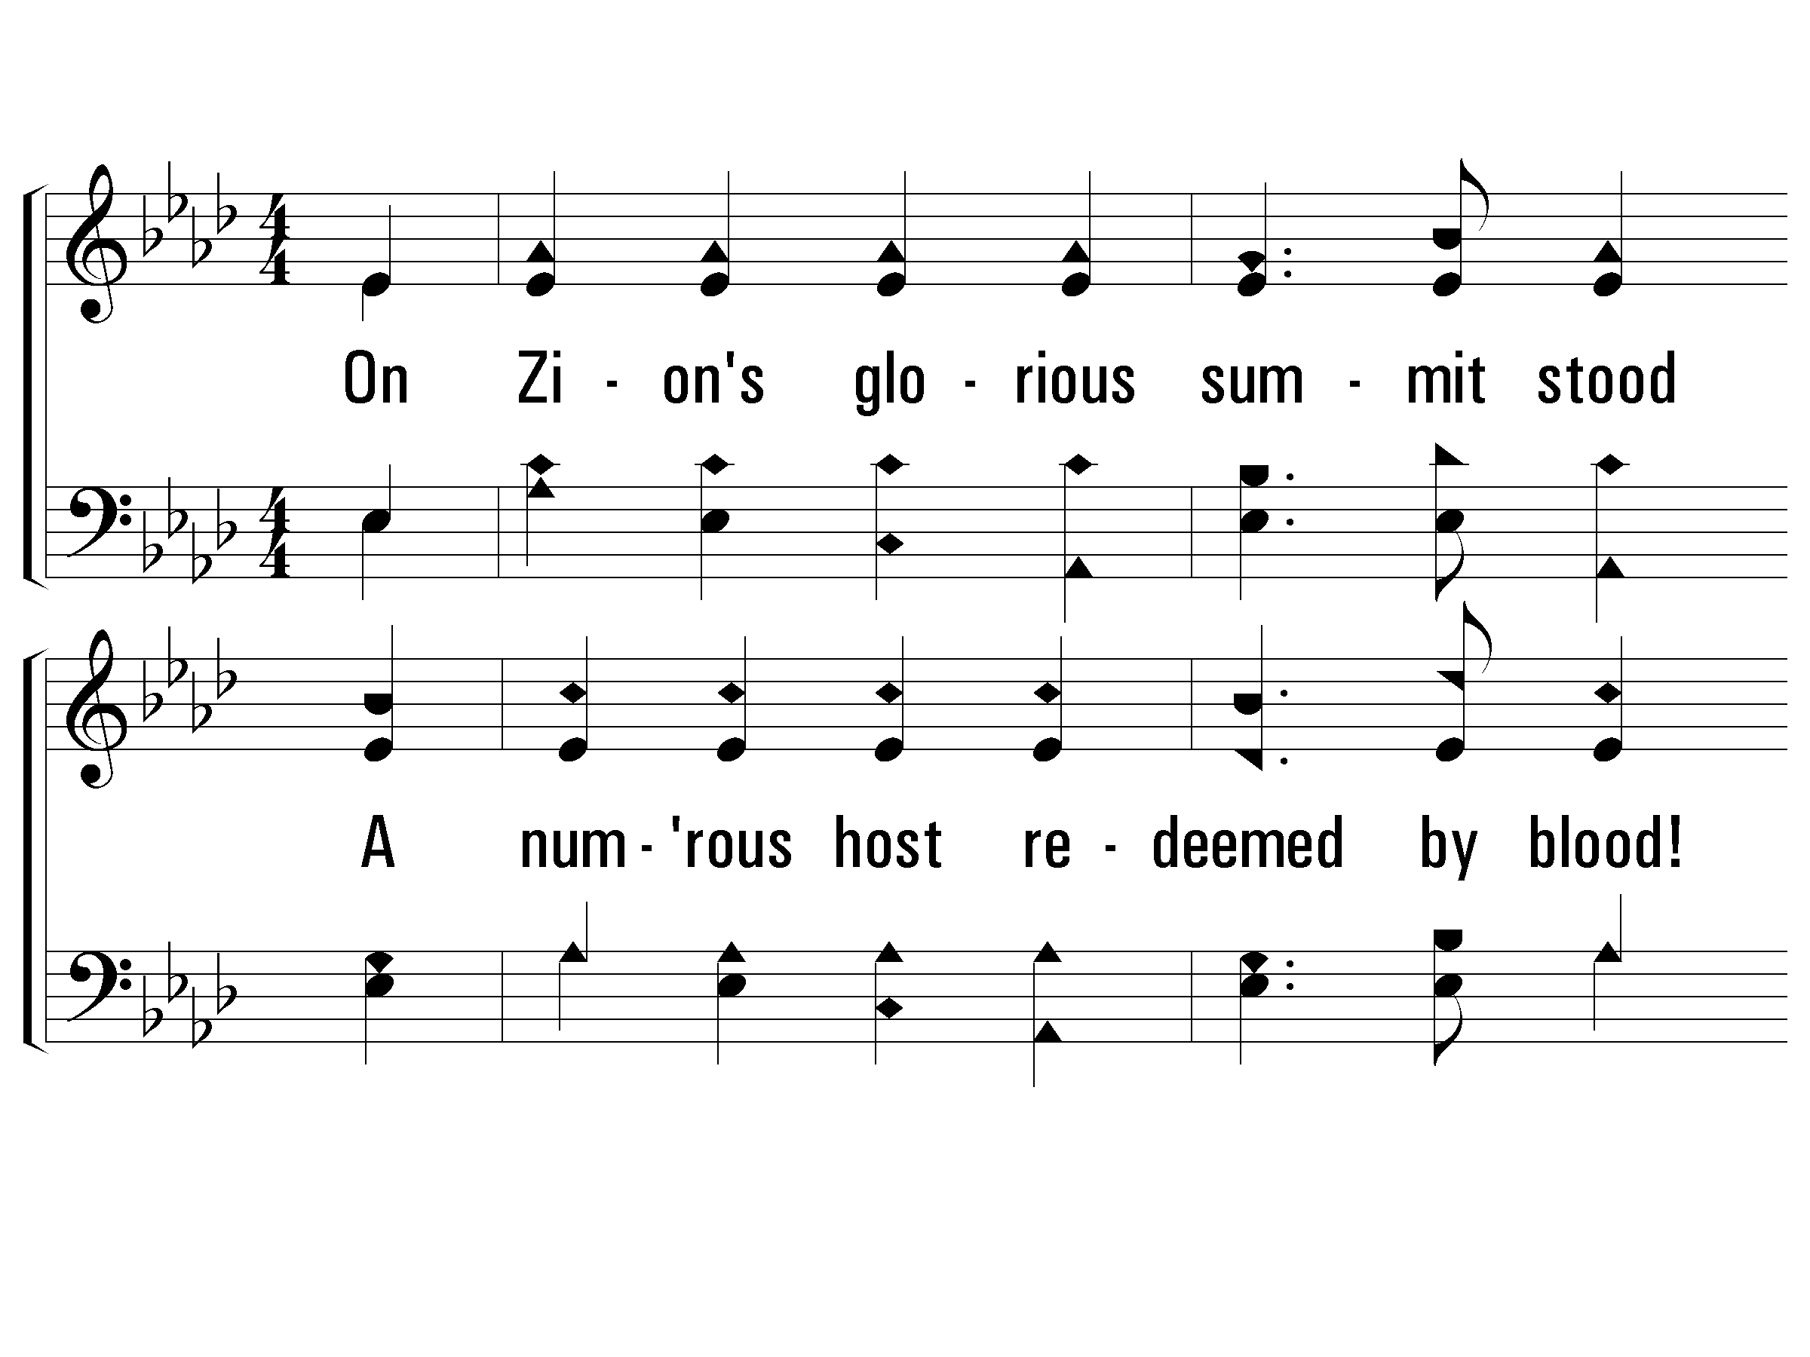
1 – On Zion’s Glorious Summit
1.
On Zion's glorious summit stood
A numerous host redeemed by blood!
They hymned their King in strains divine;
I heard the song and strove to join,
I heard the song and strove to join.

Slide 76
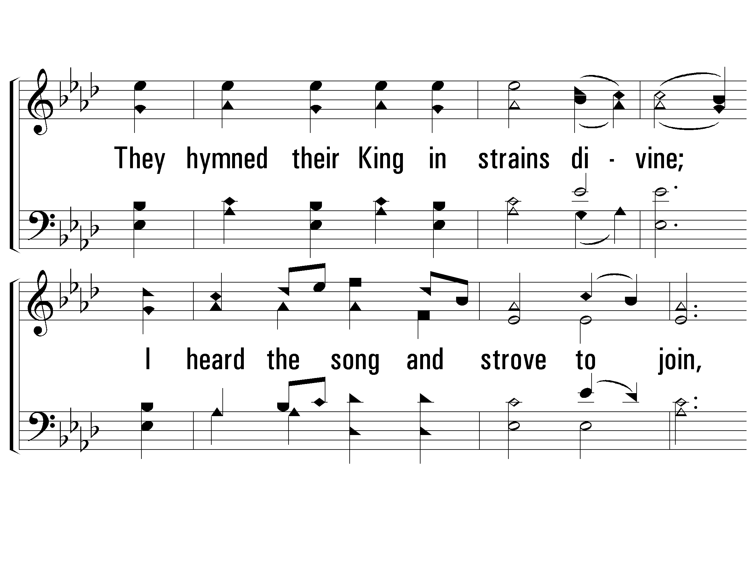
1 – On Zion’s Glorious Summit

Slide 77
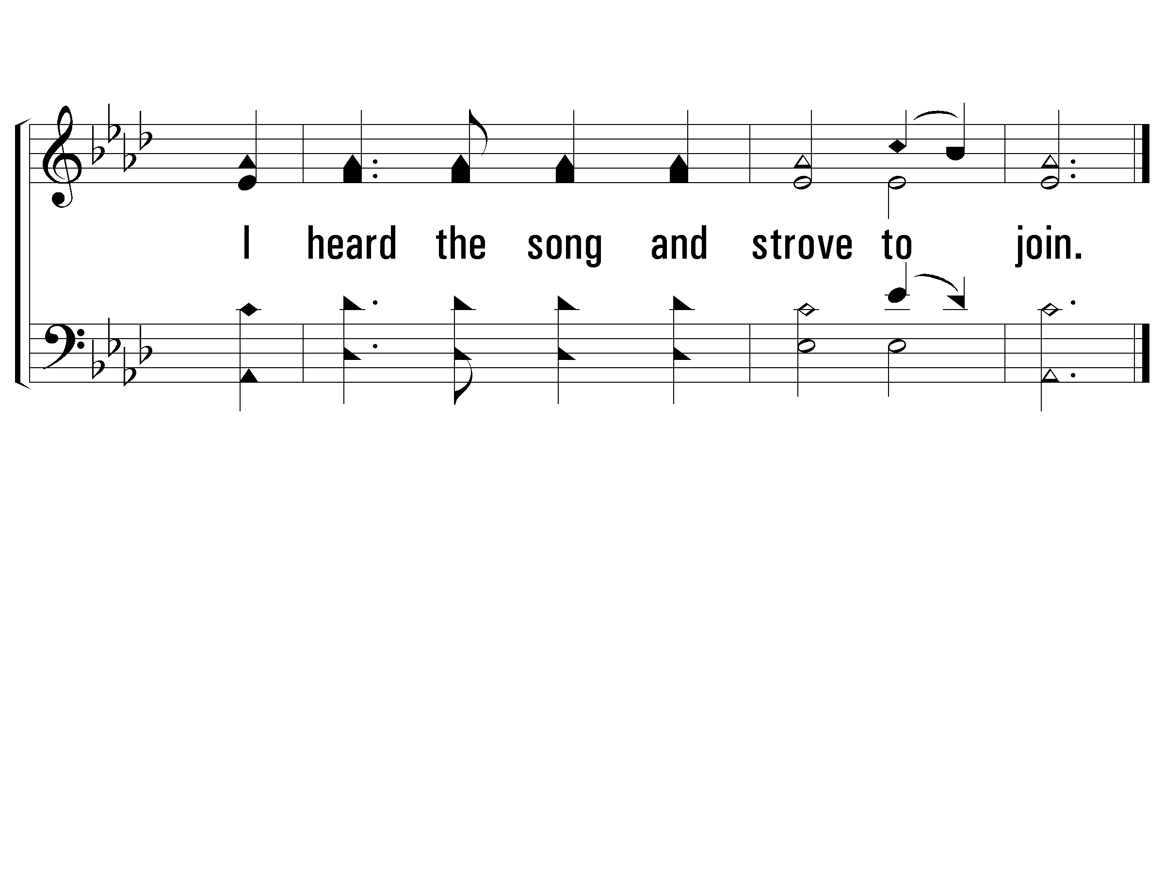
1 – On Zion’s Glorious Summit

Slide 78
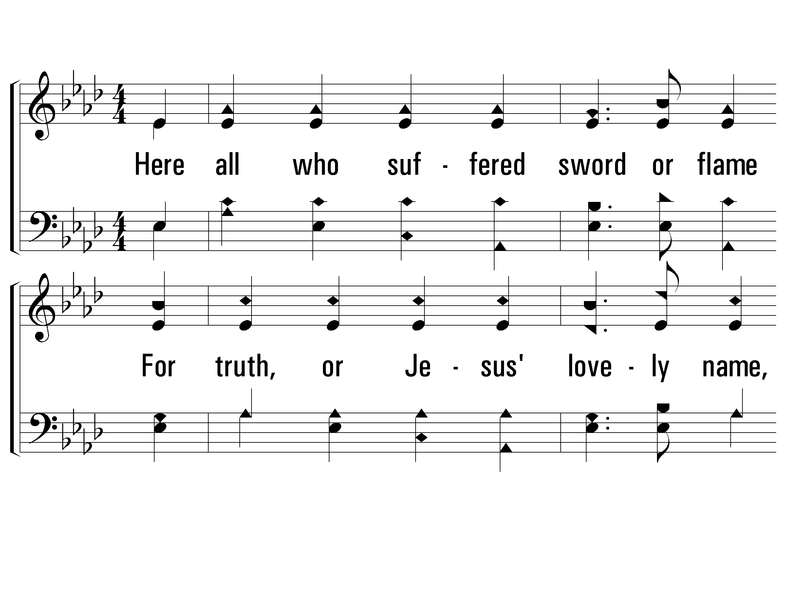
2 – On Zion’s Glorious Summit
2.
Here all who suffered sword or flame
For truth, or Jesus' lovely name,
Shout victory now and hail the Lamb,
And bow before the great I AM,
And bow before the great I AM.

Slide 79
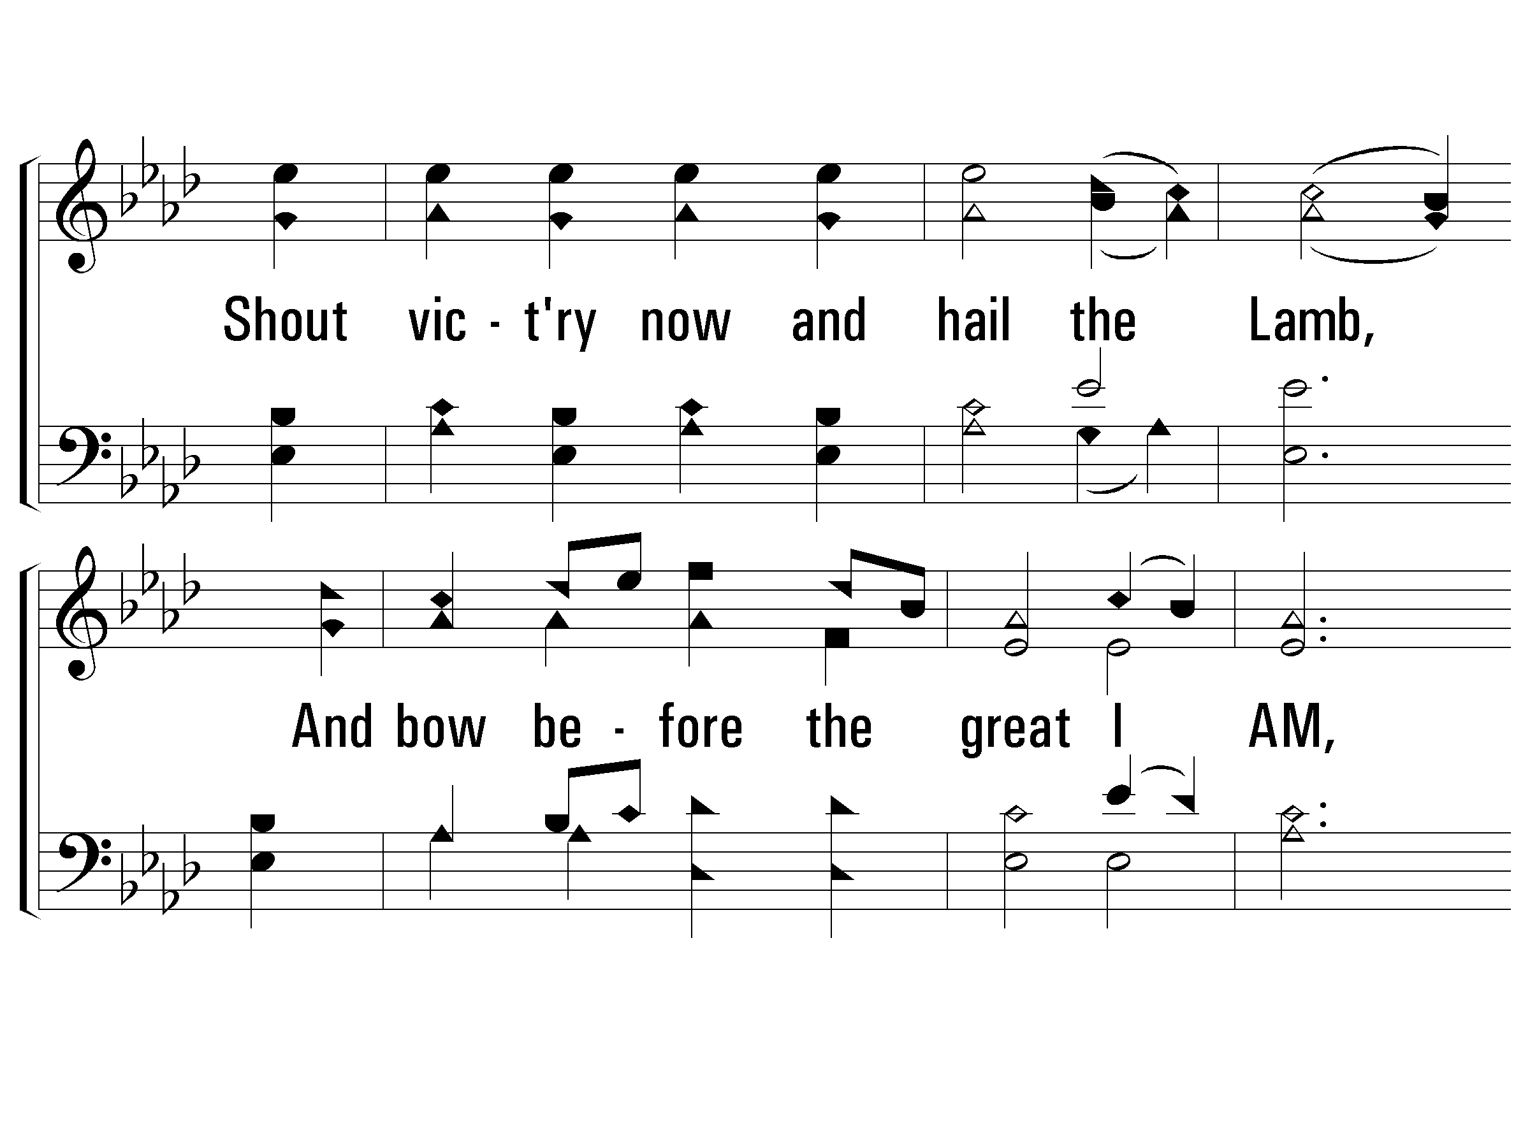
2 – On Zion’s Glorious Summit

Slide 80
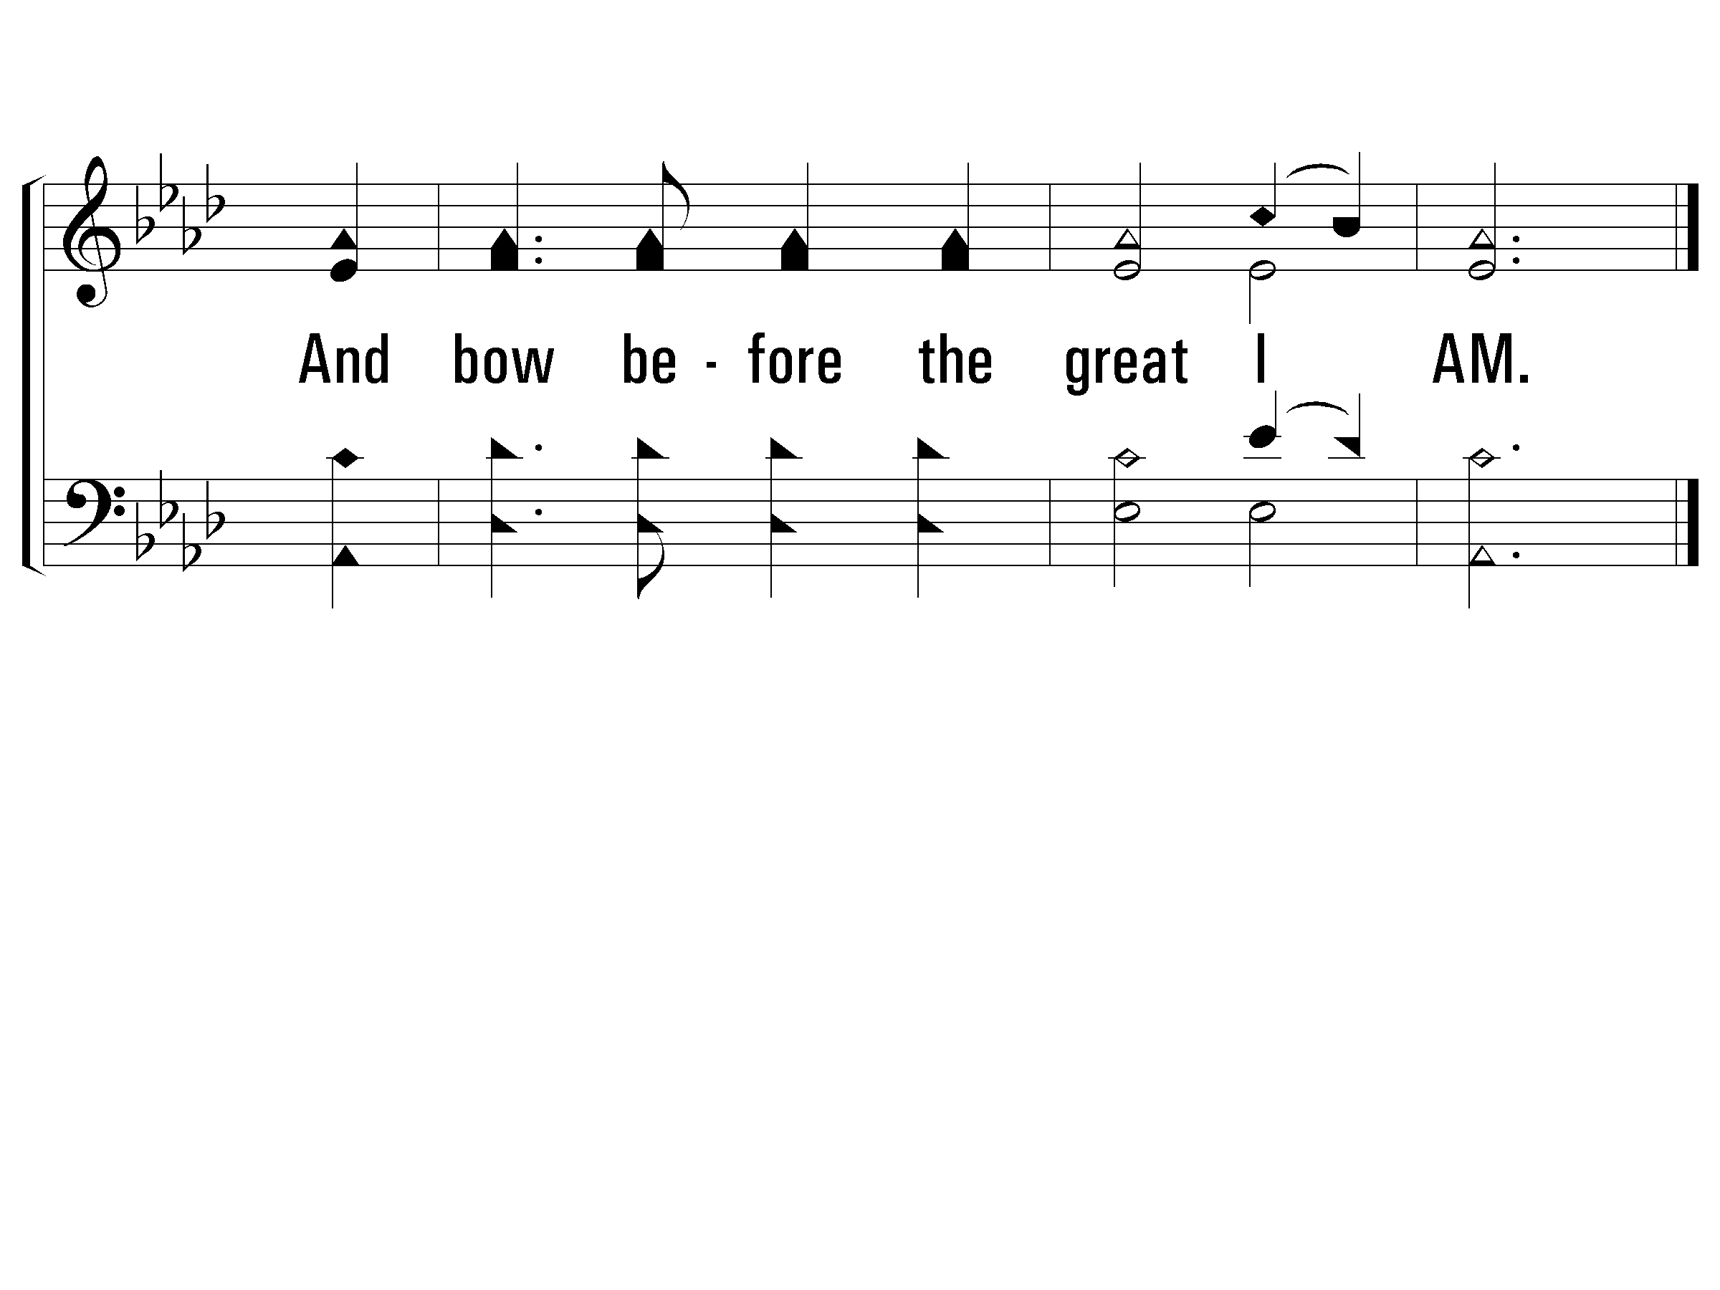
2 – On Zion’s Glorious Summit

Slide 81
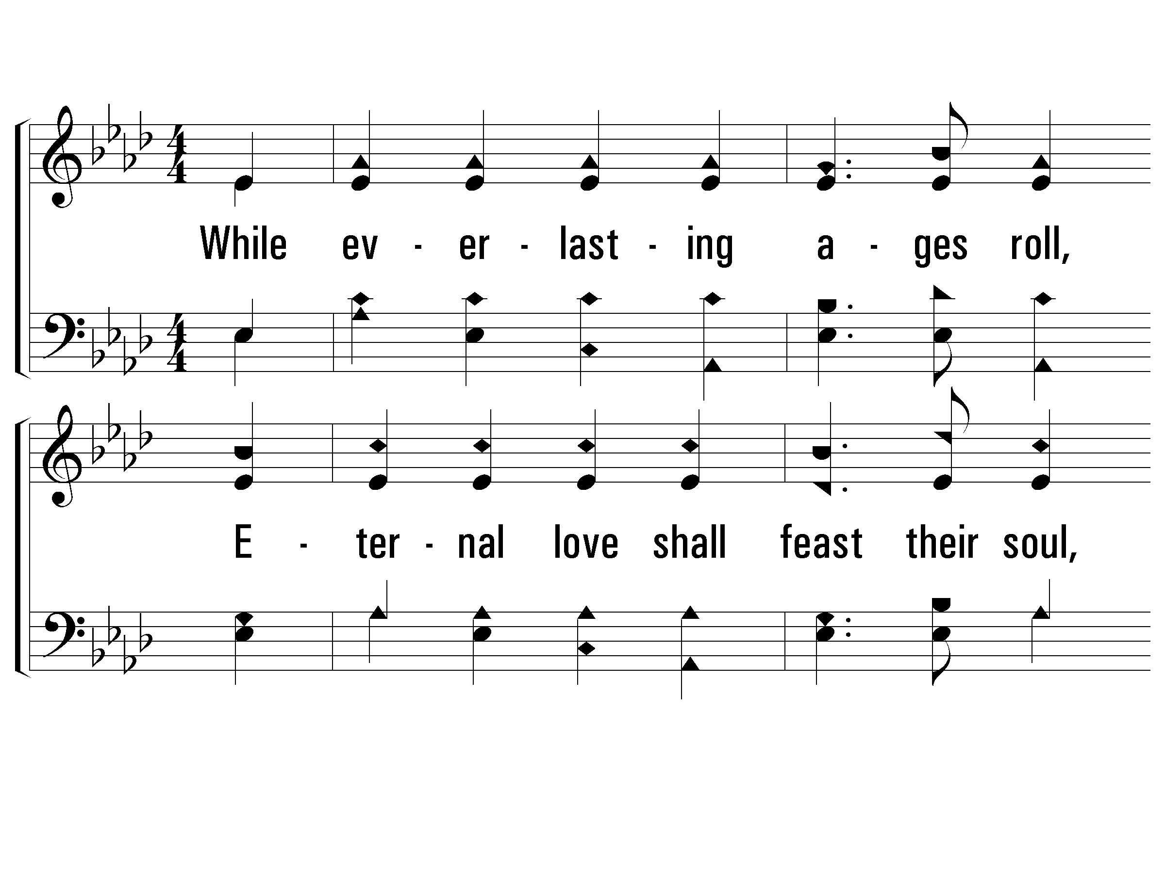
3 – On Zion’s Glorious Summit
3.
While everlasting ages roll,
Eternal love shall feast their soul,
And scenes of bliss, for ever new,
Rise in succession to their view,
Rise in succession to their view.

Slide 82

3 – On Zion’s Glorious Summit

Slide 83

3 – On Zion’s Glorious Summit

Slide 84

s – On Zion’s Glorious Summit
Holy, holy, holy Lord,
God of hosts, on high adored!
Who like me Thy praise should sing,
O Almighty King!
Holy, holy, holy Lord,
God of hosts, on high adored!
Holy, holy, holy.

Slide 85

s – On Zion’s Glorious Summit

Slide 86

S – On Zion’s Glorious Summit

Slide 87

S – On Zion’s Glorious Summit

Slide 89
I Am Resolved
Isaiah 50:4-7
- Obedience, Humility, Resolve
Luke 9:51
  When the days were approaching for His ascension, He resolutely set His face to go to Jerusalem.

Slide 90

1 – I Am Resolved
1.
I am resolved no longer to linger,
Charmed by the world's delight;
Things that are higher,
things that are nobler,
These have allured my sight.

Slide 91

1 – I Am Resolved

Slide 92

2 – I Am Resolved
2.
I am resolved to go to the Savior,
Leaving my sin and strife;
He is the true One,
He is the just One,
He hath the words of life.

Slide 93

2 – I Am Resolved

Slide 94

3 – I Am Resolved
3.
I am resolved to follow the Savior,
Faithful and true each day,
Heed what He sayeth,
do what He willeth, He is the living way.

Slide 95

3 – I Am Resolved

Slide 96

4 – I Am Resolved
4.
I am resolved to enter the kingdom,
Leaving the paths of sin;
Friends may oppose me,
foes may beset me,
Still will I enter in.

Slide 97

4 – I Am Resolved

Slide 98

c – I Am Resolved
I will hasten to Him
Hasten so glad and free,
Jesus, greatest, highest,
I will come to Thee.

Slide 99

c – I Am Resolved

Slide 100
Seeing God
On His Throne

