Slide 2
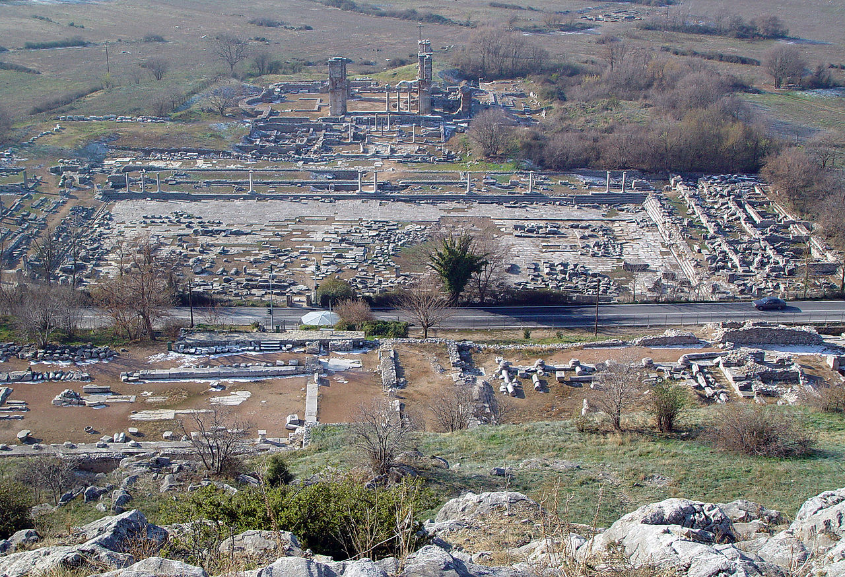
Becoming a Church That Matters
PHILIPPI

Slide 3

Faithfully Follow the Spirit

Slide 4
And they went through the region of Phrygia and Galatia, having been forbidden by the Holy Spirit to speak the word in Asia. And when they had come up to Mysia, they attempted to go into Bithynia, but the Spirit of Jesus did not allow them. So, passing by Mysia, they went down to Troas. And a vision appeared to Paul in the night: a man of Macedonia was standing there, urging him and saying, “Come over to Macedonia and help us.” And when Paul had seen the vision, immediately we sought to go on into Macedonia, concluding that God had called us to preach the gospel to them.
ACTS 16:6-10

Slide 5

Cultivate Brotherly
Love

Slide 6
And it is my prayer that your love may abound more and more…
PHILIPPIANS 1:9

Slide 7

Work
Together

Slide 8
Only let your manner of life be worthy of the gospel of Christ, so that whether I come and see you or am absent, I may hear of you that you are standing firm in one spirit, with one mind striving side by side for the faith of the gospel, and not frightened in anything by your opponents.
PHILIPPIANS 1:27-28

Slide 9

Pursue
Unity &
Holiness

Slide 10
UNITY
Philippians 2:1-11
HOLINESS
Philippians 2:12-16
We cannot pursue
one at the exclusion
of the other

Slide 11

Aim
High

Slide 12
…forgetting what lies behind and straining forward to what lies ahead, I press on toward the goal for the prize of the upward call of God in Christ Jesus. Let those of us who are mature think this way…
PHILIPPIANS 3:13-15

Slide 13

radiate the Beauty of God in the World

Slide 14
Finally, brothers, whatever is true, whatever is honorable, whatever is just, whatever is pure, whatever is lovely, whatever is commendable, if there is any excellence, if there is anything worthy of praise, think about these things.
PHILIPPIANS 4:8

Slide 15
Becoming a Church That Matters
PHILIPPI

