Slide 1

Basic Facts About God

Slide 2
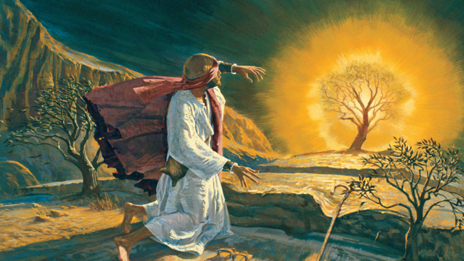
1. God is Holy
Exodus 3:1-6
God alone is unique and separated above all of His creation.
God is completely separated from sin.

Slide 3
1. God is Holy
Exodus 3:1-6
God alone is unique and separated above all of His creation.
God is completely separated from sin.
“By those who come near Me I must be regarded as holy;
and before all the people I must be glorified.”
Leviticus 10:3

Slide 4

2. God is Bigger
Than We Can Imagine
Isaiah 40:12, 15, 21-22
Holds the waters of the earth in His hand.
Measures the universe with His hand.
Measures the mountains on His scales.
Population a drop in a bucket.
Stretches the sky like a curtain.

Slide 5

3. God Has Authority Over Us
Jeremiah 18:1-6
Romans 9:20-21

Slide 6
3. God Has Authority Over Us
Jeremiah 18:1-6
Romans 9:20-21
And do not be conformed to this world, but be transformed by the renewing of your mind, that you may prove what is that good and acceptable and perfect will of God.
Romans 12:2

Slide 7

4. God is Merciful
Psalm 103:1-4, 8-14
This mercy is conditional, being shown to
“those who fear Him” (vs. 11, 13).

Slide 8
Basic Facts About God
God is Holy
God is Bigger Than We Can Imagine
God Has Authority Over Us
God is Merciful

