Slide 2
A Generation Who Did Not Know the Lord
“In those days there was no king in Israel; everyone did what was right
in his own eyes.” Judges 21:25

Slide 3
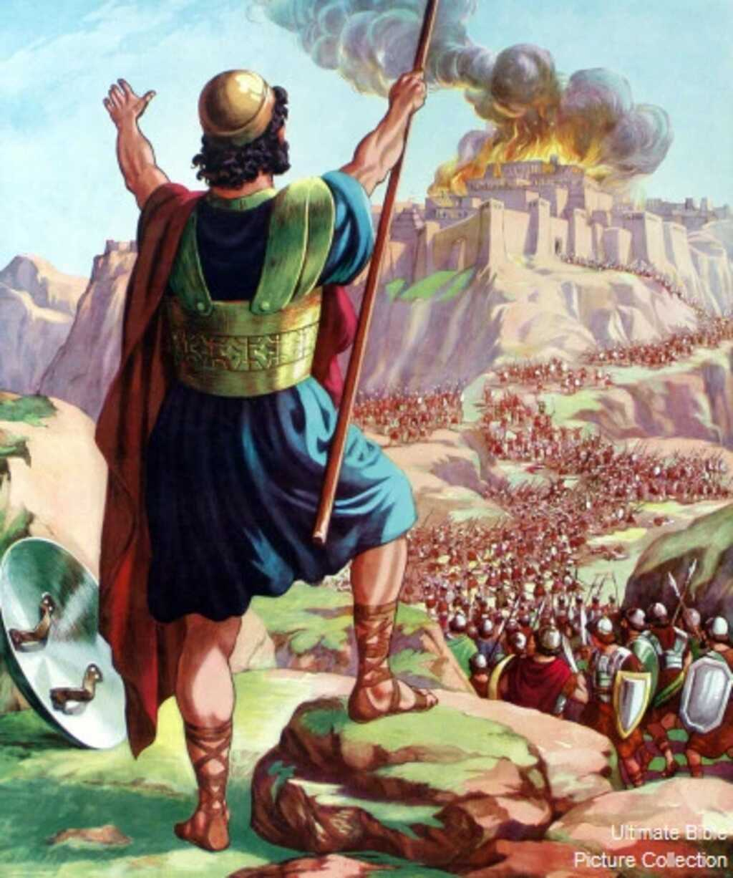
Joshua is a book of VICTORY!

Slide 4
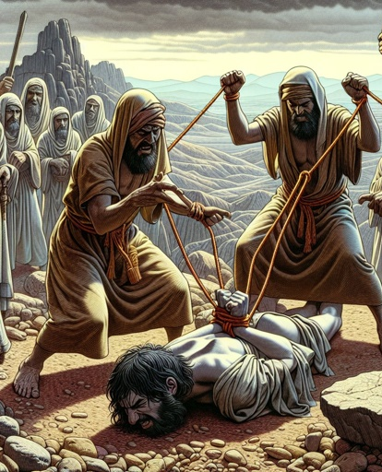
Joshua is a book of VICTORY!
Judges is a book of DEFEAT and LOSS.

Slide 5
Cycles of Apostasy
Judges 2:11-19
Rebellion
Oppression
Deliverance
Crying Out

Slide 6
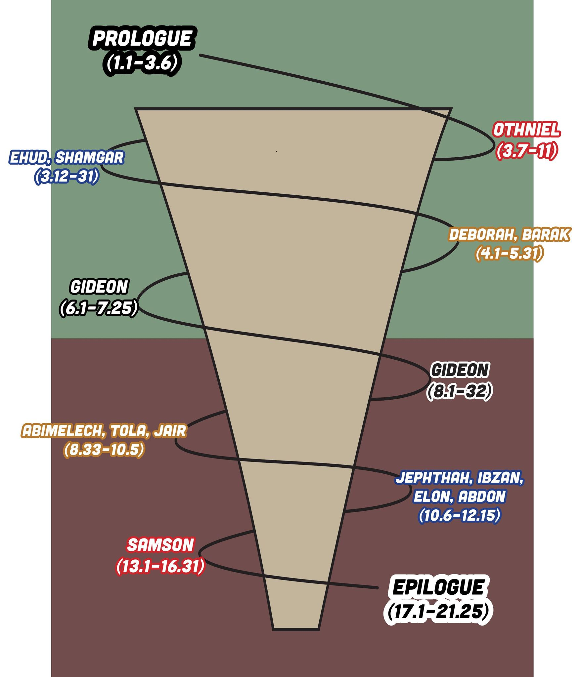
Each cycle got progressively worse (2:19).

Slide 7
How Israel’s Apostasy Happened
They were at ease.
They focused on themselves.
They gave in to the influence of their surroundings (3:5-7).
They weren’t taught about the Lord (2:7-10).

Slide 8
The Religion of Jehovah is a Taught Religion
Patriarchs had to teach their children (Gen. 18:19).
Israelite fathers had to teach their children (Deut. 6:6-9).
Christian fathers must teach their children (Eph. 6:4).

Slide 9
The Religion of Jehovah is a Taught Religion
The Psalmists lamented this failure.
  Psalm 78:5-8, 56-66
  Psalm 106:34-47

