Slide 2
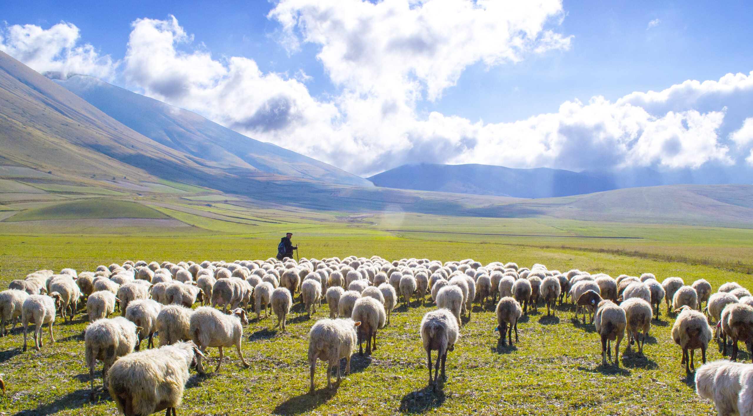
The Work of Elders

Slide 3
Defined by Greek Terms
The elders who are among you I exhort, I who am a fellow elder and a witness of the sufferings of Christ, and also a partaker of the glory that will be revealed:
Shepherd the flock of God which is among you, serving as overseers, not by compulsion but willingly, not for dishonest gain but eagerly.
1 Peter 5:1-2
Presbuteros
  Elder, Presbyter
Poimen
  Shepherd, Pastor
Episkopos
  Overseer, Bishop

Slide 4
Defined by Listed Tasks
Therefore take heed to yourselves and to all the flock, among which the Holy Spirit has made you overseers, to shepherd the church of God which He purchased with His own blood.
Acts 20:28
Take Heed to Themselves
Take Heed to the Local Church
Oversee the Local Church
Shepherd or Feed the Local Church

Slide 5
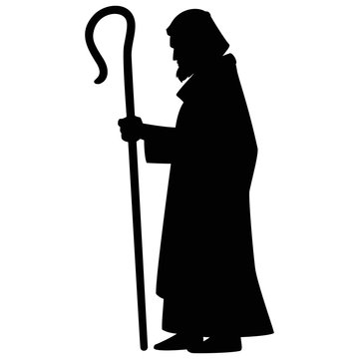
5. Watch Out for the
Souls of the Members
Obey those who rule over you, and be submissive, for they watch out for your souls, as those who must give account. Let them do so with joy and not with grief, for that would be unprofitable for you.
Hebrews 13:17

Slide 6
5. Watch Out for the
Souls of the Members
Find missing sheep - Heb. 10:25
Admonish the members - 1 Thess. 5:12
Warn and rebuke the unruly - 1 Thess. 5:14
Restore members - Matt. 18:12-14

Slide 7
The Work of Elders
Take Heed to Themselves
Take Heed to the Church
Oversee the Church
Shepherd or Feed the Church
Watch Out for the Souls of the Members

