Slide 2
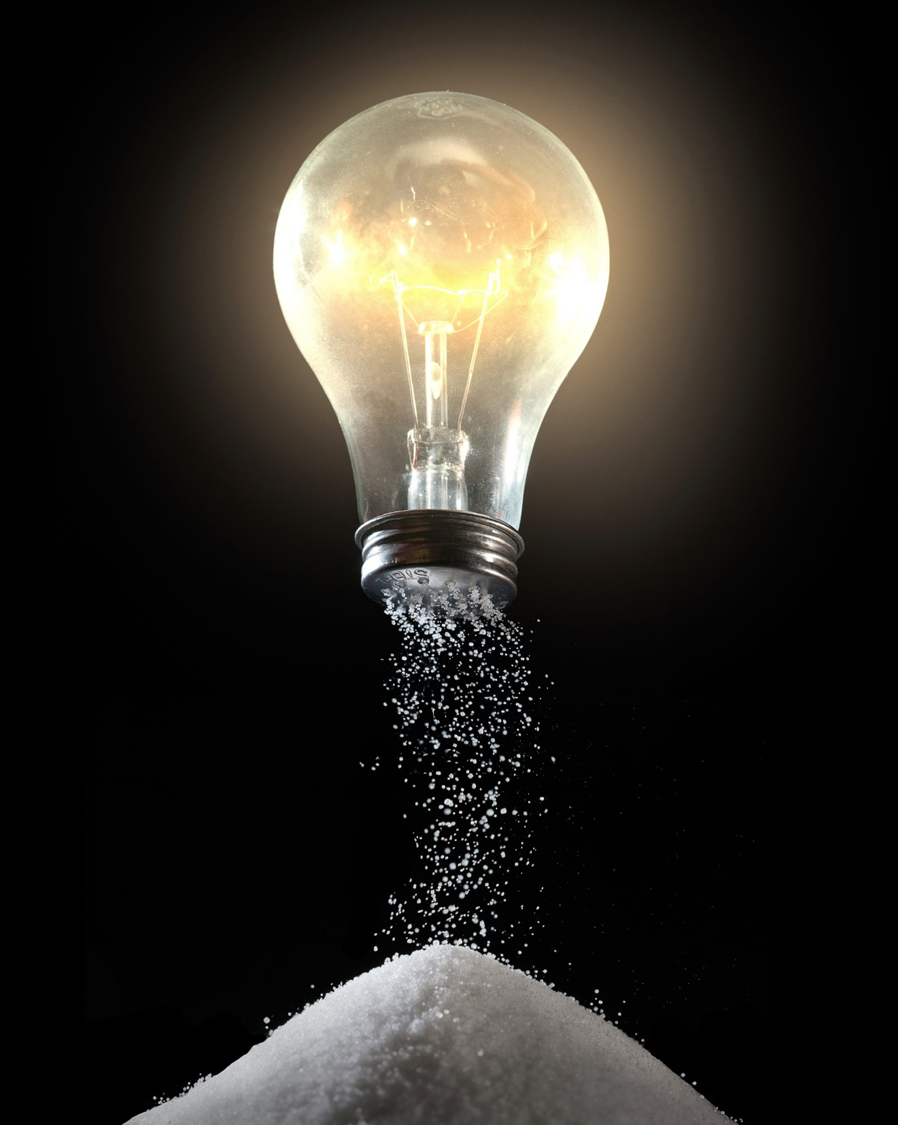
Salt and Light
Matthew 5:13-16

Slide 3
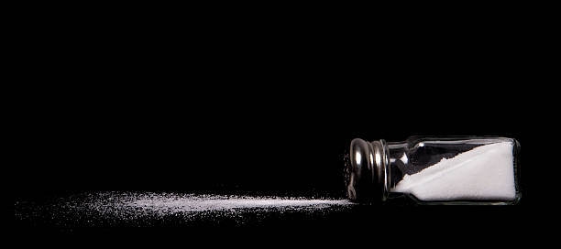
Salt
Preservative
  Gen. 18:22-33; Jer. 5:1
Gives Flavor
  Col. 4:5-6
Creates Thirst
  1 Pet. 3:15

Slide 4

Light
Drives Away Darkness
  Eph. 5:8-11
Reveals and Illuminates
  Eph. 5:13
Gives Guidance
  Prov. 4:18
Warms and Comforts
  Eccl. 11:7
Draws Some Out of Darkness
  John 3:19-21; Phil. 2:15

Slide 5
Will you be saved today?
Believe in Jesus - John 8:24
Repent of your sins - Luke 13:3
Confess your faith - Rom. 10:9-10
Be baptized - Acts 22:16

