Slide 1
Be Like Silas
Be Reliable
“Brethren, join in following my example, and note those who so walk,
as you have us for a pattern.”
Philippians 3:17

Slide 2
Silas in Jerusalem
He was one of the “leading men among the brethren” in Jerusalem - Acts 15:22
He had risked his life for the name of the Lord Jesus Christ - v. 26
He was a prophet; could exhort and strengthen the brethren with the word - v. 32

Slide 3
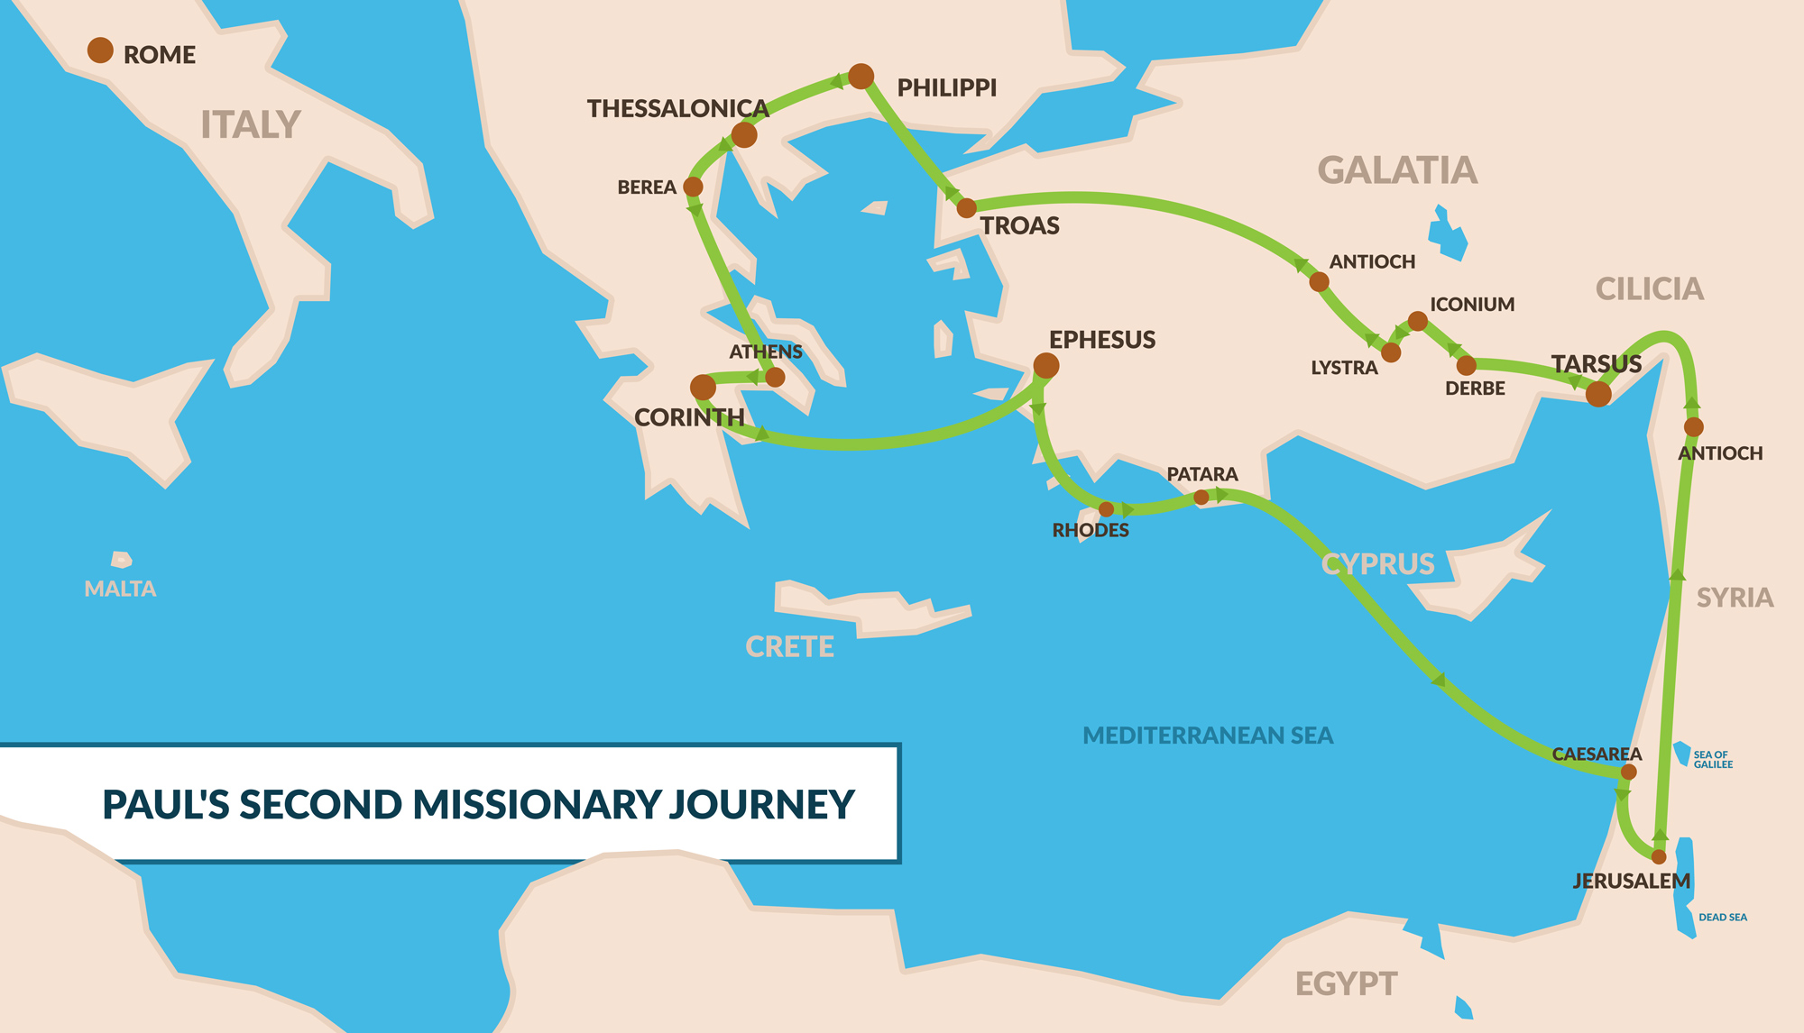

Slide 4
Joined by Timothy and Luke.

Slide 5
In Philippi, Paul and Silas were arrested, beaten, and imprisoned.
Converted the Jailer.

Slide 6
A riot breaks out in Thessalonica. They escape to Berea.

Slide 7
Paul travels alone to Athens.
Silas and Timothy join him in Corinth.

Slide 8
Silas with Peter
By Silvanus, our faithful brother as I consider him, I have written to you briefly, exhorting and testifying that this is the true grace of God in which you stand.
1 Peter 5:12

Slide 9
Be Like Silas
He was trusted to accurately represent the church in Jerusalem.
He stood by and suffered with Paul in preaching the gospel.
He was a “leading” man, but made himself a servant of Paul and Peter.
He was loyal to Christ above any person.

