Slide 1

Finding Ourselves in the Psalms
Psalm 71
A Psalm for Old Age

Slide 2
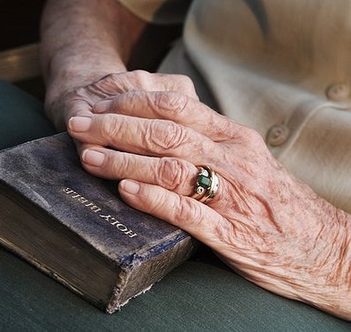
Written by someone approaching old age
He looks back at his youth (vs. 5-6, 17)
He looks ahead to old age (vs. 9, 18)

Slide 3

“when my strength fails” - v. 9
There are challenges to reaching old age.
Physical - Eccl. 12:1-5
Mental
Emotional

Slide 4

1. The need to be near God
“Be my strong refuge, to which I may resort continually; You have given the commandment to save me, for You are my rock and my fortress.”
Psalm 71:3

Slide 5
1. The need to be near God
“You are my strong refuge” (v. 7)
“O God, do not be far from me; O my God,
make haste to help me!” (v. 12)
“O God, do not forsake me” (v. 18)

Slide 6
2. The need for confidence in God
My mouth shall tell of Your righteousness and Your salvation all the day, for I do not know their limits.
I will go in the strength of the Lord God; I will make mention of Your righteousness, of Yours only.

Slide 7
2. The need for confidence in God
You, who have shown me great and severe troubles, shall revive me again, and bring me up again from the depths of the earth.
You shall increase my greatness, and comfort me on every side.

Slide 8

3. The need for hope in God
“For You are my hope, O Lord God; You are my trust from my youth” (v. 5)
“But I will hope continually, and will praise You yet more and more” (v. 14)

Slide 9

4. The need for purpose in God
“I have become as a wonder to many,
but You are my strong refuge.”

Slide 10
4. The need for purpose in God
My mouth shall tell of Your righteousness and Your salvation all the day, for I do not know their limits.
I will go in the strength of the
Lord God; I will make mention
of Your righteousness, of
Yours only.

Slide 11
4. The need for purpose in God
O God, You have taught me from my youth; and to this day I declare Your wondrous works.
Now also when I am old and grayheaded,
O God, do not forsake me,
until I declare Your strength
to this generation, Your power
to everyone who is to come.

Slide 12
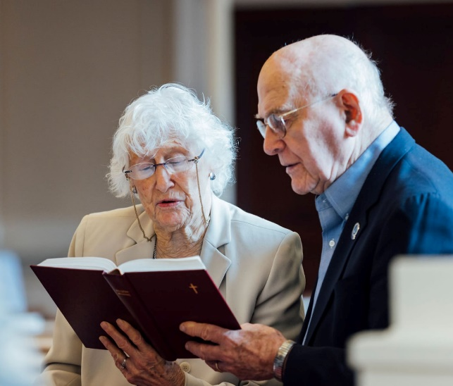
5. The need to praise God
“My praise shall be continually of You” (v. 6)
“Let my mouth be filled with Your praise and with Your glory all the day” (v. 8)
“And will praise You yet more and more” (v. 14)
“I will make mention of Your righteousness, of Yours only” (v. 16)

Slide 13
5. The need to praise God
Also with the lute I will praise You - and Your faithfulness, O my God! To You I will sing with the harp, O Holy One of Israel.
My lips shall greatly rejoice when I sing to You, and my soul, which You have redeemed.
My tongue also shall talk of
Your righteousness
all the day long…

Slide 14
Psalm 71
There are challenges to every stage of life.
God has the answers for the most pressing needs faced in our Golden Years.
  Strength, Confidence, Hope, and Purpose
  Resulting in Praise!
Have you found yourself in this psalm?

