Slide 2

How to Clothe Ourselves with Humility
1 Peter 5:5

Slide 3
Humble: “low lying, to make low”
Humility “the state or quality of being humble, absence of pride of self-assertion”
tapeinophrosune – “having a humble opinion of oneself; a deep sense of one’s (moral) littleness; lowliness of mind” (Thayer)

Slide 4
“Therefore, as the elect of God, holy and beloved, put on tender mercies, kindness, humility, meekness, longsuffering”
(Col. 3:12).
“Yes, all of you be submissive to one another, and be clothed with humility, for ‘God resists the proud, But gives
grace to the humble’” (1 Pet. 5:5).

Slide 5
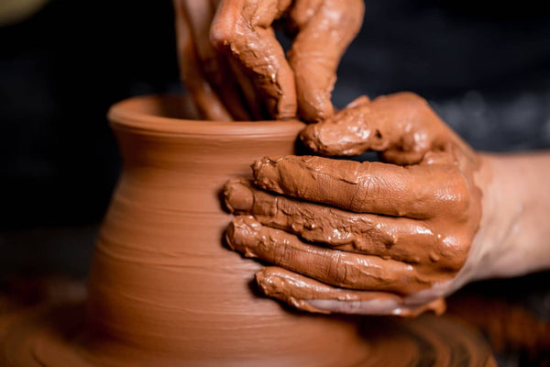
1. Realize Who We Are Before God
God is our Creator
  Rom. 9:20-21; Eccl. 5:2
God gives us everything
  Acts 17:24-25
We have sinned against God
  Luke 15:17-19; 18:13

Slide 6
2. Respond Appropriately to Life’s Challenges

Slide 7
2. Respond Appropriately to Life’s Challenges
And you shall remember that the Lord your God led you all the way these forty years in the wilderness, to humble you and test you, to know what was in your heart, whether you would keep His commandments or not.
Deuteronomy 8:2

Slide 8
2. Respond Appropriately to Life’s Challenges
Now when he was in affliction, he implored the Lord his God, and humbled himself greatly before the God of his fathers.
2 Chronicles 33:12

Slide 9
2. Respond Appropriately to Life’s Challenges
Paul is a great example.
As Saul of Tarsus, he was an arrogant man
(1 Tim. 1:13).
He was given a “thorn in the flesh” to humble
him (2 Cor. 12:7-10).
Paul responded to this in the right way.

Slide 10
2. Respond Appropriately to Life’s Challenges
What will we do?
The challenges of life can make us bitter and resentful.
Or they can make us more patient, more reliant
on God, and more grateful for our blessings.

Slide 11
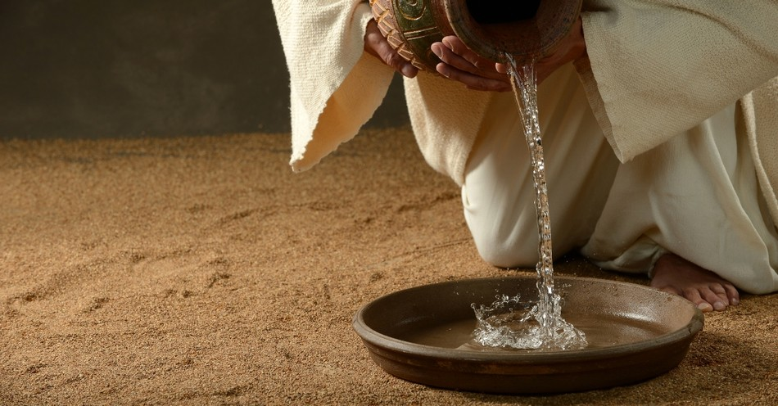
3. Serve Others
Mark 10:35-45
Philippians 2:3-8

Slide 12
4. Praise and Encourage Others

Slide 13
4. Praise and Encourage Others
Let another man praise you, and not your own mouth; a stranger, and not your own lips.
Proverbs 27:2

Slide 14
4. Praise and Encourage Others
Let nothing be done through selfish ambition or conceit, but in lowliness of mind let each esteem others better than himself.
Let each of you look out not only for his own interests, but also for the interests of others.
Philippians 2:3-4

Slide 15
4. Praise and Encourage Others
It is He who, coming after me, is preferred before me, whose sandal strap I am not worthy to loose.
He must increase, but I must decrease.
John 1:27; 3:30

Slide 16
How to Clothe Ourselves with Humility
Realize Who We Are Before God
Respond Appropriately to Life’s Challenges
Serve Others
Praise and Encourage Others

