Slide 2

Deuteronomy 6:1-9

Slide 3
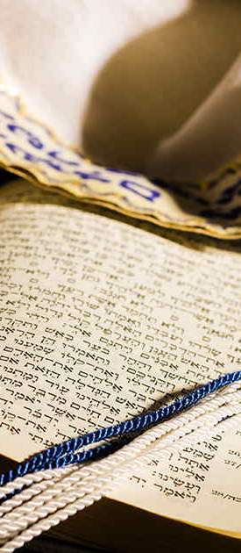
Hear, O Israel: The Lord our God, the Lord is one!
You shall love the Lord your God with all your heart, with all your soul, and with all your strength.
Deuteronomy 6:4-5

Slide 4
1. Keeping God’s Commandments
Deuteronomy 6:1-3
observe them in the land…
fear the Lord your God…
to keep all His statutes and His commandments…
to be careful to observe it…

Slide 5
1. Keeping God’s Commandments
This fear and reverence will be shown in the quality of our worship.
  Malachi 1:6-8
This fear and reverence will be shown in our careful obedience.
  Ex. 20:6; Deut. 7:9; 10:12-13; Dan. 9:4

Slide 6
1. Keeping God’s Commandments
“If you love Me, keep My commandments”
(John 14:15).
“Circumcision is nothing and uncircumcision is nothing, but keeping the commandments of God is what matters” (1 Cor. 7:19).

Slide 7
1. Keeping God’s Commandments
By this we know that we love the children of God, when we love God and keep His commandments.
For this is the love of God, that we keep His commandments. And His commandments are not burdensome.
1 John 5:2-3

Slide 8
2. Keeping God’s Word in Our Heart
“And these words which I command you today
shall be in your heart” (Deut. 6:6).

Slide 9
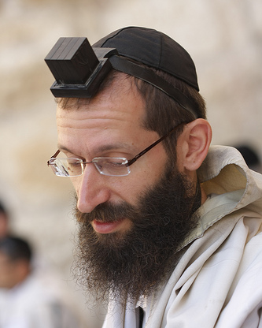
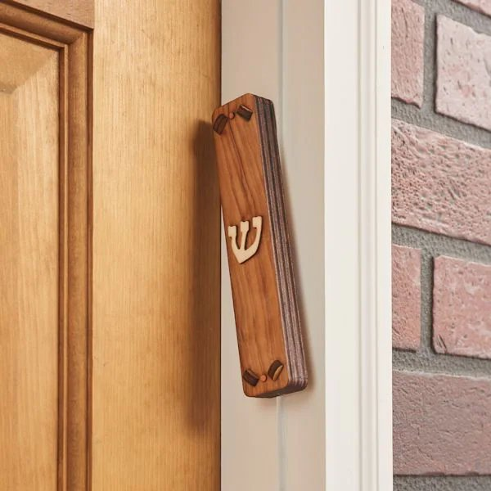
2. Keeping God’s Word in Our Heart
You shall bind them as a sign on your hand, and they shall be as frontlets between your eyes.
You shall write them on the doorposts of your house and on your gates.
Deuteronomy 6:8-9

Slide 10
3. Teaching God’s Word to Others
“You shall teach them diligently to your children, and shall talk of them when you sit in your house, when you walk by the way, when you lie down,
and when you rise up” (Deut. 6:7).

Slide 11
3. Teaching God’s Word to Others
We must teach our children (Eph. 6:4).
We must teach those who will teach others
(2 Tim. 2:2).
We must teach the lost (Acts 8:4).

Slide 12
If We Love God We Will…
Keep His Commandments
Write it on Our Heart
Teach it to Others

