Slide 1
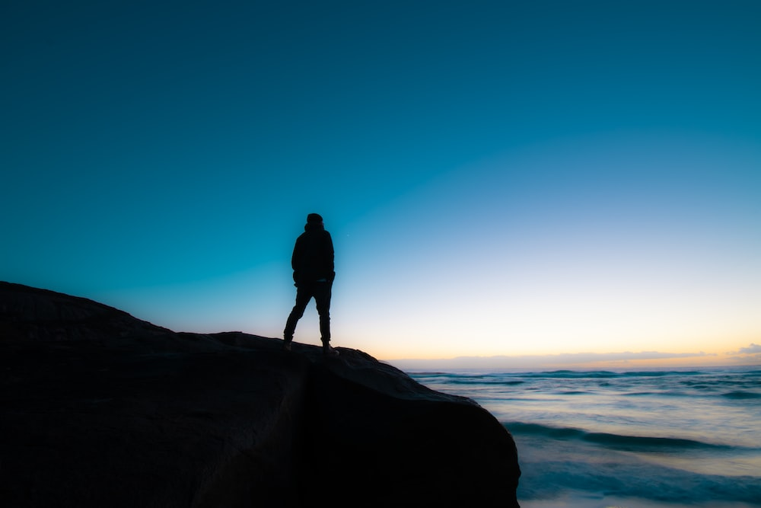
Finding Ourselves in the Psalms
Psalm 30
Thanksgiving

Slide 2

Psalms of Thanksgiving
18
30
31
32
40
65
66
92
107
116
118
120
124
129

Slide 3
I will extol You, O Lord, for You have
lifted me up, and have not let my foes rejoice over me.
O Lord my God, I cried out to You, and You healed me.
O Lord, You brought my soul up from the grave; You have kept me alive, that I should not go down to the pit.

Slide 4
I will extol You, O Lord, for You have
lifted me up, and have not let my foes rejoice over me.
O Lord my God, I cried out to You, and You healed me.
O Lord, You brought my soul up from the grave; You have kept me alive, that I should not go down to the pit.

Slide 5
Sing praise to the Lord, you saints of His, and give thanks at the remembrance
of His holy name.
For His anger is but for a moment,
His favor is for life;
weeping may endure for a night,
but joy comes in the morning.

Slide 6
Sing praise to the Lord, you saints of His, and give thanks at the remembrance
of His holy name.
For His anger is but for a moment,
His favor is for life;
weeping may endure for a night,
but joy comes in the morning.
Isaiah 54:7-8

Slide 7
Sing praise to the Lord, you saints of His, and give thanks at the remembrance
of His holy name.
For His anger is but for a moment,
His favor is for life;
weeping may endure for a night,
but joy comes in the morning.

Slide 8
Now in my prosperity I said,
“I shall never be moved.”
Lord, by Your favor You have made
my mountain stand strong;
You hid Your face, and I was troubled.

Slide 9
Now in my prosperity I said,
“I shall never be moved.”
Lord, by Your favor You have made
my mountain stand strong;
You hid Your face, and I was troubled.

Slide 10
Now in my prosperity I said,
“I shall never be moved.”
Lord, by Your favor You have made
my mountain stand strong;
You hid Your face, and I was troubled.

Slide 11
I cried out to You, O Lord;
and to the Lord I made supplication:
What profit is there in my blood,
when I go down to the pit?
Will the dust praise You?
Will it declare Your truth?
Hear, O Lord, and have mercy on me;
Lord, be my helper!

Slide 12
You have turned for me my
mourning into dancing;
You have put off my sackcloth
and clothed me with gladness,
To the end that my glory may sing
praise to You and not be silent.
O Lord my God, I will give thanks
to You forever.

Slide 13
You have turned for me my
mourning into dancing;
You have put off my sackcloth
and clothed me with gladness,
To the end that my glory may sing
praise to You and not be silent.
O Lord my God, I will give thanks
to You forever.

Slide 14
You have turned for me my
mourning into dancing;
You have put off my sackcloth
and clothed me with gladness,
To the end that my glory may sing
praise to You and not be silent.
O Lord my God, I will give thanks
to You forever.

Slide 15
Psalm 30
God will act to discipline us when necessary.
God’s anger is brief – His goodness is eternal.
God is quick and faithful to return the light
and joy to our lives.
God is worthy of our continual praise and everlasting thanksgiving.
Have you found yourself in this psalm?

