Slide 2



Slide 3
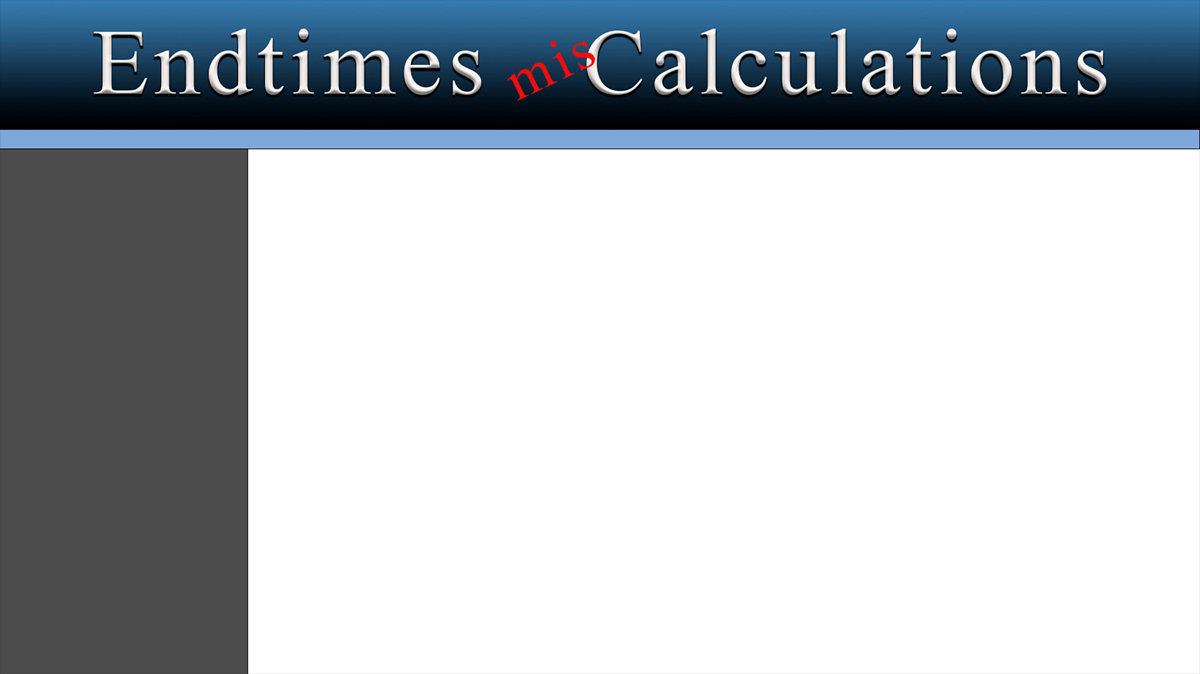
1970’s
1970’S
Concerns about everything
Oil reserves running out
Global cooling,
Vietnam war going on
Social unrest
1990’s
Gulf war / Saddam Hussein
Approaching Millennium
Religious crisis – numbers down
1990’s
2000
2000
Y2K
Rising technology dependence
Automation in workforce
2023
Post pandemic
Political division
Societal unrest
War
2023
All of these things have 2 common elements …

Slide 4
1970’s
Fear!
1990’s
Stream of predictions about the End Times, the Second Coming of Christ & the End of the World
2000
2023
Matthew 24.3 - Tell us, when shall these things be? and what shall be the sign of thy coming, and of the end of the world?

Slide 5
1970’s
Projections & calculations
Misunderstanding of biblical prophecy
Counting days / years to predict
Ultimate goal – predict the 2nd coming
1990’s
2000
The Antichrist
The End Times
The Second Coming
2023

Slide 6
Proposed identity of the Antichrist …
Rev 13.18
Rev 13.18
Here is wisdom. Let him that hath understanding count the number of the
beast: for it is the number of a man; and his number is Six hundred threescore and six.
1 John 4.3
1 John 2.18

Slide 7
Proposed identity of the Antichrist …
Rev 13.18
666 – Calculated from name
Letters transliterated to Hebrew, Greek, Latin
Online 666 calculator
1 John 4.3
1 John 2.18
Adolf Hitler
Joseph Stalin
Henry Kissinger
Saddam Hussein
Vladimir Putin

Slide 8
Proposed identity of the Antichrist …
Rev 13.18
1 John 4.3
And every spirit that confesseth not that Jesus Christ is come in the flesh is not of God: and this is that spirit of antichrist, whereof ye have heard that it should come; and even now already is it in the world.
1 John 4.3
1 John 2.18

Slide 9
Proposed identity of the Antichrist …
Rev 13.18
1 John 4.3
1 John 2.18
Little children, it is the last time: and as ye have heard that antichrist shall come, even now are there many antichrists; whereby we know that it is the last time
1 John 2.18

Slide 10
When will the End Times begin ??
Recent example - calculation of the beginning of the end times
Typical of the type of reasoning & calculation that has been done for years

Slide 11
Recent example of calculation of the beginning of the End Times
Ezek 4.1-7
1. Ezek 4.1 - draw city of Jerusalem - lay siege to it
2. Ezek 4.4-5 - lie on left side - 390 days - day for each year
3. Ezek 4.6 - lie on right side - 40 days - a day for each year
4. There are some certainties we get out of this - 1 day = 1 year
5. 390 + 40 = 430 years
6. Lev 26.18,27-28 - chastised 7 times for your sins
7. 430 - 70 years for captivity = 360 years accounting for time served
8. 360 x 7 = 2520 years that God will separate the Jews from Jerusalem
9. This is Hebrew / Jewish prophecy - used lunar years - 360 days per year

Slide 12
Recent example of calculation of the beginning of the End Times
Ezek 4.1-7
10. 2520 years x 360 days = 907,200 days - to be separated from Jerusalem
11. Cyrus - July 23, 537 - release from captivity
12. Fast forward from July 23, 587 for 907,200 days - account for leap years
13. Leads to May 15, 1948 - exact day Israel became a nation again
14. You can’t deny that Israel is going through the end times prophesied by Ezekiel
15. Matthew 24 - that generation shall not pass - generation of 1948

Slide 13
Problems with these calculations –
430 years are in the past at this point
70 years of captivity – Jer 25.11
536 B.C. remnant returned – Temple / Jerusalem rebuilt
A multiplier from Leviticus isn’t applicable
Jeremiah return to Jerusalem after 70 years – Jer 29.10
Leap years …
Jews used a lunar calendar
Jews later used a luno-solar calendar
Adjusted years for differences
Calendars adjusted by Julius Caesar 46 B.C
Other changes Gregory – Gregorian calendar
No way to accurately determine these dates
Ezek 4.1-7

Slide 14
When did or will the End Times begin ???
End Times / Last Days – 3 conditions to be met
1. Messiah - Isa 7.14, John 4.25-26
2. Law - Jer 31.31-32, Heb 8.8-13
3. Kingdom - Isa 2.2, Mic 4.1-2, Col 1.12-13
All of these conditions have been met
The last days are now
Have been since the first century

Slide 15
When did or will the End Times begin ???
1 Cor 10.11
Now all these things happened unto them for ensamples: and they are written for our admonition, upon whom the ends of the world are come.
Heb 1.1-2
1 John 2.18

Slide 16
When did or will the End Times begin ???
1 Cor 10.11
God, who at sundry times and in divers manners spake in time past unto the fathers by the prophets, Hath in these last days spoken unto us by his Son, whom he hath appointed heir of all things, by whom also he made the worlds;
Heb 1.1-2
1 John 2.18

Slide 17
When did or will the End Times begin ???
1 Cor 10.11
Little children, it is the last time: and as ye have heard that antichrist shall come, even now are there many antichrists; whereby we know that it is the last time
Heb 1.1-2
1 John 2.18
We are living in
The End Times …
The End of Days …
The Last Days

Slide 18
The Second Coming
The goal of these calculations is to predict the time of Christ’s return
What do the scriptures say …. ??

Slide 19
Matt 24.36
The Second Coming
2 Pet 3.10
But of that day and hour knoweth no man, no, not the angels of heaven, but my Father only.
Matthew
24.37-39
Matt 24.42
2 Pet 3.10

Slide 20
Matt 24.36
The Second Coming
2 Pet 3.10
But the day of the Lord will come as a thief in the night
Matthew
24.37-39
Matt 24.42
2 Pet 3.10

Slide 21
Matt 24.36
The Second Coming
2 Pet 3.10
But as the days of Noe were, so shall also the coming of the Son of man be. For as in the days that were before the flood they were eating and drinking, marrying and giving in marriage, until the day that Noe entered into the ark, And knew not until the flood came, and took them all away; so shall also the coming of the Son of man be.
Matthew
24.37-39
Matt 24.42
2 Pet 3.10

Slide 22
Matt 24.36
The Second Coming
2 Pet 3.10
Watch therefore: for ye know not what hour your Lord doth come
Matthew
24.37-39
Matt 24.42
2 Pet 3.10

Slide 23
Matt 24.36
The Second Coming
2 Pet 3.10
But the day of the Lord will come as a thief in the night; in the which the heavens shall pass away with a great noise, and the elements shall melt with fervent heat, the earth also and the works that are therein shall be burned up
Matthew
24.37-39
Matt 24.42
2 Pet 3.10

Slide 24
What we need to know & do ...
So many are preoccupied with the End Times, signs, the Antichrist, the mark of the beast, warfare & government control
Many are living with anxiety & fear … but that isn’t necessary

Slide 25
What we need to know & do ...
2 Tim 1.7
For God hath not given us the spirit of fear; but of power, and of love, and of a sound mind.
1 Thess 1.10
Acts 17.30
2 Cor 6.2

Slide 26
What we need to know & do ...
2 Tim 1.7
And to wait for his Son from heaven, whom he raised from the dead, even Jesus, which delivered us from the wrath to come
1 Thess 1.10
Acts 17.30
2 Cor 6.2

Slide 27
What we need to know & do ...
2 Tim 1.7
And the times of this ignorance God winked at; but now commandeth all men every where to repent
1 Thess 1.10
Acts 17.30
2 Cor 6.2

Slide 28
What we need to know & do ...
2 Tim 1.7
For he saith, I have heard thee in a time accepted, and in the day of salvation have I succoured thee: behold, now is the accepted time; behold, now is the day of salvation
1 Thess 1.10
Acts 17.30
2 Cor 6.2

Slide 29
What we need to know & do ...
We’re in the last days
We don’t know when they’ll end
There won’t be a warning
Christ will return … when God sends him
We need to be ready

