Slide 2

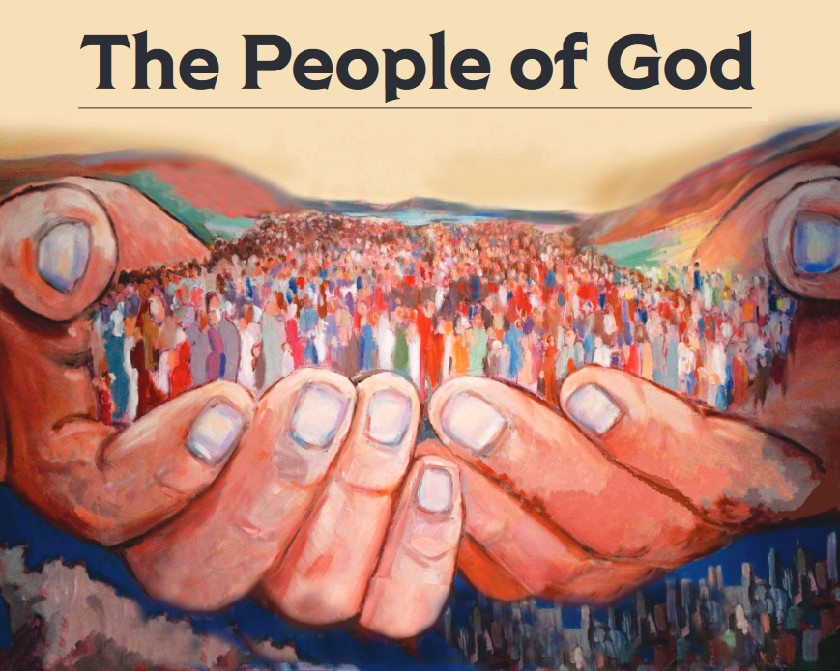
“But you are a chosen race, a royal priesthood, a holy nation, a people for God’s own possession, so that you may proclaim the excellencies of Him who has called you out of darkness into His marvelous light; for you once were not a people, but now you are the people of God.” (1 Peter 2:9-10)

Slide 3

A Proclaiming People
Luke 19:10

Slide 4

Who Are The Lost? The Lost…
…Are People Outside of Christ
…Are Unforgiven Sinners
…Are Going To Hell
  …Are Often Good, Moral People
    …Need You To Model Genuine Christianity For Them
        …Need You To Help Teach Them The Gospel

