Slide 2

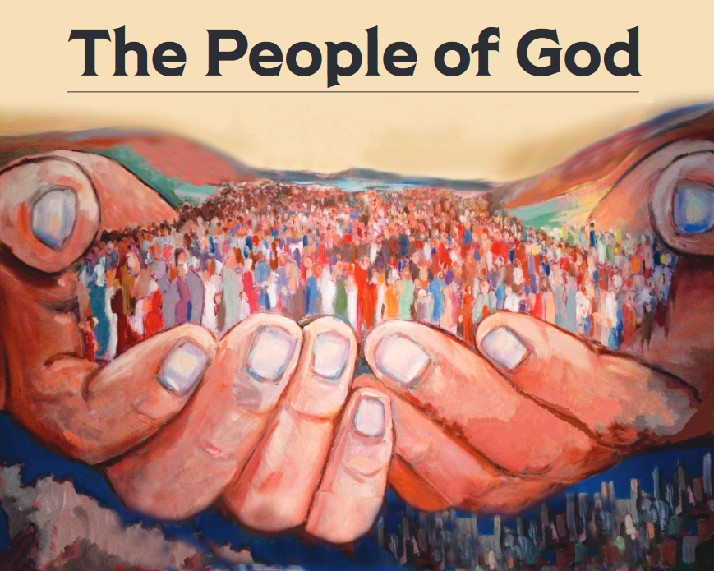
“But you are a chosen race, a royal priesthood, a holy nation, a people for God’s own possession, so that you may proclaim the excellencies of Him who has called you out of darkness into His marvelous light; for you once were not a people, but now you are the people of God.” (1 Peter 2:9-10)

Slide 3
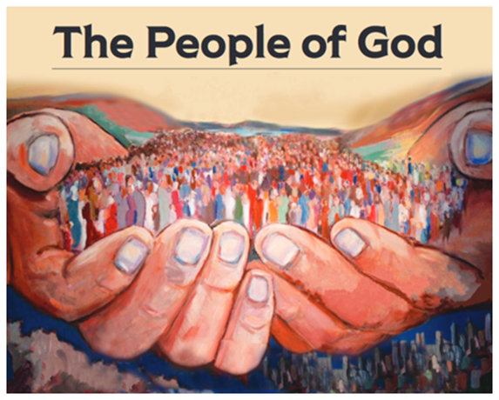
A Marriage-Honoring People
Matthew 19:3-6

Slide 4
3 Essential Keys
Cut off the “auto-pilot”
Colossians 3:18-19
  “Submit” and “love” require action
Song of Solomon 5:2-6

Slide 5
3 Essential Keys
Cultivate oneness
Genesis 2:22-25
1 Corinthians 12:26
  Operate as a team
1 Peter 3:7

Slide 6

3 Essential Keys
Fulfill God-given roles
Ephesians 5:22-33
  Husbands: sacrificial leadership
  Wives: trusting followership

