Slide 2

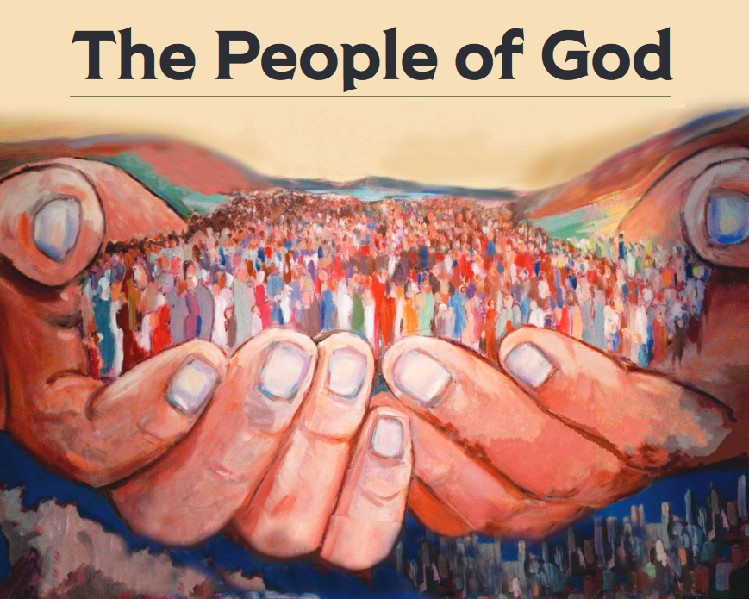
“But you are a chosen race, a royal priesthood, a holy nation, a people for God’s own possession, so that you may proclaim the excellencies of Him who has called you out of darkness into His marvelous light; for you once were not a people, but now you are the people of God.” (1 Peter 2:9-10)

Slide 3

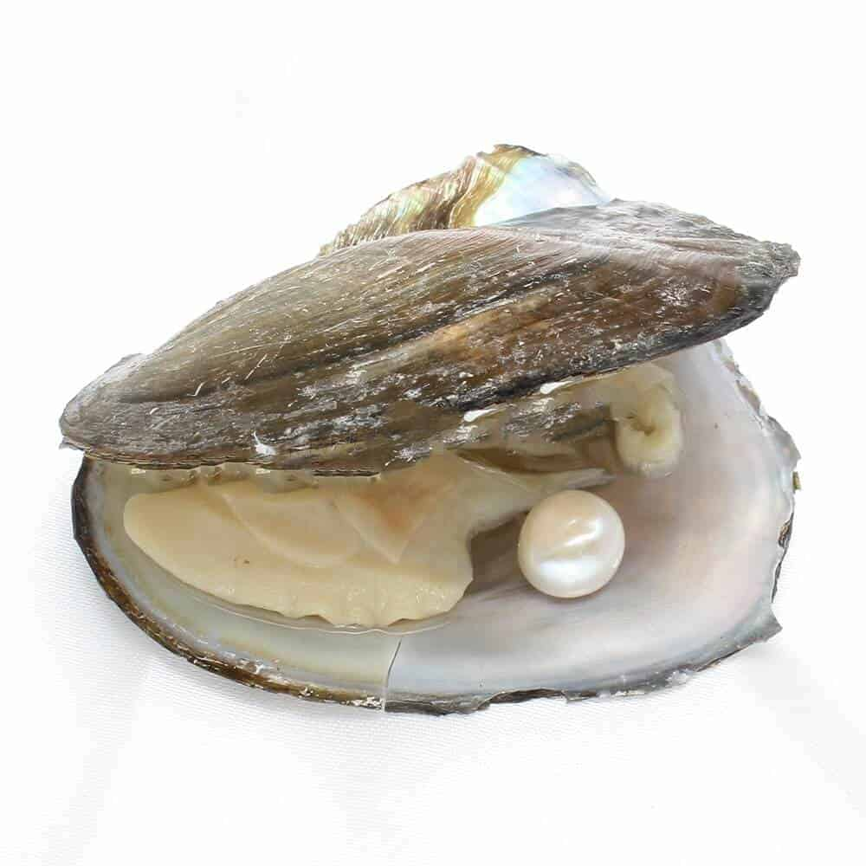
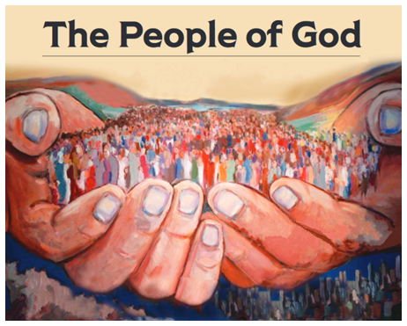
A Tried & Tested People
James 1:2-4

Slide 4
5 Opportunities That Trials Afford Us:
“Dear brothers and sisters, when troubles of any kind come your way, consider it an opportunity for great joy.
For you know that when your faith is tested, your endurance has a chance to grow.
So let it grow, for when your endurance is fully developed, you will be perfect and complete, needing nothing.”
(James 1:2-4, NLT)

Slide 5

5 Opportunities That Trials Afford Us:
Trials can build within us the character of Christ
Trials can serve to deepen our joy
Trials can increase our dependence on God
Trials can make us more prayerful
Trials can cause us to evaluate the condition of our souls

Slide 6
“Jesus, Draw Me Ever Nearer”
Verse 3:
Let the treasures of the trial
form within me as I go.
At the end of this long passage,
let me leave them at Your throne.
“Blessed is the man who remains steadfast under trial, for when he has stood the test he will receive the crown of life, which God has promised to those who love him.” (James 1:12)

