Slide 1

Finding Ourselves in the Psalms
Psalm 51
Needing Forgiveness

Slide 2
The Enormity of Our Sins
Have mercy upon me, O God, according to Your lovingkindness; according to the multitude of Your tender mercies, blot out my transgressions.
Wash me thoroughly from my iniquity,
and cleanse me from my sin.

Slide 3
The Enormity of Our Sins
For I acknowledge my transgressions,
and my sin is always before me.
Against You, You only, have I sinned, and done this evil in Your sight — that You may be found just when You speak, and blameless when You judge.

Slide 4
The Enormity of Our Sins
For I acknowledge my transgressions,
and my sin is always before me.
Against You, You only, have I sinned, and done this evil in Your sight — that You may be found just when You speak, and blameless when You judge.

Slide 5
The Enormity of Our Sins
Behold, I was brought forth in iniquity, and in sin my mother conceived me.

Slide 6
Our Need for Forgiveness
Purge me with hyssop, and I shall be clean;
wash me, and I shall be whiter than snow.
Make me hear joy and gladness, that the bones You have broken may rejoice.
Hide Your face from my sins,
and blot out all my iniquities.

Slide 7
Our Need for Forgiveness
Purge me with hyssop, and I shall be clean;
wash me, and I shall be whiter than snow.
Make me hear joy and gladness, that the bones You have broken may rejoice.
Hide Your face from my sins,
and blot out all my iniquities.

Slide 8
Our Need for Forgiveness
Purge me with hyssop, and I shall be clean;
wash me, and I shall be whiter than snow.
Make me hear joy and gladness, that the bones You have broken may rejoice.
Hide Your face from my sins,
and blot out all my iniquities.

Slide 9
Our Need for Forgiveness
Purge me with hyssop, and I shall be clean;
wash me, and I shall be whiter than snow.
Make me hear joy and gladness, that the bones You have broken may rejoice.
Hide Your face from my sins,
and blot out all my iniquities.

Slide 10
Our Need for Forgiveness
Purge me with hyssop, and I shall be clean;
wash me, and I shall be whiter than snow.
Make me hear joy and gladness, that the bones You have broken may rejoice.
Hide Your face from my sins,
and blot out all my iniquities.

Slide 11
Our Need for Forgiveness
Purge me with hyssop, and I shall be clean;
wash me, and I shall be whiter than snow.
Make me hear joy and gladness, that the bones You have broken may rejoice.
Hide Your face from my sins,
and blot out all my iniquities.

Slide 12
Our Need for Forgiveness
Create in me a clean heart, O God,
and renew a steadfast spirit within me.

Slide 13
Our Need for Forgiveness
Create in me a clean heart, O God,
and renew a steadfast spirit within me.

Slide 14
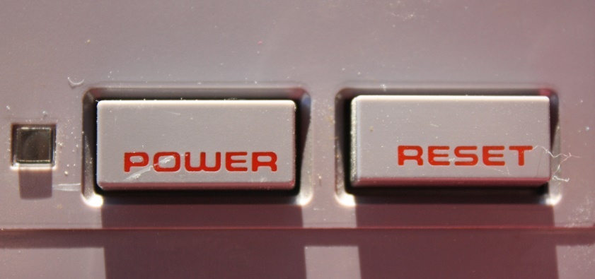
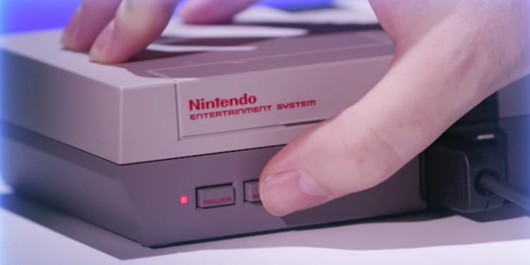
Our Need for Forgiveness
Create in me a clean heart, O God,
and renew a steadfast spirit within me.

Slide 15
Response to Being Forgiven

Slide 16
Response to Being Forgiven
Restore to me the joy of Your salvation, and uphold me by Your generous Spirit.
Then I will teach transgressors Your ways, and sinners shall be converted to You.

Slide 17
Response to Being Forgiven
Deliver me from the guilt of bloodshed, O God, the God of my salvation, and my tongue shall sing aloud of Your righteousness.
O Lord, open my lips, and my mouth shall show forth Your praise.

Slide 18
Response to Being Forgiven
For You do not desire sacrifice, or else I would give it; You do not delight in burnt offering.
The sacrifices of God are a broken spirit, a broken and a contrite heart —
these, O God, You will not despise.

Slide 19
Response to Being Forgiven
For You do not desire sacrifice, or else I would give it; You do not delight in burnt offering.
The sacrifices of God are a broken spirit, a broken and a contrite heart —
these, O God, You will not despise.
"Now, therefore," says the Lord, "Turn to Me with all your heart, with fasting, with weeping, and with mourning."
So rend your heart, and not your garments; return to the Lord your God, for He is gracious and merciful, slow to anger, and of great kindness; and He relents from doing harm.
Joel 2:12-13

Slide 20
The God of Psalm 51
Be gracious to me, O God,
according to Your lovingkindness;
according to the greatness of Your compassion blot out my transgressions.
Psalm 51:1, NASU

Slide 21
The God of Psalm 51
Be gracious to me, O God,
according to Your lovingkindness;
according to the greatness of Your compassion blot out my transgressions.
Psalm 51:1, NASU

Slide 22
The God of Psalm 51
Be gracious to me, O God,
according to Your lovingkindness;
according to the greatness of Your compassion blot out my transgressions.
Psalm 51:1, NASU

Slide 23
The God of Psalm 51
Be gracious to me, O God,
according to Your lovingkindness;
according to the greatness of Your compassion blot out my transgressions.
Psalm 51:1, NASU

Slide 24
Psalm 51
Our sin is always worse than we initially think.
God’s mercy and compassion is always greater than we think.
God’s forgiveness is free, but it calls for us to respond with a sense of gratitude, praise, and indebtedness to share God’s grace with others.
Have you found yourself in this psalm?

