Slide 2

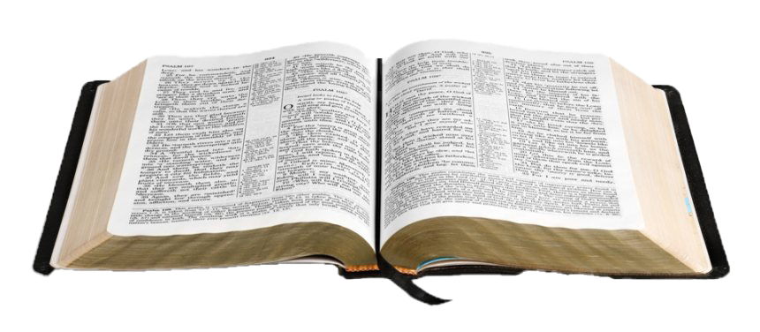
God’s Pattern for the Local Church

Slide 3
Now I plead with you, brethren, by the name of our Lord Jesus Christ, that you all speak the same thing, and that there be no divisions among you, but that you be perfectly joined together in the same mind and in the same judgment.
1 Corinthians 1:10

Slide 4
What is the local church supposed to do?
Not determined by…
Our own ideas - 2 Kings 5:11
The churches of men - 1 Samuel 8:5
The expectations of society - Romans 12:2

Slide 5
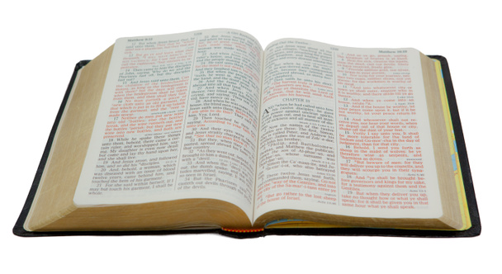
What is the local church supposed to do?
“Who serve the copy and shadow of the heavenly things, as Moses was divinely instructed when he was about to make the tabernacle. For He said,
‘See that you make all things according to the pattern shown you on the mountain.’”
Hebrews 8:5

Slide 6
1. Worship God

Slide 7
1. Worship God
“And they continued steadfastly in the apostles’ doctrine and fellowship, in the breaking of bread, and in prayers.”
Acts 2:42

Slide 8
1. Worship God
Singing - 1 Cor. 14:26, 15
Preaching - 1 Cor. 14:26; Acts 2:42
Prayers - Acts 2:42
Lord’s Supper - 1 Cor. 11:23-26; Acts 20:7
Giving - 1 Cor. 16:1-2

Slide 9
2. Save the Lost
“But if I am delayed, I write so that you may know how you ought to conduct yourself in the house of God, which is the church of the living God, the pillar and ground of the truth.”
1 Timothy 3:15

Slide 10
2. Save the Lost
In the preaching of the assemblies.
Efforts of the individual members.
  Eph. 4:11-12; Acts 8:4; Matt. 5:16

Slide 11
3. Strengthen the Saved
Ephesians 4:11-16
Accomplished through the teaching of God’s word - Acts 20:32
Accomplished in our worship assemblies -
1 Corinthians 14:26

Slide 12
4. Relieve Needy Members
Local churches cared for members in financial need - Acts 4:34-37
Local churches cared for their needy widows -
Acts 6:1-2; 1 Tim. 5:3-16
Local churches sent funds to needy saints in other areas - Acts 11:27-30; Rom. 15:26
Notice: these funds were for needy “brethren” or “saints” - not for all the poor.

Slide 13
The Church and the Individual

Slide 14
The Church and the Individual
And he kept back part of the proceeds, his wife also being aware of it, and brought a certain part and laid it at the apostles’ feet.
But Peter said, “Ananias, why has Satan filled your heart to lie to the Holy Spirit and keep back part of the price of the land for yourself?
While it remained, was it not your own? And after it was sold, was it not in your own control? Why have you conceived this thing in your heart? You have not lied to men but to God.”
Acts 5:2-4

Slide 15
The Work of the Local Church
Worship God
Save the Lost (Evangelism)
Strengthen the Saved (Edification)
Relieve Needy Members (Benevolence)

