Slide 2

Special Sermon
September 17th at 11:00 AM
Why You Need God in Your Life!

Slide 3

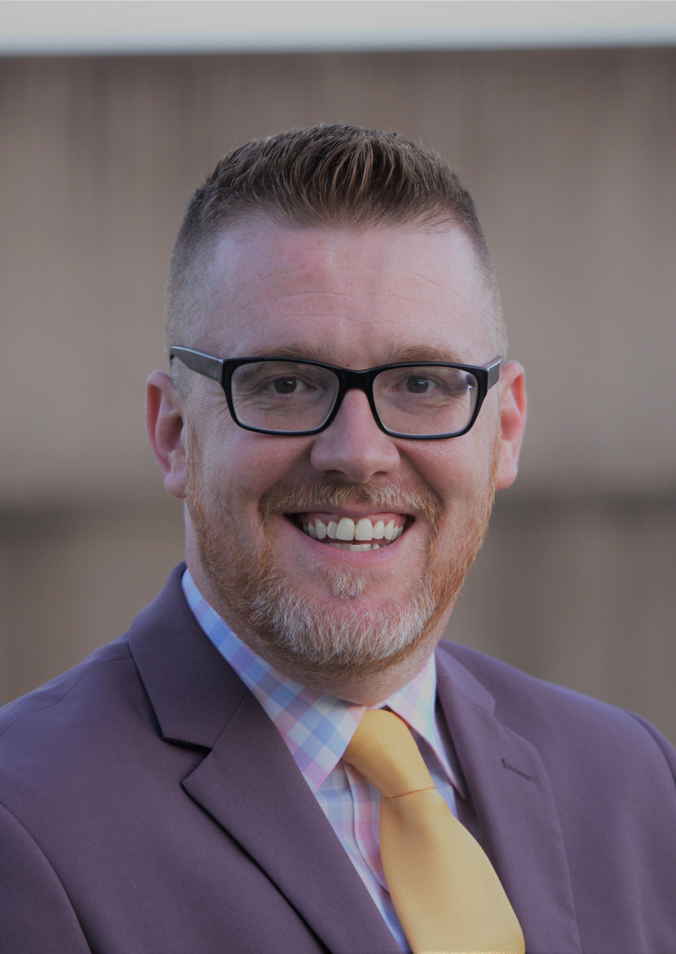
Our Fall Gospel Meeting
With Josh McKibben, October 8-13

Slide 4

Hebrews 12:1-2

Slide 5
An Enduring Faith
Our Admonition Hebrews 10:36-39
Our Examples Hebrews 11
Our Instruction Hebrews 12:1-2

Slide 6

Look to Others for Encouragement
“since we are surrounded by so great a cloud of witnesses”
Romans 15:4
1 Peter 5:8-9

Slide 7
Lay Aside Every Weight
“let us lay aside every weight”

Slide 8
Refuse to Doubt
“and the sin which so easily ensnares us”
“and sin which clings so closely” (ESV)
The sin of unbelief (Heb. 3:12-13; 10:38)

Slide 9
Run!
“and let us run with endurance the race that is set before us”
1 Corinthians 15:58
Galatians 5:7

Slide 10
Stay Focused
“looking unto Jesus, the author and finisher of our faith”
“fixing our eyes on Jesus” (NASU)
1 Peter 2:21

Slide 11
Find the Joy in Serving the Lord
“who for the joy that was set before Him endured the cross”
James 1:2-4
Philippians 4:4

Slide 12
Look to others for encouragement
Lay aside things that weigh us down
Refuse to doubt God’s promises
Run!
Stay focused on the Lord and His work
Find the joy in serving the Lord

